Slide 1
Decoherence Free Subsystems/Subspaces
control of decoherence via Subspace/Subsystem selection
collective decoherence eliminable - condensed phase QC/QM
fault tolerant universal quantum computation with minimal
decoherence
new paradigm for universal QC via DFS encodings
E.g., universal QC with exchange interaction only - condensed phase
optimal gate constructions - e.g. 19-gate exchange-only CNOT
Future Goals:
develop universal computation from system specific interactions
optimization/minimization of gate interactions
simulation of computation - quantum trajectories
develop optical implementations of DFS - QC in the dark

Slide 2
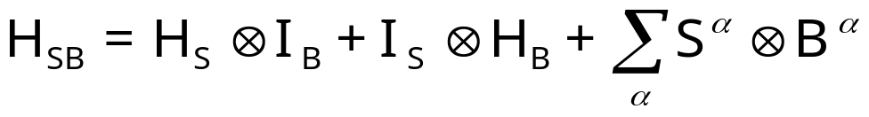
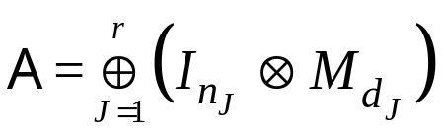


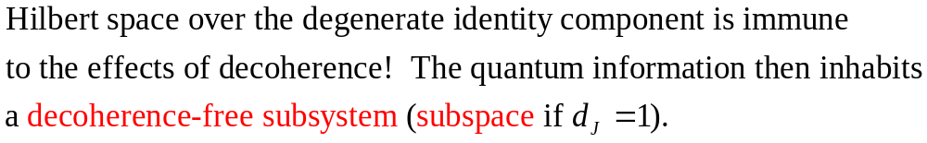
DF Subspaces and Subsystems:
Zanardi 1997, Duan and Guo 1997,
Lidar et al. 1998, E. Knill et al. 2000
System
Bath
Interaction causing
DECOHERENCE
System evolution
Bath evolution
Expansion into
system and bath
operators

Slide 3

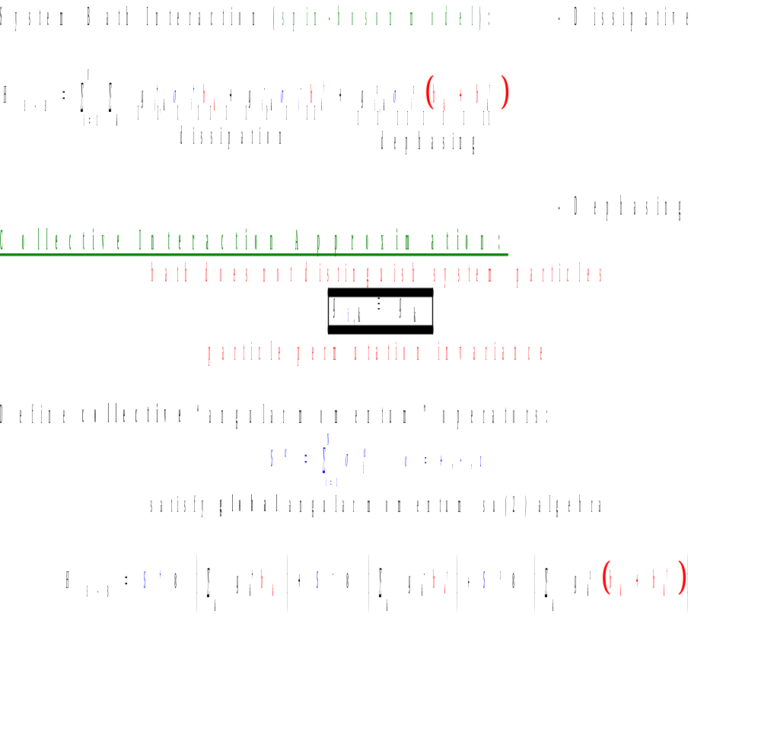



Collective Decoherence:
●
bath boson mode,
Δx
examples/candidates:
quantum optics “Dicke subradiance”
solid state systems at low temperatures,
atoms trapped in a cavity, etc.

Slide 4
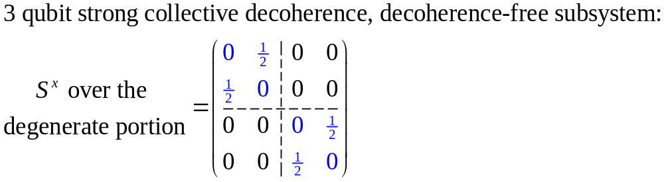
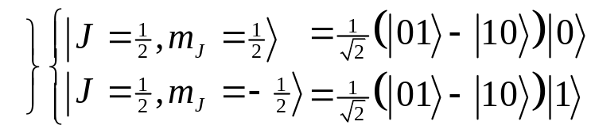
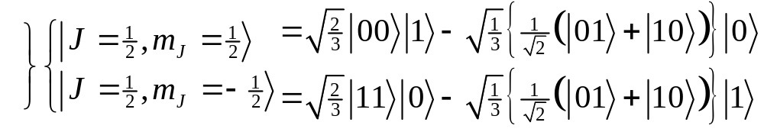

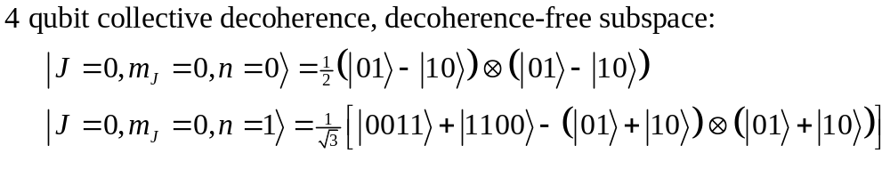
Collective DFS Examples:
Information encoded over the degenerate component will not decohere!
Information encoded over the subspace will not decohere
J
2
1
4
dimension of DFS = degeneracy of the n qubit, total angular momentum J, collective su(2) operators
= dimension of quantum information which can be encoded
into the DFS.
3/2
1
1
1
3
9
1/2
1
2
5
14
The J=0 irreps of su(2) are 1- dimensional
Decoherence Free Subspaces.
1
2
5
14
N
1 2 3 4 5 6 7 8

Slide 5

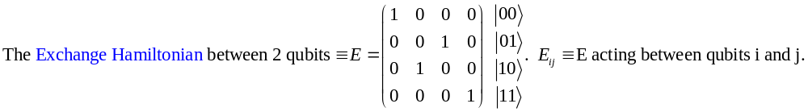


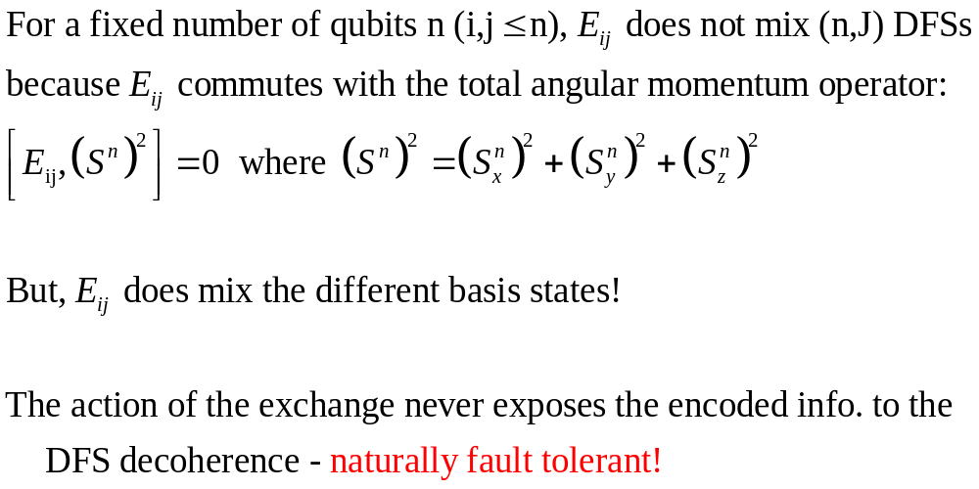






Exchange
1
2
3
4
5

Slide 6



Quantum Computation on a DFS:
3
1
Exchange can be used to perform su(d)’s on each of the DFSs.
Each su(n) can be enacted when the others turned off (independent action on each J irrep)
su(d) means we have a d-dimensional Hilbert space (encoded) and we can perform all unitary manipulations on this d-dimensional Hilbert space
2
5
1
9
5
0
1
2
3
4
5
6
Exchange alone produces fault tolerant quantum computation on collective decoherence-free subsystems!!
system never leaves the code space during entire gate switching time

Slide 7
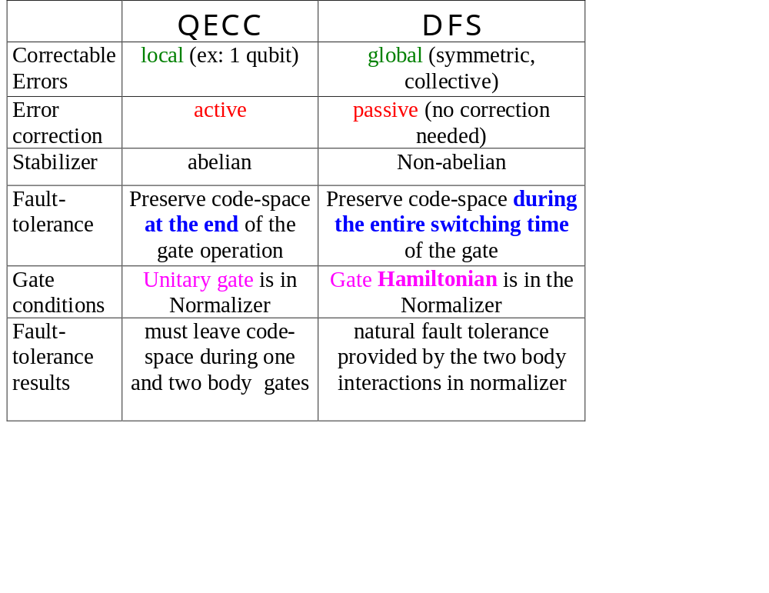
QECC versus DFS:

Slide 8
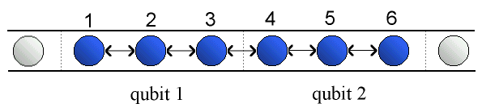
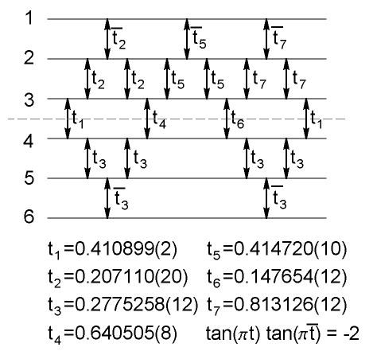
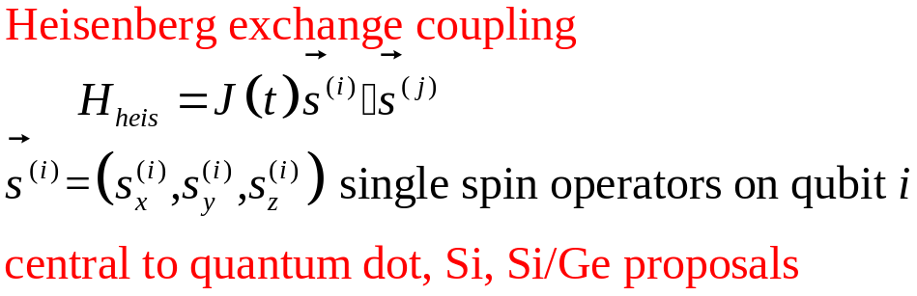

Explicit CNOT Gate Construction using Exchange only
exchange gate
i
j
DiVincenzo et al., quant-ph/0005116

