Slide 1
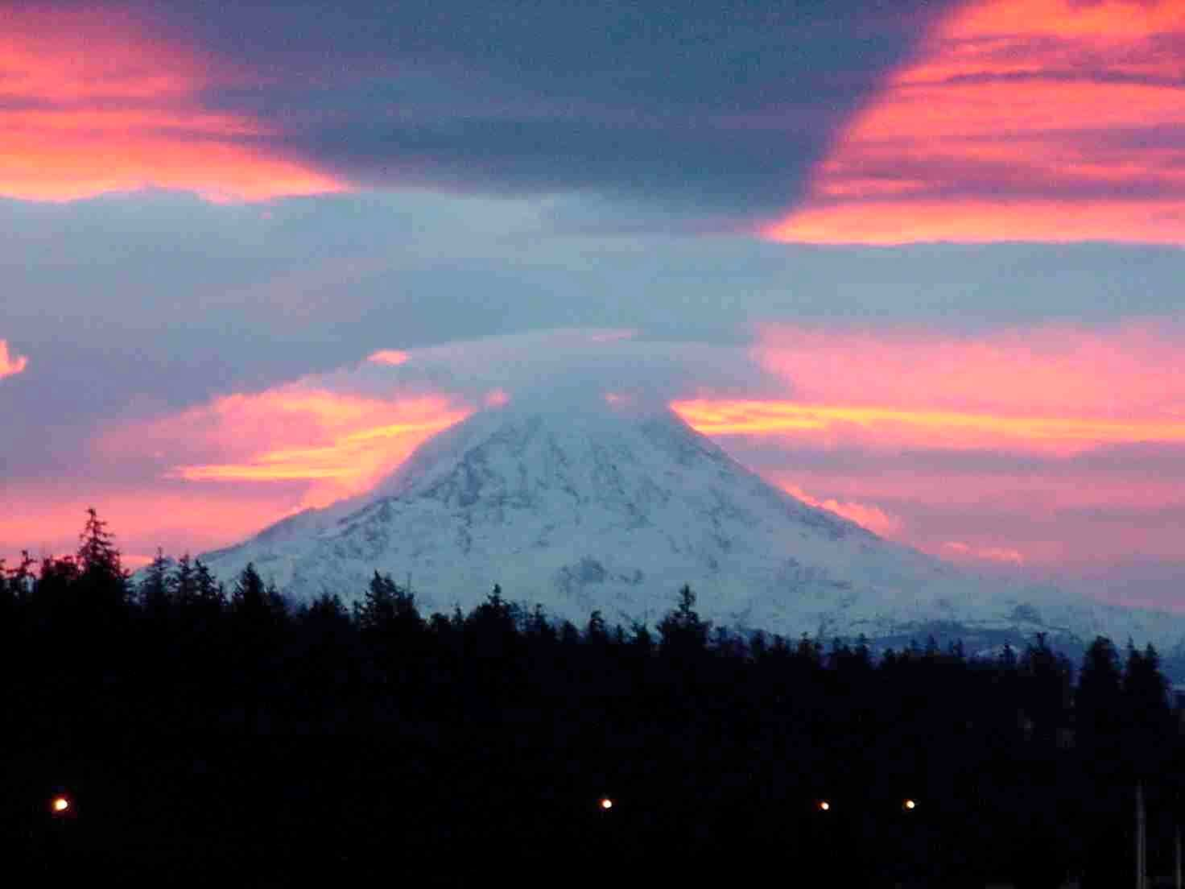

Quantum Algorithms Using Clebsch-Gordan
Transforms
Dave Bacon
University of Washington

Slide 2
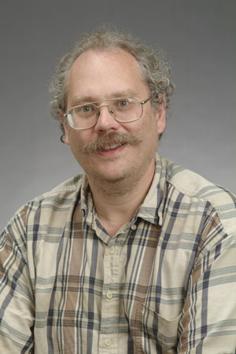
Quantum Computers
18819881292060796383869723946165043
98071635633794173827007633564229888
59715234665485319060606504743045317
38801130339671619969232120573403187
9550656996221305168759307650257059
3980750864240649373971
2550055038649119906436
2342526708406385189575
946388957261768583317
4727721461074353025362
2307197304822463291469
5302097116459852171130
520711256363590397527
1994
Quantum computers can efficiently factor whole numbers (and compute discrete log.)
No known classical efficient algorithm.
Breaks RSA, Diffie-Hellman cryptosystems.
Peter Shor

Slide 3

Dr. Quantum Love
“Only time will tell if and when the problems of building a
quantum computer can be overcome…. the development
of a fully operational quantum computer would imperil
our personal privacy, destroy electronic commerce and
demolish the concept of national security. A quantum
computer would jeopardize the stability of the world.
Whichever country gets there first will have the ability to
monitor the communications of its citizens, read the minds
of its commercial rivals and eavesdrop on the plans of its
enemies. Although it is still in its infancy, quantum computing
presents a potential threat to the individual, to international
business and to global security.”
-Simon Singh

Slide 4

Physicists and Computer Scientists
Smaller transistors, please!
Err…can you
fix my computer?

Slide 5

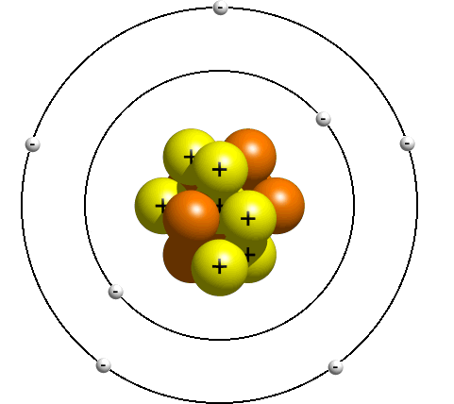
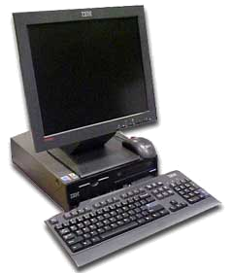
A Golden Era
Email I received from Wim van Dam about FOCS 2006:
Leslie Valiant in his great talk on 'accidental algorithms': "We have all these complexity classes, and we don't know at all if they are different... It would be a nightmare if they turn out to be all the same, such that NC2=P=P^#P and so on." <comment from the audience about if this would really be so bad> "Yes it would be a nightmare, but the *worst* possible nightmare would be if NC=P=P^#P and if it was a *physicist* who proved it."

Slide 6


On Quantum Algorithms
From a 2003 review of three quantum computing books:
“Finally, to all those currently working on yet another book on quantum computing: what this field needs most is more algorithms, not more books.”
Ronald de Wolf (CWI)
HELP WANTED Quantum programmer. Only skill necessary is ability to type in large RSA keys. Pay inversely commensurate with years since Ph.D. completed.
HELP WANTED Real estate agent. Best market since bubble popped in 07. Join a dedicated
HE
ne
ar
kr
st.
ed
r
ay
ed
m
HE
Sh
we
the
us
My Nightmare

Slide 7
The State of Quantum Algorithms
Grover-Type
Shor-Type
Factoring, Discrete Logarithm
[Shor 94]
Needle in Haystack Search
[Grover 96]
Pell’s Equation
[Hallgren 02]
Quantum amplitude amplification
[Brassard, Hoyer, Mosca,
Tapp 00]
Some Hidden Shift Problems
[van Dam, Hallgren, Ip 02]
[van Dam, Childs 05]
Adiabatic quantum algorithms
[Farhi, Goldstone Gutman,
Sipser 00]
Gauss Sums
[van Dam, Seroussi 02]
NAND tree algorithm
[Farhi, Goldstone Gutman 07]
Hidden Subgroup Problems
Abelian groups, almost abelian
groups, near Hamiltonian groups,
normal subgroups, small
commutator subgroup, solvable
groups of bounded exponent and
of bounded derived series
extraspecial groups, groups of
nilpotency class at most 2, more
Quantum simulated annealing
[Somma, Boixo, Barnum 07]
BQP completeness of Jones, Tutte, and other polynomials, Exponential speedups in quantum random walks, Simulation of
Schrodinger’s equation, Physical chemistry, etc.

Slide 8


The Power of Quantum Computers
Clichéd Question: Where does the power of quantum computers come from?
Retort: Where does the power of classical computers come from?
PSPACE
= powerful exactly why?
PH
NP
coNP
P

Slide 9
Outline
1. Lessons from a simple quantum algorithm
2. Lessons from the symmetric and unitary groups
3. When at first you don’t succeed…..symmeterize
4. Quantum algorithms from Clebsch-Gordan transforms

Slide 10






Simon’s Problem
(is that nobody does what Simon says)
Given: A function with n bit strings as input and one bit as
output
Promise: The function is guaranteed to satisfy
Problem: Find the n bit string

Slide 11


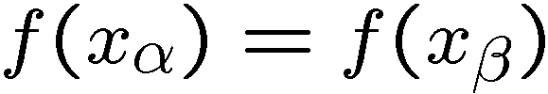

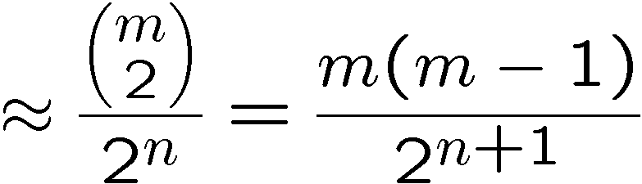
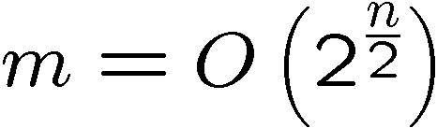
Classical Simon’s Problem
query pairs
If we find such that then
Querying the function m times….
Probability of getting a matching pair
Bounded error query complexity:

Slide 12
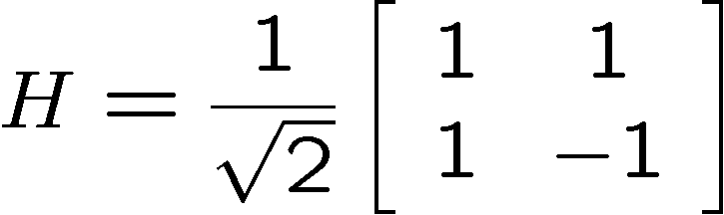
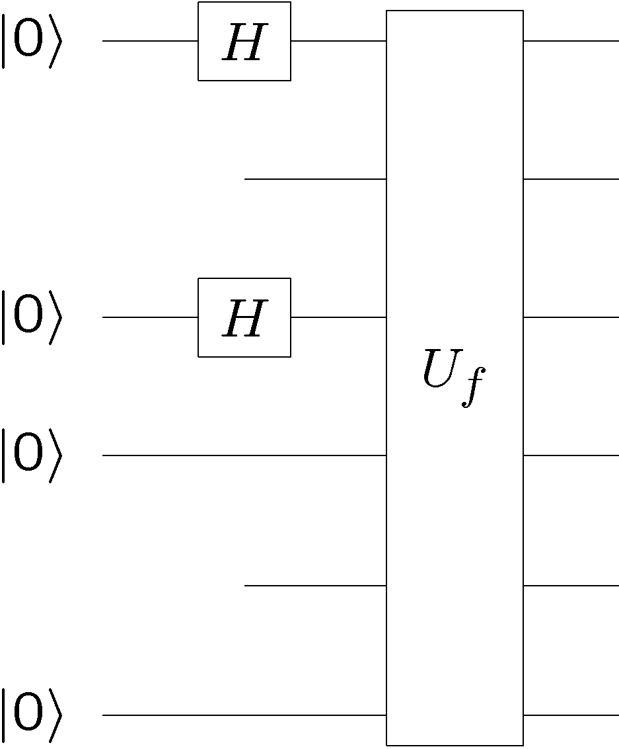
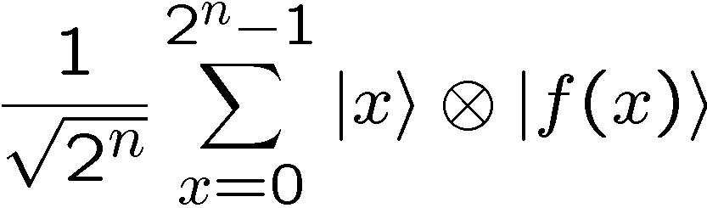
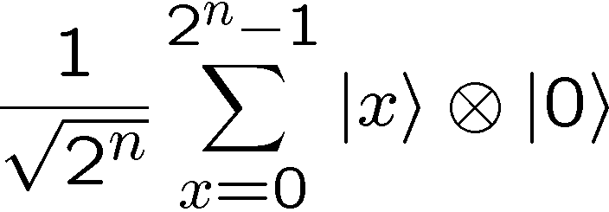
Quantum Simon’s Problem
n qubits
n qubits

Slide 13

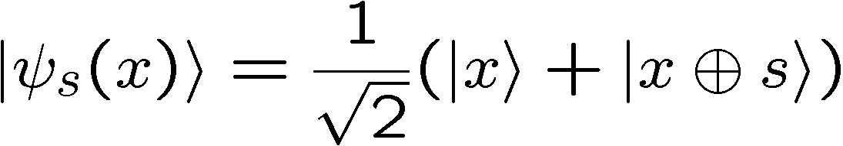
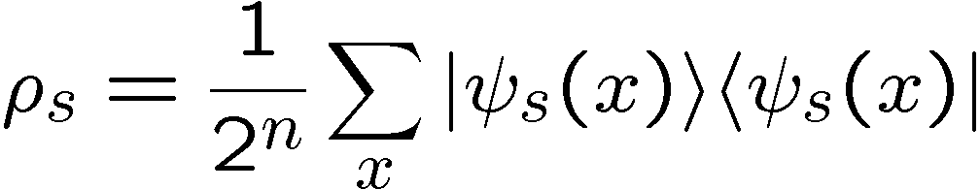

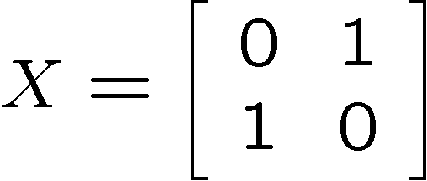
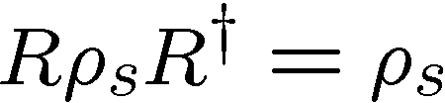
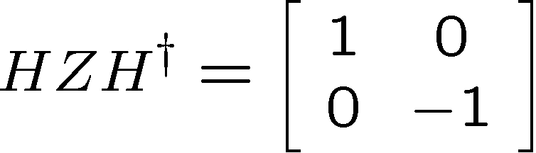
Quantum Simon’s Problem
For random uniformly distributed
Symmetry:
Symmetry → Simultaneously diagonalize symmetry operators
and symmetric operator

Slide 14
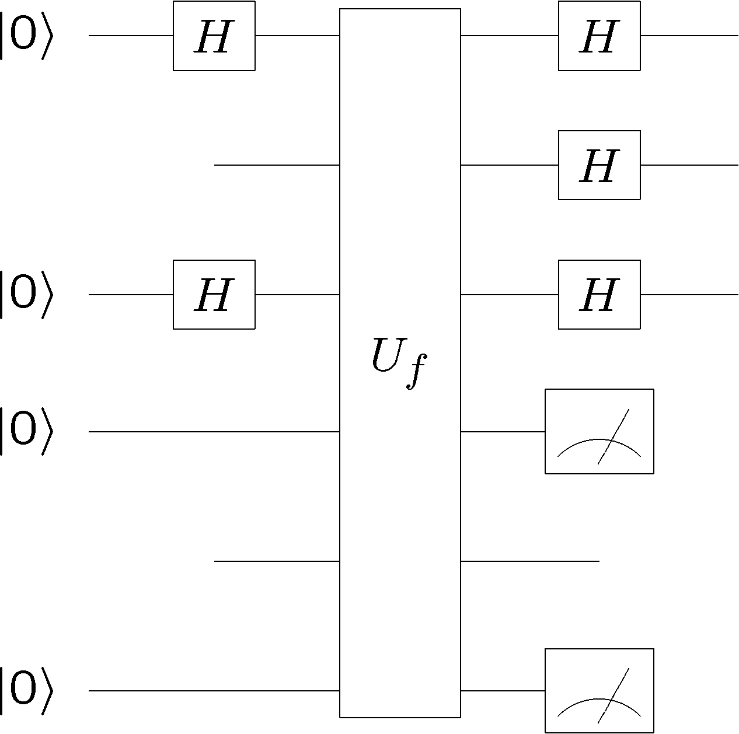
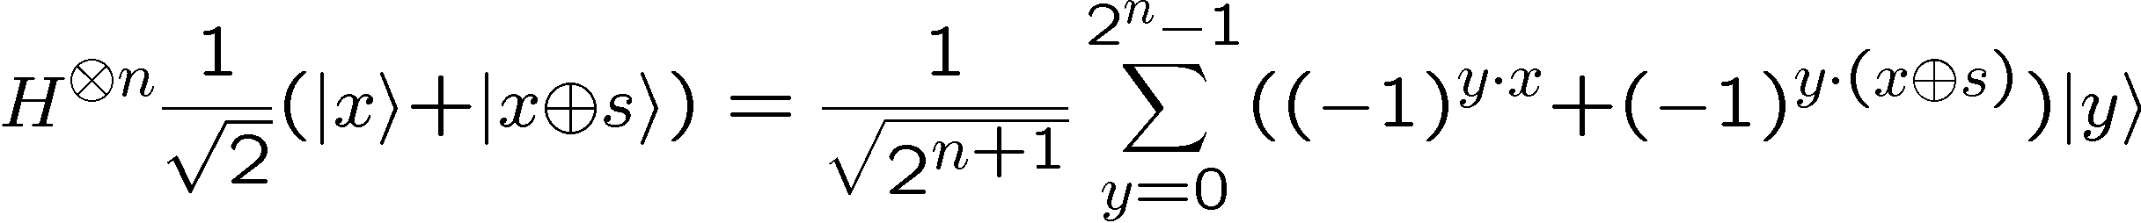
Quantum Simon’s Problem
n qubits
n qubits

Slide 15
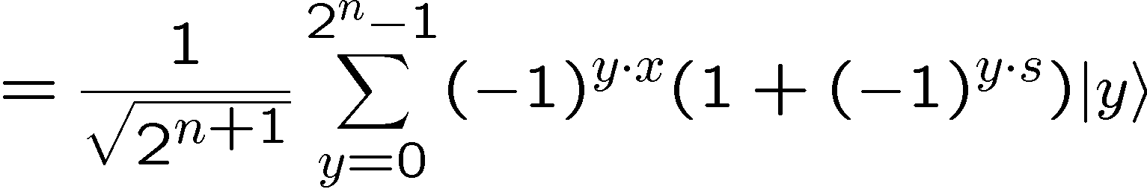







Quantum Simon’s Problem
Measuring this state, uniformly distributed random such that
Multiple runs:
random
uniform
If we obtain linearly independent equations of this form,
we win (Gaussian elimination)

Slide 16
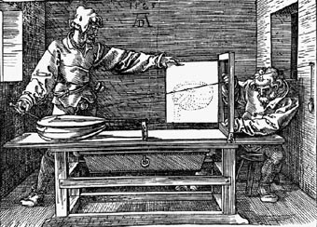
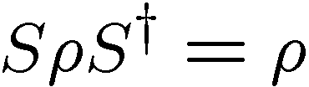



Moral
Symmetries
Diagonalize with respect to symmetry
Quantum algorithm
Quantum
Classical
and simultaneously
diagonalized
What do we do?
But what about that Gaussian Elimination?

Slide 17



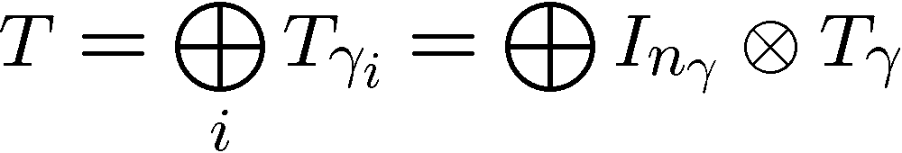
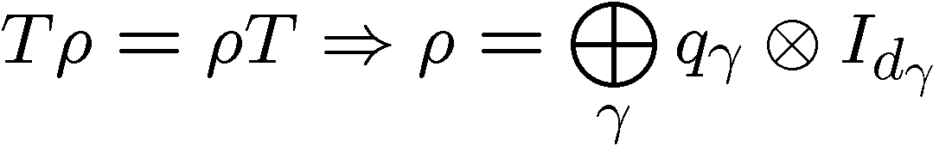
Representation Theory in 1 Slide
Group
Representation of group
Irreducible representations of a group (irreps):
has no invariant subspace except
full space and empty subspace
Decomposition into irreps
Schur’s lemma:

Slide 18


Simon’s Problem Redux
Group
addition bitwise mod 2
Representation of group
Irreps of group:
Unitary transform to direct product of irreps:

Slide 19
More Simon’s Problem Redux
random
uniform
are irrep labels
Gaussian elimination : adding bitwise mod 2
Symmetry interpretation?

Slide 20
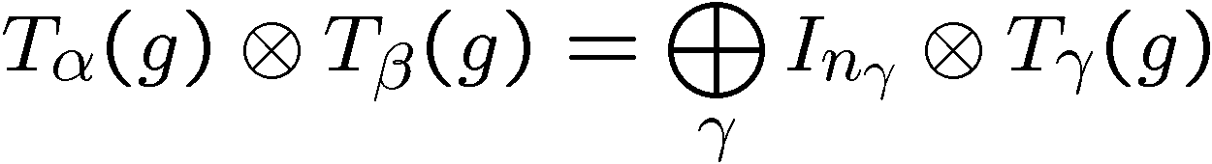
Symmetry Interpretation
Clebsch-Gordan transform:
So the “addition” of Gaussian elimination in Simon’s algorithm
can be interpreted as a Clebsch-Gordan transform….

Slide 21
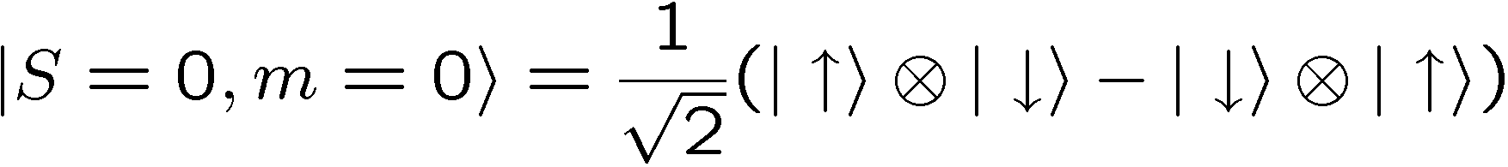

The Second Basis Change We
Learn In Quantum Mechanics:
Clebsch-Gordan Transform
Singlet:
Triplet:
What Use?

Slide 22

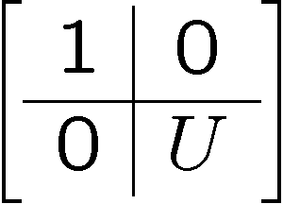


Collective Unitaries
Symmetry Under n Collective Unitary Rotations

Slide 23
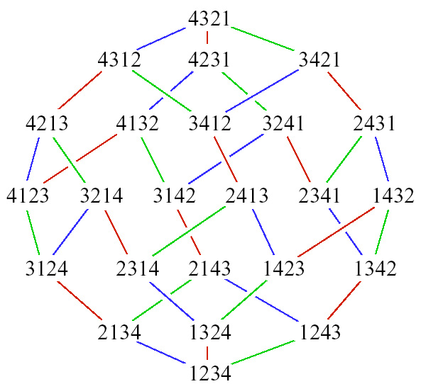


The Symmetric Group
Transform Under
SWAP
Singlet:
Triplet:
Symmetry Under Permutation of n Subsystems

Slide 24
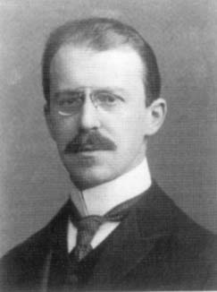


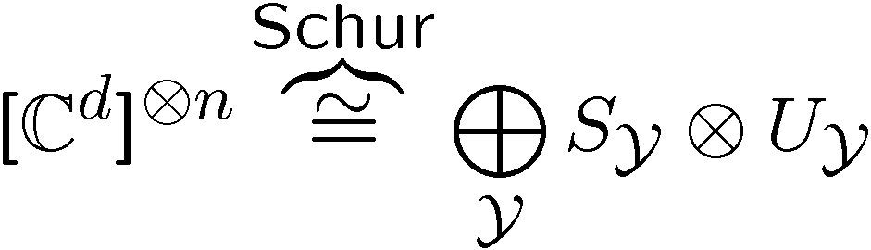

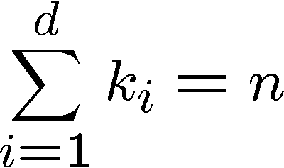
Quantum Schur Transform
Young diagram
n d-dimensional
systems
(n qudits)
irrep space
irrep space
Schur duality
Young diagram

Slide 25


Uses of Schur
Young diagram
What does this remind you of?
like probabilities like the spectrum of a density operator
Young diagram
Optimal spectrum estimate
[Keyl and Werner. PRA, 2001]
irrep space
irrep space

Slide 26
The Plethora of Uses of Schur
Optimal spectrum estimation
[M. Keyl and R. F. Werner. Phys. Rev. A, 2001]
Universal distortion-free entanglement concentration
[M. Hayashi and K. Matsumoto. Information Theory, 2004]
Universal compression with optimal overflow exponent
[M. Hayashi and K. Matsumoto. Phys. Rev. A, 2002]
Optimal quantum hypothesis testing
[M. Hayashi, J. Phys. A, 2002]
Communicating without a shared reference frame
[S. Bartlett, T. Rudolph, and R. Spekkens, Phys. Rev. Lett., 2003]
Encoding into decoherence-free (noiseless) subsystems
[J. Kempe, D. Bacon, D. A. Lidar, and K. B. Whaley, Phys. Rev. A, 2001]
Simulating lattice gauge theories on a quantum computer
[T. Byrnes and Y. Yoshihisa, Phys. Rev. A 2006]
….

Slide 27
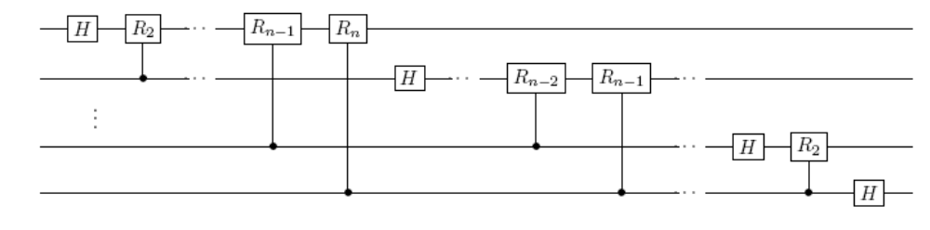
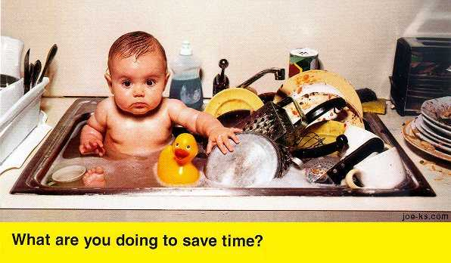
But Efficient?
QFT
Schur
?
Who would need to efficiently calculate Clebsch-Gordan
coefficients for SU(d)?
[L. C. Biedenharn and J. D. Louck, Commun. Math. Phys. 1968]

Slide 28
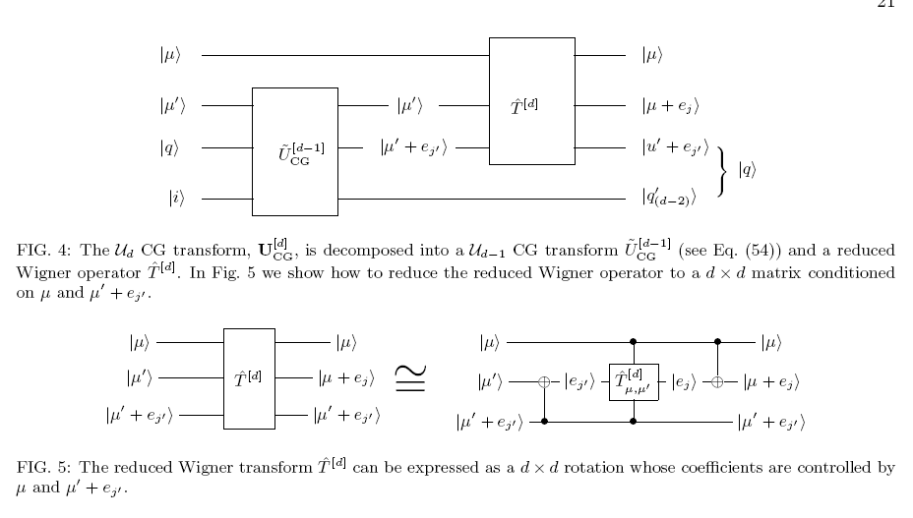
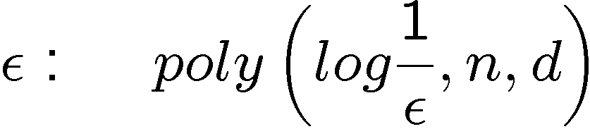
Efficient Schur
[D. Bacon, I.L. Chuang, A. Harrow, Phys. Rev. Lett. 2006]
[D. Bacon, I.L. Chuang, A. Harrow, SODA 2007]
Schur transform to accuracy time

Slide 29
The Plethora of Uses of Schur
Optimal spectrum estimation
[M. Keyl and R. F. Werner. Phys. Rev. A, 2001]
Universal distortion-free entanglement concentration
[M. Hayashi and K. Matsumoto. Information Theory, 2004]
Universal compression with optimal overflow exponent
[M. Hayashi and K. Matsumoto. Phys. Rev. A, 2002]
Optimal quantum hypothesis testing
[M. Hayashi, J. Phys. A, 2002]
Communicating without a shared reference frame
[S. Bartlett, T. Rudolph, and R. Spekkens, Phys. Rev. Lett., 2003]
Encoding into decoherence-free (noiseless) subsystems
[J. Kempe, D. Bacon, D. A. Lidar, and K. B. Whaley, Phys. Rev. A, 2001]
Simulating lattice gauge theories on a quantum computer
[T. Byrnes and Y. Yoshihisa, Phys. Rev. A 2006]
….
Tractable

Slide 30
But Quantum Algorithms?

Slide 31



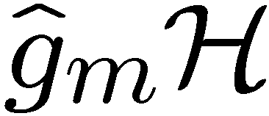
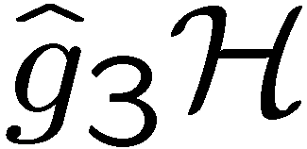
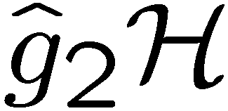
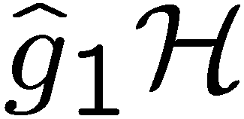

The Hidden Subgroup Problem
Setup: Fix a group (known) and a subgroup (unknown). Given query access to a function f : → S that is constant and distinct on left (right) cosets of in . We say that f hides .
Problem: Find a generating set for (“identify ”).
Efficient: If runs in time polylog(| |)
f
S

Slide 32
Hidden Subgroup Disease
“The quantum measurement problem refers to a set of people.”
- Hideo Mabuchi
“The hidden subgroup problem refers to a subgroup of people.”

Slide 33

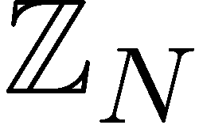
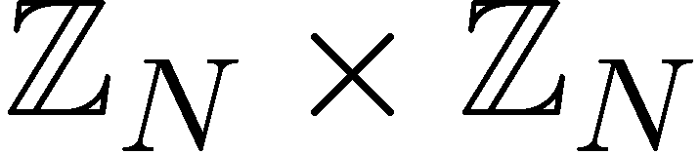

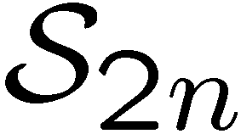

Why the Fuss?
Solved Problems (Shor 1994)
efficient algorithm for HSP
over
efficient algorithm for factoring whole numbers
efficient algorithm for HSP
over
efficient algorithm for the discrete logarithm problem
Open Problems
efficient algorithm for HSP
over (or )
efficient algorithm for the
graph isomorphism problem
efficient “standard” quantum
algorithm for HSP over
dihedral group
efficient algorithm for the poly(n) unique shortest vector in a lattice problem

Slide 34
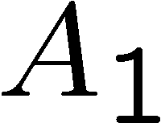
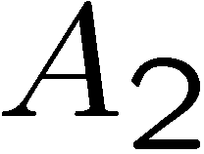
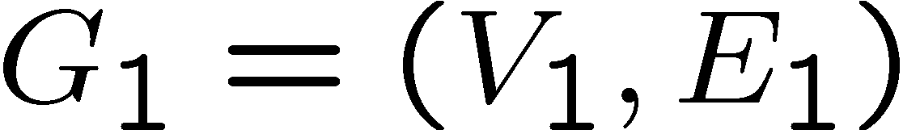
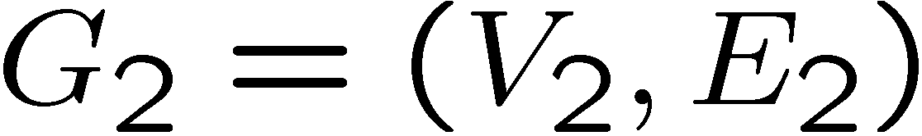

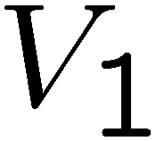
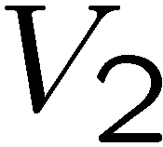
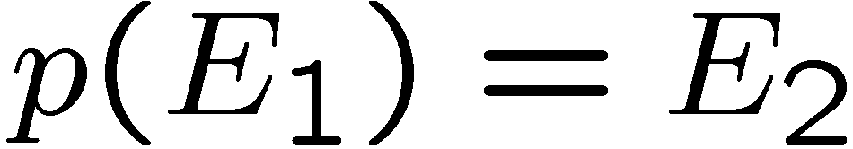
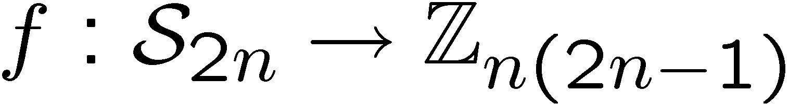
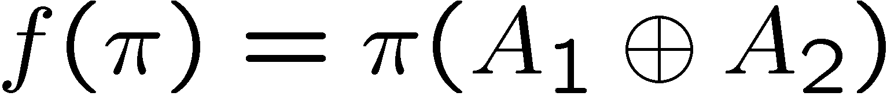
Graph Isomorphism
adjacency
matrix
adjacency
matrix
Problem: Is there a 1-to-1 mapping from the vertices to the
vertices such that the edges are respected, ?
Mapping to the HSP:
If graphs are not isomorphic, hidden subgroup will not mix
the graphs. If they are isomorphic, they will mix the graphs.

Slide 35







Standard Query Model
Oracle:
U_{f}
Query in equal superposition over group elements
hidden subgroup state

Slide 36






You Down With Symmetry?
hidden subgroup state
Symmetry under left regular representation:
Fourier transform over finite group
Can we solve HSP this way?

Slide 37





Multicopy
Can we make a measurement on
copies and
learn the subgroup?
In general (and for important case
of symmetric group) NO
[Moore, Russell, Hallgren,
Roetteler, Sen 05]
Required:

Slide 38

You Down With Symmetry?
hidden subgroup state
Symmetry under left regular representation:
Symmetry of two copies?
Permutation symmetry….measure the Young Diagram?
Nope [Childs, Harrow, Wocjan 06]

Slide 39






Heisenberg Group
Semidirect product group
Elements of the group:
Multiplication rule:
From the play “Copenhagen” Margrethe Bohr to Heisenberg:
  “Your talent is for ski-ing too fast for anyone to see where you are. For always being
  in more than one position at a time, like one of your particles.”

Slide 40


Multicopy Success!
Efficient algorithm for the Heisenberg HSP:
[D. Bacon, A.M. Childs, and W. van Dam FOCS 2005]
PGM/optimal measurement approach:
Efficient algorithm for the Heisenberg HSP:
PGM is optimal and succeed w.h.p.
How to efficiently implement the PGM?
But Why Does It Work?

Slide 41

Clebsch-Gordan Transform
To The Rescue?
Problem:
does not have a Clebsch-Gordan related symmetry

Slide 42


Graph Isomorphism
adjacency
matrix
adjacency
matrix
Problem: Is there a 1-to-1 mapping from the vertices to the
vertices such that the edges are respected, ?
Mapping to the HSP:
Notice now we are only worried if hidden subgroup has
a nontrivial

Slide 43





Conjugate Subgroups
Two subgroups, and , are conjugate if there exists an
element of the group such that
This is an equivalence relation among the subgroups of
ir: voy, vas, va, vamos, van

Slide 44
Hidden Subgroup Conjugacy Problem
Setup: Fix a group (known) and a subgroup (unknown). Given query access to a function f : → S that is constant and distinct on left (right) cosets of in . We say that f hides .
Problem: identify the conjugate subgroup class of .
Efficient: If runs in time polylog(| |)
f
S

Slide 45



Symmetries of HSCP States
Hidden subgroup conjugate state
Hidden subgroup conjugate states
In context of optimal measurement method (PGM)
[e.g. Ip 03, Bacon, Childs, and van Dam 05]
this translates into extra symmetry of the optimal measurement

Slide 46


Symmetries of HSCP States
What is the extra symmetry of the multiple HSCP states?
Clebsch-Gordan transform for the regular representation of
finite groups:

Slide 47

Relationships
How do the hidden subgroup problem (HSP) and the
hidden subgroup conjugacy problem (HSCP) differ?
1. If group is abelian, HSCP=HSP
All subgroups are only conjugate to themselves
2. If subgroups are normal, HSCP=HSP
All subgroups are only conjugate to themselves
These are two cases where we know quantum computers
can efficiently solve the HSP. Coincidence?

Slide 48















General Circuit

Slide 49
Heisenberg HSCP and HSP
[Bacon, arXiv:quant-ph/0612107]
Heisenberg HSCP ⇒ Heisenberg HSP
Conjugate subgroups are all normal subgroups
of a subgroup of Heisenberg group
Identifying which conjugate subgroup
identifies this subgroup
Thus solving HSCP implies solving HSP
(use normal subgroup algorithm)

Slide 50




Heisenberg HSCP, CG Way
[Bacon, arXiv:quant-ph/0612107]
i labels set of conjugate subgroups

Slide 51

Heisenberg HSCP, CG Way
[Bacon, arXiv:quant-ph/0612107]
i can be found by performing
and performing a QFT
Clebsch-Gordan transform over Heisenberg group is related
to “symmetry” which allows for efficient quantum algorithm
for the Heisenberg HSP.

Slide 52




Heisenberg HS State
Restricted subgroups:
Random coset states:
Coset labels:
Hidden Subgroup states:

Slide 53




HS States
Perform the QFT over to the first two registers:
Measure these two registers:

Slide 54





HS States
Two copies:
Compute v and w:

Slide 55

Uncompute
If we could erase the b₁,b₂ values:
Then a QFT over would find d₁ and d₂.
Remember v and w are a function of b₁ and b₂.

Slide 56



Solving Equations
Compute v and w:
For fixed x₁,x₂,y₁,y₂ let be the set of b₁,b₂
solutions to these equations.
We want to implement

Slide 57

Solving Equations
Easier to think about the inverse (do it unitarily):
i.e. given v and w, transform to superposition over
solutions to the equations

Slide 58





Solving Equations
Assuming y₁,y₂,y₁+y₂ do not equal 0 (prob O(1/p)),
then
solutions have
solutions have
solutions have

Slide 59


Solving Equations
Focus on when there are two solutions.
We can use standard finite arithmetic to find these
solutions. Use to create labeled superposition of
solutions:
Hadamard first qubit, measure. If 0, you have

Slide 60
Heisenberg HSP Solved
This allows us to perform:
Which has a O(1/2) fidelity squared with the
state we desire.
QFTing the second register will let us find d₁ and d₂
Efficient algorithm for the Heisenberg HSP!

Slide 61

Heisenberg HSP Lesson
Clebsch-Gordan transform can be used to help
solve HSPs
Other groups where this works?
[Ivanyos, Magniez, Sen 01]
Some Extraspecial groups [Ivanyos, Sanselme, Santha 07]
But for important groups like dihedral and symmetric?

Slide 62

Hidden Subgroup Divide
Successes
abelian groups
almost abelian groups
near Hamiltonian groups
normal subgroups
small commutator subgroup
solvable groups of bounded exponent and of bounded derived series
extraspecial groups
groups of nilpotency class at most 2
Specific groups
Failures
symmetric group (graph ismorphism!)
dihedral group (shortest vector!)
G^{n}, fixed G. Even for G=S₃!
Pessimism
in standard approach, multiregister measurements required
optimal measurement for dihedral HSP leads naturally to subset sum problem
Clebsch-Gordan sieves cannot solve symmetric group HSP
some including
the Heisenberg group
Subexponential algorithms
Dihedral
G^{n}, fixed G

Slide 63

Fin
Clebsch-Gordan transform reveals essential symmetry of efficiently solvable nonabelian hidden subgroup problems….Can they lead us all the way, the $10⁹ question

Slide 64

Quick advertisement: Scirate.com

Slide 65


