Slide 1

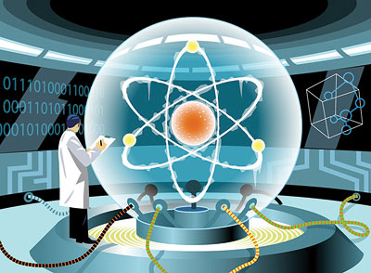



Quantum Computing
Myth, Fact, and Potential
Dave Bacon
Department of Computer Science & Engineering
Department of Physics
University of Washington
Funded by
NSF
ARO
NSA

Slide 2
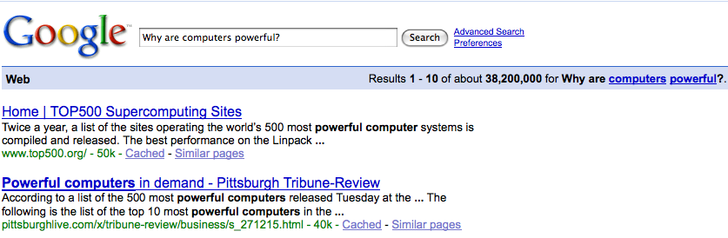
A Question
Where does the power of computers come from?
Notes:
Ask google?
I’ve come to the right place...

Slide 3




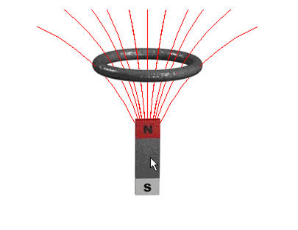
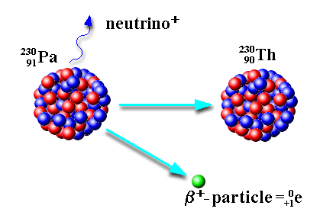
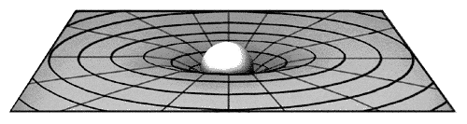
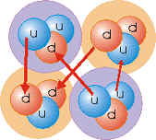
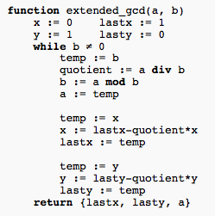

Can We Derive the Power of the Algorithm?
Physics
Computer Science
Notes:
Students: Do we have to?
Anti-Steve-Wolfram question
“New Kind of Science” (an old kind of science)

Slide 4
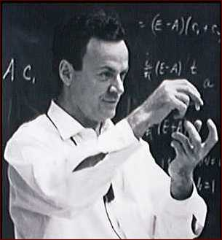
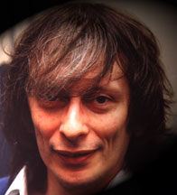
Some Simple Insights of Geniuses
Laws of physics are quantum mechanical
Quantum theory appears to be hard to simulate on today’s computers
Yet somehow nature “simulates”
Richard Feynman
Dave Deutsch
Computers built from parts which obey quantum theory?
Notes:
War games

Slide 5
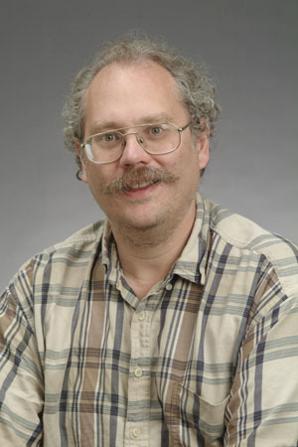
Quantum Computers!
18819881292060796383869723946165043
98071635633794173827007633564229888
59715234665485319060606504743045317
38801130339671619969232120573403187
9550656996221305168759307650257059
=
3980750864240649373971
2550055038649119906436
2342526708406385189575
946388957261768583317
4727721461074353025362
2307197304822463291469
5302097116459852171130
520711256363590397527
x
Peter Shor (1994)
Quantum computers can efficiently factor
No known classical efficient algorithm.
Breaks RSA public key cryptosystem
Notes:
Check that I didn’t cheat

Slide 6
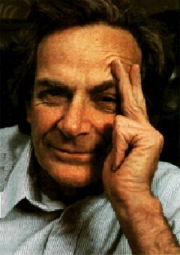
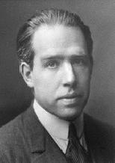
Quantum Propoganda
I think I can safely say that nobody understands quantum mechanics.
Richard Feynman
Nobel Prize 1965
Anyone who is not shocked by quantum
theory has not understood it.
Niels Bohr
Nobel Prize 1922

Slide 7
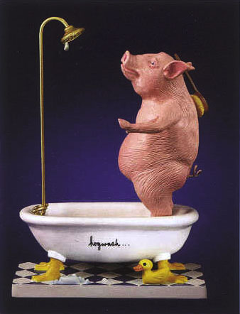
Hogwash
They understand it
They use it
It just defies their sensibilities

Slide 8









Quantum Theory.... Quickly
bits
pbits
qubits
Description:
0
0
1
1
Observation:
0
certainty
0
p percent
0
percent
1
1-p percent
1
percent
Evolution:
deterministic
stochastic
unitary

Slide 9
Garden of Re-forking Paths
0.5
0.6
0.5
(0.6)(0.5)+(0.4)(0.7)=0.58
0.4
0.7
0.3
0.787
0.787
0.787
2
|(0.787)(0.787)+(-0.787) (0.787)| =0
0.787
-0.787
0.787

Slide 10
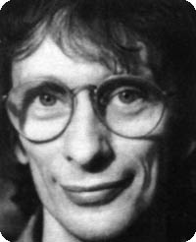
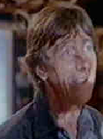




Deutsch’s Problem
David Deutsch
Dr. Falcon
constant
balanced

Slide 11









Deutsch’s Problem
constant
balanced

Slide 12







Deutsch’s Problem
=
constant
balanced

Slide 13
Deutsch’s Problem
1985
Classically: 2 queries
Quatumly: 1 query
Might the computational complexity depend on physics?

Slide 14


Beyond a Curiosity
Quantum computers offer superpolynomial query complexity speedups over classical computers [Bernstein, Vazirani 1993]
Umesh Vazirani
(Berkeley)
Quantum computers offer exponential query complexity speedups over classical computers [Simon 1994]
Dan Simon
(Microsoft)

Slide 15


Shor’s Breakthrough
18819881292060796383869723946165043
98071635633794173827007633564229888
59715234665485319060606504743045317
38801130339671619969232120573403187
9550656996221305168759307650257059
Peter Shor
=
3980750864240649373971
2550055038649119906436
2342526708406385189575
946388957261768583317
4727721461074353025362
2307197304822463291469
5302097116459852171130
520711256363590397527
x
Best classical algorithm
Shor’s quantum
algorithm

Slide 16
Myth, Fact, and Potential
Myth
Fact
Potential

Slide 17
Myth: Parallelism
Claim: Quantum computers are massively parallel computers
To search over an exponentially large space, simply branch the universe into an exponential number of copies
dead
alive
dead
dead
dead
dead
dead
dead
universe
Exponentially small probability of alive

Slide 18
Fact: The Power of Quantum Computers
Quantum computers are faster at some problems:
Exponential speedups: Factoring, discrete logarithm, solving Pell’s equation...
Polynomial speedups: Searching for a need in a haystack, NAND tree problem, ....
Quantum computers are not thought to allow efficient solution to NP-complete problems

Slide 19


Fact: Origin of the Power of Quantum Computers
Classical
Quantum
0
50 %
0
0
1
50 %
1
1
0
0
1
1
Symmetries of quantum wave functions can be exploited

Slide 20
Fact: Origin of the Power of Quantum Computers
Classical correlation
Quantum entanglement
0
0
50 %
0
0
1
1
50 %
1
1
Bells Theorem: Entangled quantum systems exhibit
correlations which cannot be explained by classical local hidden variable theories
Translation: Entanglement is genuinely quantum

Slide 21
Potential: Quantum Insights
“Small” Entanglement = Efficiently classical simulation
M₁
M₂
M₃
Density Matrix Renormalization Group [White, 1991]

Slide 22
Potential: Quantum Insights
In “many” quantum systems, the low energy sector has an entropy of a region which grows like the perimeter of the region
“Small” entanglement
Design algorithms whose variational ansatz respect this scaling
[Vidal, Verstraete...]
New classical algorithms for efficiently simulating quantum systems

Slide 23
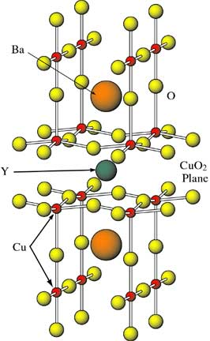
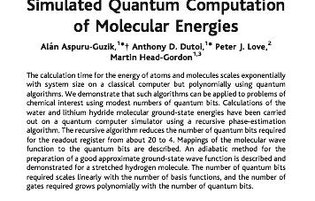
Potential: Quantum Algorithms
Annie Get Your Gun Principle
~50 to 100 qubit can compete with today’s physical
chemistry algorithms

Slide 24
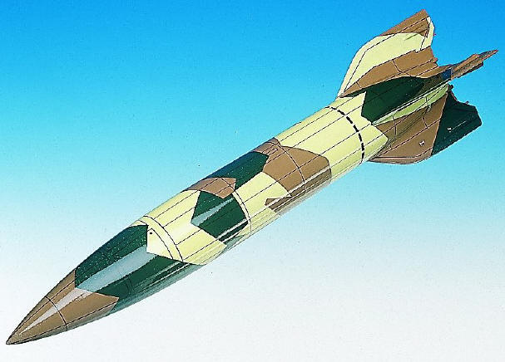
Myth: Quantum Computers are Analog Computers
Myth: Quantum computers are analog computers
Infinite precision required to
specify quantum state

Slide 25

Category Errors
Analog / Digital
x
vs
0
1
0.998213123....
0
Probabilistic / Deterministic
1
0.9
vs
0.4
0.1
0.6
1

Slide 26
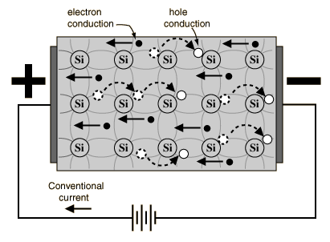
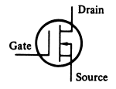
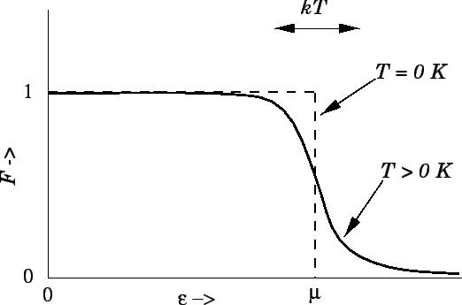
Analog Probabilistic
Digital Deterministic
D
Analog
Voltages
Digital
Signal
bits
Probabilistic
Electrons
Deterministic
Gates
behind the bit

Slide 27
The Real Categories
Analog / Digital
x
vs
0
1
0.998213123....
0
Probabilistic / Deterministic / Quantum
1
0.707
0.9
-0.707
0.707
vs
0.4
vs
0.707
0.1
0.6
-1
1
1

Slide 28
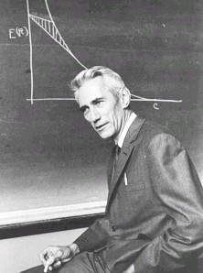
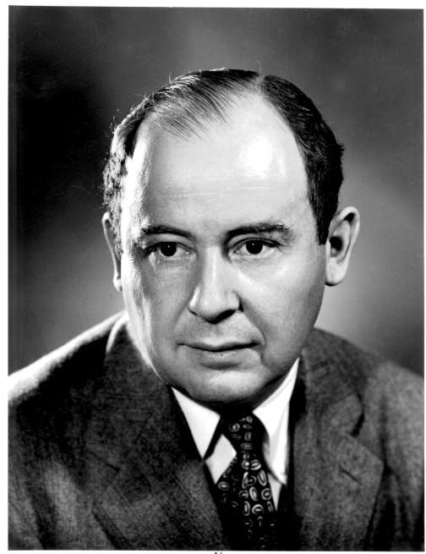
Noisy Probabilistic Bits
How to communicate in the presence of noise?
“A mathematical theory of communication” (1948)
Error correcting codes
Claude
Shannon
How to compute when the subsystems
of your computer can fail?
“Probabilistic logics and the synthesis of reliable organisms from unreliable components” (1956)
John
von Neumann
Fault-tolerant architectures

Slide 29

Fact: Fault-Tolerance
errosol
QC
“decoherence”
“imprecision”
Threshold Theorem for Fault-Tolerant Quantum Computation
[Aharonov, Ben-Or, Knill, LaFlamme, Zurek, Shor, Gottesman, Preskill]
If noise is weak enough and control is precise enough, then a
quantum computation to a desired accuracy can be carried out
with an overhead polynomial in the log of the accuracy.

Slide 30
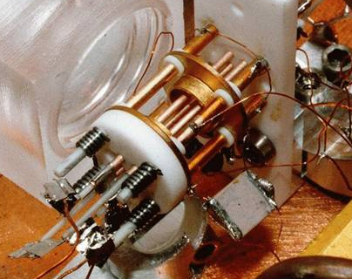
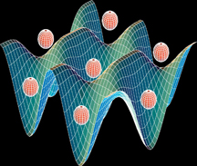
Potential: Quantum Hardware
Solid State
Atomic
superconducting circuits
electron spin in Phosphorus doped Silicon
quantum dots
defects in diamonds
cavity QED
neutral atoms in optical lattices
ion traps
Photon Based
linear optics + single photon devices
Pics: Martinis (UCSB), Wineland (NIST), Orlando (MIT)

Slide 31
The Quantum Conundrum
Quantum computers can efficiently factor.
There exists a classical efficient algorithm for factoring!
Quantum computers cannot be built
Quantum theory is wrong!
Some fundamental physical mechanism exists preventing quantum computers!
Pics: Martinis (UCSB), Wineland (NIST), Orlando (MIT)

Slide 32
Quantum Computing
Myth, Fact, and Potential
Dave Bacon
Department of Computer Science & Engineering
Department of Physics
University of Washington
Funded by
NSF
ARO
NSA

