Slide 1
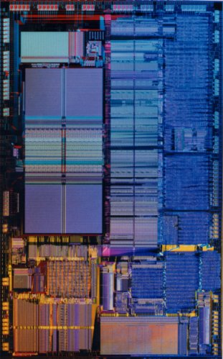
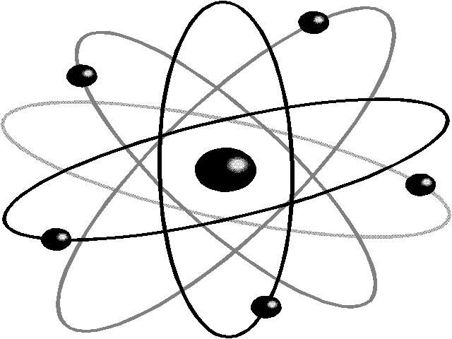
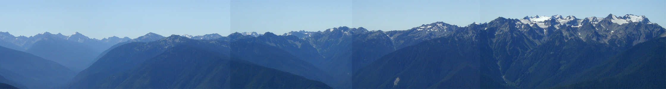
Architectures for Quantum Computers
CSE 471 Lecture
June 2, 2006
Dave Bacon
Soon summer will be here and you can be over here!

Slide 2
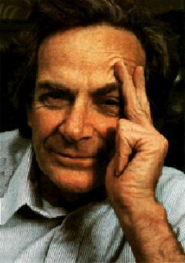
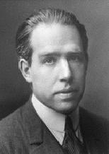
Quantum Slander
I think I can safely say that nobody
understands quantum mechanics.
Richard Feynman
Nobel Prize 1965
Anyone who is not shocked by quantum
theory has not understood it.
Niels Bohr
Nobel Prize 1922

Slide 3
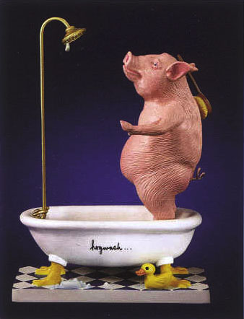
Do not be intemidated by quantum physicists!

Slide 4
Today: Into the Quantum Void
What is a quantum computer?
What, really, is a quantum computer?
  DiVincenzo’s criteria
Architectures for quantum computers
(What really really will a quantum computer look like?)

Slide 5
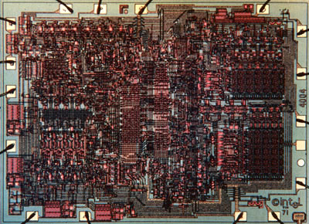
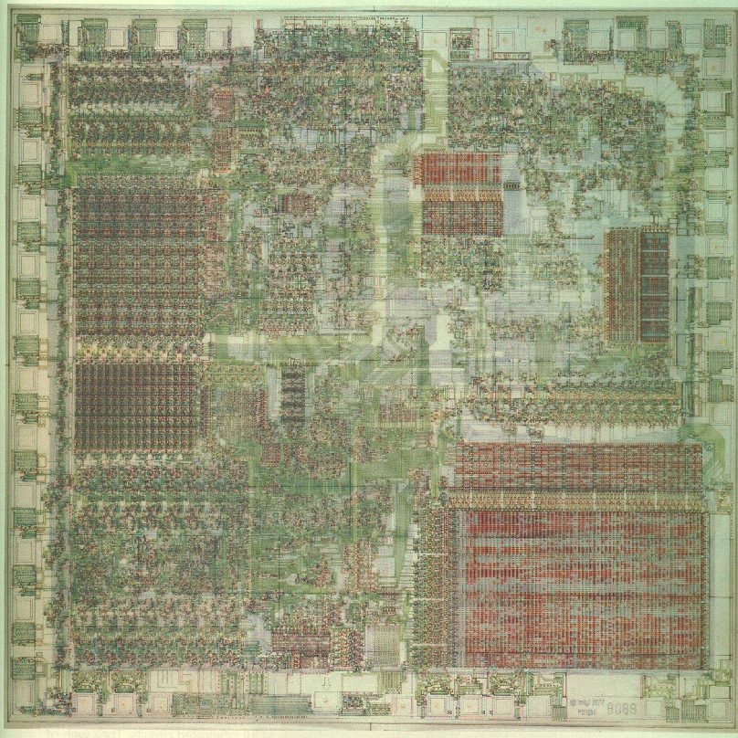
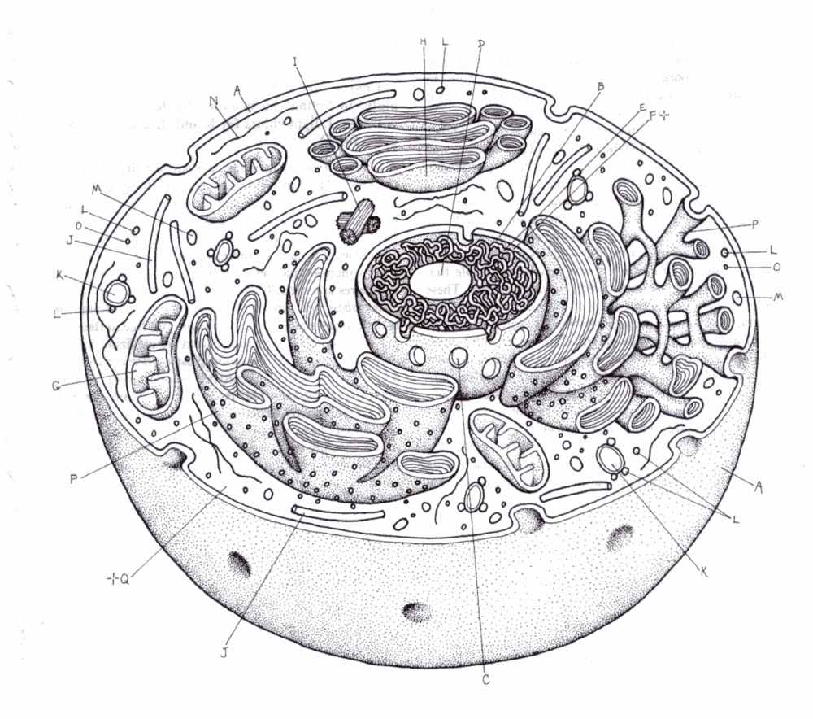
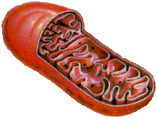
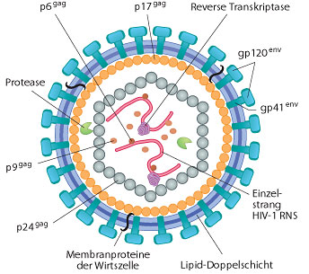
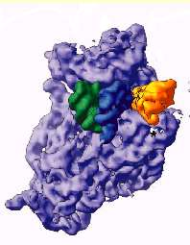
New Sizes, New Rules
NOISY (FAULTY)
QUANTUM
10,000nm
1,000nm
100nm
10nm
1nm
0.1nm
1. Can we build digital devices?
2. Quantum computers?
Why would we want to build here?

Slide 6
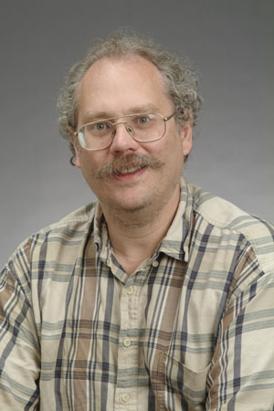
Quantum Computers
18819881292060796383869723946165043
98071635633794173827007633564229888
59715234665485319060606504743045317
38801130339671619969232120573403187
9550656996221305168759307650257059
3980750864240649373971
2550055038649119906436
2342526708406385189575
946388957261768583317
4727721461074353025362
2307197304822463291469
5302097116459852171130
520711256363590397527
1994
Quantum computers can efficiently factor whole numbers (and compute discrete log.)
No known classical efficient algorithm.
Breaks RSA, Diffie-Hellman cryptosystems.
Peter Shor

Slide 7
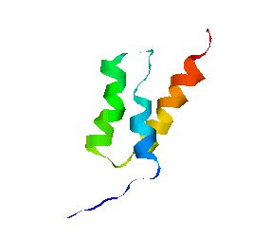
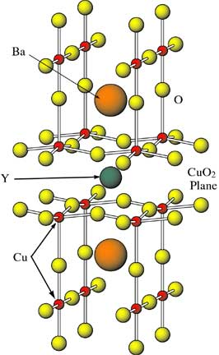
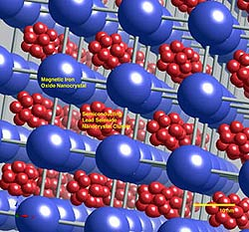
Quantum Simulations
Simulating quantum systems on classical computers is hard
Simulating quantum systems on quantum computers is easy
Richard Feynman
Quantum algorithms for simulating quantum processes
high temperature
superconductors
biochemistry
novel materials

Slide 8
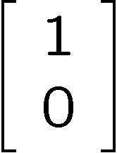
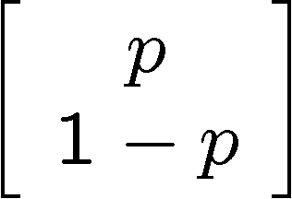
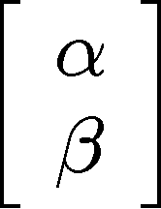


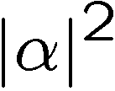
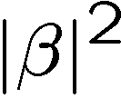
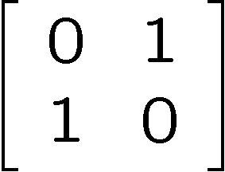
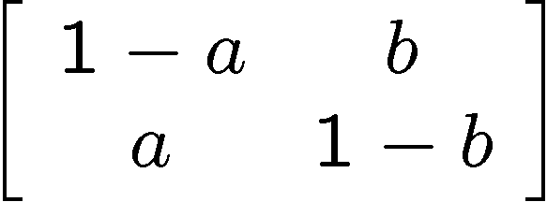
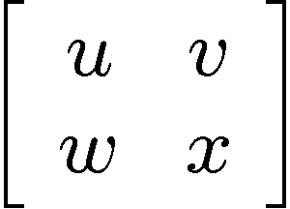
Bit, Pbit, and Qubit
bit
probabilistic bit
quantum bit
Configurations:
0
1
0
1
0
1
Description:
Observation:
0
certainty
0
p percent
0
percent
1
1-p percent
1
percent
Evolution:
deterministic
stochastic
unitary

Slide 9

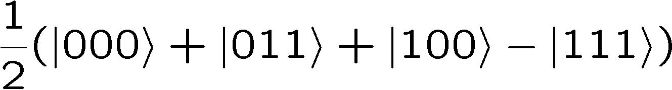


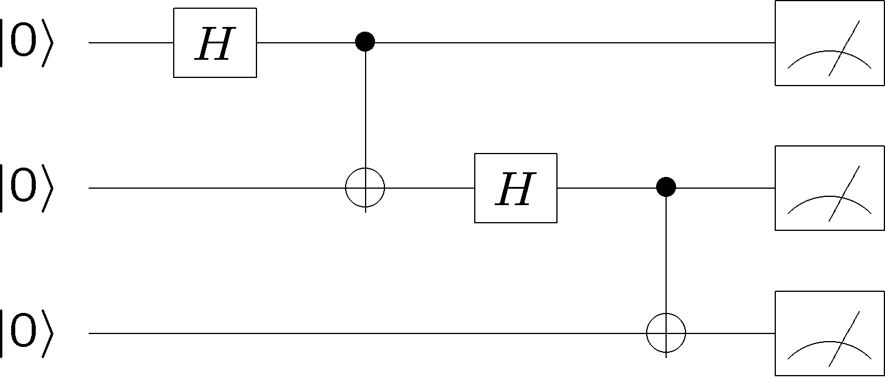
What is a Quantum Computer?
qubits
Quantum algorithm
1. Initialize
2. Series of unitary gates
3. Measurement

Slide 10
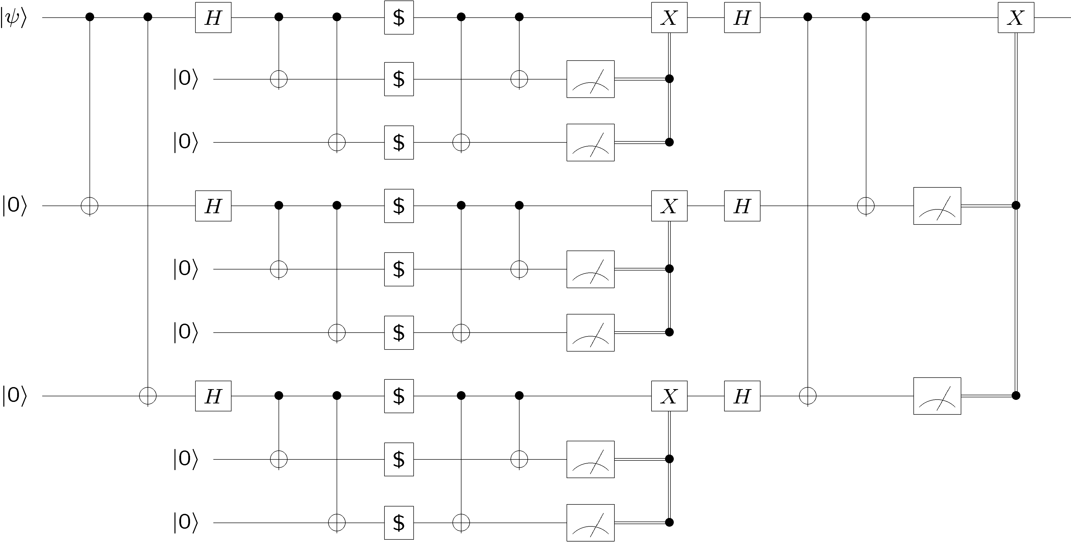
Quantum Circuits
Quantum algorithms are usually expressed as families of quantum circuits
WARNING: quantum computers will (probably) not be made of etched circuit boards
corresponding to the above circuits. Quantum circuits = Quantum algorithms

Slide 11
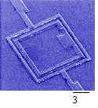
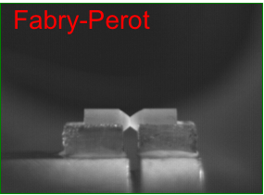
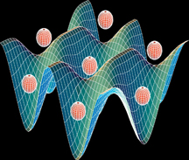
But What Will It Look Like?
Atomic
cavity QED
neutral atoms in optical lattices
ion traps
Solid State
superconducting circuits
electron spin in Phosphorus doped Silicon
quantum dots
defects in diamonds
Molecular
Photon Based
Liquid NMR (no longer?)
linear optics plus single photon devices
Pics: Mabuchi (Caltech), Orlando (MIT)

Slide 12

DiVincenzo’s Criteria
1. Well defined qubits in a “scalable” architecture
David
DiVincenzo
2. The ability to initialize the system to a state
3. Have faster control over the system than error processes in the system.
4. Have the ability to perform a universal set of quantum gates.
5. Have the ability to perform high quality measurements

Slide 13
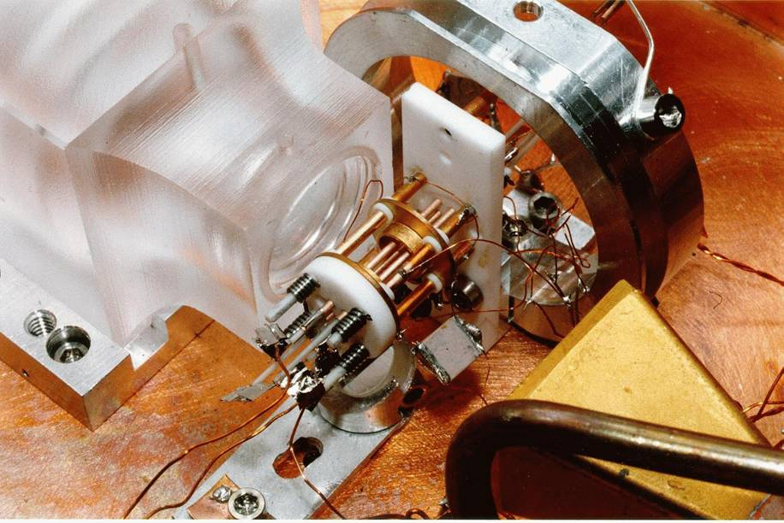
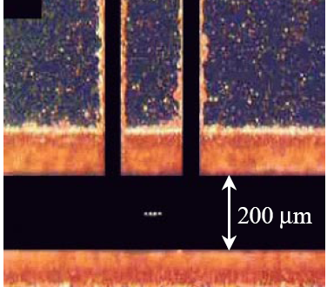
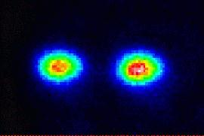
Ion Trap
Oscillating electric
fields trap ions
like charges repel
2 ⁹Be⁺ Ions in an Ion Trap
(picture from NIST Boulder)

Slide 14
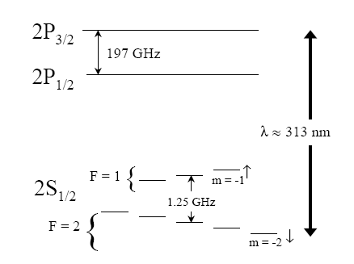
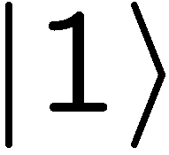

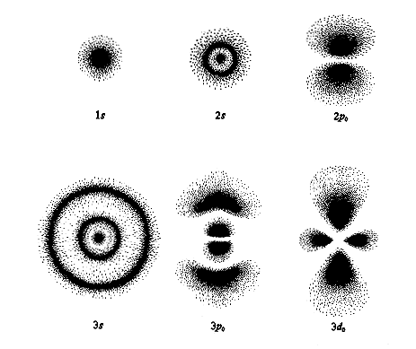
Where’s the Qubit?
Energy
Each ion = 1 qubit
1. Well defined qubits 
orbitals

Slide 15
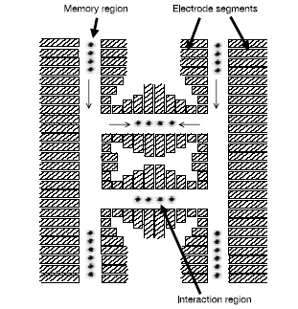
Scalable?
. Well defined qubits in a scalable architecture?
More to say about this later!!!

Slide 16
DiVincenzo’s Criteria
1. Well defined qubits in a “scalable” architecture
David
DiVincenzo
2. The ability to initialize the system to a state
3. Have faster control over the system than error processes in the system.
4. Have the ability to perform a universal set of quantum gates.
5. Have the ability to perform high quality measurements

Slide 17
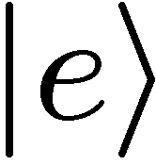
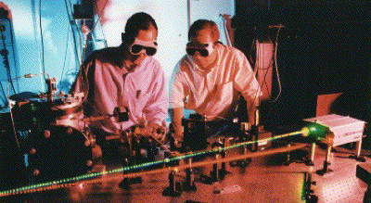
Measurement
Energy
laser
decay
Detecting florescence implies
in state 0
99.99% efficiency
5. Have the ability to perform high quality measurements 

Slide 18
DiVincenzo’s Criteria
1. Well defined qubits in a “scalable” architecture
David
DiVincenzo
2. The ability to initialize the system to a state
3. Have faster control over the system than error processes in the system.
4. Have the ability to perform a universal set of quantum gates.
5. Have the ability to perform high quality measurements

Slide 19
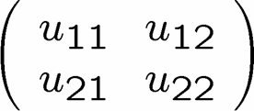
Single Qubit Operations
Laser 1
Energy
Laser 2
Allows any one qubit unitary operations

Slide 20
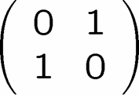
Initialization
Laser 1
laser
Laser 2
decay
If not in zero state, flip
measure
2. The ability to initial the system to a deterministic state. 

Slide 21
DiVincenzo’s Criteria
1. Well defined qubits in a “scalable” architecture
David
DiVincenzo
2. The ability to initialize the system to a state
3. Have faster control over the system than error processes in the system.
4. Have the ability to perform a universal set of quantum gates.
5. Have the ability to perform high quality measurements

Slide 22
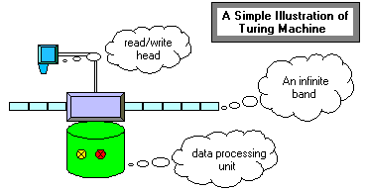
Universal Computers
Turing machine reads state of tape at current position.
Based on this reading and state of machine, Turing machine writes new symbol at current position and possibly moves left or right.
A Universal Turing Machine can act like any other possible
Turing machine (i.e. it is programmable)

Slide 23

Universal Quantum Computer
Universal Quantum Computer
a quantum computer which can be programmed to perform any algorithmic manipulation on quantum information.
U(2)
Set of Universal Quantum Gates
a set of operations/gates which, acting on the quantum information, can be used to implement (to any desired accuracy) any unitary evolution of the quantum info.
The Royal King and Queen of Universal Quantum Gates
CNOT and 1-qubit rotations

Slide 24
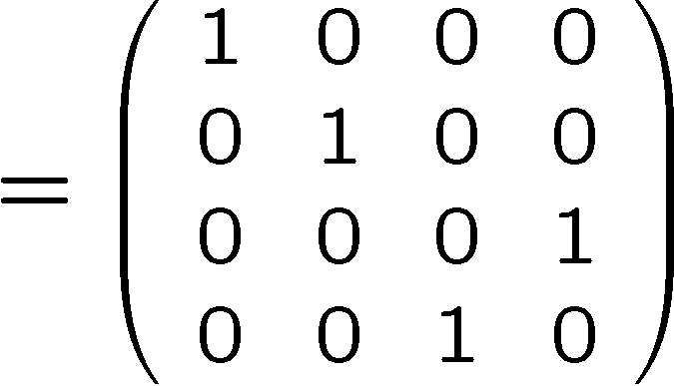
Coupling Two Qubits
stationary
sloshing mode
These modes can be used as a bus between the qubits.
4. Have the ability to perform a universal set of quantum gates 

Slide 25
DiVincenzo’s Criteria
1. Well defined qubits in a “scalable” architecture
David
DiVincenzo
2. The ability to initialize the system to a state
3. Have faster control over the system than error processes in the system.
4. Have the ability to perform a universal set of quantum gates.
5. Have the ability to perform high quality measurements

Slide 26



What is the Problem?
3. Have faster control over the system than error processes in the system.
Real quantum systems are open quantum systems!
system
environment
Quantum systems readily couple to an environment…
qubits
0
System decoheres:
pbits
1
50% 0 50% 1
Quantum
Classical
The Decoherence Problem
Notes:
Quantum systems readily couple to an environment.

Slide 27

My Mortal Enemy

Slide 28

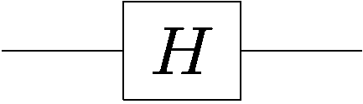

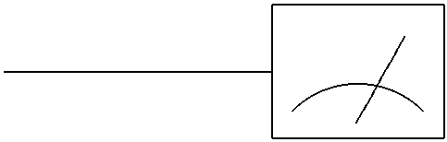

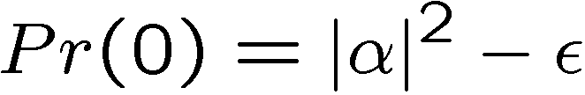

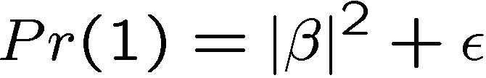
More Obstructions
FAULTY CONTROL
System
Controller
Imperfect state
preparation
Imprecise or faulty unitary gates
Imperfect
measurements
like not having control
over probabilities…

Slide 29

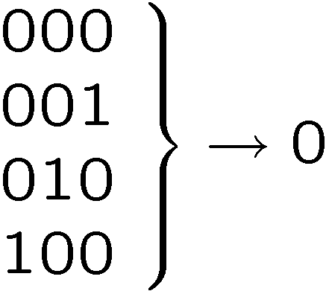






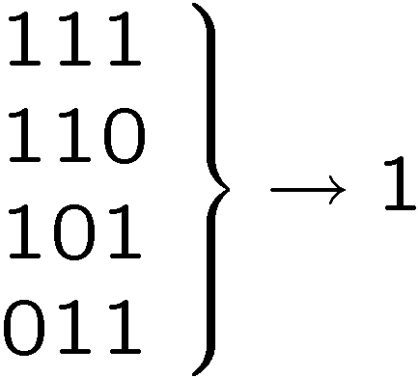
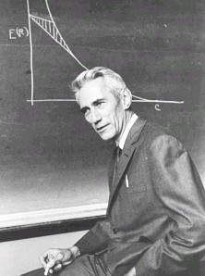
Classical Solutions
Probability of bit flip = p
Solution: redundancy
Probability of failure =3(1-p)p²+p³
=3p²-2p³
<p if p<1/2
Use redundancy to protect information against noise
Claude Shannon 1948
“A mathematical theory of communication”

Slide 30


More Classical Solutions
Classical gates fail with probability p
Solution: error correcting codes + fault tolerant construction
M
John von Neumann, 1956
“Probabilistic logics and the synthesis of reliable organisms from unreliable components”
M
M

Slide 31



Quantum Error Correcting Codes
By encoding quantum information we can protect it from the
effects of noise:
“bare” error rate = p
error rate on encoded = O(p²)

Slide 32






Perfection Through Concatenation
failure
probability
p
cp²
c(cp²)²
At k^{th} level of concatenation, probability of an error which
destroys the encoded quantum information is
and uses qubits

Slide 33

Fault-Tolerant Quantum Computation
Must design quantum circuits which succeed even when
every element of the circuit (preparation, unitary gates,
measurements) can fail.
Quantum error correction + Fault-tolerant procedures

Slide 34

Threshold Theorem, ~1996
QC
errosol
“decoherence”
“imprecision”
Threshold Theorem for Fault-Tolerant Quantum Computation
[Aharonov, Ben-Or, Knill, LaFlamme, Zurek,
Kitaev, Gottesman, Preskill, Shor, + others]
If noise is weak enough and control is precise enough, then a
quantum computation to a desired accuracy can be carried out
with an overhead polynomial in the log of the accuracy.

Slide 35
Threshold(s) Theorem(s)
Threshold theorems come in many different forms….
provable bounds, Monte Carlo estimates, …
different shapes…
assumptions of error models
assumptions of physical devices
assumptions of architectures
yielding threshold values for error rates from between
10⁻¹⁰ to 10⁻²
…but device complexities are universally very high. (hundreds to thousands to millions of “bare” qubits per encoded qubit with extremely complex manipulations)

Slide 36
Ion Trap Parameters
Operation | Time μs Now (Future) | Failure Rate Now (Future)
Single Gate | 1 (1) | 10⁻⁴ (10⁻⁸)
Double Gate | 10 (10) | 0.03 (10⁻⁷)
Measurement | 200 (10) | 0.01 (10⁻⁸)
Movement | 20 (10) | 0.005 (10⁻⁷)/ μm
Split | 200 (0.1)
Cooling | 200 (0.1)
Memory | 10 to 100 s
Trap Size | ~200 (1-5) μm
from Thaker et. al. ISCA-33

Slide 37
DiVincenzo’s Criteria
1. Well defined qubits in a “scalable” architecture
David
DiVincenzo
2. The ability to initialize the system to a state
3. Have faster control over the system than error processes in the system.
4. Have the ability to perform a universal set of quantum gates.
5. Have the ability to perform high quality measurements
Ion traps “satisfy” all requirements but…

Slide 38
Quantum Computing Architectures
“Large Scale”
Quantum
Architecture
“Quantum Error Correcting”
Architecture

Slide 39




A Major Issue
Qubits cannot be copied:
No cloning theorem
Qubits must be moved from place to place, interact with other qubits, etc.

Slide 40
Moving Qubits
SWAP channel?
Problem: bandwidth decays exponentially with distance
(SWAP error multiply)
Move the qubits?
Problem: qubits heat up when you move them

Slide 41






Quantum Teleportation
Alice wants to send to Bob
1 qubit
X
2 bits
Y
Alice performs operation on
her state and half of entangled
system and sends outcome
Conditional on received bits,
Bob performs manipulation of
his half of entangled system

Slide 42
Moving Qubits
Teleportation channel
classical control
entangled qubits
Entanglement distillation
classical control

Slide 43
Teleportation Units
Entanglement
Generator
classical control
For large scale architecture
teleportation provides a
robust method for moving
quantum information
Purification
Teleportation

Slide 44

Quantum Logic Array
(from Metodi et al, MICRO-38 )
Build quantum computer from array of uniform blocks. These blocks can be configured as teleportation units, quantum gates, preparation, and measurement. But each element will have a serious quantum error correcting microarchitecture.

Slide 45
Correcting, Correcting, Correcting
“Quantum Error Correcting”
Microarchitecture
Quantum
Error
Correcting
Code
Fault-Tolerant
Constructs
Architecture
Physical
Implementation
Abstract Concrete

Slide 46

Quantum CCD Architecture
interaction regions
X
X
X
X
X
X
X
X
X
X
X
X
X
X
X
X
X
X
X
X
X
X
X
X
electrodes
ions
X
X
X
X
X
X
X
X
X
X
X
laser
Kielpinski et al Nature 2002
MEMS mirror control
(example from Sandia)

Slide 47
Simple Block Architecture
X
X
X
X
X
X
X
X
X
X
X
X
X
X
X
X
X
X
X
X
X
X
X
X
storage
X
X
X
X
X
X
X
X
X
X
X
X
X
X
X
X
X
X
X
X
X
channel
X
X
X
X
X
X
X
X
X
X
X
X
X
X
X

Slide 48
Fault-tolerant Procedures

Slide 49
Tools!
Error Correction
Compiler
Stabilizer
Designer
Device
Cells
High level
description of
fault-tolerant
error correction
Assembly
compiler
QASM
Mapper/
Scheduler
Physical
Control
Sequence
QCL
Fast
Error
Simulation
Exact
Simulation
Visualizer/
Analyzer
error rates

Slide 50
High Level Languages
Example in QCL (http://tph.tuwien.ac.at/~oemer/qcl.html)
operator dft(qureg q) { // main operator
const n=#q; // set n to length of input
int i; int j; // declare loop counters
for i=0 to n-1 {
for j=0 to i-1 { // apply conditional phase gates
CPhase(2*pi/2^(i-j+1),q[n-i-1] & q[n-j-1]);
}
Mix(q[n-i-1]); // qubit rotation
}
flip(q); // swap bit order of the output
}

Slide 51

Quantum Assembly Language
qubit q0
qubit q1
qubit q2
h q1 # create EPR pair
cnot q1,q2
cnot q0,q1 # Bell basis measurement
h q0
nop q1
measure q0
measure q1
c-x q1,q2 # correction step
c-z q0,q2
QASM

Slide 52

Scheduler
Example from Chuang group at http://www.media.mit.edu/quanta

Slide 53

Metrics
Main goal for QEC microarchitecture is to extract error rate
encoded error rate
bare error rate
from Svore et al 2006

Slide 54

Brave New World
Designing entire architecture from QEC to large scale task
Thaker et al ICSA 33

Slide 55
Major Challenges
Quantum error correction microarchitecture
Design of quantum error correcting codes
Design of fault-tolerant procedures (lack systematic theory)
Designing cells customized to error correction
Designing cells to maximize parallelism in error correction
Designing quantum error correction customized to physical parameters
Macro quantum architecture (largely unexplored)
Maximization of parallelism at circuit level
Everything you’ve learned in this class!

Slide 56


Quantum Architectures
Today: a taste
On the verge of becoming extremely important
5-8 qubit ion trap machines
microfabricated ion traps
large effort to scale up to traps with
30-100 in next few year
Picture from http://iontrap.physics.lsa.umich.edu/research/trap

Slide 57




Architects to the Rescue!
Land of Large
Quantum
Computers
More than a
few qubits

