Slide 1
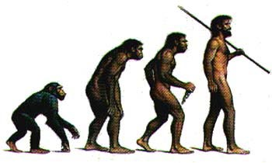
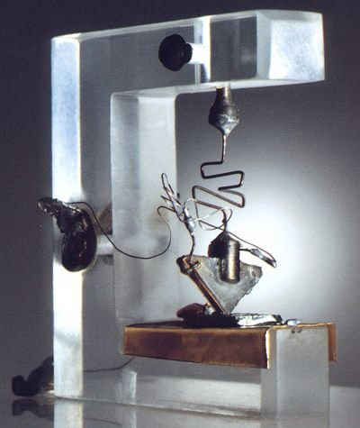
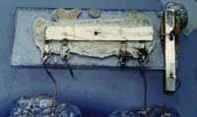
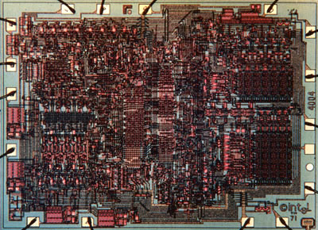
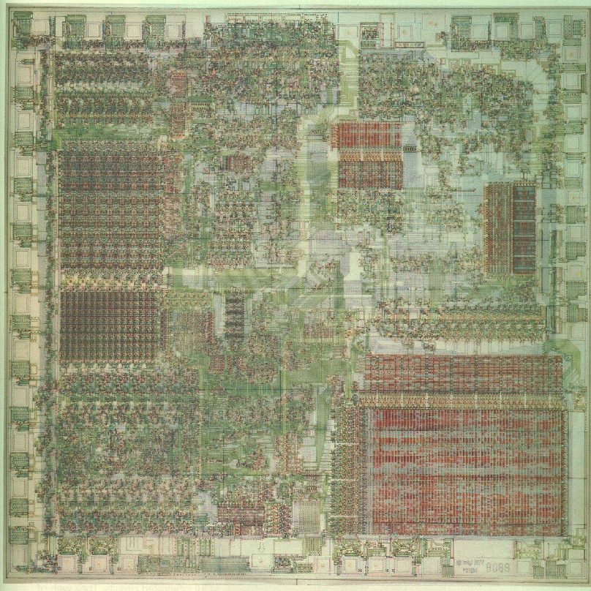
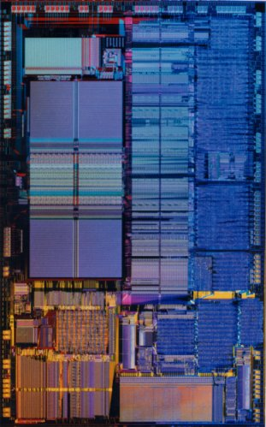
Quantum Computing
Dave Bacon
?

Slide 2
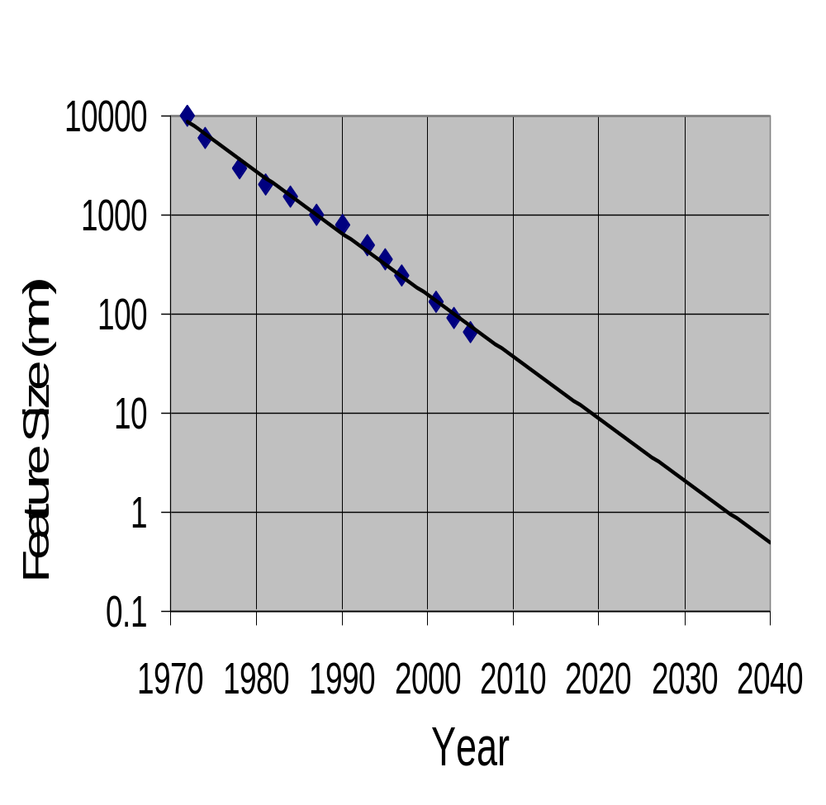
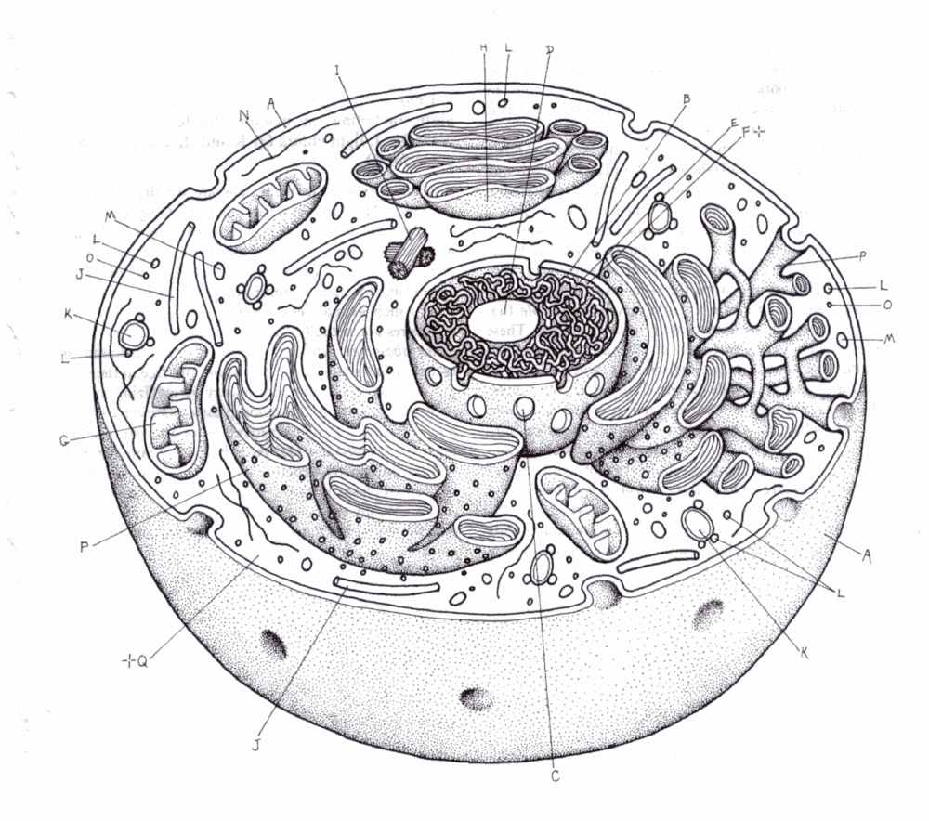
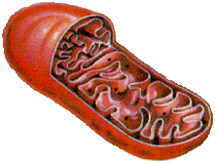

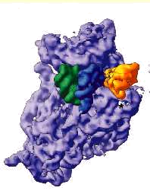
Into the Future
Computer Chip Feature Size versus Time
Eukaryotic cells
Mitochondria
Moore’s Law
(self-fulfilling?)
AIDS virus
Amino acid

Slide 3
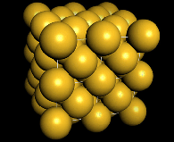
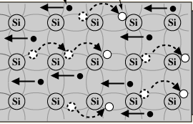
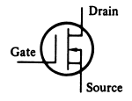
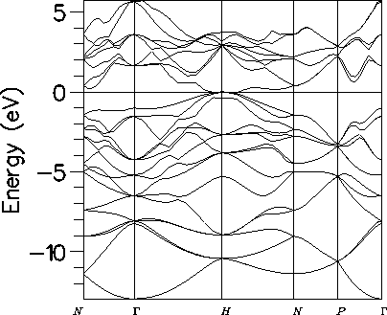
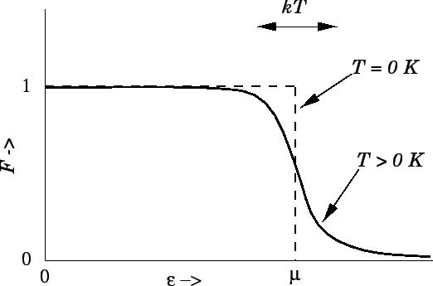
Behind the Bit
bits
noisy bits
quantum bit
Why is computation possible at all?
2. What does physics have to say about computation?

Slide 4
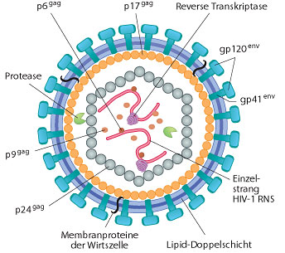
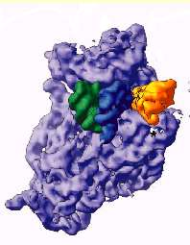

New Sizes, New Rules
NOISY (FAULTY)
QUANTUM
10,000nm
1,000nm
100nm
10nm
1nm
0.1nm
1. Can we build digital devices?
2. “Quantum” computers?

Slide 5
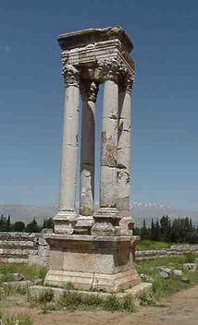
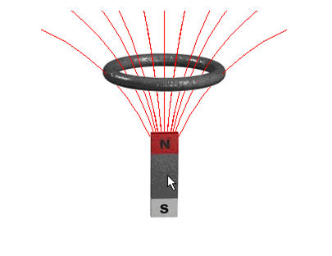
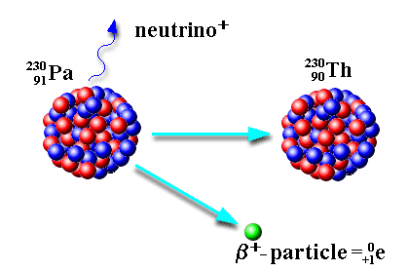
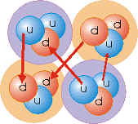
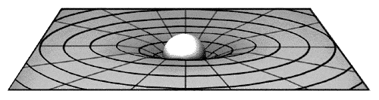
What is Quantum Theory?
Electromagnetic
Force
Weak
Force
Strong
Force
Gravitational
Force (?!?!)
Quantum Theory
Quantum theory is the “machine language” of the universe

Slide 6
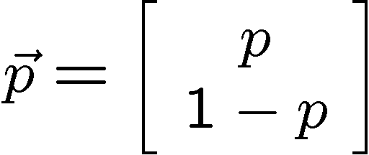


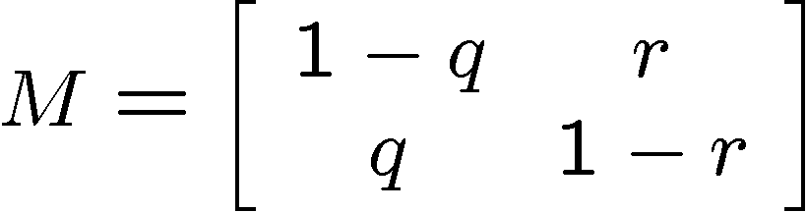

Probabilistic bits
Configuration:
0
1
0
Description:
1
1-q
Evolution:
0
0
q
r
1
1
1-r
Stochastic Matrix
Measurement:
0
p percent
1
1-p percent

Slide 7
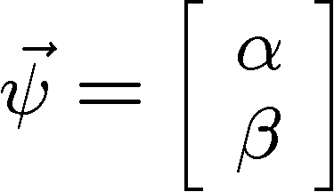

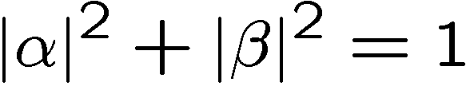


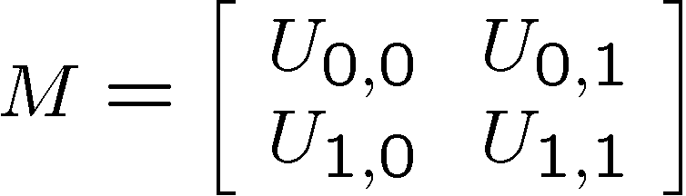


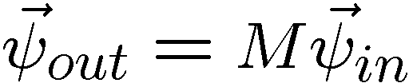
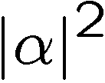
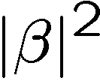
Quantum bits (qubits)
Configuration:
0
1
0
Description:
1
Evolution:
0
0
1
1
Unitary Matrix
Measurement:
0
percent
1
percent

Slide 8

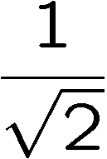
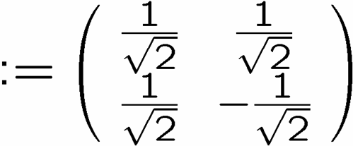

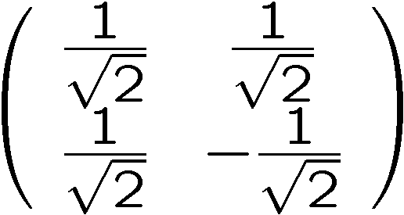
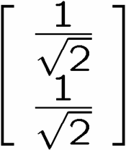
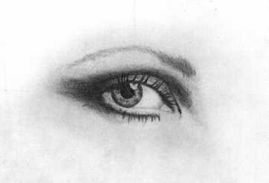
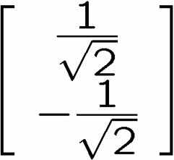
Interference?
0
0
1
1
qubit
input
0
50%
100%
1
50%
0%
measure
0
50%
0%
1
50%
100%
measure

Slide 9
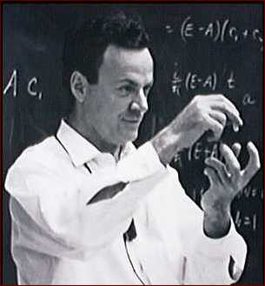
A Worrying Physicist
2040 is a long time in the future….so why worry?
Richard Feynman
Observations
No efficient computer simulations of
quantum theory
2. Systems evolving according to quantum
theory efficiently compute properties of the
quantum system (that’s what experiments are!)
“How can we simulate quantum mechanics?...
Can we do it with a new kind of computer…a
quantum computer? It’s not a Turing machine
but a machine of a different kind” (1981)

Slide 10


Shocking Discoveries
Quantum computers offer superpolynomial speedups (for certain oracle promise problems) over classical computers
[Bernstein, Vazirani 93]
Umesh Vazirani
(U.C. Berkeley)
Quantum computers offer exponential speedups (for certain oracle promise
problems) over classical computers
[Simon 94]
Dan Simon
(Microsoft)

Slide 11


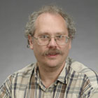
The Factoring Firestorm
18819881292060796383869723946165043
98071635633794173827007633564229888
59715234665485319060606504743045317
38801130339671619969232120573403187
9550656996221305168759307650257059
3980750864240649373971
2550055038649119906436
2342526708406385189575
946388957261768583317
4727721461074353025362
2307197304822463291469
5302097116459852171130
520711256363590397527
Best classical algorithm
takes time
Shor’s quantum algorithm
takes time
Quantum computers can efficiently factor integers and can efficiently compute the discrete logarithm [Shor 94]
Peter Shor

Slide 12
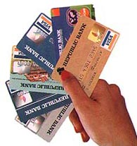
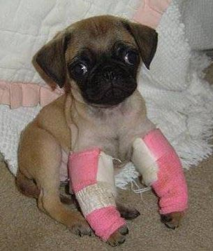
Quantum Computers!
Public Key Cryptosystems
RSA
Diffie-Hellman
Elliptic Curves
BROKEN
18819881292060796383869723
94616504398071635633794173
82700763356422988859715234
66548531906060650474304531
73880113033967161996923212
05734031879550656996221305
168759307650257059

Slide 13

Over the Top
“Only time will tell if and when the problems of building a quantum computer can be overcome….As information becomes the world’s most valuable commodity, the economic, political and military fate of nations will depend on the strength of ciphers. Consequently, the development of a fully operational quantum computer would imperil our personal privacy, destroy electronic commerce and demolish the concept of national security. A quantum computer would jeopardize the stability of the world. Whichever country gets there first will have the ability to monitor the communications of its citizens, read the minds of its commercial rivals and eavesdrop on the plans of its enemies. Although it is still in its infancy, quantum computing presents a potential threat to the individual, to international business and to global security.” -Simon Singh

Slide 14


Quantum Computers!
The world obeys the laws of quantum theory
Computers obey the laws of physics
Computers should obey the laws of quantum theory
Quantum computers!
What can quantum computers do? Why do they work?
(Will Google buy one?)
Can we actually build a quantum computer?
(Will Google buy one?)
What does the quantum model of computation tell us about
the limits of computation in our universe?

Slide 15
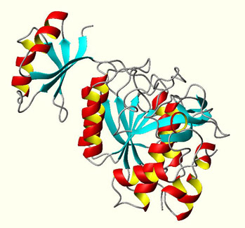
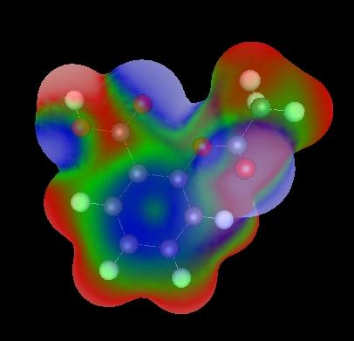
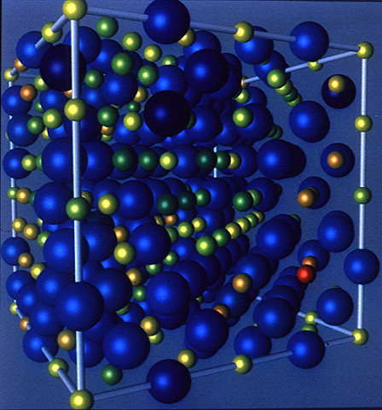
Why Build a Quantum Computer?
(if you’re not the NSA)
Simulation of quantum systems crucial to
biology, chemistry, material science, ….
Quantum computers can do this! So why can they do this?

Slide 16
GHZ/Mermin Game
Alice
Input A
Output a
Bob
Input B
Output b
Input: X or Y, Output: +1 or -1
Winning Payoffs:
A B C abc
X X X +1
Y Y X -1
Y X Y -1
X Y Y -1
Charlie
Input C
Output c
deterministic local strategies, given by a_{X} a_{Y} b_{X} b_{Y} c_{X} c_{Y}
a_{Y} b_{Y} c_{X} = -1
even with
prior classical
communication
not possible
to always win
a_{Y} b_{X} c_{Y} = -1
×
a_{X} b_{Y} c_{Y} = -1
convex sum
of deterministic
local stratgies
a_{X} b_{X} c_{X} = -1

Slide 17

GHZ/Mermin Game
Alice
Input A
Output a
Bob
Input B
Output b
Input: X or Y, Output: +1 or -1
Winning Payoffs:
A B C abc
X X X +1
Y Y X -1
Y X Y -1
X Y Y -1
Charlie
Input C
Output c
Quantum communication before game is played:
Each party measure along
X or Y direction
⟨GHZ|XXX|GHZ⟩=+1
⟨GHZ|YYX|GHZ⟩=-1
⟨GHZ|YXY|GHZ⟩=-1
⟨GHZ|XYY|GHZ⟩=-1
possible to always win!

Slide 18
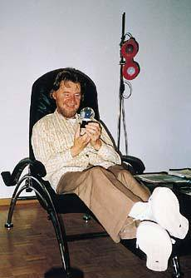


Bell’s Theorem
Alice
time
Bob
space
Separable:
Entangled:
John Bell
Measurements on space-like separated entangled quantum systems cannot be explained by local classical communication.

Slide 19


Minimizing the
Yakking
1 if a=b
0 if a≠b
F_{eq}(a,b)=
ALICE
BOB
a
b
0
1
0
1
0
0
1
1
1
0
n bits
n bits
How many bits do Alice and Bob need to exchange
(in the worst case) to compute F(a,b)?
With no error: n+1 bits
With one-sided error ε: O(log(n/ε)) bits

Slide 20
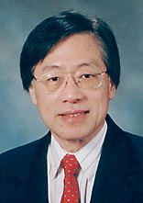
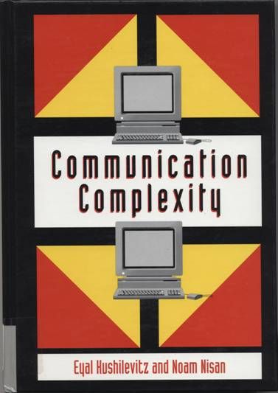
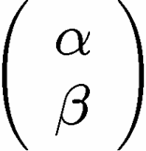
Communication Complexity
Classical communication
costs of distributed
classical computations
[Yao, STOC 79]
[Kushilevitz and Nisan 96]
Quantum communication
costs of distributed
classical computations
[Yao, FOCS 93]
exchange qubits

Slide 21

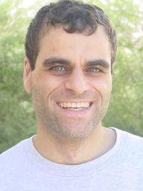
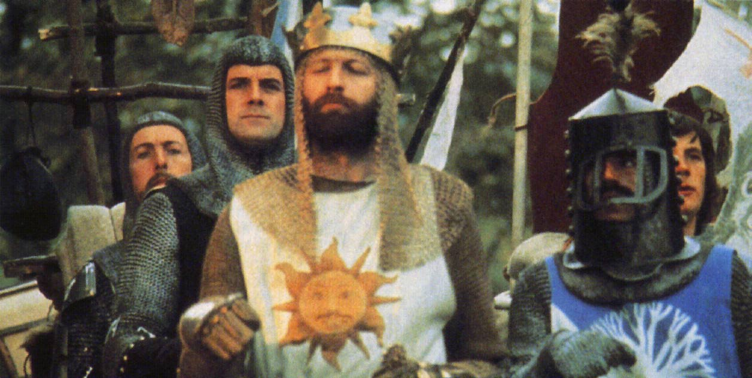
Quantum Communication
Complexity
Holevo’s Theoerem: sending n classical bits
over a quantum channel requires n qubits
There exist functions F(a,b) which require
Ω(m^{1/4}/log(m)) bits of communication to solve
(with error) but can be solved using only
O(log(m)) qubits of communication.
(m is the length of a and b)
[Raz, STOC 99]
Exponential benefit of
quantum over classical.

Slide 22
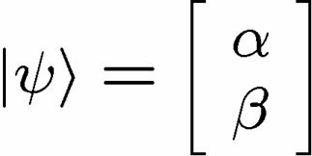



Quantum Teleportation
Alice wants to send to Bob
1 qubit
X
2 bits
Y
Alice performs operation on
her state and half of entangled
system and sends outcome
Conditional on received bits,
Bob performs manipulation of
his half of entangled system

Slide 23

Rehash
There exist functions F(a,b) which require
Ω(m^{1/4}/log(m)) bits of communication to solve
(with error) but can be solved using only
O(log(m)) bits and O(log(m)) ebits.
(m is the length of a and b)
[Raz, STOC 99]
1 ebit :=
Entanglement can be used to gain exponential reduction in
  communication resources
2. Entanglement is “like” classically correlated bits…but it’s
  different…
Preliminary thesis: entanglement is involved in quantum benefits

Slide 24

Entanglement Hungry
Entanglement is the resource consumed by quantum computers
to achieve speedups over classical algorithms
Why aren’t quantum computers everywhere?

Slide 25


“Big” Quantum Computers
Isaac Chuang’s group
used 7 qubits to factor 15
Rainer Blatt’s group entangled
a quantum byte (8 qubits)
from http://www.quantumoptics.at/

Slide 26






Two Views of Information
Information is “fungible” adj. being of such a nature that one part or quantity may be replaced by another equal part or quantity in the satisfaction of an obligation.
Al Gore
George Bush
Ralph Nader
Pat Buchanan
No Information without Physical Representation!
Not all physical systems are robust
information processing machines
Rolf Landauer

Slide 27
Information
No Information without Physical Representation!
Not all physical systems are robust
information processing machines
Rolf Landauer
Position: (x,y,z)
pobre electron
Store information in position?

Slide 28


Analog Information?
two complex numbers, i.e. four real numbers
digits of precision?
Worse yet, to describe quantum state of n qubits requires 2^{n}
complex numbers!
300 qubits = 2³⁰⁰ ≈ 2×10⁹⁰
Number of particles in universe ≈ 10⁷² - 10⁸⁷

Slide 29

Noise
Position of particle:
But particle is not isolated, so it’s environment bumps it around
And measurement cannot be perfect
0
1
1
1
0
1
0
1
?
Each digit requires more
and more resources

Slide 30



A Trap
Common misconception
Digital
Analog
0
1
versus
Deterministic
Nondeterministic
Probabilistic
Quantum

Slide 31












Classical Solutions
Probability of bit flip = p
Solution: redundancy
Probability of failure =3(1-p)p²+p³
=3p²-2p³
<p if p<1/2
Use redundancy to protect information against noise
Claude Shannon 1948
“A mathematical theory of communication”

Slide 32






Perfection Through Concatenation
failure
probability
p
cp²
c(cp²)²
At k^{th} level of concatenation, probability of an error which
destroys the encoded information is
and uses qubits

Slide 33

Threshold Theorem, 1996
QC
errosol
“decoherence”
“imprecision”
Threshold Theorem for Fault-Tolerant Quantum Computation
[Aharonov, Ben-Or, Knill, LaFlamme, Zurek, Shor, Gottesman, Preskill]
If noise is weak enough and control is precise enough, then a
quantum computation to a desired accuracy can be carried out
with an overhead polynomial in the log of the accuracy.

Slide 34
Partial Answers
Why aren’t quantum computers everywhere?
Noise can destroy quantum information
This can be overcome using complex quantum error correcting procedure... (Quantum computing is a valid model of computing!)
But ?

Slide 35

Whence Physics?
RANT
MODE
ON
What is the phase of matter corresponding to the computer?
There are distinct PHYSICAL and DYNAMICAL reasons why
robust classical computation is possible.
not all physical systems are equally good for computation
there exists systems whose PHYSICS guarantees
their ability to enact robust classical computation.
THE BILLION DOLLAR QUANTUM QUESTION:
Are there (or can we engineer) physical systems whose
PHYSICS guarantees robust quantum computation?

Slide 36




Toy Classical Model
Ising model in two+ dimensions
Redundancy code:

Slide 37






Dynamical Ising Model
Energy of excitation=
2J (Sum of perimeters of flipped domains)
Dynamics obeying principle of detailed balance:
Competition between growth and decimation of flipped domains

Slide 38








Robust
Relaxation to thermal
Imperfect preparation
Manipulation
The two encoded states have lifetimes which grow with the size
of the system:
free energy
magnetization

Slide 39



Quantum Hard Drive?
Do there exist (or can we engineer) quantum systems whose
physics guarantees fault-tolerant quantum computation?

Slide 40
Into the Future
A NEW model of computation
can we build it? what will it look like?
what ultimate computational powers does it have?
what ultimate computational powers does it lack?
[useful for physicists simulating quantum systems]
might it allow us to understand classical computation
better?

Slide 41



What Gets Me Out of Bed
Quantum Information Science
Intellectual Merit
Practical Consequences

