Slide 1

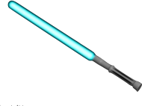
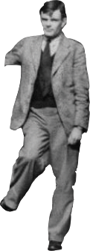
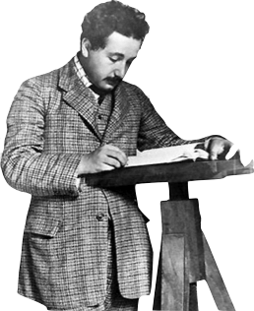
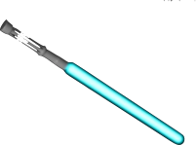
The War to Build a Quantum Computer
Dave Bacon
University of Washington

Slide 2

ENIAC, 1946
17,468 vacuum tubes
7,200 crystal diodes
1,500 relays
70,000 resistors
10,000 capacitors
~5,000,000 hand-soldered joints
~ one vacuum tube failure / day
(equivalent to ~ one transistor failure /second today)

Slide 3

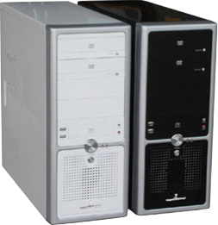
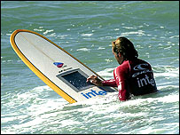

Alternative History
Imagine: no transistors, no integrated circuits...
Could we build a computer out of unreliable components?
J. von Neumann, “Probabilistic Logics and the Synthesis of Reliable Organism from Unreliable Components” 1956

Slide 4
Von Neumann’s Model
x y f
0 0 1
0 1 1
1 0 1
1 1 0
full adder
x
S
y
f
c
1
S
NAND gate
M
M
a
s
x y z f
0 0 0 0
0 0 1 0
0 1 0 0
0 1 1 1
1 0 0 0
1 0 1 1
1 1 0 1
1 1 1 1
1
S
x
M
M
y
f
cout
b
z
CS time
suppose each gate fails (outputs wrong answer) independently and with
probability p
majority gate

Slide 5
Von Neumann’s Conundrum
Observation: If all gates fail with probability p, then an output bit of any circuit most fail with at least probability p
Rest of Circuit
M
input
output
“Loophole”: replace wire by “bundle” of N wires
⇒
≤βN 0s decode as “1”
⎫
⎬
⎭
N
≥(1-β)N 0s decode as “0”
0<β<1/2

Slide 6
Von Neumann’s Solution 1
x
M
Simulate the majority gate redundantly:
y
f
z
M
1x
1x
M
2x
1y
x
3x
1z
4x
2x
5x
2y
M
1y
2z
1f
2y
3x
M
2f
y
3y
3y
3f
f
4y
3z
4f
5y
4x
5f
4y
M
N=5
1z
4z
2z
z
3z
5x
M
4z
5y
5z
5z
2. incoming errors may add
1. M gates may fail

Slide 7
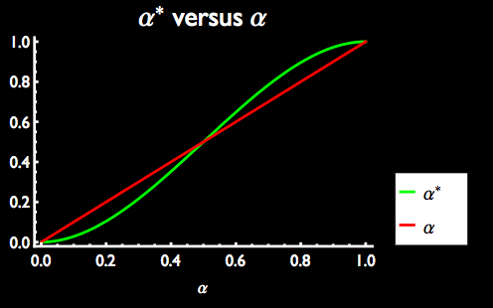
Von Neumann’s Solution 2
“Restorative organ”:
π
M
M
M
M
M
random
permutation
αN “0s” ⇒ [3α²(1-α)+α³]N “0s” = α*N “0”s

Slide 8
Von Neumann’s Solution 1&2
M
1x
1y
1x
M
3x
2x
1z
4x
2x
π
M
5x
2y
M
1y
2z
M
3y
2y
3y
3x
M
M
5y
4y
3z
4y
4x
M
M
2z
1z
4z
M
4z
3z
5y
5x
M
5z
5z
gate
error correction
Theorem (von Neumann): A circuit of g gates can be made to fail with probability ε using O(g log (g/ε) ) gates which fail with probability p, assuming p<pth (vN estimated pth ~ 1%)

Slide 9
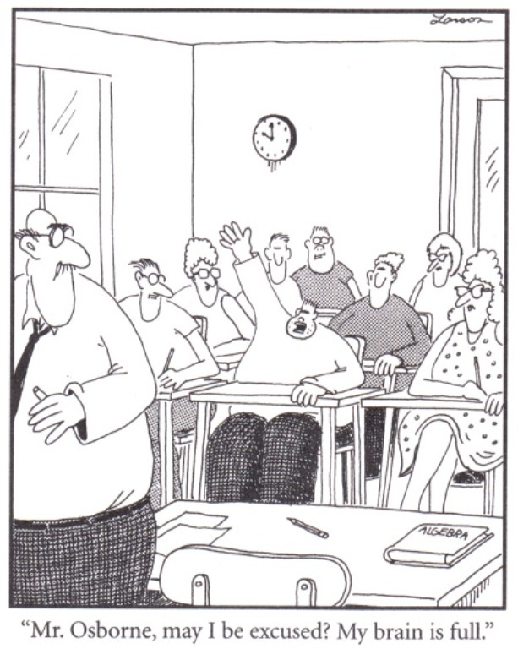
Dave? Did someone forget to tell you this is a physics colloquium?

Slide 10
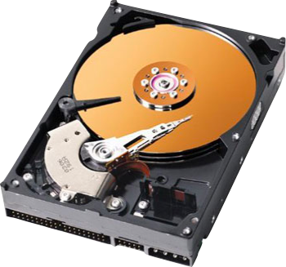
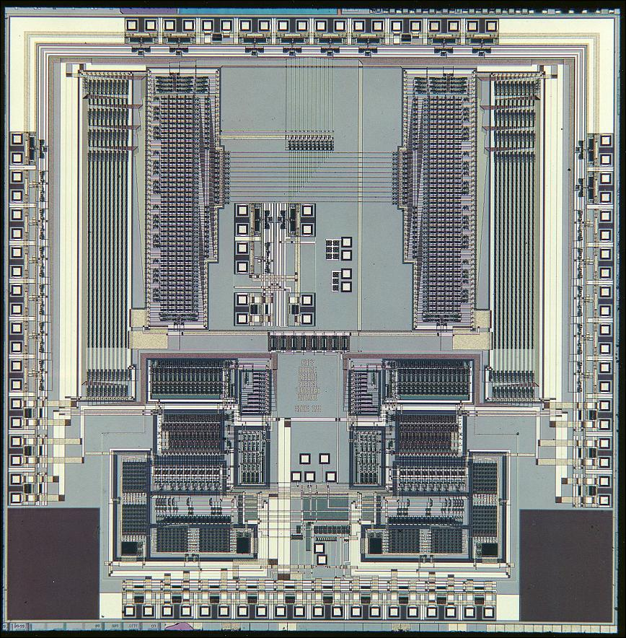
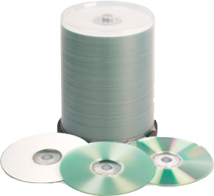
We Don’t Need Your Stickin’ Engineering
There are distinct physical reasons why robust classical computation is possible

Slide 11





Cartoon Guide to Classical Physical Fault-Tolerance
Energy
neighbors
total magnetization
spin
“0” as
“1” as

Slide 12



Cartoon Guide to Classical Physical Fault-Tolerance
Simple noise model
1. Pick spin at random
2. If flipping spin would decrease energy
a. flip spin
3. If flipping spin would increase energy:
a. flip spin with probability
“bare” noise time step
runs of 1-3

Slide 13
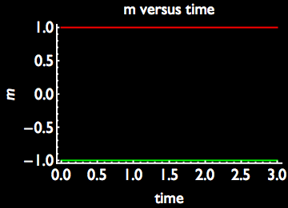
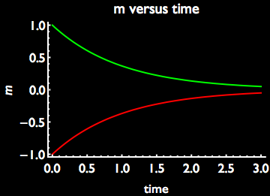



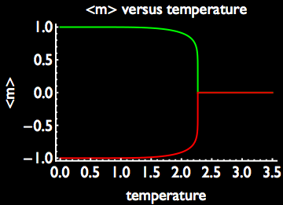
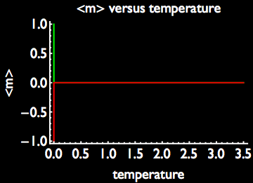
Memory
2D
1D
rate ~

Slide 14

Self-Correcting
1D
2D
Free energy change to flip all spins
entropy wins
energy wins
entropy wins

Slide 15
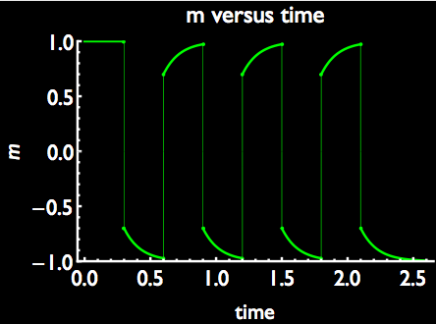
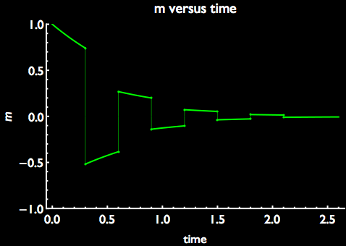
Fault-Tolerance
2D
1D

Slide 16
Dave? Weren’t you going to be talking about quantum computing?

Slide 17

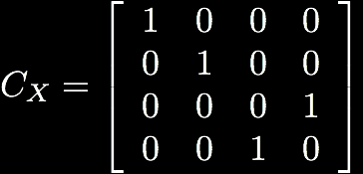

Quantum Computing
Circuit model for quantum algorithms
measurement
state
preparation
quantum gate
quantum gate
CS time

Slide 18
Quantum Algorithms
18819881292060796383869723946165043
98071635633794173827007633564229888
59715234665485319060606504743045317
38801130339671619969232120573403187
9550656996221305168759307650257059
18819881292060796383869723946165043
98071635633794173827007633564229888
59715234665485319060606504743045317
38801130339671619969232120573403187
9550656996221305168759307650257059
Factor
3980750864240649373971
2550055038649119906436
2342526708406385189575
946388957261768583317
4727721461074353025362
2307197304822463291469
5302097116459852171130
520711256363590397527
=
x
 | Running time
Best classical algorithm | exp(N^{1/3})
Shor’s 1994 quantum algorithm | N³
Breaks public key cryptosystems (RSA, Elliptic curves)

Slide 19

Quantum Algorithms
?
 | Time
Best classical algorithm | Nª
quantum algorithm | N^{1/2}
S
S
S
S
S
S
S
S
S
S
S
S
S
S
S
Find root by querying
fewest leaves
01 01 00 11 00 01 10 11
Farhi, Goldstone, and Gutman, “A Quantum Algorithm for the Hamiltonian NAND Tree” 2007

Slide 20
Quantum Algorithms
right going initial wave packet
wait N^{1/2} time
reflect: NAND=0
transmit: NAND=1
0101101110011011
Farhi, Goldstone, and Gutman, “A Quantum Algorithm for the Hamiltonian NAND Tree” 2007

Slide 21
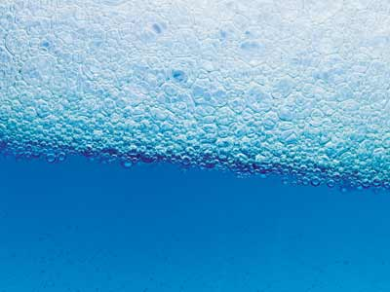

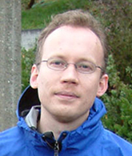
Obstacles
Decoherence:
environment
environment
System
System
pure
mixed
Infinite precision needed for gates?
my laser doesn’t have a setting for one over square root of two

Slide 22
Error Correction
encode
0→000
1→111
diagnose
decode
000→0
111→1
Each bit flipped indepdently with probability p
001
110
flip 1st bit
flip 1st bit
000
111
flip 2nd bit
010
101
flip 2nd bit
000
111
pfail=3p²-p³
flip 3rd bit
If p<1/2, then pfail<p...success!
flip 3rd bit
100
011
no error
000
111

Slide 23
Error Correction
encode
0→000
1→111
parity
1 and 2
parity
2 and 3
001
110
0
1
flip 1st bit
diagnose which error occurred without revealing value of encoded information
000
111
flip 2nd bit
010
101
1
1
flip 3rd bit
100
011
1
0
000
111
0
0

Slide 24








Quantum Error Correction
Basic idea: encoding information can help protect it
error correcting subspace
errors take codespace to orthogonal subspaces

Slide 25




Quantum Error Correction
Commuting set of four operators
Basis:
Codespace:

Slide 26






Quantum Error Correction
Every operator which acts
nontrivially on only one qubit
moves to orthogonal subspace
We can diagnose single qubit errors without destroying quantum information by measuring

Slide 27




Quantum Restorative Organ
D
R
E
E
E
E
E
entropy
dump
If local transition error transition amplitudes are
then output states has error amplitude
Note: a continuous set of error are corrected by
the above procedure (quantum theory is linear)

Slide 28




Fault-Tolerant Quantum Computing
Consider quantum computing where all quantum circuit components can fail:
state preparation
gates
wires
measurements

Slide 29



The Quantum Threshold Theorem
robust
quantum
computing
quantum
computing
not possible
error
rate
Theorem: If decoherence and lack of control are below a threshold p* (relative to coherent control), then a quantum computation of size g can be carried out with error probability ε using O(g log(g/ε)) extra qubits
Aharonov, Ben-Or, Knill, LaFlamme, Zurek, Shor, Kitaev, Gottesman, Preskill (1996)

Slide 30
The War
But....

Slide 31
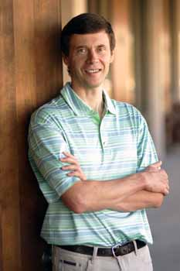
Kitaev’s Idea
“Magnetism arise from spins of individual atoms. Each spin is quite sensitive to thermal ﬂuctuations. But the spins interact with each other and tend to be oriented in the same direction. If some spin ﬂips to the opposite direction, the interaction forces it to ﬂip back to the direction of other spins. This process is quite similar to the standard error correction procedure for the repetition code. We may say that errors are being corrected at the physical level. Can we propose something similar in the quantum case? Yes, but it is not so simple.”
Alexei Kitaev
Kitaev, “Fault-tolerant quantum computation by anyons” (1997, published 2003)

Slide 32





Kitaev’s Toric System
plaquette operator
vertex operator
periodic boundary conditions (torus)
Kitaev Hamiltonian:

Slide 33


Kitaev’s Toric System
Ground state has
Degeneracy?

Slide 34

Kitaev’s Toric System
plaquette operator
algebra: products of loops on lattice which wrap around torus directions an even number of times
Not in algebra

Slide 35

Kitaev’s Toric System
vertex operator
algebra: products of loops on dual lattice which wrap around torus directions an even number of times
Not in algebra

Slide 36





Kitaev’s Toric System
operators which loop around an odd number of times
commute with but not all among each other
ground state is 4-fold degenerate

Slide 37
Kitaev’s Toric System
Kitaev Hamiltonian:
ground state is a quantum error correcting code
L² qubits, encodes 4 qubits, can correct L/2 qubit errors

Slide 38


Kitaev’s Toric Protection
Kitaev Hamiltonian:
Single qubit perturbation
Exponential suppression of level splitting due to external
(local) perturbations

Slide 39

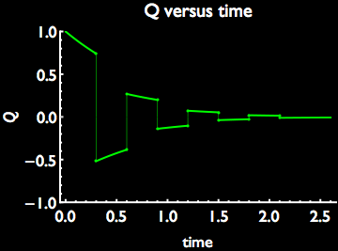
Kitaev’s Toric Protection
End of chain of operators
on dual lattice only changes
at the end of the chain
Excitations are particles
Like 1D Ising model:
good for memory but not
self correcting

Slide 40
Anyons Anyone?
Two types of particles X and Z
-1
braiding X around Z type
particles multiplies wave function by -1
X/X boson, Z/Z boson, X/Z fermions

Slide 41
Topological Quantum Computing
non-abelian Anyons can be used
to build a universal quantum computer
quantum computing
using representations
of braid group
Kitaev, “Fault-tolerant quantum computation by anyons” (1997, published 2003)
Freedman, “Quantum computation and the localization of modular functors” (2001)

Slide 42


4D Toric Code
cube operators
link operators
qubits on plaquettes
Excitations are now strings
4D code is self-correcting
Dennis, Kitaev, Landahl, Preskill “Topological quantum memory” (2002)

Slide 43
Dave, we don’t live in a world with four spatial dimensions!
Challenge: Does there exist a self-correcting quantum system in 3 spatial dimensions?
and in the meantime....the computer engineers...

Slide 44
Surface Code
rough
Z (X) particles can fall off
rough (smooth) boundaries
smooth
Use as a code not as a
physical system
Advantage: no torus!
local measurements!
Memory threshold ~ 10⁻⁴
Dennis, Kitaev, Landahl, Preskill “Topological quantum memory” (2002)

Slide 45
Puncturing Surface Codes
rough
rough
smooth
smooth
smooth defect
rough defect
each defect can be used to encode a qubit

Slide 46
Local Architecture
Build a nearly local quantum error correcting architecture:
encoded
qubits
magic state
injectors
The Computer Engineers have hijacked topological
quantum computing!

Slide 47

Quantum Compass Model
Dorier, Becca, Mila “The Quantum Compass Model on a Square Lattice” (2005)

Slide 48
Quantum Compass Model
Operators which commute with Hamiltonian:
imply ground state is two-fold degenerate
Can it be used to protect quantum information?

Slide 49
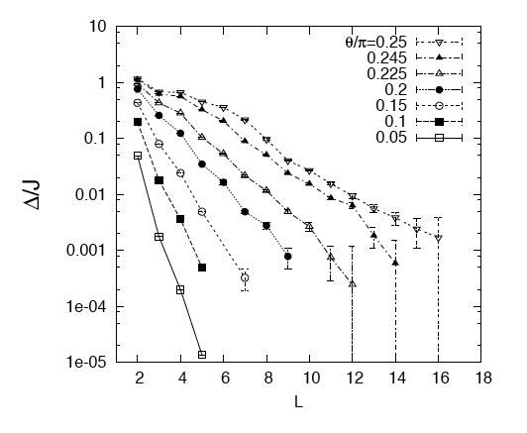

Quantum Compass Model
= ratio of
XX and ZZ interactions
Energy gap
Length of square lattice
Dorier, Becca, Mila “The Quantum Compass Model on a Square Lattice” (2005)

Slide 50




Subsystem Codes
Take a subspace and put a tensor product on it
encode quantum information into
One doesn’t care what happens to information in
Quantum information protected up to change in “gauge”

Slide 51
Compass Model Subsystem Code
group generated by
abelian invariant subgroup:
logical qubit operators:
L² qubits
1 encoded qubit
corrects L/2 errors
L²-2L-3 gauge qubits
Bacon, “Operator Quantum Error-correcting Subsystems for Self-correcting Quantum Memories” (2006)

Slide 52
Fault-Tolerance in Subsystem Code
Normally to fault-tolerantly measure syndrome
have to use lots of ancilla qubits
M
ancilla
syndrome

Slide 53


Fault-Tolerance in Subsystem Code
gauge degrees of freedom allow fault-tolerant syndrome
measurement two qubits at a time:
Best proven threshold for fault-tolerant quantum computing:
Aliferis , Cross “Subsystem fault tolerance with the Bacon-Shor code” (2007)

Slide 54

War
Fault-tolerant quantum computing
justifies the model of quantum computing
But do we really need it, or can physics based methods be used?
Quick! The computer engineers are stealing all the physicists’ ideas*
        *it wouldn’t be the first time that has happened...

Slide 55



Quantum Computing
Theory Group
Graduate Students
Gregory Crosswhite (Physics)
Alice Neels (CSE)
Evening Masters Students
Roger Wolfson (Physics)
Undergraduates
Elizabeth Muhm (CSE/Math)
Alper Sarikaya (CSE/Chem)
William Johnson (CSE)
funded by
ARO
NSA
NSF

