Slide 1
Some Quantum Computing Heresy
Dave Bacon
Dept. of Computer Science & Engineering
University of Washington
UW quantum computing theory group
Eric Chastain (CSE), Isaac Crosson (Physics)
Gregory Crosswhite (Physics), Lukas Svec (Physics)
IARPA visit to UW Nov 16, 2009

Slide 2
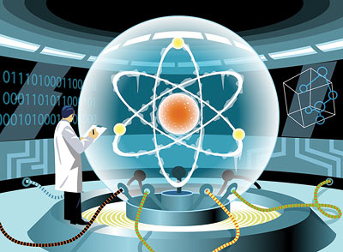
The Central Dogma of Quantum Computing
Faulty quantum computing elements can be put together to build a quantum computer with a low probability of failure if the individual elements fail with small enough probability (the threshold)
Therefore we should focus on one and two qubit devices, making all effort to get devices below threshold
theory
magic occurs
large quantum
computer breaking
a cryptosystem
one qubit
two qubits
many
qubits

Slide 3
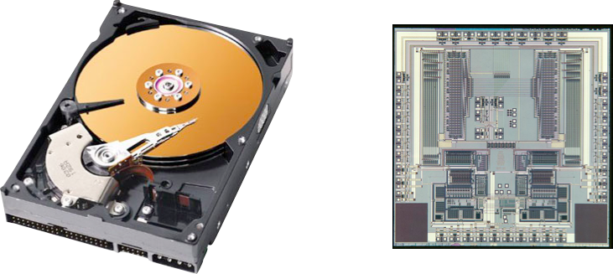
Looking Nothing Like the Classical World
Classical devices need no or little error correction?
No fault-tolerant computing methods?
Observation: The statistical physics of classical computing devices
is responsible for their ability to robust store and manipulate data.

Slide 4
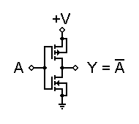
A Second Look at the Transistor
Can we build a quantum transistor?
Integrated Circuit
Transistors
Current Quantum Computer
Designs
information propagates
spatially across device
static information carriers,
algorithm applied to static carriers (or flying qubits)
Phase transition used to
induce this propagation
(on/off = different phases)
“Pulsed” implementations
involving precise timing to apply computations

Slide 5


How to Build a Quantum Transistor
apply
“magnetic”
field
Applied field induces quantum phase transition and quantum
information is propagated from input to output with a quantum
circuit applied
No pulsing: applied field need only be applied “slowly”, errors
in timing do not affect result.
Can we build this quantum transistor? D-wave might.

Slide 6
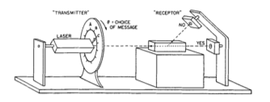
One More Heresy For the Road
The quantum laws of probability can be (nearly) derived from maximizing information in setting where angle is revealed through stochastic “yes”/“no” clicks (Wootters)
Can we invert this observation: derive optimal machine learning algorithms for learning data when it is revealed only through probabilities of outcomes?
Dual motivations for quantum computing

