Slide 1

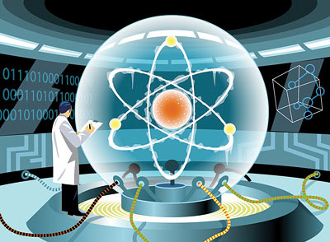
Quantum Computing
Dave Bacon
University of Washington

Slide 2
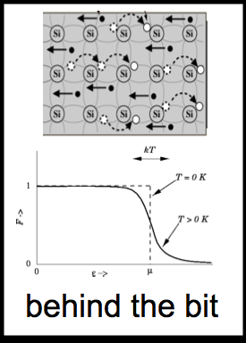
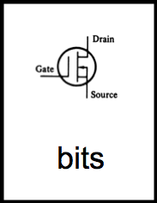
A Simple Question
Why is computation physically possible?

Slide 3

Category Errors
Analog / Digital
x
vs
0
1
0.998213123....
0
Deterministic / Probabilistic
1
0.9
vs
0.4
0.1
0.6
1

Slide 4
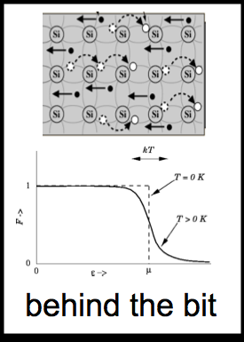
Analog Probabilistic
Digital Deterministic
D
Analog Probabilistic
Digital Deterministic
Category Errors
Analog
Voltages
Digital
Signal
Probabilistic
Electrons
Deterministic
Gates

Slide 5
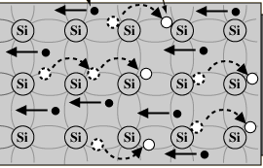
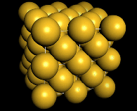
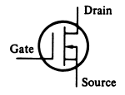
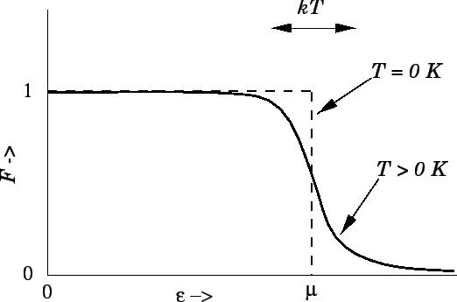
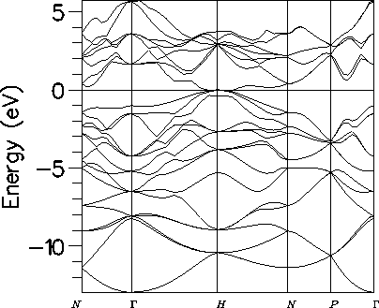
Deeper
bits
noisy bits
quantum bit
Deterministic / Probabilistic / Quantum

Slide 6
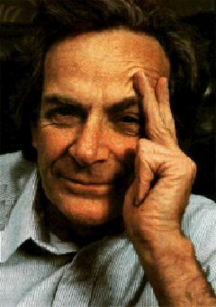
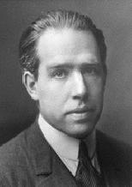
Quantum Propaganda
I think I can safely say that nobody understands quantum mechanics.
Richard Feynman
Nobel Prize 1965
Anyone who is not shocked by quantum theory has not understood it.
Niels Bohr
Nobel Prize 1922

Slide 7
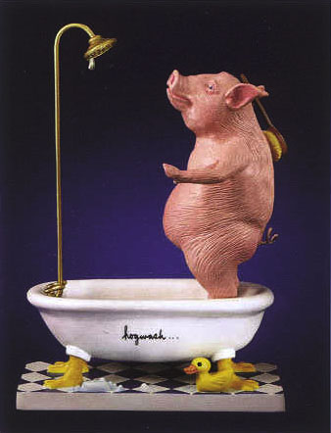
Hogwash
They understand it
They use it
But do they believe it?

Slide 8
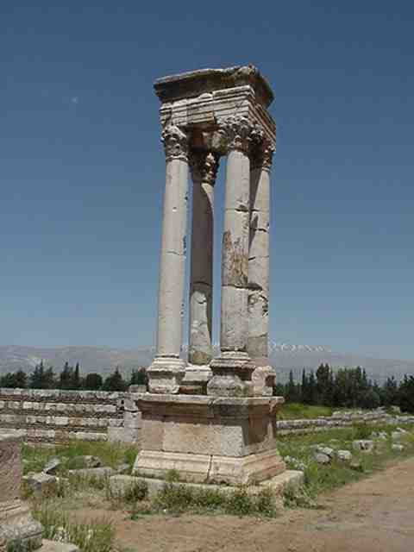


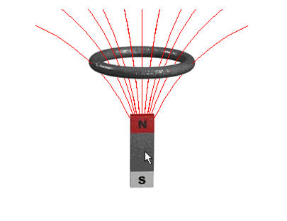
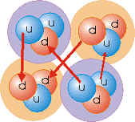

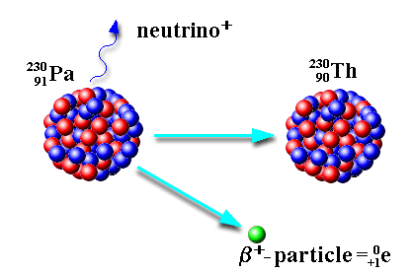

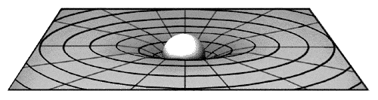
What is Quantum Theory?
Electromagnetism
Strong force
Weak force
Gravity ?!?!
Quantum Theory

Slide 9










Bits, Pbits, Qubits
bit
probabilistic bit
quantum bit
Configurations:
0
1
0
1
0
1
Description:
Observation:
0
certainty
0
p percent
0
percent
1
1-p percent
1
percent
Evolution:
deterministic
stochastic
probabilistic
unitary

Slide 10
Garden of Re-forking Paths
0.5
0.6
0.5
(0.6)(0.5)+(0.4)(0.7)=0.58
0.4
0.7
0.3
0.787
0.787
0.787
2
|(0.787)(0.787)+(-0.787) (0.787)| =0
0.787
-0.787
0.787

Slide 11
Quantum Computers
18819881292060796383869723946165043
98071635633794173827007633564229888
59715234665485319060606504743045317
38801130339671619969232120573403187
9550656996221305168759307650257059
=
x

Slide 12
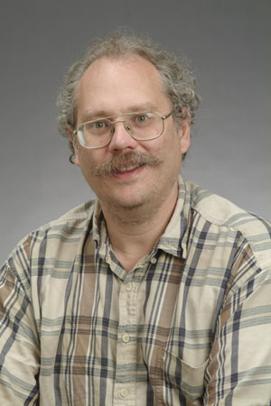
Quantum Computers
18819881292060796383869723946165043
98071635633794173827007633564229888
59715234665485319060606504743045317
38801130339671619969232120573403187
9550656996221305168759307650257059
=
3980750864240649373971
2550055038649119906436
2342526708406385189575
946388957261768583317
4727721461074353025362
2307197304822463291469
5302097116459852171130
520711256363590397527
x
Peter Shor, 1994:
Quantum computers can efficiently factor
No known classical efficient algorithm.
Breaks RSA, Diffie-Hellman cryptosystems.

Slide 13
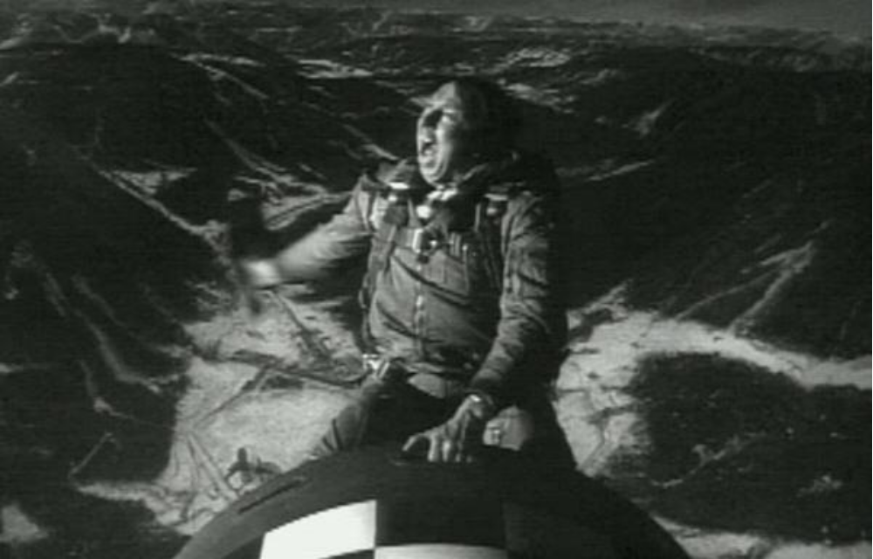
Stop Worrying and Love Quantum Theory

Slide 14


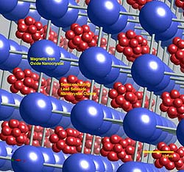
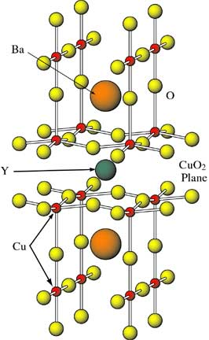
Quantum Algorithms
Exponential speedup
Polynomial speedup
Shor’s algorithm
Breaks RSA, Diffie-Helman
Only a few alternatives which are note broken by quantum computers
Grover’s algorithm
quadratic speedup in needle-in-haystack search
NAND tree algorithm
quadratic speedup in game algorithms
Amplitude amplifiction
Ubiquitous quadratic speedups
Simulation of quantum physics

Slide 15
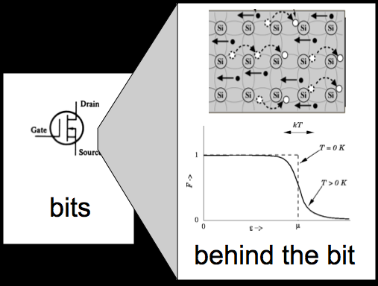
A Simple Question
Why is computation physically possible?

Slide 16
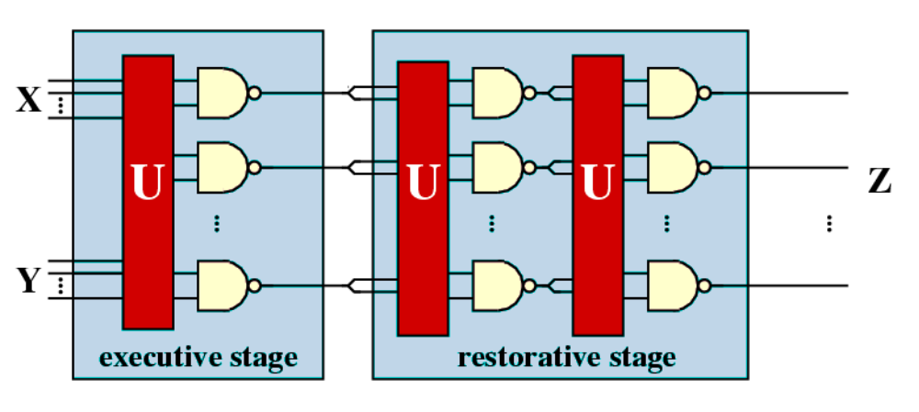
Fault-Tolerant Computation
von Neumann 1952

Slide 17

Threshold Theorem, 1996
errosol
QC
“decoherence”
“imprecision”
Threshold Theorem for Fault-Tolerant Quantum Computation
[Aharonov, Ben-Or, Knill, LaFlamme, Zurek, Shor, Gottesman, Preskill]
If noise is weak enough and control is precise enough, then a
quantum computation to a desired accuracy can be carried out
with an overhead polynomial in the log of the accuracy.

Slide 18
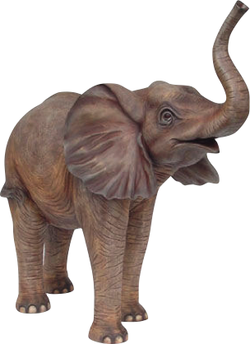
Architectures For Quantum Computers
Systems-level challenges to achieving scalable, fault-tolerant
quantum computation
Designing computer architectures
when components fail
The error correcting architectures
must be massively (but fairly
embarrassingly) parallel
Error Correction

Slide 19
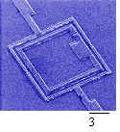
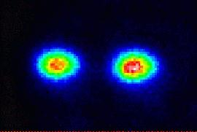
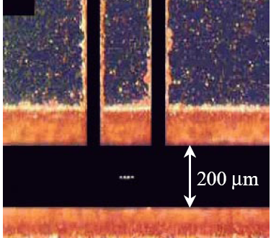
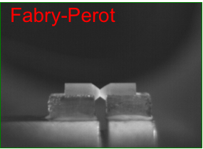
Building Blocks
Example:
superconducting qubits
stationary
fixed location
qubits
walking
Example:
ion trap qubits
“slow”
flying
Example:
photons
“fast”

Slide 20
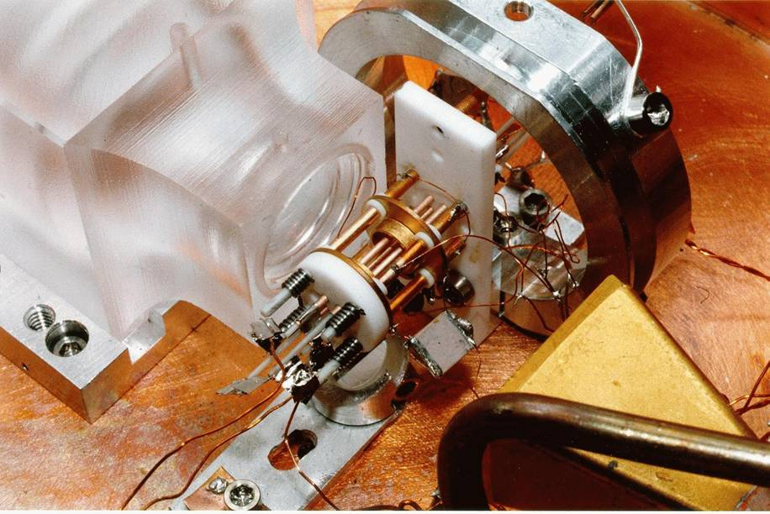

Ion Trap
Oscillating electric
fields trap ions
like charges repel
2 Be Ions in an Ion Trap

Slide 21
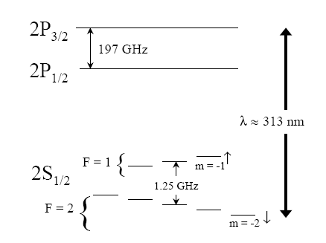
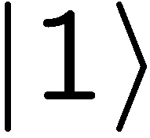

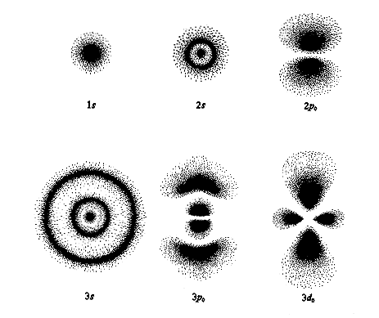

Where’s the Qubit?
Energy
Each ion = 1 qubit
orbitals

Slide 22
Time Scales
walking
Example:
ion trap qubits
“slow”
Operation | Time (μs) | Failure rate (today) | Failure rate (future)
single qubit gate | 1 | 10-4 | 10-8
two qubit gate | 10 | 10-2 | 10-7
measurement | 200 | 10-2 | 10-8
movement | 20 | 10-3/ μm | 10-7/ μm
cooling | 200 | 10-4 | ?
wait | 10-7 / error

Slide 23
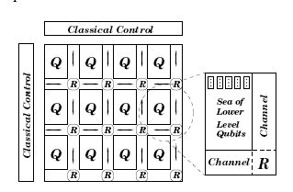
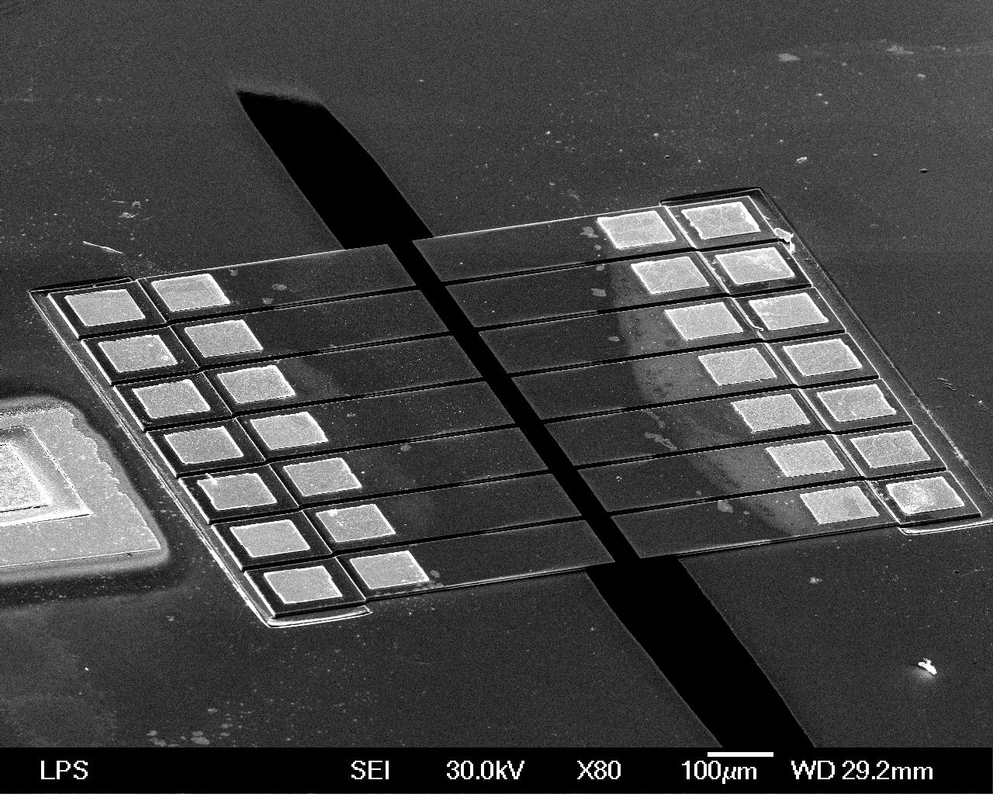
Sketch Ion Trap QC
http://iontrap.physics.lsa.umich.edu/
research/trap
(from Metodi et al, MICRO-38 )
Interaction “trapping” regions
X
X
X
X
X
X
X
X
X
X
X
X
X
X
X
X
X
X
X
X
X
X
X
X
“electrodes”
X
X
X
X
X
X
X
X
X
ions
X
X

Slide 24
Further Resources
Quantum Computing For Computer Scientists (David Mermin):
http://people.ccmr.cornell.edu/~mermin/qcomp/CS483.html
“Standard” Textbook:
Quantum Computation and Quantum Information
by Michael Nielsen and Isaac Chuang
ISCA 2002 Tutorial Page (Oskin and Chong):
http://www.cs.washington.edu/homes/oskin/quantum-tutorial/
My Lecture Notes on Quantum Computing:
http://www.cs.washington.edu/education/courses/cse599d/06wi/

