Slide 1

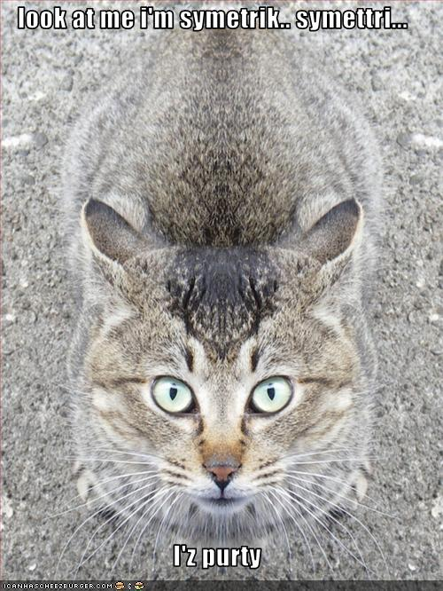
Symmetry and Quantum Algorithms
Dave Bacon
University of Washington
Department of
Computer Science & Engineering
Misfit Faculty

Slide 2
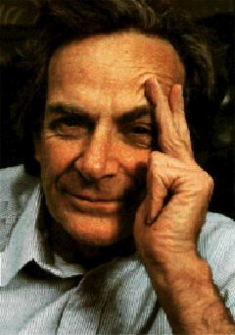
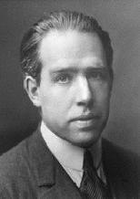
Quantum Propaganda
I think I can safely say that nobody understands quantum mechanics.
Richard Feynman
Nobel Prize 1965
Anyone who is not shocked by quantum
theory has not understood it.
Niels Bohr
Nobel Prize 1922

Slide 3
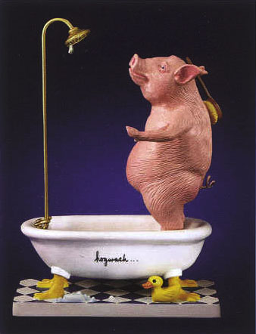
Hogwash
They understand it
They use it
It just defies their sensibilities

Slide 4







These Are a Few of My Favorite Norms
p-norm:
“0-norm” (not really a norm)
number of nonzero
1-norm (taxicab distance)
2-norm (euclidean distance)

Slide 5




Deterministic
“Description” of n bits:
Enforce
“Description” = vector with one nonzero entry
“Evolution” = matrix with one nonzero entry
        in every row and column
“Observation” = bits in configuration with non-zero
        description entry

Slide 6

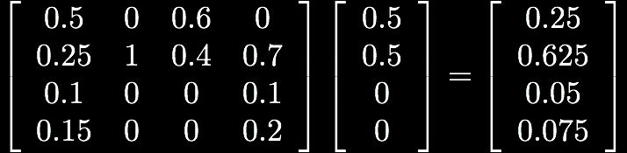
Probabilistic
“Description” of n bits:
Enforce
“Description” = vector whose absolute values sum
        to unity, choice of sign forces a convention
“Evolution” = stochastic matrix (modulo the sign)
“Observation” = bits in configuration with probability given by the absolute value of entry in the description

Slide 7


Quantum
“Description” of n bits:
Enforce
“Description” = vector whose absolute values squared
      sum to unity
“Evolution” = orthogonal matrix
“Observation” = bits in configuration with probability given by the absolute value squared of entry in the description

Slide 8




Quantum Algorithms
Circuit model for quantum algorithms
measurement
state
preparation
quantum gate
quantum gate
CS time

Slide 9






Physicist’s Notation
= column vector (ket)
= inner product
(a number)
= row vector (bra)
“computational basis”:
= outer product
(a matrix)
Tensor product:

Slide 10
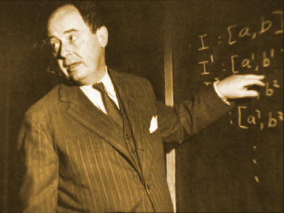


Physicist’s Notation II
When you need to combine 1 and 2 norms, use the
density matrix:
Johnny von Neumann says
with probability

Slide 11
Quantum Algorithms
18819881292060796383869723946165043
98071635633794173827007633564229888
59715234665485319060606504743045317
38801130339671619969232120573403187
9550656996221305168759307650257059
18819881292060796383869723946165043
98071635633794173827007633564229888
59715234665485319060606504743045317
38801130339671619969232120573403187
9550656996221305168759307650257059
Factor
3980750864240649373971
2550055038649119906436
2342526708406385189575
946388957261768583317
4727721461074353025362
2307197304822463291469
5302097116459852171130
520711256363590397527
=
x
 | Running time
Best classical algorithm | exp(N^{1/3})
Shor’s 1994 quantum algorithm | N³
Breaks public key cryptosystems (RSA, Elliptic curves)

Slide 12
Quantum Algorithms
Grover Type
Shor Type
Unstructured Search
[Grover 96]
Factoring, Discrete Logarithm
[Shor 94]
Quantum amplitude amplification
[Brassard, Hoyer, Mosca,
Tapp 00]
Pell’s Equation
[Hallgren 02]
Some Hidden Shift Problems
[van Dam, Hallgren, Ip 02]
[van Dam, Childs 05]
Adiabatic quantum algorithms
[Farhi, Goldstone Gutman,
Sipser 00]
Gauss Sums
[van Dam, Seroussi 02]
NAND tree algorithm
[Farhi, Goldstone Gutman 07]
Hidden Subgroup Problems
Abelian groups, almost abelian
groups, near Hamiltonian groups,
normal subgroups, small
commutator subgroup, solvable
groups of bounded exponent and
of bounded derived series
extraspecial groups, groups of
nilpotency class at most 2, more
Quantum simulated annealing
[Somma, Boixo, Barnum 07]
Misc Type
BQP completeness of Jones, Tutte, and other polynomials, Exponential speedups in quantum random walks, Simulation of
Schrodinger’s equation, Physical chemistry, etc.

Slide 13

On Quantum Algorithms
HELP WANTED Quantum programmer. Only skill necessary is ability to type in large RSA keys. Pay inversely commensurate with years since Ph.D. completed.
HELP WANTED Real estate agent. Best market since bubble popped in 08. Join a dedicated
HE
ne
ar
kr
st.
ed
r
ay
ed
m
HE
Sh
we
the
us
My Nightmare

Slide 14


Quantum Algorithms
?
 | Time
Best classical algorithm | Nª
quantum algorithm | N^{1/2}
S
S
S
S
S
S
S
S
S
S
S
S
S
S
S
Find root by querying
fewest leaves
01 01 00 11 00 01 10 11
Farhi, Goldstone, and Gutman, “A Quantum Algorithm for the Hamiltonian NAND Tree” 2007

Slide 15
Quantum Algorithms
right going initial wave packet
wait N^{1/2} time
reflect: NAND=0
transmit: NAND=1
0101101110011011
Farhi, Goldstone, and Gutman, “A Quantum Algorithm for the Hamiltonian NAND Tree” 2007

Slide 16
Questions
Where does the power of quantum algorithms come from?
Where does the power of classical algorithms come from?
Why are quantum algorithms sometimes exponentially more powerful than classical computers?

Slide 17
The Symmetry “Conjecture”
Vague version 1: Quantum computers exponentially outperform classical computers because they can efficiently “exploit” symmetry
Vague version II: Permutation groups admit unitary representations which can be useful computationally only on quantum computers

Slide 18
Example
Two probability distributions p and q over {1,2,..2N}
Both are evenly distributed over subset size N
  p equals q
  p is complement of q
Problem: distinguish two cases
Classically: Ω(N^{1/2}) copies of this distribution needed

Slide 19
Example
Two amplitude distributions p and q over {1,2,..2N}
Both are evenly distributed over subset size N
  p equals q
  p is complement of q
Problem: distinguish two cases
Quantum: O(1) copies of distribution needed

Slide 20

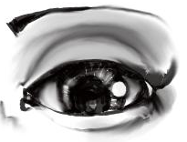






The Swap Test
H
SWAP
What’s this got to do with symmetry?

Slide 21



Symmetry
SWAP
Under unitary basis change this becomes
Classical probabilistic transforms are stochastic and
cannot perform this basis change.

Slide 22
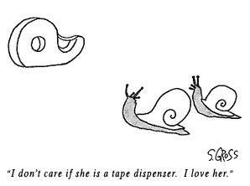
Cognitive Dissonance
Algorithms that offer exponential speedups but don’t seem to exploit symmetry

Slide 23






Simon’s Problem
(is that nobody does what Simon says)
Given: A function with n bit strings as input and one bit as
output
Promise: The function is guaranteed to satisfy
Problem: Find the n bit string

Slide 24


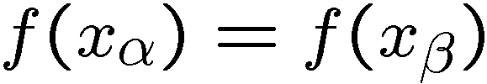

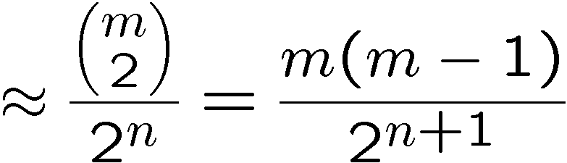
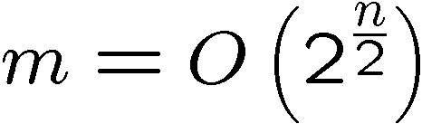
Classical Simon’s Problem
query pairs
If we find such that then
Querying the function m times….
Probability of getting a matching pair
Bounded error query complexity:

Slide 25
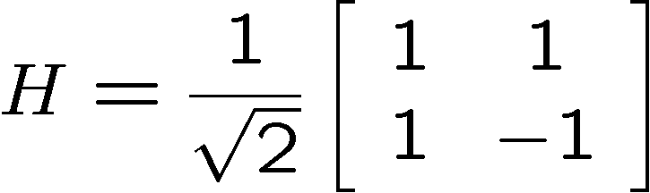
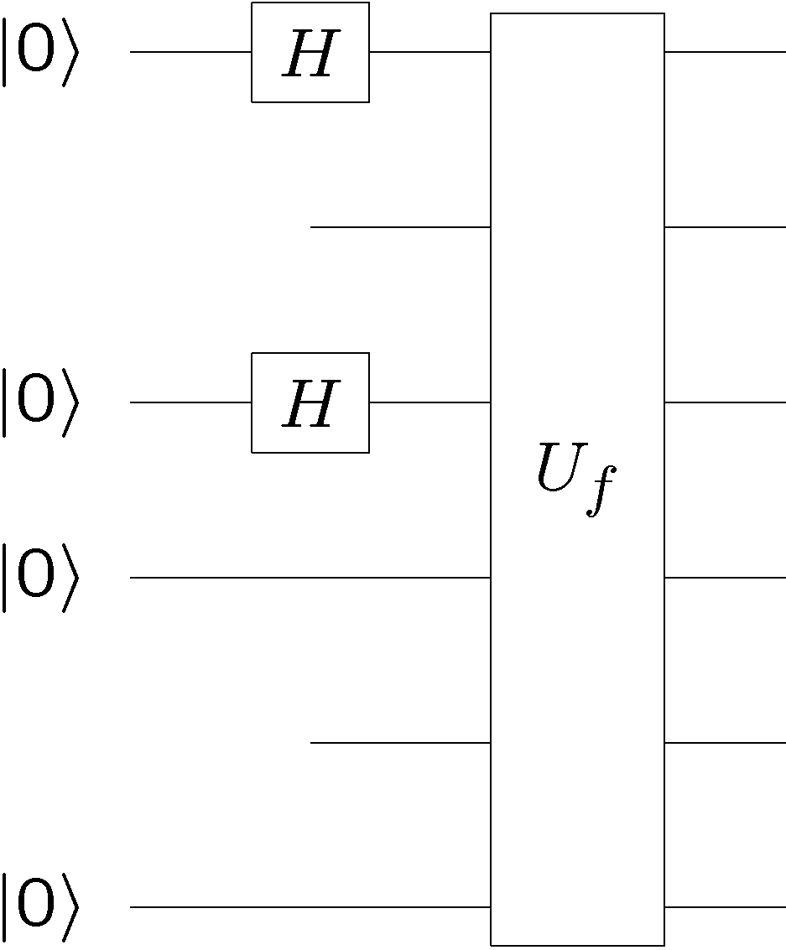
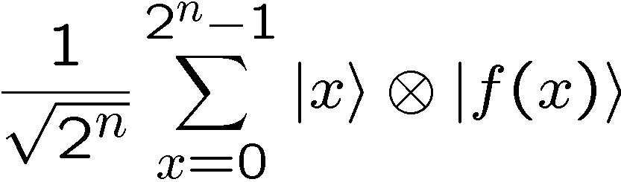
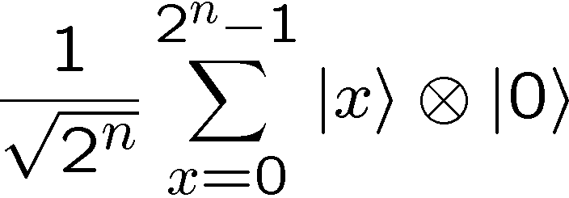
Quantum Simon’s Problem
n qubits
n qubits

Slide 26

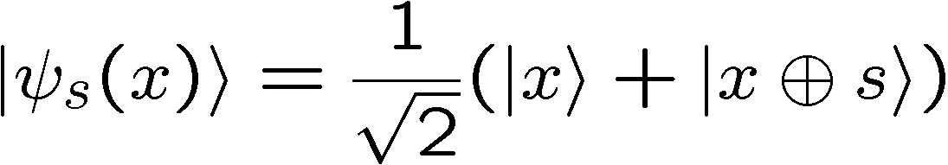
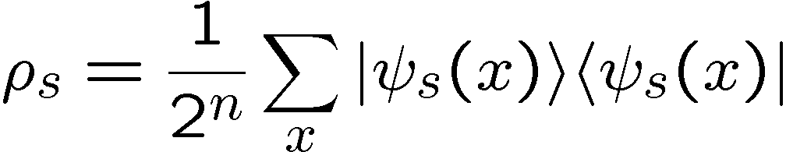

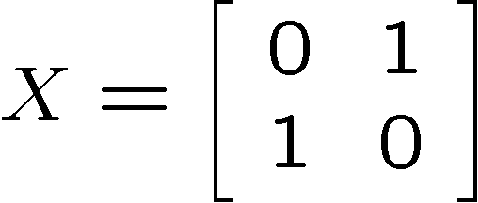
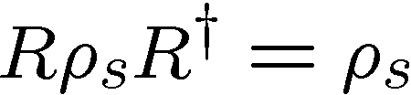
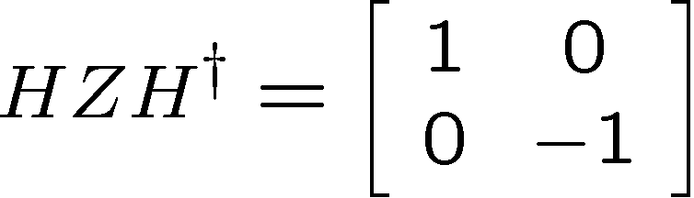
Quantum Simon’s Problem
For random uniformly distributed
Symmetry:
Symmetry → Simultaneously diagonalize symmetry operators
and symmetric operator

Slide 27
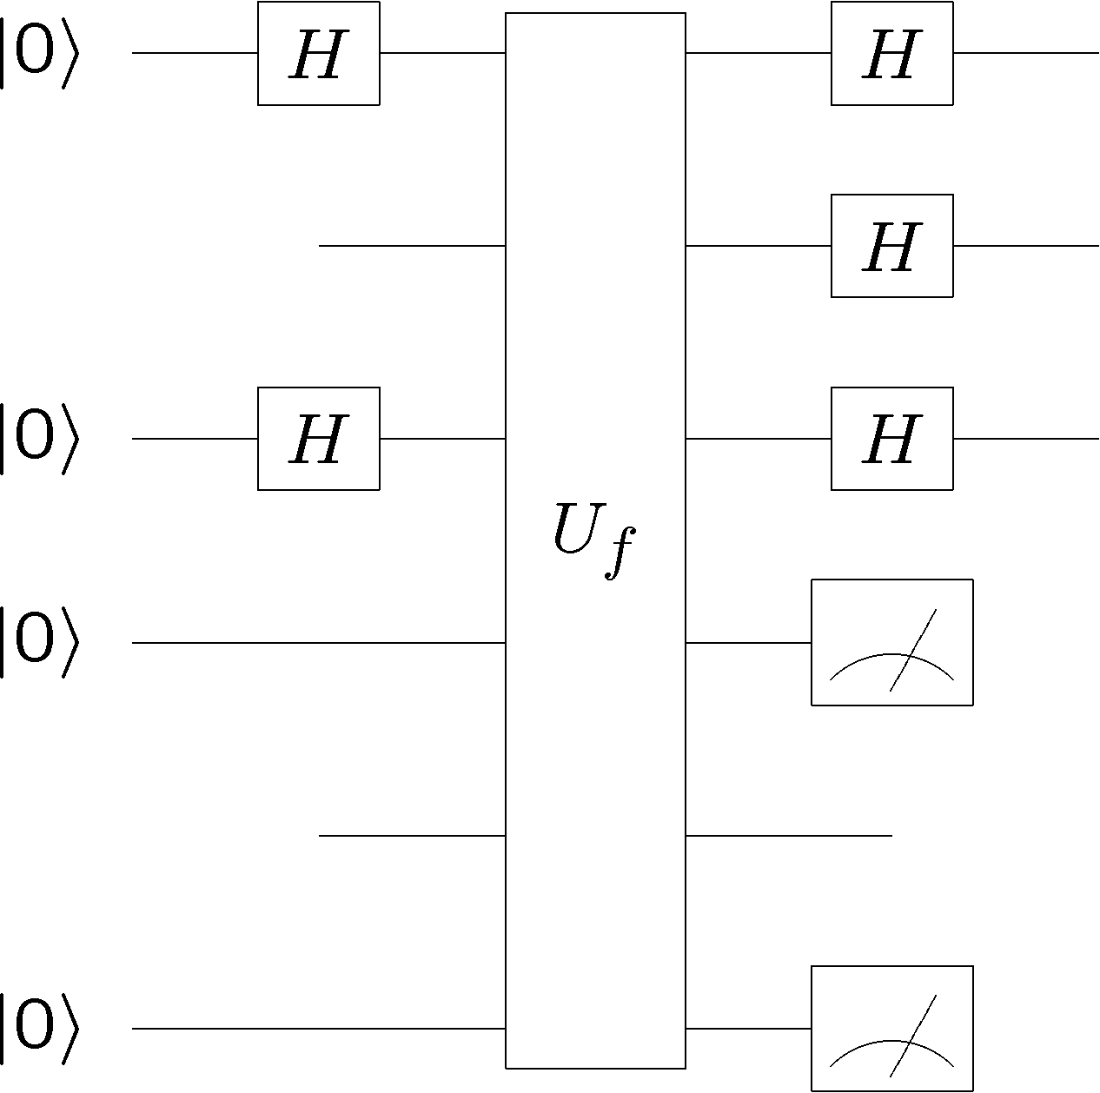
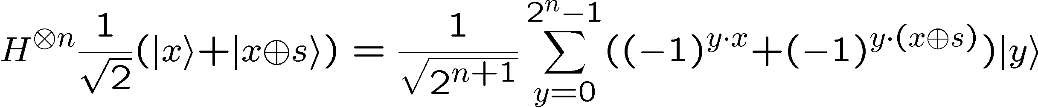
Quantum Simon’s Problem
n qubits
n qubits

Slide 28
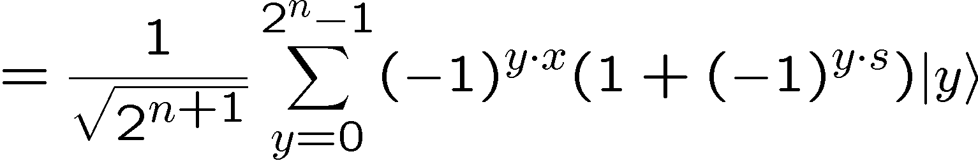







Quantum Simon’s Problem
Measuring this state, uniformly distributed random such that
Multiple runs:
random
uniform
If we obtain linearly independent equations of this form,
we win (Gaussian elimination)

Slide 29
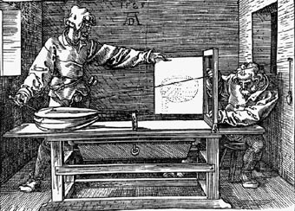
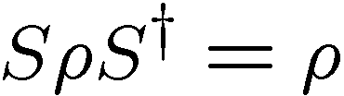



Moral
Symmetries
Diagonalize with respect to symmetry
Quantum algorithm
Quantum
Classical
and simultaneously
diagonalized
What do we do?
But what about that Gaussian Elimination?

Slide 30





Representation Theory in 1 Slide
Group
(Set with binary operator which is closed, associative, has an identity, and inverses)
Unitary representation of group
Irreducible representations of a group (irreps):
has no invariant subspace except
full space and empty subspace
Decomposition into irreps
Schur’s lemma:

Slide 31


Simon’s Problem Redux
Group
addition bitwise mod 2
Representation of group
Irreps of group:
Unitary transform to direct product of irreps:

Slide 32
More Simon’s Problem Redux
random
uniform
are irrep labels
Gaussian elimination : adding bitwise mod 2
Symmetry interpretation?

Slide 33
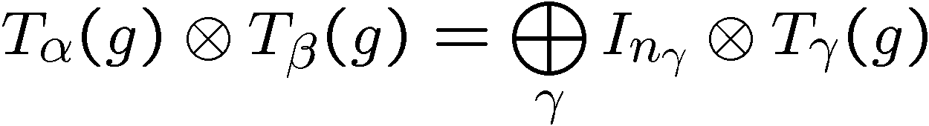
Symmetry Interpretation
Clebsch-Gordan transform:
So the “addition” of Gaussian elimination in Simon’s algorithm
can be interpreted as a Clebsch-Gordan transform….

Slide 34
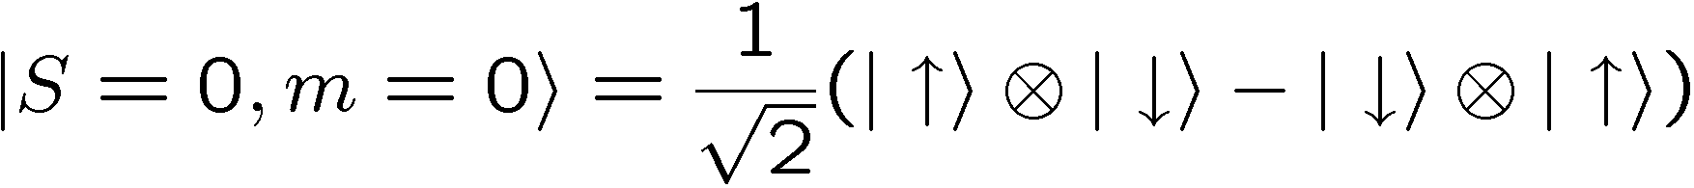

The Second Basis Change
Learned In Quantum Mechanics:
Clebsch-Gordan Transform
Singlet:
Triplet:
What Use?

Slide 35

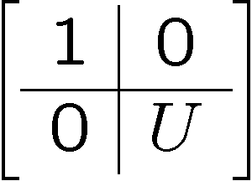


Collective Unitaries
Symmetry Under n Collective Unitary Rotations

Slide 36
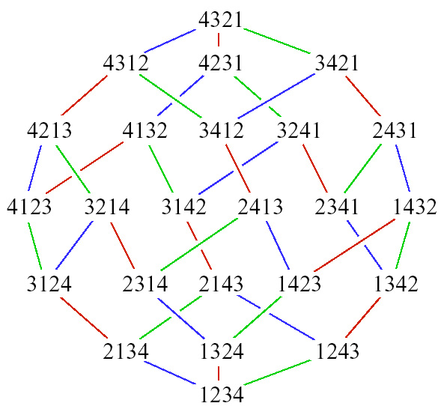


The Symmetric Group
Transform Under
SWAP
Singlet:
Triplet:
Symmetry Under Permutation of n Subsystems

Slide 37
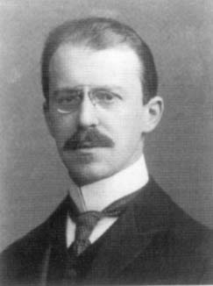


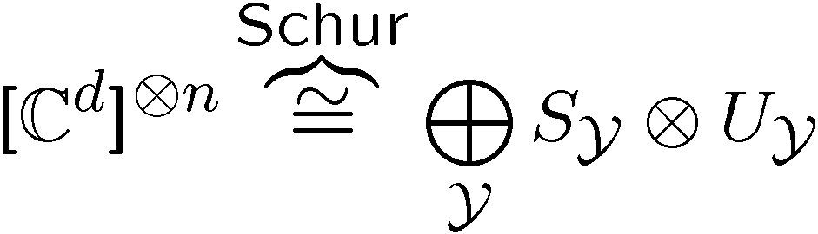

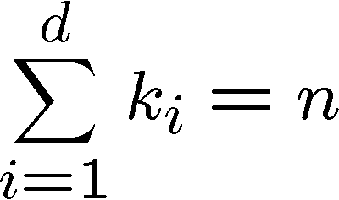
Quantum Schur Transform
Young diagram
n d-dimensional
systems
(n qudits)
irrep space
irrep space
Schur duality
Young diagram

Slide 38
The Plethora of Uses of Schur
Optimal spectrum estimation
[M. Keyl and R. F. Werner. Phys. Rev. A, 2001]
Universal distortion-free entanglement concentration
[M. Hayashi and K. Matsumoto. Information Theory, 2004]
Universal compression with optimal overflow exponent
[M. Hayashi and K. Matsumoto. Phys. Rev. A, 2002]
Optimal quantum hypothesis testing
[M. Hayashi, J. Phys. A, 2002]
Communicating without a shared reference frame
[S. Bartlett, T. Rudolph, and R. Spekkens, Phys. Rev. Lett., 2003]
Encoding into decoherence-free (noiseless) subsystems
[J. Kempe, D. Bacon, D. A. Lidar, and K. B. Whaley, Phys. Rev. A, 2001]
Simulating lattice gauge theories on a quantum computer
[T. Byrnes and Y. Yoshihisa, Phys. Rev. A 2006]
….

Slide 39
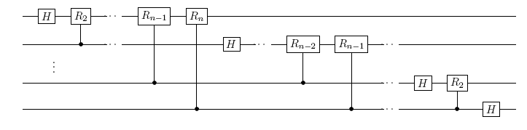
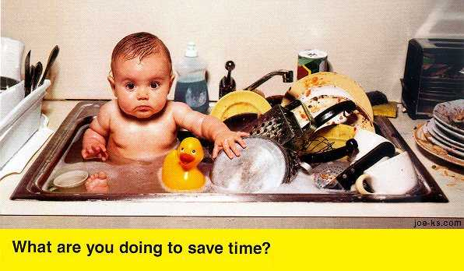
But Efficient?
QFT
Schur
?
Who would need to efficiently calculate Clebsch-Gordan
coefficients for SU(d)?
[L. C. Biedenharn and J. D. Louck, Commun. Math. Phys. 1968]

Slide 40
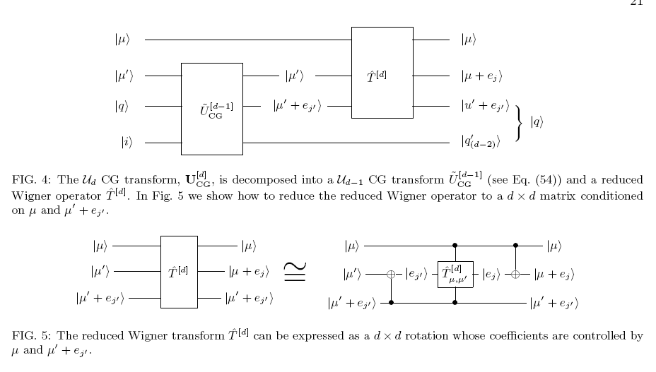
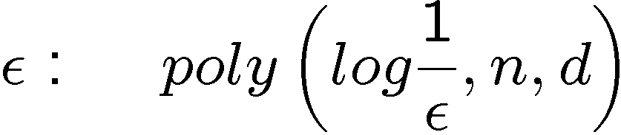
Efficient Schur
[D. Bacon, I.L. Chuang, A. Harrow, Phys. Rev. Lett. 2006]
[D. Bacon, I.L. Chuang, A. Harrow, SODA 2007]
Schur transform to accuracy time

Slide 41
The Plethora of Uses of Schur
Optimal spectrum estimation
[M. Keyl and R. F. Werner. Phys. Rev. A, 2001]
Universal distortion-free entanglement concentration
[M. Hayashi and K. Matsumoto. Information Theory, 2004]
Universal compression with optimal overflow exponent
[M. Hayashi and K. Matsumoto. Phys. Rev. A, 2002]
Optimal quantum hypothesis testing
[M. Hayashi, J. Phys. A, 2002]
Communicating without a shared reference frame
[S. Bartlett, T. Rudolph, and R. Spekkens, Phys. Rev. Lett., 2003]
Encoding into decoherence-free (noiseless) subsystems
[J. Kempe, D. Bacon, D. A. Lidar, and K. B. Whaley, Phys. Rev. A, 2001]
Simulating lattice gauge theories on a quantum computer
[T. Byrnes and Y. Yoshihisa, Phys. Rev. A 2006]
….
Tractable

Slide 42
But Quantum Algorithms?

Slide 43



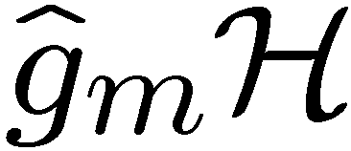
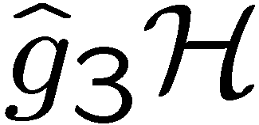
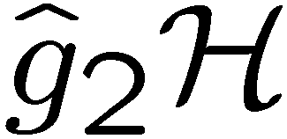
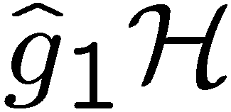

The Hidden Subgroup Problem
Setup: Fix a group (known) and a subgroup (unknown). Given query access to a function f : → S that is constant and distinct on left (right) cosets of in . We say that f hides .
Problem: Find a generating set for (“identify ”).
Efficient: If runs in time polylog(| |)
f
S

Slide 44

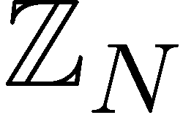
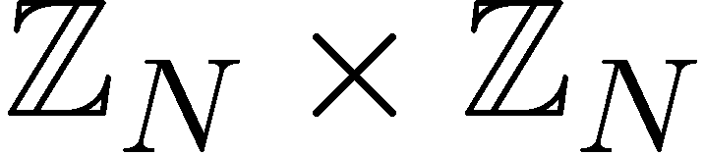
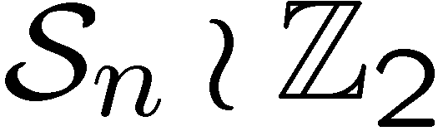
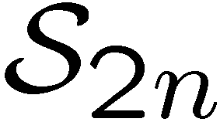

Why the Fuss?
Solved Problems (Shor 1994)
efficient algorithm for HSP
over
efficient algorithm for factoring whole numbers
efficient algorithm for HSP
over
efficient algorithm for the discrete logarithm problem
Open Problems
efficient algorithm for HSP
over (or )
efficient algorithm for the
graph isomorphism problem
efficient “standard” quantum
algorithm for HSP over
dihedral group
efficient algorithm for the poly(n) unique shortest vector in a lattice problem

Slide 45
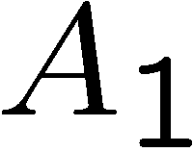
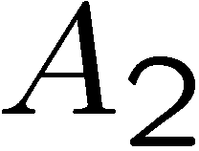
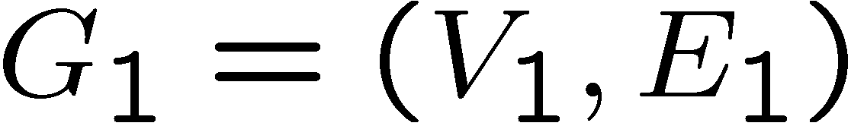
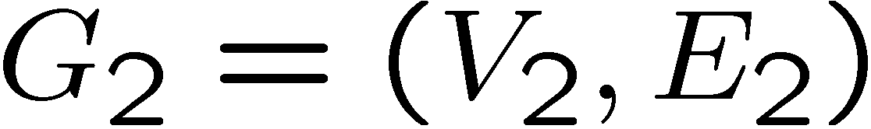

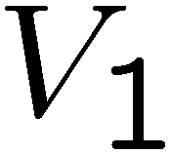
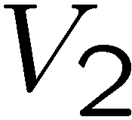



Graph Isomorphism
adjacency
matrix
adjacency
matrix
Problem: Is there a 1-to-1 mapping from the vertices to the
vertices such that the edges are respected, ?
Mapping to the HSP:
If graphs are not isomorphic, hidden subgroup will not mix
the graphs. If they are isomorphic, they will mix the graphs.

Slide 46







Standard Query Model
Oracle:
U_{f}
Query in equal superposition over group elements
hidden subgroup state

Slide 47






You Down With Symmetry?
hidden subgroup state
Symmetry under left regular representation:
Fourier transform over finite group
Can we solve HSP this way?

Slide 48





Multicopy
Can we make a measurement on
copies and
learn the subgroup?
In general (and for important case
of symmetric group) NO
[Moore, Russell, Hallgren,
Roetteler, Sen 05]
Required:

Slide 49

You Down With Symmetry?
hidden subgroup state
Symmetry under left regular representation:
Symmetry of two copies?
Permutation symmetry….measure the Young Diagram?
Nope [Childs, Harrow, Wocjan 06]

Slide 50






Heisenberg Group
Semidirect product group
Elements of the group:
Multiplication rule:
From the play “Copenhagen” Margrethe Bohr to Heisenberg:
“Your talent is for ski-ing too fast for anyone to see where you are. For always being
in more than one position at a time, like one of your particles.”

Slide 51


Multicopy Success!
Efficient algorithm for the Heisenberg HSP:
[D. Bacon, A.M. Childs, and W. van Dam FOCS 2005]
PGM/optimal measurement approach:
Efficient algorithm for the Heisenberg HSP:
PGM is optimal and succeed w.h.p.
How to efficiently implement the PGM?
But Why Does It Work?

Slide 52

Clebsch-Gordan Transform
To The Rescue?
Problem:
does not have a Clebsch-Gordan related symmetry

Slide 53





Conjugate Subgroups
Two subgroups, and , are conjugate if there exists an
element of the group such that
This is an equivalence relation among the subgroups of
ir: voy, vas, va, vamos, van

Slide 54
Hidden Subgroup Conjugacy Problem
Setup: Fix a group (known) and a subgroup (unknown). Given query access to a function f : → S that is constant and distinct on left (right) cosets of in . We say that f hides .
Problem: identify the conjugate subgroup class of .
Efficient: If runs in time polylog(| |)
f
S

Slide 55



Symmetries of HSCP States
Hidden subgroup conjugate state
Hidden subgroup conjugate states
In context of optimal measurement method (PGM)
[e.g. Ip 03, Bacon, Childs, and van Dam 05]
this translates into extra symmetry of the optimal measurement

Slide 56


Symmetries of HSCP States
What is the extra symmetry of the multiple HSCP states?
Clebsch-Gordan transform for the regular representation of
finite groups:

Slide 57

Relationships
How do the hidden subgroup problem (HSP) and the
hidden subgroup conjugacy problem (HSCP) differ?
1. If group is abelian, HSCP=HSP
All subgroups are only conjugate to themselves
2. If subgroups are normal, HSCP=HSP
All subgroups are only conjugate to themselves
These are two cases where we know quantum computers
can efficiently solve the HSP. Coincidence?

Slide 58















General Circuit

Slide 59
Heisenberg HSCP and HSP
[Bacon, arXiv:quant-ph/0612107]
Heisenberg HSCP ⇒ Heisenberg HSP
Conjugate subgroups are all normal subgroups
of a subgroup of Heisenberg group
Identifying which conjugate subgroup
identifies this subgroup
Thus solving HSCP implies solving HSP
(use normal subgroup algorithm)

Slide 60




Heisenberg HSCP, CG Way
[Bacon, arXiv:quant-ph/0612107]
i labels set of conjugate subgroups

Slide 61

Heisenberg HSCP, CG Way
[Bacon, arXiv:quant-ph/0612107]
i can be found by performing (which can be done with high prob)
and performing a QFT
Clebsch-Gordan transform over Heisenberg group is related
to “symmetry” which allows for efficient quantum algorithm
for the Heisenberg HSP.

Slide 62

Heisenberg HSP Lesson
Clebsch-Gordan transform can be used to help
solve HSPs
Other groups where this works?
Krovi and Roetteler: Weyl-Heisenberg Groups
Bacon: Hidden symmetries of multiple squares
Krovi and Roetteler: some automorphisms can be used to change irrep labels...this allows for a two step sieve algorithm
Moore, Russell: sieving on irrep labels cannot be the strategy taken for the symmetric group

Slide 63





Fin
Clebsch-Gordan transform reveals essential symmetry of efficiently solvable nonabelian hidden subgroup problems….Can they lead us further, the $10⁹ question
funded by
ARO
NSA
NSF
DARPA

Slide 64
Quantum Computing Peoples
Graduate Students
Gregory Crosswhite (Physics)
Alice Neels (CSE)
Masters Students
Roger Wolfson (Physics)
Undergraduates
Elizabeth Muhm (CSE/Math)
Alper Sarikaya (CSE/Chem)
William Johnson (CSE)
funded by
ARO
NSA
NSF
DARPA

Slide 65


Uses of Schur
Young diagram
What does this remind you of?
like probabilities like the spectrum of a density operator
Young diagram
Optimal spectrum estimate
[Keyl and Werner. PRA, 2001]
irrep space
irrep space

Slide 66
You Down With Symmetry?
And now, I will, for symmetries sake give the entire talk in reverse.

Slide 67


Graph Isomorphism
adjacency
matrix
adjacency
matrix
Problem: Is there a 1-to-1 mapping from the vertices to the
vertices such that the edges are respected, ?
Mapping to the HSP:
Notice now we are only worried if hidden subgroup has
a nontrivial

