Slide 1


Quantum State and Process Tomography
(and Quantum Algorithms)
Dave Bacon (University of Washington)
MUSIQC Kickoff Meeting
October 14, 2010

Slide 2
QW (“Q”-Dub) Theory Group
Dave Bacon
Aram Harrow
Gregory Crosswhite (Physics)
Paul Pham (CS)
Jijian Yan (Physics)
Lukas Svec (Physics)
Isaac Crosson (Physics)
Kamil Mitchnicki (Physics)
David Rosenbaum (CS)
Kevin Zatloukal (CS)
(this animation brought to you by a procrastinating grad student)

Slide 3
Overview
To verify the workings of the MUSIQC prototypes, we must provide tools for characterizing the basic operating units acting alone and acting together.
For small systems this is tractable, but for larger systems this quickly becomes intractable (time to perform >> time to obtain Ph.D.)
However [insert evil theorist laugh] there are “ways” around this...

Slide 4
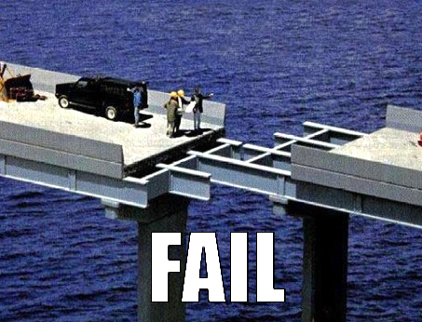
Goals
Provide tools and protocols necessary for the experimentalists to perform tractable heralded ansatz tomography (state and process). Pass results of this onto system model / FT efforts.
Design quantum algorithms that are specifically designed to make the above procedures fail.
[UW, UBC, Georgia Tech, Michigan, plus integration into experimental efforts]

Slide 5





Qubits Tomography
State:
pure
mixed
Process:
unitary
open
parameters
Subtleties:
Estimating potentially very small numbers
Given experimental data, some methods produce states or processes that are not physically allowed (Example: may produce negative probabilities!)
Tomography process is noisy
Obstacles:
Intractable!!!

Slide 6



Not All States Are Created Equal
Separable states on n qubits
parameters
We would like to consider methods for
Efficiently classically store information about state
Use this information to efficiently calculate results of few qubit measurements
Shouldn’t have “holes”: inefficient use can capture generic state
....data structure for quantum states

Slide 7
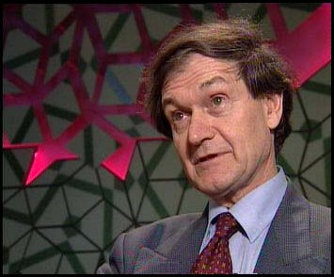










Matrix Product States
total parameters
If D is polynomial in n, then # parameters poly in n
(D exponential in n captures all possible pure states)

Slide 8










Matrix Product States
OMG

Slide 9










Matrix Product States
matrix

Slide 10








Matrix Product States
-dim vector
matrices
-dim vector
If D is polynomial in n then this calculation is polytime

Slide 11
Matrix Product States
Efficiently classically store information about state
Use this information to efficiently calculate results of few-qubit measurements
Shouldn’t have “holes”: inefficient use can capture generic state
MPS states are a useful ansatz:
In practice capture one dimensional low energy eigenstates
Can be used to simulate quantum algorithms beyond the tens of qubit regime
Key to classical density matrix renormalization group algorithm

Slide 12
Matrix Product State Tomography
Can we make polynomial # measurement on n qubit state and learn a MPS description of the state (if it exists)?
“YES WE CAN”
[Cramer, Plenio arXiv:1002.3780]
[Flammia, Gross, Bartlett, Somma arXiv:1002.3839]
[Landon-Cardinal, Liu, Poulin arXiv:1002.4632]

Slide 13


MPS Pure State Tomography
Basic idea:
Perform traditional (or compressed sensing based) tomography on constant k contiguous qubits
Solve for MPS using variational method, DMRG based method, quantum 2-SAT approach
Profit!

Slide 14
Matrix Product State Tomography
[Cramer, Plenio arXiv:1002.3780]
- Compressed sensing approach to obtaining local density matrices
[Flammia, Gross, Bartlett, Somma arXiv:1002.3839]
- Certificate
[Landon-Cardinal, Liu, Poulin arXiv:1002.4632]
- Works beyond “injective” MPS
All can be made to work for mixed states and process tomography by suitable hard work not carried out in these papers

Slide 15

Heralded Tomography
[Flammia, Gross, Bartlett, Somma arXiv:1002.3839]
By constructing the “parent Hamiltonian” of a MPS description one can use this to verify the accuracy of the MPS
“Announces when it fails”

Slide 16
Symmetrized Tomography
If states (processes) are symmetric with respect to some group, this can reduce the size of their description
Example: permutationally invariant qubit mixed states
[Toth, Wieczorek, Gross, Krischek, Schwemmer, Weinfurter arXiv:1005.3313]
Or we can enforce this symmetry, very useful for process tomography:
[Emerson, Silva,Moussa, Ryan, Laforest, Baugh, Cory, Laflamme, arXiv:0707.0685]

Slide 17

Tomography Tool Chest
Variety of tomography protocols: MPS, Symmetry based, Compressed sensing, MERA + other ansatz based methods
Estimation procedures: MPS and MERA (Variational, DMRG, Quantum 2-SAT), Maximum likelihood, Hedged maximum likelihood, Baysian methods(?)
Constraints: limits imposed by time constraints, # parallel operations, fidelity of operations

Slide 18
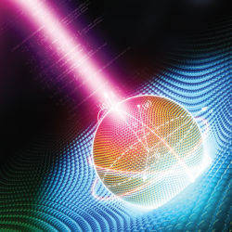
Quantum Algorithms
Factoring
Discrete Log
Grover Search
Amplitude Amplification
Order Finding
Solving Pell’s Equation
Heisenberg Hidden Subgroup
Sampling Solutions to Linear Equations
NAND Tree
Quantum Simulation
Quantum Error Correction
......
Which to choose?

Slide 19
Quantum Algorithms
Which to choose?
System optimization study will identify what reasonable fault-tolerant quantum error correction plus algorithm can be implemented on MUSIQC
In the mean time....

Slide 20
Starting a War With DMRG
MUSIQC-80 will be in a size range where
Simulating it using the best classical methods will start to be come difficult
Density matrix renormalization group works when there is a efficient MPS description (i.e. when our MPS tomography works)
Design efficient MUSIQC executable quantum circuits which have large MPS descriptions and challenge classical DMRG to simulate circuit

Slide 21

Why MPS classically efficient?
To keep the matrix problems arising in DMRG, one enforces
this is nothing more than condition that A is valid quantum superoperator!
DMRG works because it is simulating D dimensional quantum circuit!

Slide 22
Conclusion
MPS Tomography and Symmetrized Tomography provide tractable methods for analyzing MUSIQC architecture.
Will produce toolkit that describes measurement protocol and processes measurement data to execute this tomography
Quantum algorithms - System optimization will guide, but also design quantum circuits to foil best classical algorithms and our tomography

