Slide 1
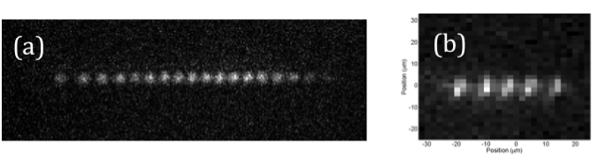
Quantum Computers
Dave Bacon
Can we build a large robust
quantum computer?
What would we do with a large robust quantum computer?
Factor large numbers
(boring?...unless your the NSA!)
MUSIQC project (IARPA) goal ~40 qubit ion trap quantum computer by 2015
Simulate dynamics of large quantum systems?
How important is it to get the quantum theory correct for
(a) large biological molecules [would big pharma buy a QC?]
(b) solid state materials
[can QCs help us understand
high-TC superconductivity?]
Path 1
Long Slog. No longer fits in
one PIs lab. Big Engineering?
Path 2
Where is the equivalent of
a transistor for QC?

