Slide 1
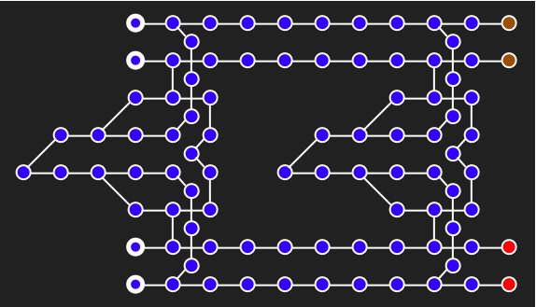
Self-Correcting Systems (Bacon + Harrow, Shi)
Goal: Realistic (spatially local and few body) Hamiltonians that are self correcting in two or three spatial dimensions
Spatially local subsystem codes provide a new class of codes that have the distance properties necessary to be self-correcting. The Hamiltonians constructed from these codes need to be analyzed for self-correcting properties.
Fig: a spatially local subsystem code in 2D
If self-correcting systems exist in two or three spatial dimensions, they provide alternative path toward building a quantum computer

Slide 2
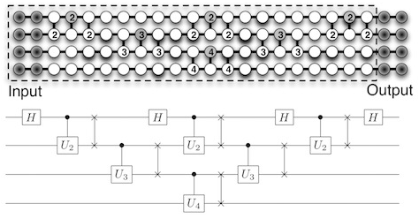
Fault-tolerant Adiabatic Quantum Computing (Bacon + Crosson, Svec)
Adiabatic quantum computing is universal for quantum computing, but it is not known to be fault-tolerant
Quantum transistors are a model of universal adiabatic quantum computation that offer many advantages over other models. By considering variations on this model we can analytically solve this Hamiltonian and then proceed to prove fault-tolerant properties
Fig: an adiabatic quantum transistor for computing a
4-qubit QFT
Adiabatic quantum computing can be less experimentally challenging (see D-wave), but without fault-tolerance it is not known if it is realistic

Slide 3
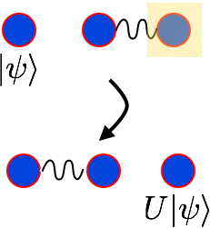
Potential for Implementation (Bacon + Michnicki)
How implementable are the ideas of small energetic protection or adiabatic gate teleportation in realistic settings?
Physical realization in different implementations of quantum computers need to be investigated. For example, can one perform adiabatic gate teleportation using a circuit QED setup with the cavity as one of the qubits?
Fig: adiabatic gate teleportation
Crucial step from abstract theory to realistic physical protocols. Could result in first interesting adiabatic protocols in quantum computing

