Slide 1

Sprocket Central Pty Ltd
Data analytics approach
Mohammad Dabak

Slide 2
Agenda
Introduction
Data Exploration
Model Development
Interpretation

Slide 3
Introduction
Problem Outline
Customer Analysis
Sprocket Central Pty Ltd is a Company that specializes in high quality bike and accessories.
The Company is targeting 1000 new customers.
The company is focused in maximizing profit through Bike Sales.
Age distributions
Number of bike purchases in 3 years
Job industry category
Wealth segments
Number of cars own on each states
Customer Profile

Slide 4
Data Exploration: Data Quality Assessment
Issue | Mitigation | Benefits | Recommendation
Accuracy Issues | Filtered out outliers in DOB, created an age_column, and introduced a profit_column in the "Transactions" dataset. | More accurate data analysis, especially regarding customer age and profitability. | Implement data quality checks to ensure accuracy of data at the point of entry.
Completeness Issues | Filtered and standardized all customer IDs from 1 to 3500. | Ensure that tables are kept up to date and originate from the same time period. | Implement data validation rules to ensure completeness of data at the point of entry.
Consistency Issues | Standardized gender labels and state names. | More consistent data analysis and reporting. | Implement dropdown options for gender and states to ensure consistency.
Currency Issues | Filtered out customers marked as "Y" in the deceased_indicator. | More accurate and up-to-date customer data. | Implement data quality checks to ensure currency of data at the point of entry.
Relevancy Issues | Removed metadata from the default_column and filtered out 'Cancelled' in order_status. | More relevant and comprehensible data for analysis and reporting. | Regularly review and format metadata to enhance comprehensibility.
Validity Issues | Formatted "product_sale_date" to a short date format and "list_price" to currency. | More consistent and valid data for analysis and reporting. | Implement data entry formats to ensure consistent data validity.

Slide 5
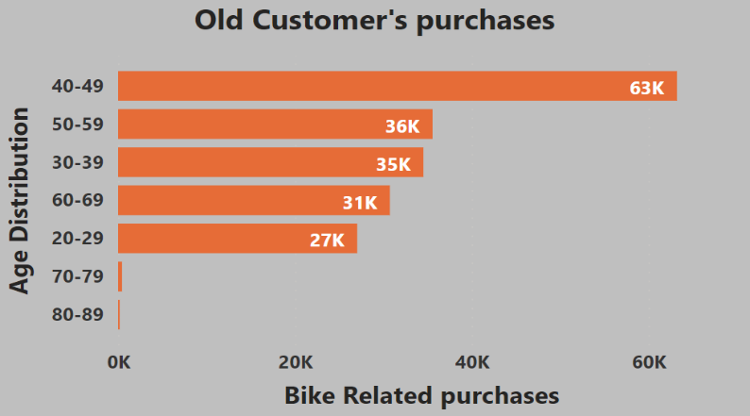
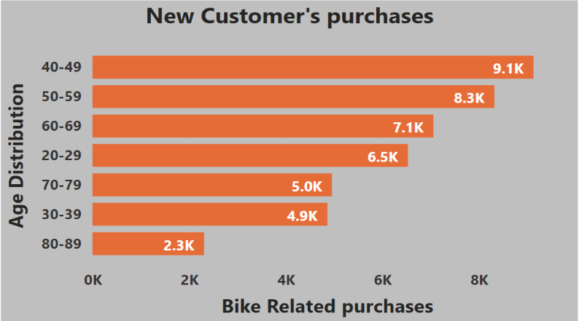
Model Development
Bike related purchases based on the Age of Customers
Most of the bike related purchases are made by customers between the age of 40 and 49.
In the New Customer purchases visual, most purchases are from the age of 40 and 49 also between the age of 50 and 59.
The Data shows that middle aged customers are one of the most potential customers.

Slide 6
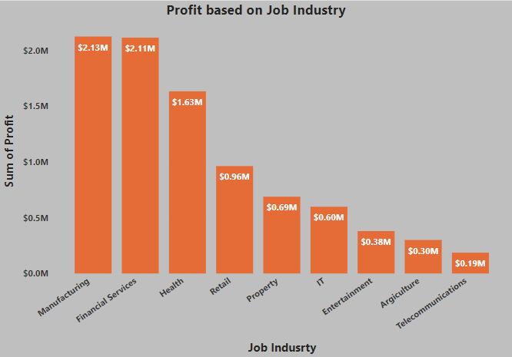
Model Development
Bike related purchases based on Job Industry
Financial services, health and manufacturing are the top three profit generating industries, followed by retail, IT and property.

Slide 7
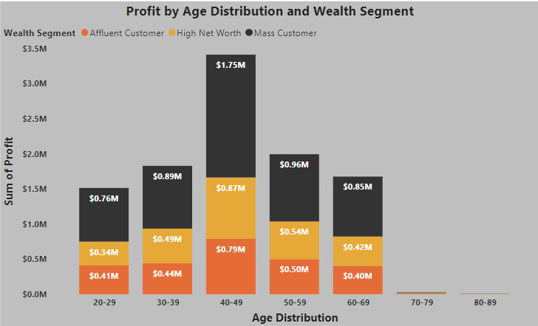
Model Development
Profit in each Wealth Segment Based on Age
The highest profit is obtained from customers of the age between 40 and 49.
At the between 40 and 49, Mass Customers have the highest profit, followed by high net-worth customers and finally Affluent Customers.

Slide 8
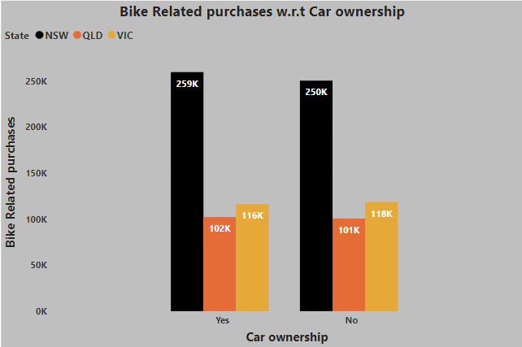
Model Development
Bike related Purchases with respect to Car ownership in each state.
Most of the Bike related purchases are from customers of NSW who own cars.
For those customers that don't own cars, most purchases are also from NSW, followed by VIC and finally QLD state.

Slide 9
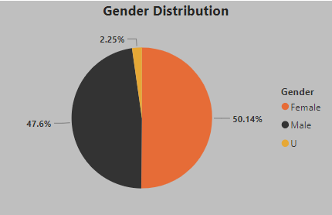
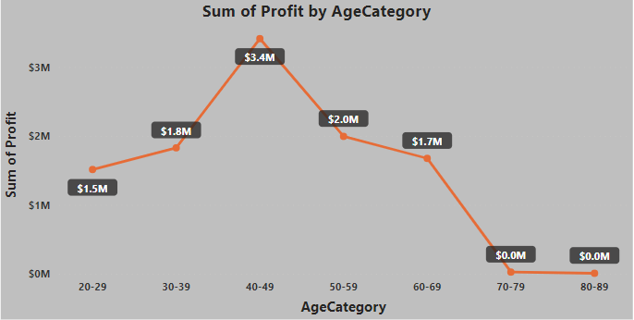
Model Development
Profit based on total number of customers and gender
From the data the highest number of customers are female followed by male.
Maximum profit is received from customers from the age of 40 to 49.

Slide 10
Model Development
CUSTOMER CLASSIFICATION - Targeting high value customers
Based on the Data analysis and visuals generated. These are the high value customers that should be targeted:
Customers between the ages of 40 and 59.
Customers who work in the Financial service, Manufacturing and health industry.
Customers who are currently living in New South Wales and Victoria states.
Most of the highly value customers are female.
Most of the highly valued customers are of the Mass Wealth Segment.

Slide 11
Thank You

