Slide 1
NLP Analysis of Attitudes towards the Russian-Ukraine conflict
Chan Yu, Naihe Xiao

Slide 2
Contents
Problem and Motivation
Data Description
Exploratory Data Analysis
Model
Results and Conclusions

Slide 3
I. Problem and Motivation

Slide 4
Problem
Attitude Analysis
Predict tweet’s attitude towards Russia-Ukraine conflict.
Two categories: completely supportive of Ukraine or otherwise(neutral, support Russia, Unclear)
Is it possible to predict tweet’s attitude towards Russian-Ukraine conflict?

Slide 5
Motivation
Russia-Ukraine issue is a real hot spot right now.
Especially involving: almost everyone takes a side
Not easy to see(ambiguous attitudes, sarcasms, playing versed role)
Trying to investigate and predict the split of people’s attitudes toward this ongoing war.

Slide 6
II. Data Description

Slide 7
Data Extraction
Application of tweepy
Search word: ‘ukraine russia’(and)
Starting date: 3.28/Date searched: 4.1
Removed duplicates

Slide 8
Labeling
Added 2 columns: Attitude and Sentiment
Attitude
Labeled 1 for tweets totally supportive of Ukraine
Labeled 0 for rest of the tweets
Sentiment
Labeled 1 for emotional tweets
Labeled 0 for unemotional/calm tweets

Slide 9
Strengths and weaknesses
Strengths
Size: 700 labeled tweets
Currentness: extracted from very recent days
Relevance: most observations are highly relevant
Storage: stored labeled version so don’t need to read every time
Weaknesses
Deficient number of columns(3)

Slide 10
III. Exploratory Data Analysis

Slide 11
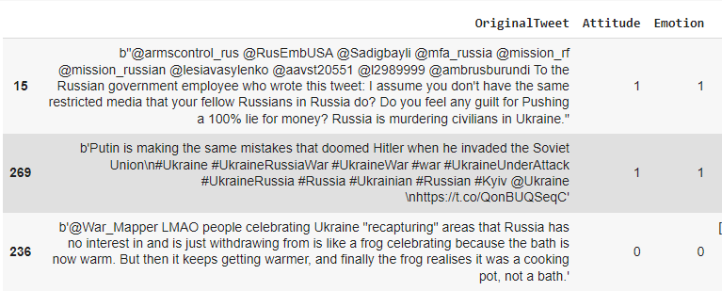
Data Display

Slide 12
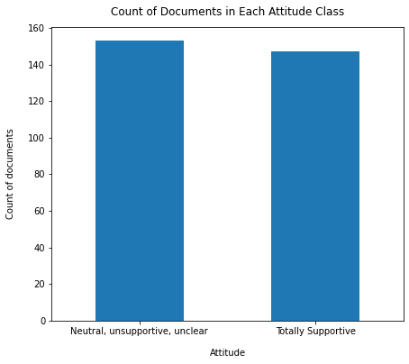
EDA Checks
Basic summary statistics (300, 3)
Null and Nan values
Data types
Proportion of the observations between two classes

Slide 13
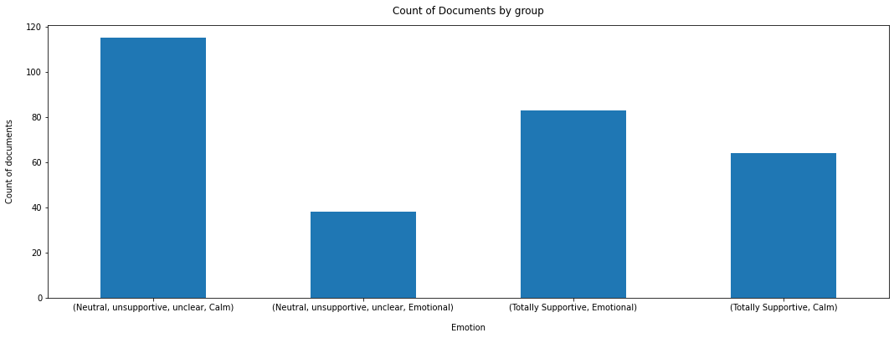
Basic Statistics

Slide 14
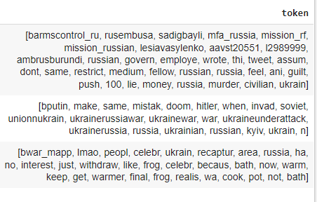
Process Data
Tokenize by space
Remove URL addresses tokens
Remove punctuations
Convert tokens to lowercase
Stemming
Lemmatization
Remove stopwords
Remove blank tokens

Slide 15
Interesting Findings
Worried about whether simply predicting “Totally Supportive” for all tweets would have reasonable accuracy
Process order matters!

Slide 16
IV. Model: Naive Bayes

Slide 17

Assumptions
(1) Posterior proportional to prior times likelihood

Slide 18

Assumptions
(2) Naive Assumption:

Slide 19
Pros & Cons
Pros
Binary classification
Data is balanced: 51% vs 49%
Cons
Assumption that words are independent of each other conditional on class is too strong

Slide 20
V. Results and Conclusions

Slide 21
Prediction Accuracy
Train accuracy is about 0.89
Test accuracy is about 0.6

Slide 22
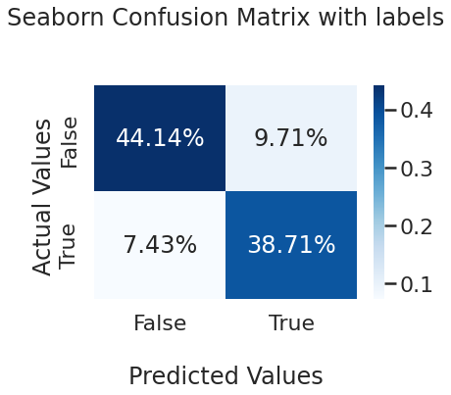
Confusion Matrix
Sensitivity (Recall): 0.84
Specificity: 0.82
Precision: 0.8

Slide 23
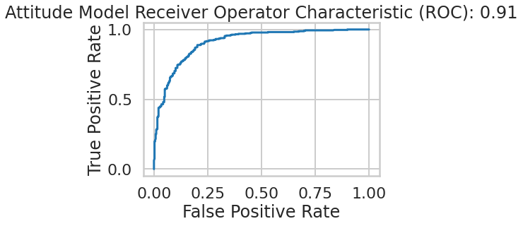
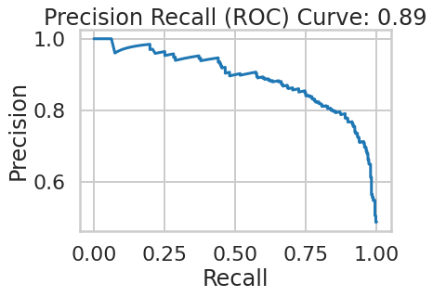
ROC & PRC

Slide 24
Conclusion
Strengths:
High Accuracy, Precision, Sensitivity and Specificity
PRC, ROC illustrate outstanding performance of model
Weaknesses:
Data is not big enough: can not split into validation set
Assumption of Naive Bayes model is not realistic: median test accuracy

Slide 25
Thanks for listening!
Questions?

