Slide 1
SNAPURL– URL Shortener
Release 0.0.1
21AIE312 - INTRODUCTION TO CLOUD COMPUTING
TEAM - 13

Slide 2
Team Members
Harsha Dabbara – CB.EN.U4AIE20010.
Divi Eswar Chowdary– CB.EN.U4AIE20012.
B.E. Pranav Kumar – CB.EN.U4AIE20052.
Rahul Ganesan – CB.EN.U4AIE20056.

Slide 3
Introduction

Slide 4
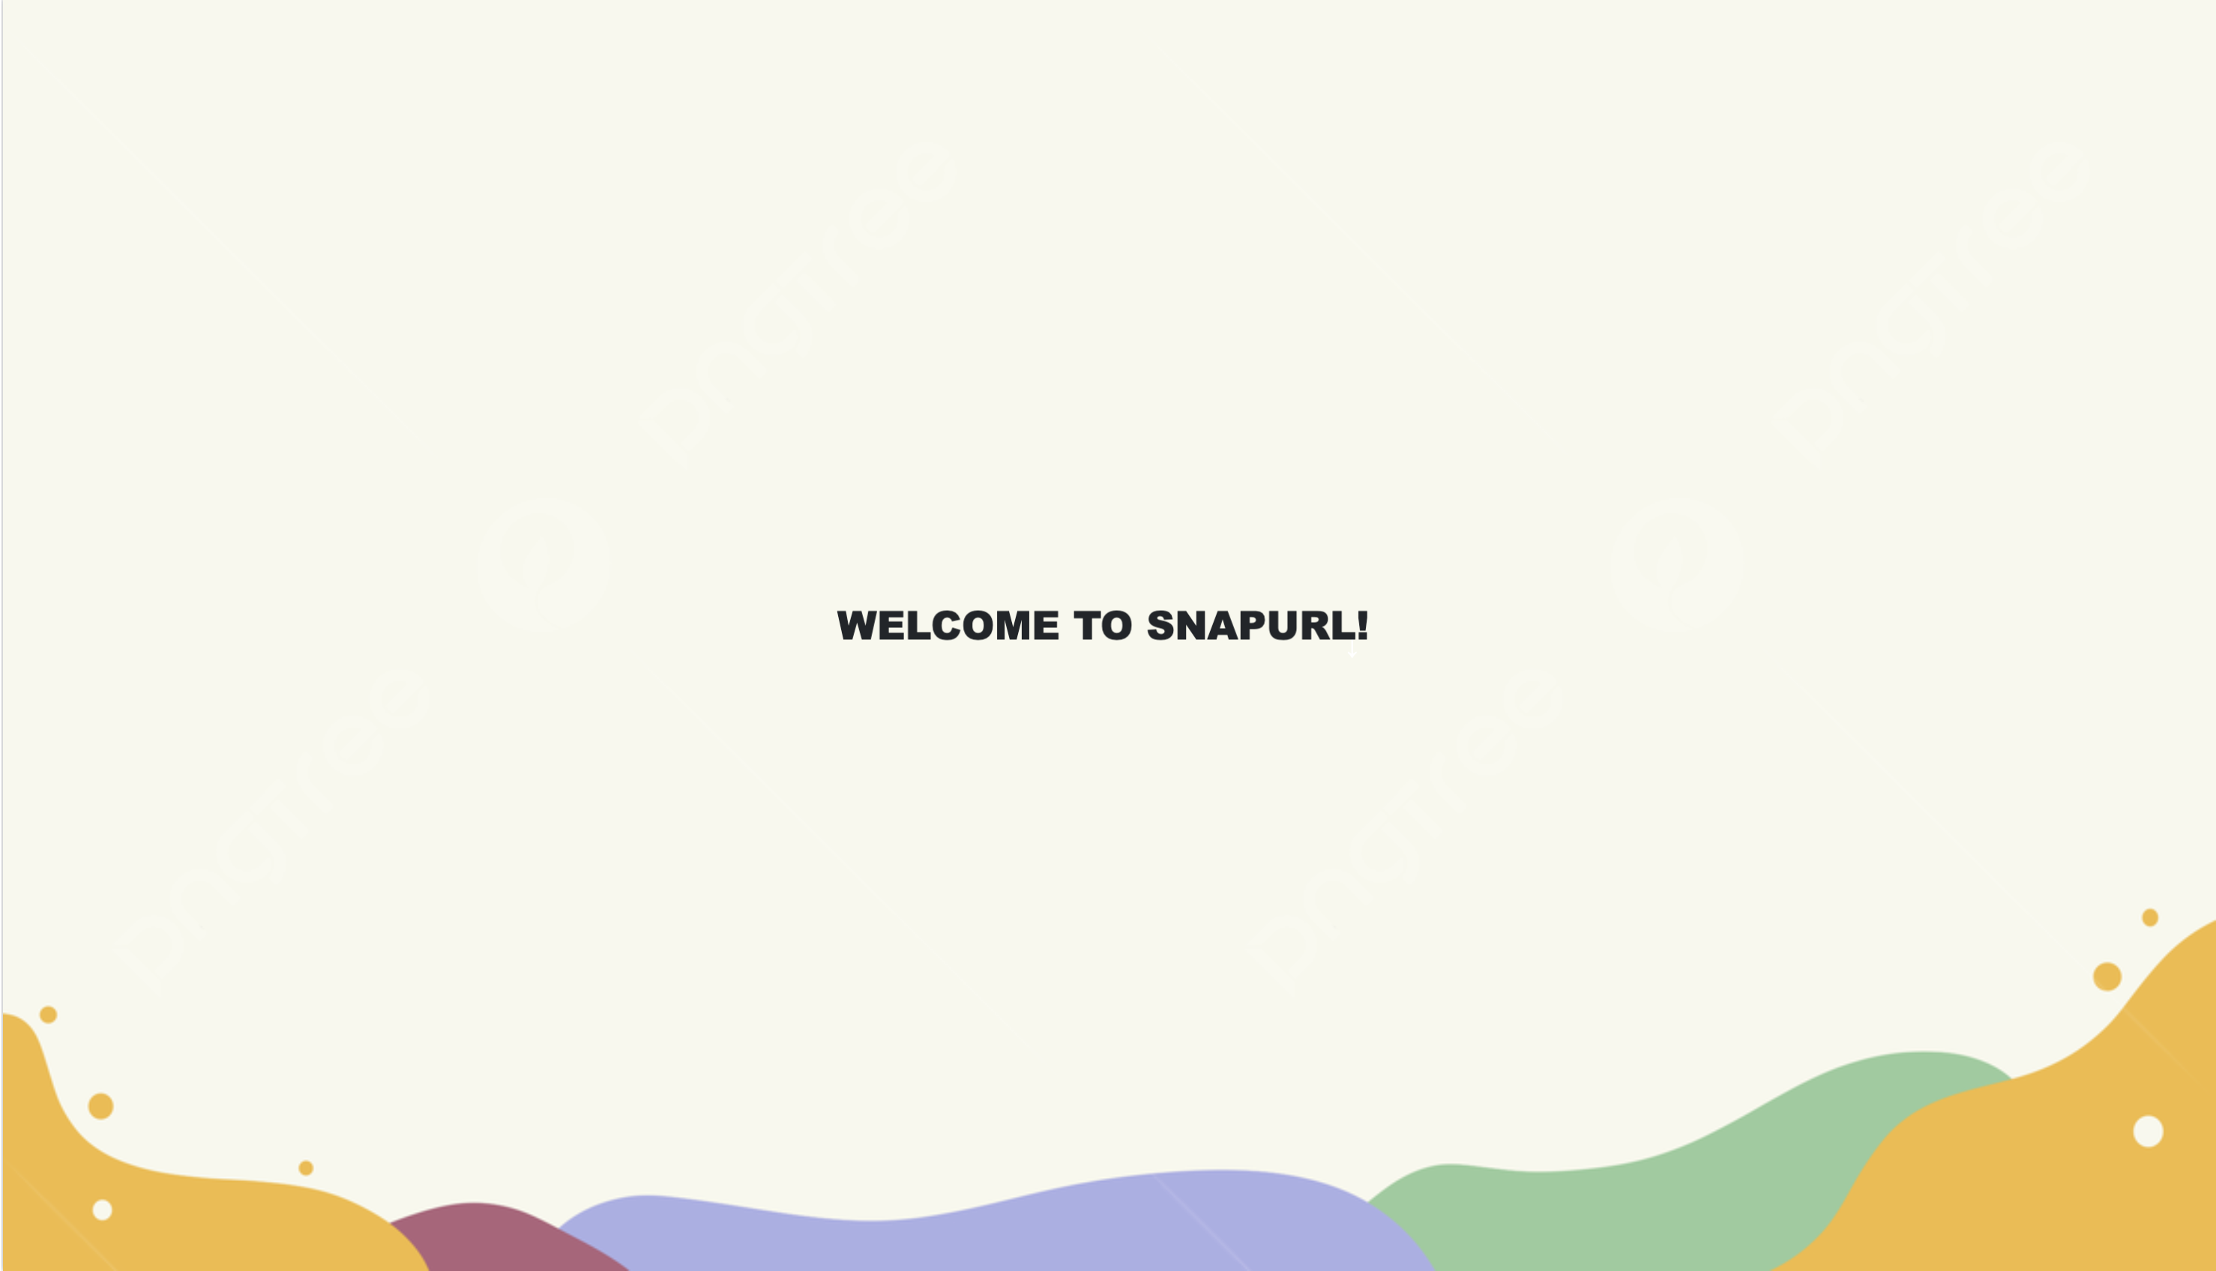
About Web Application
An innovative Web Application that combines the power of URL shortening and QR code generation. Developed a Flask-based application that allows users to create short, memorable URLs for their long and complex web addresses. By leveraging the capabilities of AWS (Amazon Web Services), we have deployed SNAPURL to the cloud for scalable and reliable access.

Slide 5
Objective
The objective of the SNAPURL project is to develop a web application that combines URL shortening and QR code generation capabilities.
Deploy the application on AWS to ensure scalability, reliability, and security.
Simplify web addresses by generating short and memorable URLs.
Enhance user experience by providing custom QR codes for easy access to web content.
Streamline the process of sharing and accessing web links, particularly in situations with character limitations.

Slide 6
AWS Services
Why Amazon Web Services ?

Slide 7

Introduction to AWS and Its Services :
Amazon Web Services (AWS) is a cloud computing platform that offers a wide range of services and solutions for businesses and individuals.
As a leading cloud provider, AWS provides a scalable, reliable, and cost-effective infrastructure for deploying web applications and managing data in the cloud.

Slide 8
Why AWS?
AWS offers numerous advantages, including:
Scalability: AWS allows you to scale your infrastructure up or down based on demand, ensuring that resources are optimally utilized and costs are optimized.
Reliability: AWS provides a highly available infrastructure with data centers located in multiple regions worldwide, ensuring minimal downtime and robust disaster recovery capabilities.
Security: AWS has implemented extensive security measures to protect customer data, including encryption, access controls, and compliance certifications.
Cost-effectiveness: AWS operates on a pay-as-you-go model, allowing you to pay only for the resources you use, minimizing upfront costs and enabling cost optimization.
Global Reach: AWS has a vast global network, enabling you to deploy applications closer to your users, reducing latency and improving performance.

Slide 9
Services
Services and Features used ,provided by AWS.

Slide 10

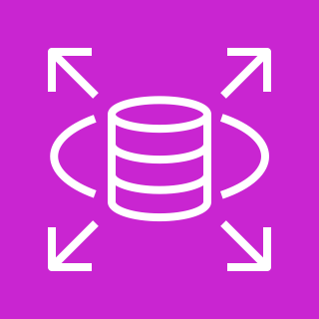

Services.
Amazon Elastic Compute Cloud (Amazon EC2)
Amazon Relational Database Service (Amazon RDS)
Amazon Simple Storage Service (Amazon S3)

Slide 11

Amazon Elastic Compute Cloud (Amazon EC2)
Instances
Elastic Compute Cloud (EC2) is a key service offered by AWS that provides resizable compute capacity in the cloud.
EC2 enables businesses to launch virtual servers, known as instances, and easily scale their computing resources to meet changing demands.

Slide 12
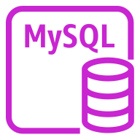
Amazon Relational Database Service (Amazon RDS)
MySQL Instance
Relational Database Service (RDS) is a managed database service provided by AWS that simplifies the deployment, management, and scaling of relational databases in the cloud.
RDS supports popular database engines such as MySQL, PostgreSQL, Oracle, SQL Server, and Amazon Aurora.

Slide 13

Amazon Simple Storage Service (Amazon S3)
S3 Standard
Simple Storage Service (S3) is an object storage service provided by AWS that offers secure, durable, and scalable storage for various types of data.

Slide 14
Flow Diagrams
AWS Architecture and Flask Application.

Slide 15









Flow Diagram
Internet
AWS Cloud
EC2 instance contents
Upload QR Images
S3
eu-north-1
Users
Instance
Query database
Response
RDS
Git push
Git webhook
Authenticated user
Git repository

Slide 16

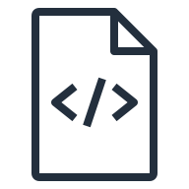
Flask Application
app.py
requirements.txt
Templates
base.html
index.html
stats.html
This Flask application leverages AWS services like EC2 for hosting the application, S3 for storing QR code images, and RDS for storing URL data. It provides users with the ability to shorten URLs, generate QR codes, track URL clicks, and view statistics.

Slide 17
Methodology
Lets get everything together……

Slide 18
Importing Dependencies : The required dependencies are imported at the beginning of the code, such as pymysql for database connection, json for handling JSON files, Hashids for generating hash IDs, Flask for creating the web application, and others. ( requirements.txt ).
Loading Configuration: The configuration settings are loaded from a JSON file (config.json) using the json module. These settings include database credentials, AWS S3 credentials, and other application-specific configurations.
Setting Up AWS S3 and Database Connections: The AWS S3 and database connections are established using the provided credentials.
Defining Utility Functions: Several utility functions are defined to perform tasks such as uploading files to S3, retrieving database connections, inserting URLs into the database, generating short URLs, and more.

Slide 19
Creating the Flask Application: The Flask application is created using Flask(__name__), and the secret key for session management is set.
Defining Routes and Handling Requests: The root route ("/") handles both GET and POST requests. For GET, it renders the index page. For POST, it processes the form data, inserts the URL into the database, and generates a QR code image if an image description is provided. The image is uploaded to AWS S3, and the index page is rendered with the short URL and image path. The "/<id>" route handles URL redirection. When a short URL is visited, the original URL is fetched from the database, and the user is redirected. The "/stats" route displays statistics. It checks if the user is logged in, retrieves the user's URLs from the database, generates graphs based on click data, and renders the stats page with the graphs and relevant information.

Slide 20
Registration and Login Routes: Routes for user registration, login, and logout are defined separately. These routes handle the registration and authentication process, validate user inputs, and interact with the database to create new users or authenticate existing users.
Running the Application: The Flask application is run by calling application.run(debug=True).
app.py
requirements.txt
Templates
base.html
index.html
stats.html

Slide 21
Custom QR
Utilizing Stable Diffusion for QR code image generation

Slide 22
Stable Diffusion for Custom QR Generation
Stable Diffusion is a deep learning technique used in this code to generate custom QR code images. It is a generative model that produces high-quality images by iteratively refining a given input image based on a prompt or guidance. The Stable Diffusion pipeline combines a controlnet model with a diffusion process to generate visually appealing QR code AI art.
Pretrained Controlnet Model
Initialization and Configuration
Image Processing
Generation of Qr Code
Note : The endpoint and Gradio integration make it easy for users to interact with the QR Code AI Art Generator without directly running the code or working with the underlying implementation.

Slide 23
Deploying SNAPURL
EC2 – S3 – RDS

Slide 24
Deploying Flask Application on AWS EC2
Clone Application FIles
Launch an EC2 instance & Install dependencies
Clone code from S3 and configure & Start the Flask app
Git Clone Flask application code and upload the configuration file to an S3 bucket.
This allows easy access to the code for deployment.
Choose the appropriate instance type based on your application's requirements.
Install the required dependencies for the Flask application, such as pymysql, hashids, gradio-client, boto3, etc.
Use pip or other package managers to install the dependencies.
Open a terminal or command prompt on the EC2 instance.
Navigate to the project directory containing the Flask application.
Run the Flask application using the command: ‘python app.py’ .
The application will be accessible at the assigned EC2 instance's public IP or domain.
© 2023, Amazon Web Services, Inc. or its affiliates.

Slide 25
Utilizing AWS RDS
Create an RDS instance & Connect Flask App to RDS
Perform database operations
Query RDS
Set up an Amazon RDS (Relational Database Service) instance using the desired database engine (e.g., MySQL).
Update the Flask application's configuration file (config.json) with the RDS endpoint, credentials, and database details.
Implement the necessary functions in the Flask application to interact with the RDS database.
Create tables, insert data, and retrieve information as required for the QR code generator.
When a user submits the form with the necessary data (QR code content, prompt, negative prompt), the Flask application queries the RDS database for generating the QR code.
The QR code generation process utilizes the provided input and the AI model.

Slide 26
AWS S3 for Image Storage and Delivery
Upload QR code image to S3 & Store the image URL in RDS
Serve QR code image from S3
Benefits of using S3 for image storage
After generating the QR code image, the Flask application uploads it to an S3 bucket using the Boto3 library.
The Flask application retrieves the S3 image URL after successfully uploading the QR code image.
The URL is stored in the RDS database along with other relevant data.
The application redirects the user to the original URL, and the QR code image URL is embedded within the response.
The user's browser can then load the QR code image directly from the S3 bucket using the provided URL.
S3 provides highly available and scalable storage for the QR code images.
The images can be easily accessed and delivered to users from anywhere on the web.
S3 offers security

Slide 27
GUI & Demonstration

Slide 28
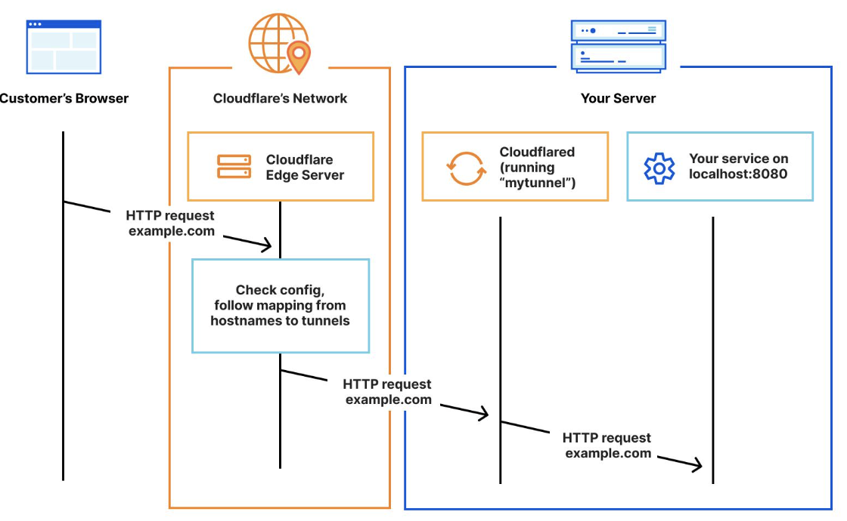
Tunnelling
Tunnelling, in the context of computer networking, is a technique that allows the encapsulation of one network protocol within another network protocol. It enables data to be securely transmitted over an insecure or public network by creating a virtual tunnel between two endpoints.

Slide 29
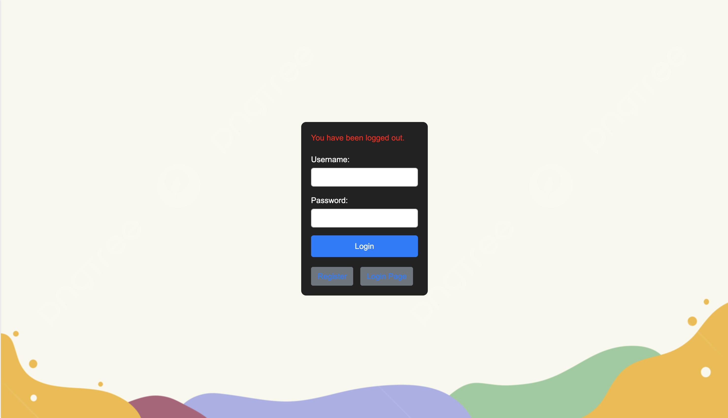
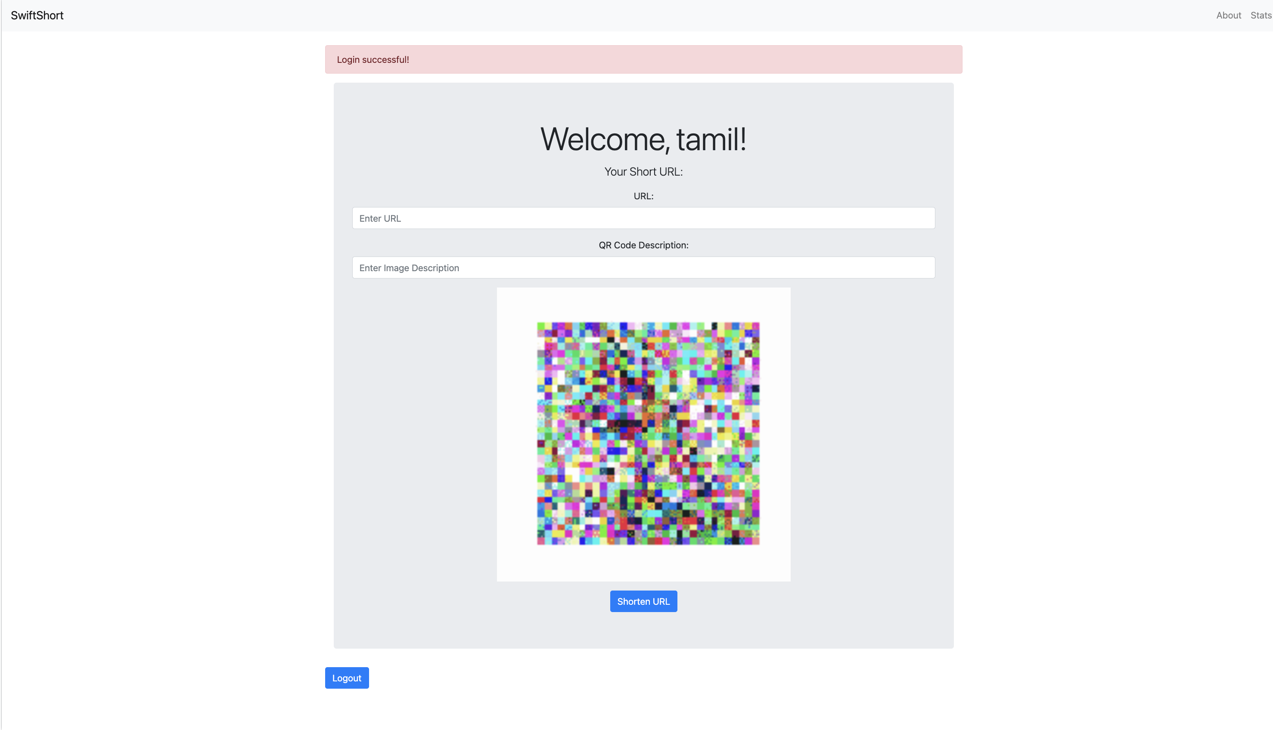
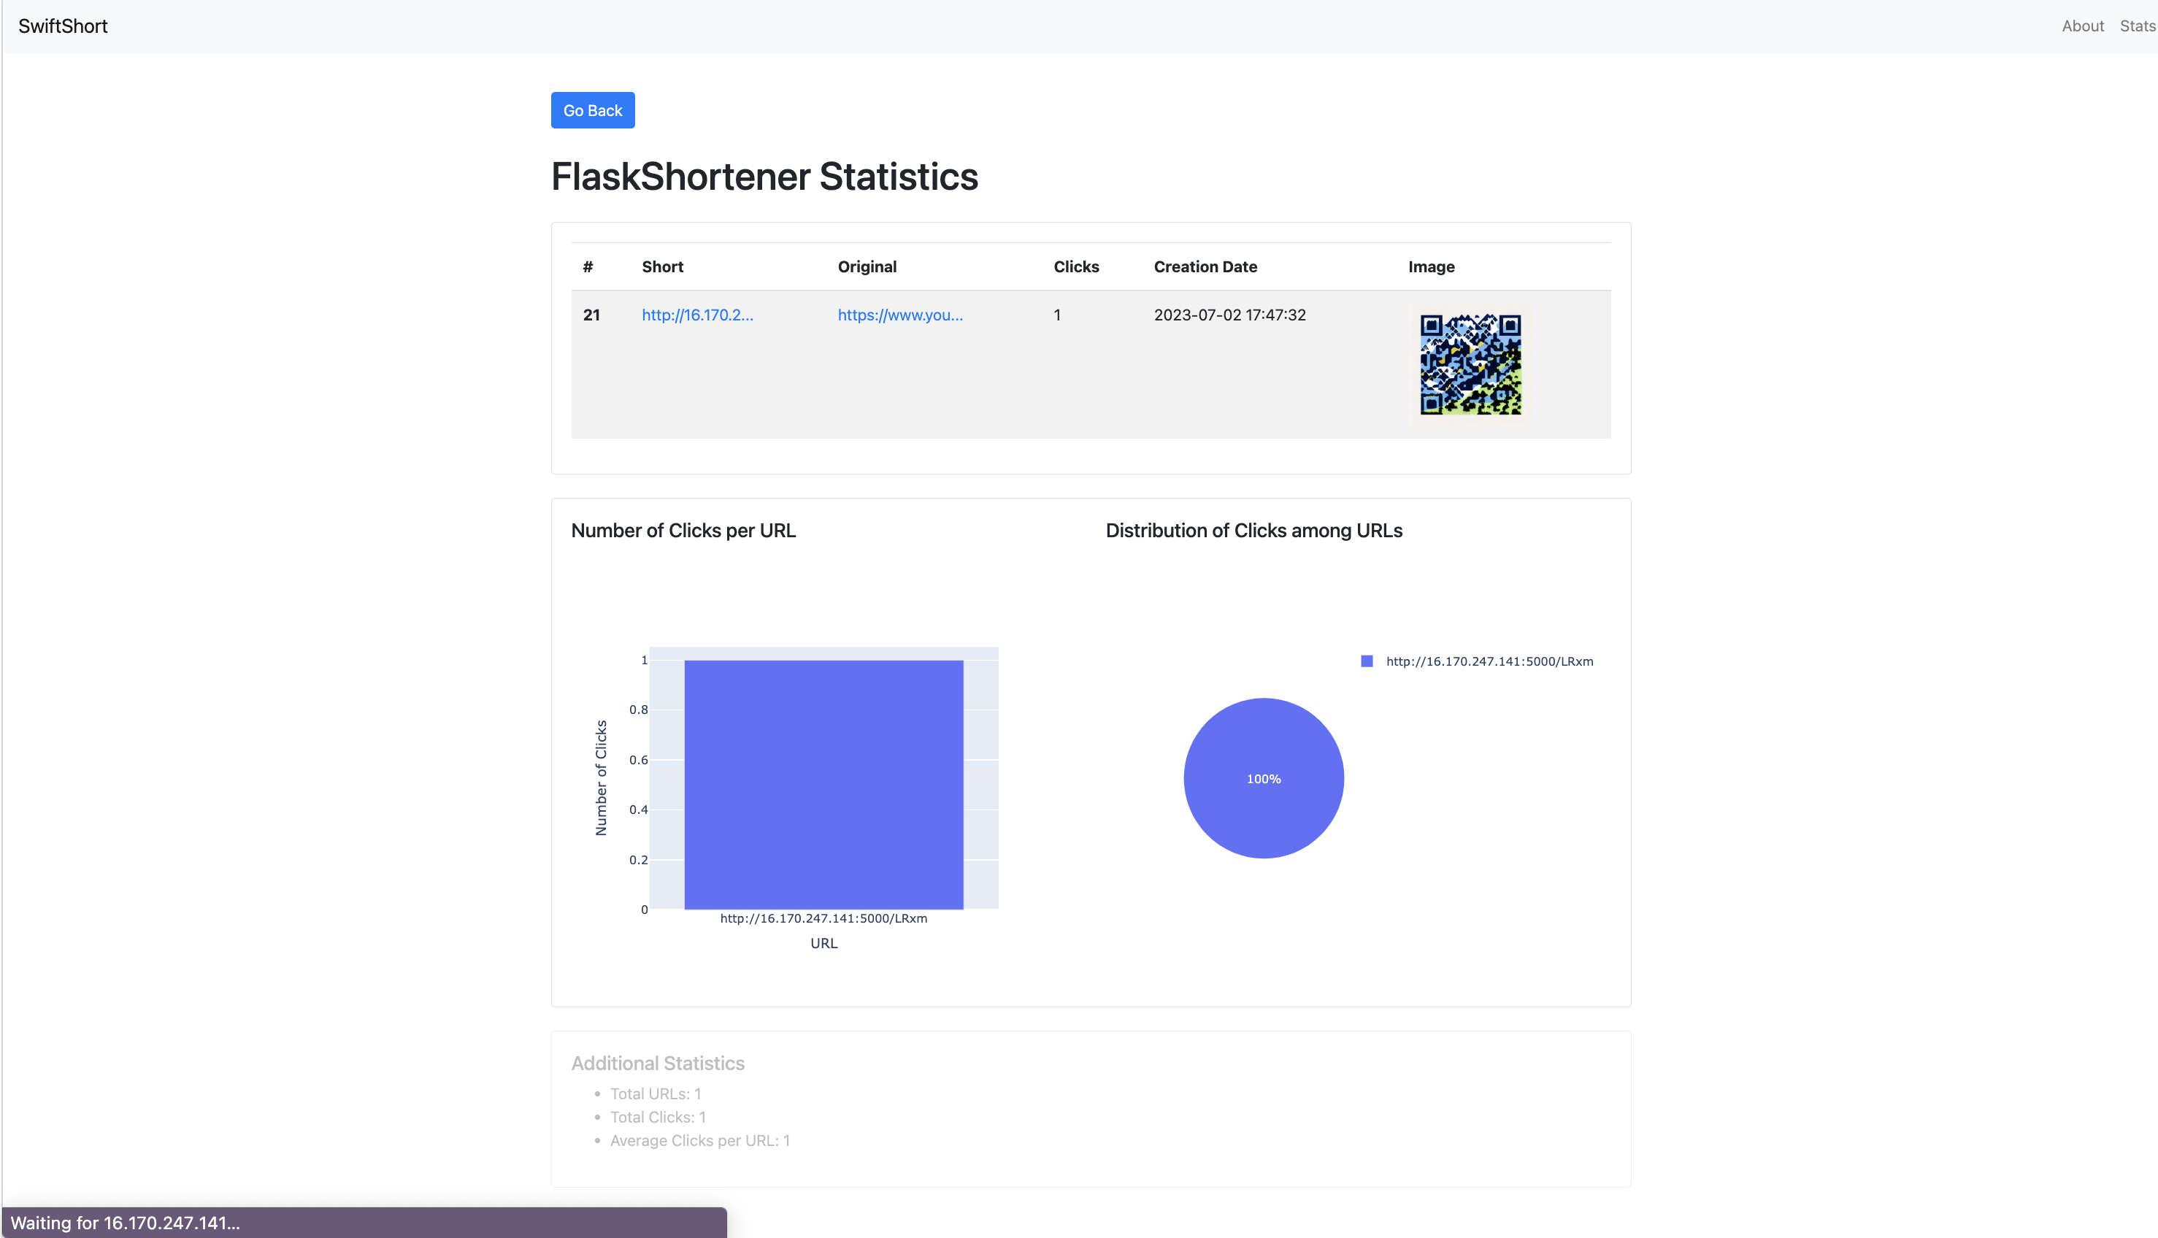

Slide 30
Thank You

