Slide 1
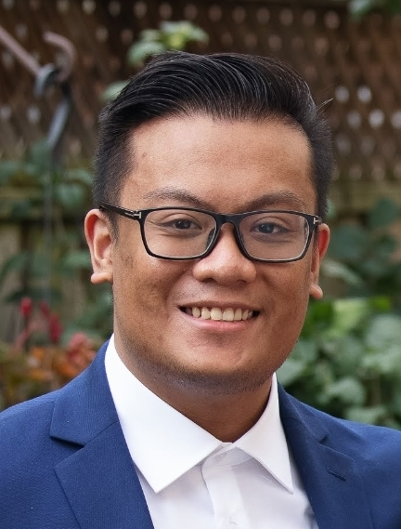
Game Engine Design & Implementation
100765502
Ayi Pranayanda

