Slide 1
UNIVERSITY OF GHANA · SCHOOL OF NUCLEAR AND ALLIED SCIENCES
30-MINUTE DEFENCE
HydroSheaf
Graph-constrained environmental and nuclear tracer modelling with inverse hydrogeochemistry for diagnosing groundwater residence time and evolution in data-limited semi-arid aquifers: development and application of HydroSheaf
PhD viva defence · Dickson Abdul-Wahab · 11004418
August 2026
One-sentence thesis
Integration is scientifically useful only when it exposes—not hides—non-uniqueness.
Notes:
Timing: 0:00–0:35
Open with the central scientific position, not the software inventory. HydroSheaf asks whether uncertain age, connectivity and chemical evidence can be combined without hiding non-uniqueness. State that universal predictive superiority is not the thesis claim.
[Sources]
- C:\Users\ThinkPad P1 G4\Documents\July_2026\NeutroProject\Groundwater\Hydrosheaf\draftbychapter\PhDChapter1_refined.docx
[/Sources]

Slide 2
OPENING TENSION
A good fit can still describe the wrong aquifer
Three plausible answers
The hidden error
Residence time
Several age distributions reproduce the same tracer signal
Narrow uncertainty
≠
correct interpretation
Connectivity
Several directed graphs explain sparse hydraulic and chemical patterns
Reactions
Several mineral pathways reproduce nearly identical concentrations
The thesis therefore evaluates discrimination, calibration, identifiability and adverse controls—not residual fit alone.
Problem
02
Notes:
Timing: 0:35–1:55
Explain the shared inverse-problem structure. The same observation can support several ages, graphs or reaction pathways. The key danger is false certainty: an integrated model can become more confident while becoming less correct. This motivates the evaluation criteria used throughout the thesis.
[Sources]
- C:\Users\ThinkPad P1 G4\Documents\July_2026\NeutroProject\Groundwater\Hydrosheaf\M5\m5_inverse_reaction_benchmark\docs\m5_results_summary.md
- C:\Users\ThinkPad P1 G4\Documents\July_2026\NeutroProject\Groundwater\Hydrosheaf\M7\m7_nonuniqueness_benchmark\docs\m7_3_results.md
[/Sources]

Slide 3
SCIENTIFIC GAP
The unknowns are coupled—but usually inferred separately
AGE
TOPOLOGY
CHEMISTRY
↔
↔
Tracer history and mixing
Directed flow paths
Reaction families and extents
HydroSheaf asks whether locally plausible relations compose into a globally compatible groundwater interpretation.
Problem
03
Notes:
Timing: 1:55–3:00
Age constrains plausible travel direction, topology conditions which samples can be compared, and chemistry constrains processes along edges. Existing workflows often estimate these sequentially and treat upstream outputs as fixed. HydroSheaf formalises their relations and propagates incompatibility instead of silently resolving it.
[Sources]
- C:\Users\ThinkPad P1 G4\Documents\July_2026\NeutroProject\Groundwater\Hydrosheaf\draftbychapter\PhDChapter1_refined.docx
[/Sources]

Slide 4
AIM AND QUESTIONS
One aim, four answerable questions
Develop, benchmark and apply HydroSheaf to jointly diagnose residence-time distributions, directed flow paths and hydrogeochemical evolution.
01
Can component methods recover known or reference behaviour?
02
When does one evidence stream add information to another?
03
What does affine sheaf structure add beyond weighted graphs?
04
What can available Ghana data support—and what remains unknowable?
Research design
04
Notes:
Timing: 3:00–4:00
State the aim and use four self-describing questions. Do not introduce internal milestone labels. Explain that the objectives are operationalised through component checks, integration experiments, representation tests and field supportability analysis.
[Sources]
- C:\Users\ThinkPad P1 G4\Documents\July_2026\NeutroProject\Groundwater\Hydrosheaf\draftbychapter\PhDChapter1_refined.docx
[/Sources]

Slide 5
WHAT IS NEW
The novelty is the coupling and the validation logic
Inherited foundations
Thesis contributions
Tracer dating and lumped-parameter models
Groundwater-specific executable coupling
Directed weighted graphs
Uncertainty and identifiability as outputs
Sheaf-theoretic compatibility
Adverse controls for false confidence
PHREEQC inverse modelling
Locked claim-decision protocols
MODFLOW / MODPATH reference transport
Field evidence-ceiling diagnostics
Contribution
05
Notes:
Timing: 4:00–5:00
Be explicit: the thesis does not claim to invent tracer dating, graph modelling, sheaf theory or inverse hydrogeochemistry. The contribution is their formal, executable, groundwater-specific coupling with uncertainty propagation, adverse controls and claim rules. This is a defensible methodological novelty.
[Sources]
- C:\Users\ThinkPad P1 G4\Documents\July_2026\NeutroProject\Groundwater\Hydrosheaf\draftbychapter\PhDChapter1_refined.docx
[/Sources]

Slide 6
MECHANISM
A sheaf represents how evidence changes across an edge
Weighted graph
Affine sheaf
M7 evidence: static scalar affine test
NODE A
—— w ——
NODE B
xᵤ
xᵥ ≈ αₑxᵤ + bₑ
xᵥ
Edge-specific gain and offset; global inconsistency localises conflict.
One scalar edge weight says how strongly nodes are related.
Multivariate vector-stalk performance remains unvalidated.
Method
06
Notes:
Timing: 5:00–6:20
Use the simplest mathematical distinction. A weighted graph assigns a scalar relation to an edge. The M7 representation benchmark tested static scalar affine relations with edge-specific gain and offset, global compatibility and conflict localisation. The wider framework can represent multivariate stalks, but that capability was not validated here. Do not imply that representation automatically improves every prediction.
[Sources]
- C:\Users\ThinkPad P1 G4\Documents\July_2026\NeutroProject\Groundwater\Hydrosheaf\hydrosheaf\sheaf\directed_section.py
- C:\Users\ThinkPad P1 G4\Documents\July_2026\NeutroProject\Groundwater\Hydrosheaf\M7\m7_nonuniqueness_benchmark\docs\m7_sheaf_vs_graph_results.md
[/Sources]

Slide 7
LOCKED EVALUATION
Claims were matched to an evidence ladder
1
Unit and conversion verification
Does the implementation reproduce its declared input?
2
Reference emulation
Does it agree with an established public workflow?
3
Controlled known-truth benchmarks
Can it recover planted topology, age and reactions?
4
Field transfer and supportability
What do real data permit without known truth?
5
Matched end-to-end field truth
Still missing: age + repeated heads + chemistry + connectivity
Validation
07
Notes:
Timing: 6:20–7:40
Define a locked test: the generator and decision rules are fixed using development data; the held-out cases are opened once for the confirmatory comparison. Emphasise that different evidence tiers support different claims. Synthetic known truth and field transfer are complementary, but neither substitutes for matched field truth.
[Sources]
- C:\Users\ThinkPad P1 G4\Documents\July_2026\NeutroProject\Groundwater\Hydrosheaf\M7\m7_nonuniqueness_benchmark\manuscript\revision\FINAL_VERIFICATION_20260730.md
- C:\Users\ThinkPad P1 G4\Documents\July_2026\NeutroProject\Groundwater\Hydrosheaf\draftbychapter\PhDChapter1_refined.docx
[/Sources]

Slide 8
COMPONENT VERIFICATION
Foundations: recover capability before testing novelty
100
0.058
0.112
controlled transport–reaction realisations
median transport absolute error
median reaction error
What this establishes
What this does not establish
• controlled recovery is operational
• MODPATH archives can be converted into reference graphs
• PHREEQC-compatible proxy executed; live PHREEQC validated later
F1 = 1.00 for archive conversion is verification of conversion—not perfect inference of an unknown topology.
Results
08
Notes:
Timing: 7:40–8:35
The early controlled benchmark checked whether the framework could recover planted transport and reaction behaviour. M2 used a PHREEQC-compatible deterministic proxy; the later reaction benchmark supplied the live-PHREEQC evidence. The perfect 174-edge MODPATH result is deliberately labelled conversion verification, not unknown-topology inference.
[Sources]
- C:\Users\ThinkPad P1 G4\Documents\July_2026\NeutroProject\Groundwater\Hydrosheaf\M2\m2_benchmark\docs\m2_results_summary.md
- C:\Users\ThinkPad P1 G4\Documents\July_2026\NeutroProject\Groundwater\Hydrosheaf\M5\m5_inverse_reaction_benchmark\docs\m5_results_summary.md
[/Sources]

Slide 9
RESIDENCE TIME
Age inference closely reproduced reported configurations—but weak topology added no value
329
0.0279
0.937
87.5%
strict reportable fits
median |Δ log₁₀ age|
R² against reported configuration
within factor two
Topology stress test
Weak hydraulic proxy
−0.00135 RMSE
factor-two agreement worsened
NO ROBUST GAIN
Wrong direction
+0.1008 RMSE
clear negative transfer
HARMFUL
Random graph
+0.6550 RMSE
severe negative transfer
HARMFUL
Results
09
Notes:
Timing: 8:35–10:25
This is close agreement with a reported TracerLPM/USGS configuration, not formal equivalence and not error-free field-age truth. HydroSheaf reproduced the reported outputs closely on 329 strict fits. It did not need to beat TracerLPM; the test asked whether topology supplied independent information. The weak proxy failed the locked improvement rule, while wrong and random graphs demonstrated negative transfer.
[Sources]
- C:\Users\ThinkPad P1 G4\Documents\July_2026\NeutroProject\Groundwater\Hydrosheaf\M3\m3_age_benchmark\M3_FINAL_ACCURACY_AUDIT.md
[/Sources]

Slide 10
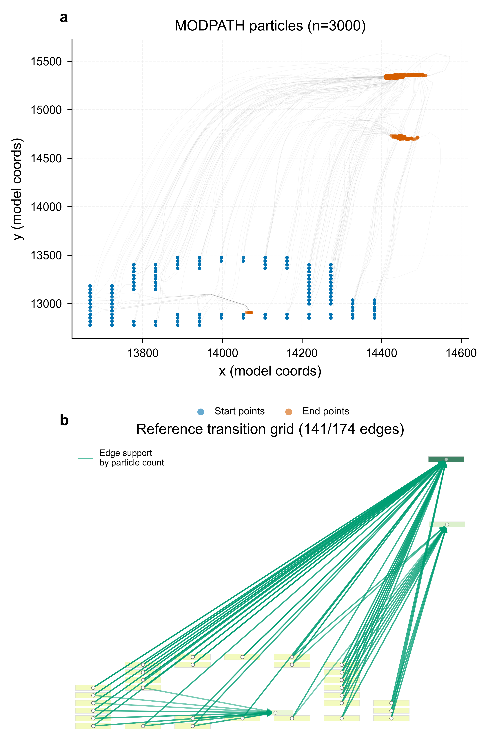
DIRECTED CONNECTIVITY
Topology skill was conditional, not perfect
Head-gradient inference
P 0.49 · R 0.84 · F1 0.62
Independent scenarios
1 perfect · 3 with FP/FN · 2 scale mismatches
Guardrail
Model-conditioned MODPATH topology ≠ field connectivity truth
Results
10
Notes:
Timing: 10:25–12:00
Explain the difference between reference construction and independent inference. The headline publication figure gives a model-conditioned head-gradient diagnostic around P 0.49, R 0.84 and F1 0.62, with negative controls near zero. Independent scenario performance varies with evidence and scale. This is conditional topology skill against MODPATH-derived reference transitions, not independently measured field connectivity.
[Sources]
- C:\Users\ThinkPad P1 G4\Documents\July_2026\NeutroProject\Groundwater\Hydrosheaf\M4\m4_topology_benchmark\docs\02_figures.md
- C:\Users\ThinkPad P1 G4\Documents\July_2026\NeutroProject\Groundwater\Hydrosheaf\M4\m4_topology_benchmark\docs\m4_results_summary.md
[/Sources]

Slide 11
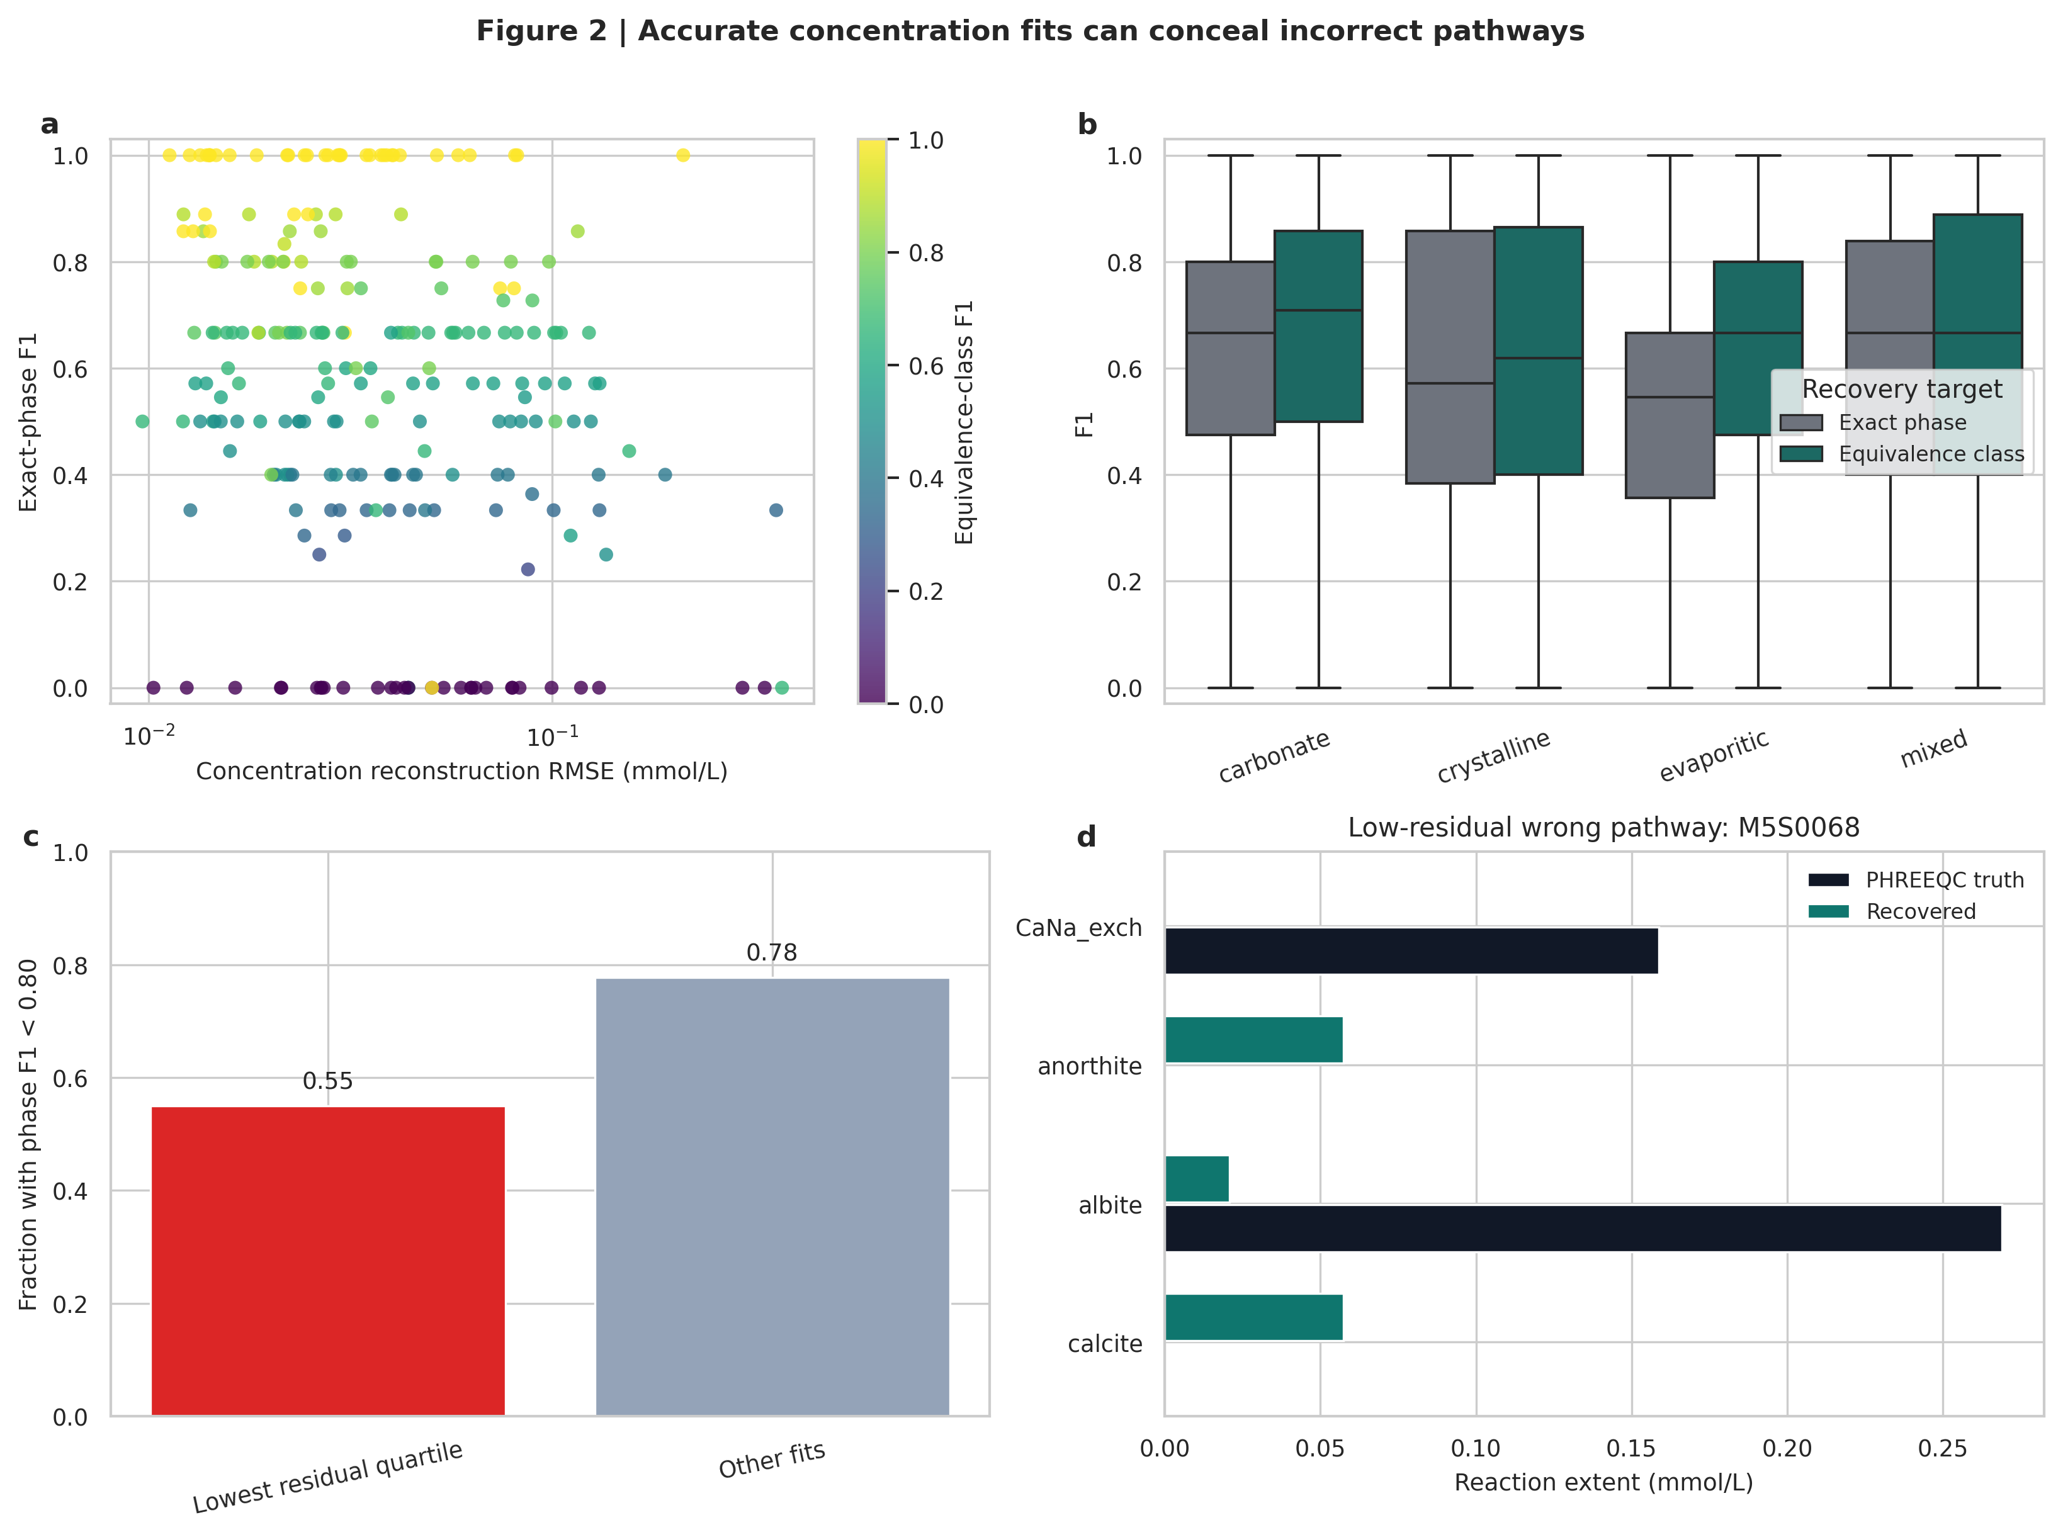
INVERSE HYDROGEOCHEMISTRY
Low residuals did not identify unique reaction mechanisms
185.78
mean feasible PHREEQC models / scenario
6.79
mean minimal models / scenario
Primary guarded result
Phase F1 0.563
Equivalence-class F1 0.609
FDR 0.361
Results
11
Notes:
Timing: 12:00–14:00
Use the figure to show that concentration reconstruction can be excellent while the recovered pathway is wrong. Conventional inverse PHREEQC produced many feasible and minimal models. The defensible output is family or equivalence-class support, not unique mineral truth. This result changes the reporting target from a single best pathway to a constrained ensemble.
[Sources]
- C:\Users\ThinkPad P1 G4\Documents\July_2026\NeutroProject\Groundwater\Hydrosheaf\M5\m5_inverse_reaction_benchmark\docs\m5_results_summary.md
[/Sources]

Slide 12
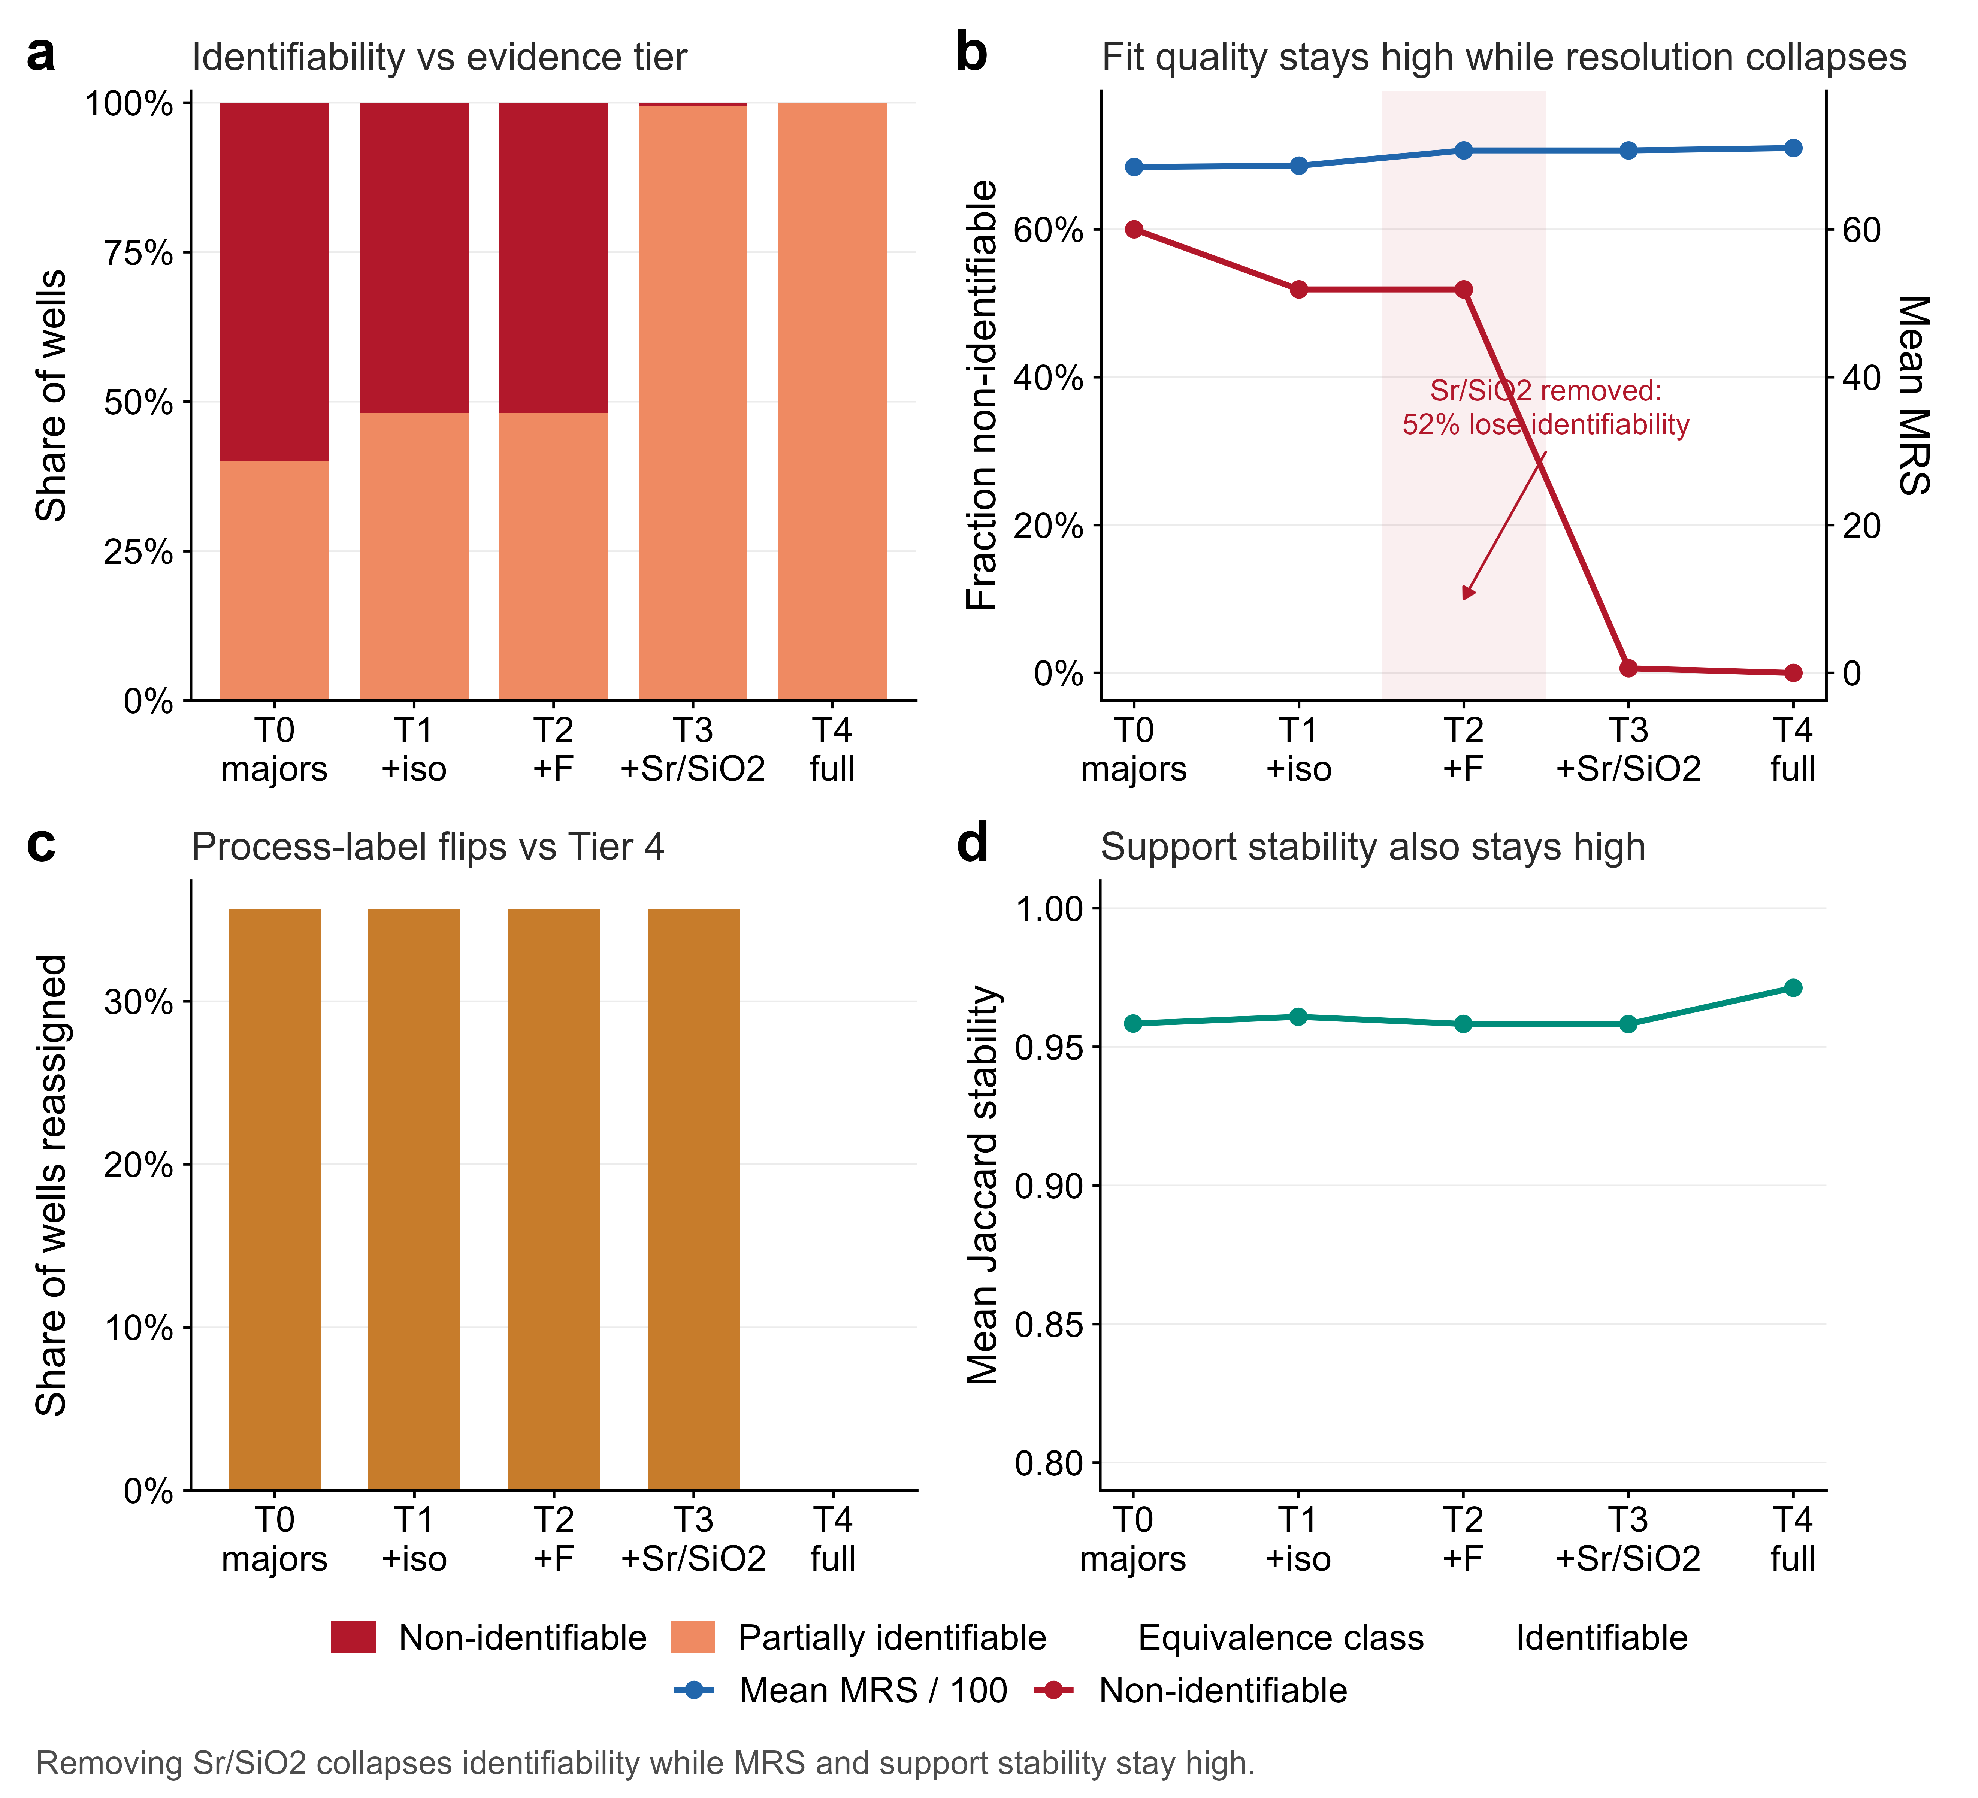
FIELD SUPPORTABILITY
Ghana field transfer identified the evidence ceiling
294 / 320
Northern Ghana quantitative records
52%
wells lose identifiability without Sr/SiO₂
The warning
Mean fit score stayed ≈68–71 while process labels flipped in 35.6% of wells.
Predeclared evidence gate; not observed field truth
Results
12
Notes:
Timing: 14:00–16:00
The Ghana result is not exact age, flow-path or reaction validation. It is an operational evidence-ceiling diagnosis under a predeclared gate, with a synthetic check supporting the direction of the result. Removing strontium and silica moved about 52 percent of wells to non-identifiable, while fit metrics and bootstrap stability remained high. This shows why conventional good-fit criteria can conceal loss of mechanistic resolution.
[Sources]
- C:\Users\ThinkPad P1 G4\Documents\July_2026\NeutroProject\Groundwater\Hydrosheaf\M6\m6_field_transfer_benchmark\docs\m6_results_summary.md
[/Sources]

Slide 13
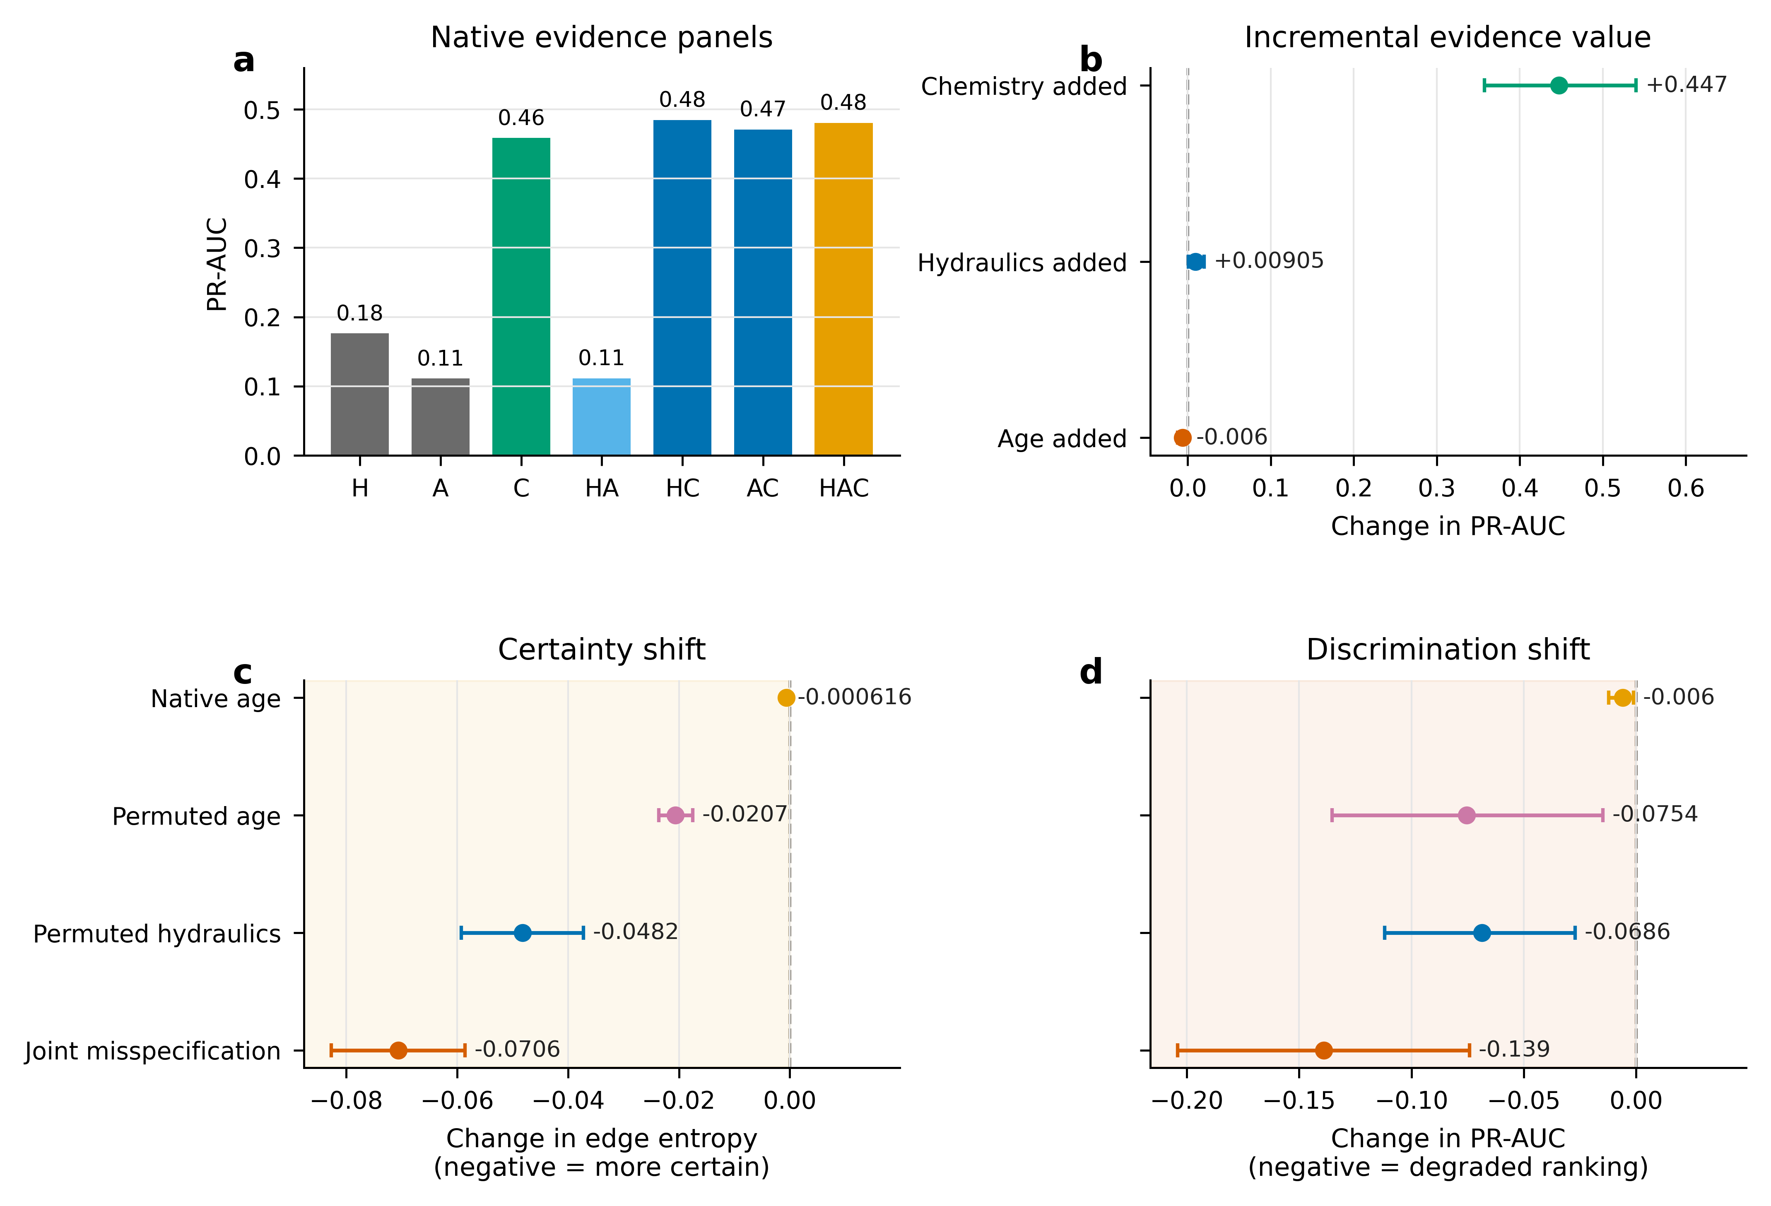
CONDITIONAL INTEGRATION
Only chemistry delivered a robust topology-ranking gain
CHEMISTRY ADDED · SURVIVES CORRECTION
+0.447 PR-AUC
HYDRAULICS ADDED
+0.0091 PR-AUC
not multiplicity-significant (adjusted p = 0.070)
AGE ADDED
−0.0060 PR-AUC
not multiplicity-significant (adjusted p = 0.070)
Added data ≠ added information
Results
13
Notes:
Timing: 16:00–17:50
In the independent generator, chemistry added strong topology-ranking information and its PR-AUC gain survived family-wise correction. The +0.0091 hydraulic PR-AUC contrast did not survive correction, although Brier and log-loss improvements did. The −0.0060 age ranking contrast also did not survive correction and supplies no evidence of positive value. The conclusion is conditional complementarity, not that every stream always helps.
[Sources]
- C:\Users\ThinkPad P1 G4\Documents\July_2026\NeutroProject\Groundwater\Hydrosheaf\M7\m7_nonuniqueness_benchmark\docs\m7_3_results.md
- C:\Users\ThinkPad P1 G4\Documents\July_2026\NeutroProject\Groundwater\Hydrosheaf\M7\m7_nonuniqueness_benchmark\manuscript\sections\03-results\section.md
[/Sources]

Slide 14
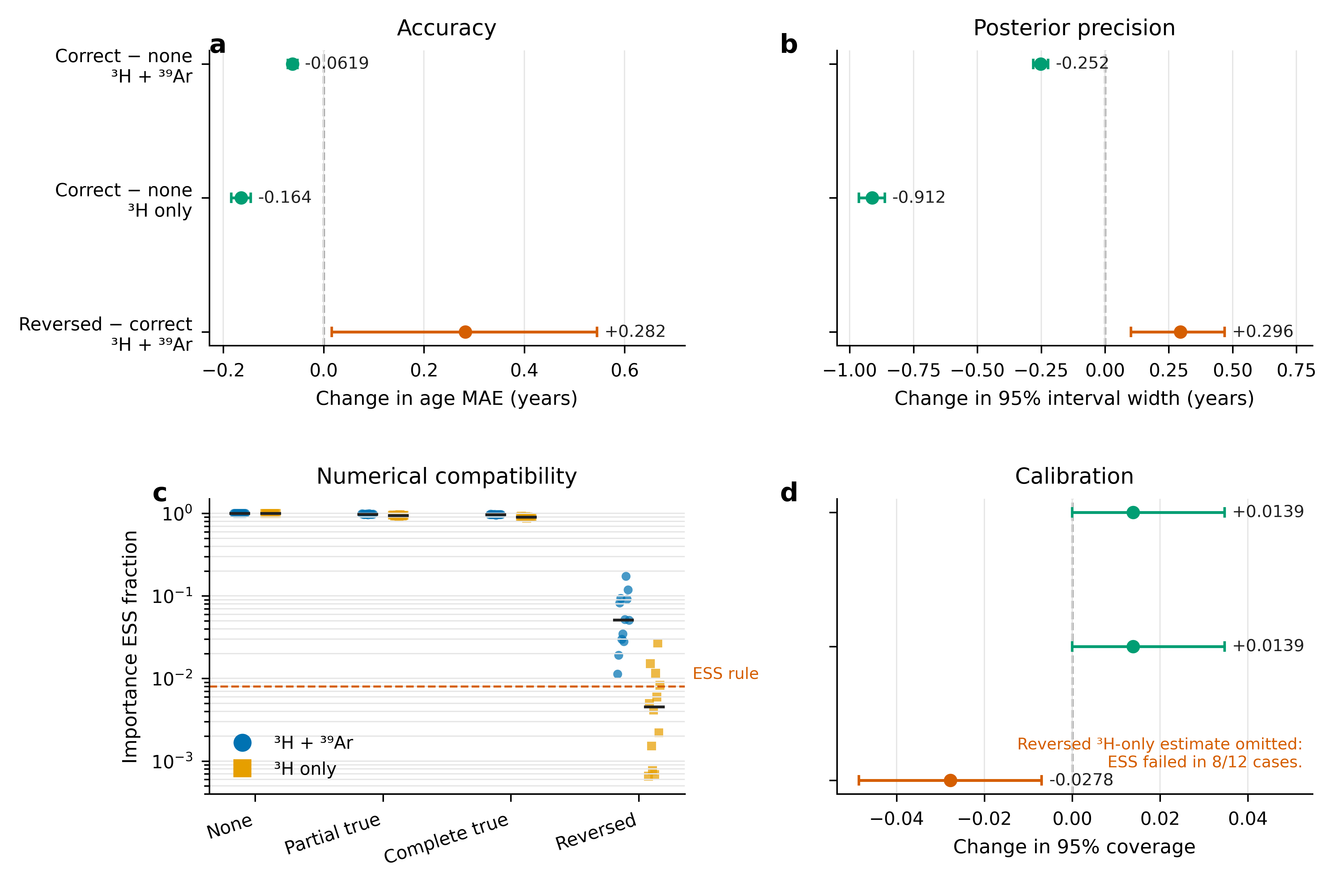
DIRECTION OF INFORMATION
Correct topology reduced age non-uniqueness—especially with weak tracers
−0.0619 y
MAE: correct graph vs no graph, two tracers
−0.1642 y
MAE: correct graph vs no graph, ³H only
Wrong direction
Reversed topology increased error and created negative transfer.
Practical MAE change: 2.24% and 3.46% of baseline
Results
14
Notes:
Timing: 17:50–19:10
This experiment reverses the direction of conditioning. Correct topology produced statistically precise but practically small MAE improvements: 2.24 and 3.46 percent of their baselines; practical planning margins were post-review diagnostics. Reversed topology harmed inference. The result supports correct topology as useful information while warning against treating an estimated graph as known.
[Sources]
- C:\Users\ThinkPad P1 G4\Documents\July_2026\NeutroProject\Groundwater\Hydrosheaf\M7\m7_nonuniqueness_benchmark\docs\m7_3_results.md
[/Sources]

Slide 15
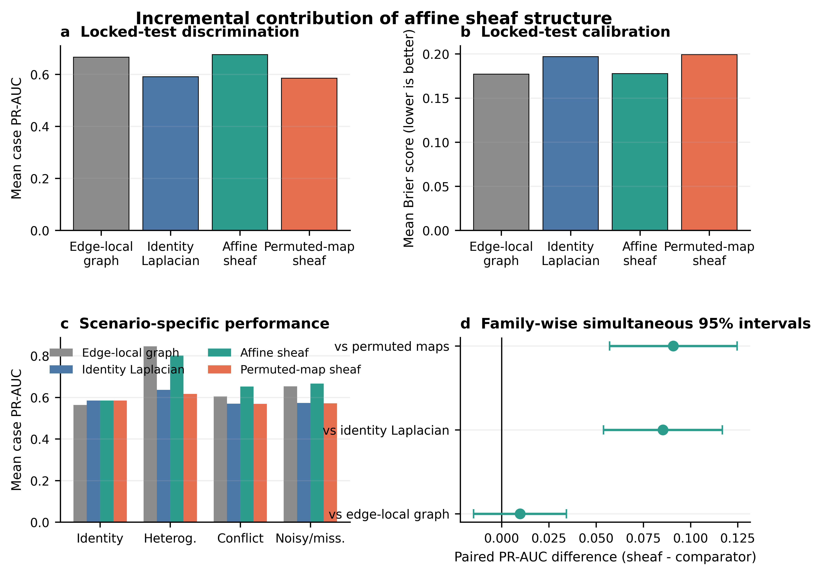
SHEAF VERSUS GRAPH
The sheaf adds representation and conflict localisation—not universal superiority
VS IDENTITY GRAPH
+0.0854 PR-AUC
NATIVE VS PERMUTED MAPS
+0.0909 PR-AUC
VS STRONG EDGE-LOCAL GRAPH
+0.0097 · CI crosses 0
GENERAL SUPERIORITY: NOT ESTABLISHED
Results
15
Notes:
Timing: 19:10–21:30
This is the centrepiece. The affine sheaf beats the identity Laplacian and permuted-map control, and exactly nests the identity limit. Against the stronger edge-local weighted graph, the overall difference is small and the simultaneous interval crosses zero; log loss is worse in the original estimator. The supported contribution is scalar edge-specific transformations, global compatibility and conflict localisation, especially in incompatible-cycle scenarios.
[Sources]
- C:\Users\ThinkPad P1 G4\Documents\July_2026\NeutroProject\Groundwater\Hydrosheaf\M7\m7_nonuniqueness_benchmark\docs\m7_sheaf_vs_graph_results.md
- C:\Users\ThinkPad P1 G4\Documents\July_2026\NeutroProject\Groundwater\Hydrosheaf\M7\m7_nonuniqueness_benchmark\M7_SHEAF_VS_GRAPH_CLAIM_DECISION.md
[/Sources]

Slide 16
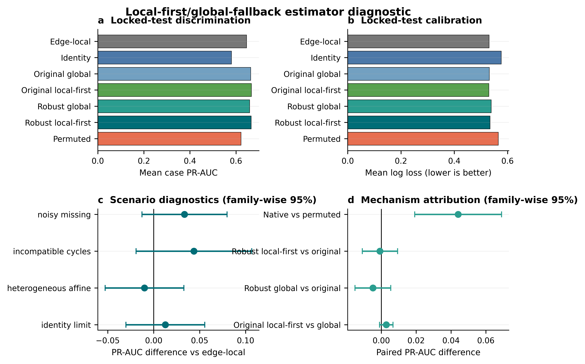
ESTIMATOR DIAGNOSTIC
The local-first estimator did not earn general superiority
LOCKED TEST: 128 CASES
+0.0200 PR-AUC
simultaneous CI [−0.0055, 0.0454]
COMPLETE GATE
Brier: inconclusive
Log loss: inconclusive
CONDITIONAL METHOD · NOT UNIVERSAL WINNER
Results
16
Notes:
Timing: 21:30–22:45
The development stage selected a local-first/global-fallback estimator and it was tested once on 128 fresh locked cases. The PR-AUC point estimate was higher, but its family-wise simultaneous interval crossed zero; Brier score and log loss also failed the all-outcome superiority gate. Leave-one-edge-out robust global weighting worsened calibration. Therefore retain an estimator diagnostic, not a general superiority claim.
[Sources]
- C:\Users\ThinkPad P1 G4\Documents\July_2026\NeutroProject\Groundwater\Hydrosheaf\M7\m7_nonuniqueness_benchmark\manuscript\sections\03-results\section.md
- C:\Users\ThinkPad P1 G4\Documents\July_2026\NeutroProject\Groundwater\Hydrosheaf\M7\m7_nonuniqueness_benchmark\M7_ROBUST_HYBRID_CLAIM_DECISION.md
[/Sources]

Slide 17
WHAT DID NOT WORK
The failures define the scientific boundary
Weak graph prior for age
NO ROBUST GAIN
Topology did not contain independent age information
Old-water prior
WITHDRAWN
RMSE 1.310; R² 0.004
Carbonate reaction families
NOT RECOVERED
0/36 scored edges per tested panel
Overall sheaf > edge-local graph
GATE FAILED
Ranking gain did not extend to calibration
Active learning
NOT VALIDATED
0 recommendations from 0 scored edges
Synthesis
17
Notes:
Timing: 22:45–23:35
Present the negative results as scientific findings. The weak graph prior did not improve age inference; the old-water prior was withdrawn; carbonate families were not recovered under either tested indicator panel, which does not prove universal non-identifiability; the general sheaf-superiority gate failed; and active learning has not produced a claim-bearing evaluation.
[Sources]
- C:\Users\ThinkPad P1 G4\Documents\July_2026\NeutroProject\Groundwater\Hydrosheaf\M3\m3_age_benchmark\M3_FINAL_ACCURACY_AUDIT.md
- C:\Users\ThinkPad P1 G4\Documents\July_2026\NeutroProject\Groundwater\Hydrosheaf\M7\m7_nonuniqueness_benchmark\docs\m7_3_results.md
- C:\Users\ThinkPad P1 G4\Documents\July_2026\NeutroProject\Groundwater\Hydrosheaf\HYDROSHEAF_REMAINING_CAPABILITIES_DECISION_20260728.md
[/Sources]

Slide 18
CLAIM LEDGER
What the thesis supports—and does not support
SUPPORTED
NOT ESTABLISHED
✓
Close agreement with reported age-model configurations
×
Universal superiority over strong baselines
✓
Conditional topology and evidence value
×
Exact Ghana ages, paths or mineral truth
✓
Reaction equivalence-class reporting
×
End-to-end field validation
✓
Affine-map and conflict-localisation value
×
Validated vector-stalk / 3-D / temporal / vadose claims
✓
Ghana measurement-value diagnosis
×
Excellent active-learning performance
Synthesis
18
Notes:
Timing: 23:35–24:35
Use the claim ledger to answer the research questions directly. The thesis supports controlled and conditional integration claims, plus field supportability diagnostics. It does not support universal superiority, exact Ghana truth, complete field validation or untested capability claims. This slide prevents overclaiming under viva pressure.
[Sources]
- C:\Users\ThinkPad P1 G4\Documents\July_2026\NeutroProject\Groundwater\Hydrosheaf\draftbychapter\PhDChapter1_refined.docx
- C:\Users\ThinkPad P1 G4\Documents\July_2026\NeutroProject\Groundwater\Hydrosheaf\M7\m7_nonuniqueness_benchmark\manuscript\revision\FINAL_VERIFICATION_20260730.md
[/Sources]

Slide 19
ANSWER TO THE THESIS
Four contributions to knowledge
01
FORMALISATION
02
DIAGNOSTICS
A groundwater-specific graph/sheaf representation linking age, flow and reactions
Identifiability, calibration and conflict localisation as primary outputs
03
EVIDENCE LOGIC
04
FIELD DESIGN
Locked tests, adverse controls and explicit claim-decision gates
Evidence-ceiling and measurement-value diagnosis for data-limited aquifers
Contribution
19
Notes:
Timing: 24:35–25:35
Summarise the contribution at the level of knowledge, not software features. First, a formal groundwater representation. Second, diagnostics that expose non-uniqueness. Third, a falsifiable evaluation logic. Fourth, a field-data design contribution that identifies which missing measurements block interpretation.
[Sources]
- C:\Users\ThinkPad P1 G4\Documents\July_2026\NeutroProject\Groundwater\Hydrosheaf\draftbychapter\PhDChapter1_refined.docx
[/Sources]

Slide 20
THE DEFENSIBLE CONCLUSION
HydroSheaf does not promise one correct aquifer story.
It tests whether cross-domain relations compose globally, quantifies when they add information, and exposes when plausible integration becomes confidently wrong.
NEXT CLAIM-BEARING TEST
Independent replication with a different generator—or matched field data containing age tracers, repeated heads, chemistry and independently measured connectivity.
Thank you
Notes:
Timing: 25:35–27:00
Return to the opening tension. HydroSheaf’s contribution is not universal superiority. It is a reproducible way to represent cross-domain relations, test global compatibility, measure incremental information and expose confident error. End with the decisive next validation: a different independent generator or a matched field dataset with connectivity truth. This leaves approximately three minutes of contingency within a 30-minute slot.
[Sources]
- C:\Users\ThinkPad P1 G4\Documents\July_2026\NeutroProject\Groundwater\Hydrosheaf\M7\m7_nonuniqueness_benchmark\manuscript\sections\05-conclusion\section.md
[/Sources]

Slide 21
SHEAF VERSUS GRAPH
Backup · What exactly does the sheaf add?
IDENTITY GRAPH
EDGE-LOCAL GRAPH
AFFINE SHEAF
Scalar similarity
Flexible edge score
Edge-specific Aₑ and bₑ
One shared coordinate system
Strong local comparator
Global compatibility residuals
Baseline limit
No global map consistency
Conflict localisation
Examiner answer: the sheaf adds relation-specific transformations and global conflict localisation; it did not establish general superiority over the strongest edge-local comparator.
Examiner backup
21
Notes:
Timing: Backup
Use only if asked what the sheaf layer contributes beyond an ordinary weighted graph. Lead with representation, nesting and conflict localisation. Then volunteer the null overall comparison with the strong edge-local graph to show command of the limitation.
[Sources]
- C:\Users\ThinkPad P1 G4\Documents\July_2026\NeutroProject\Groundwater\Hydrosheaf\M7\m7_nonuniqueness_benchmark\docs\m7_sheaf_vs_graph_results.md
[/Sources]

Slide 22
AGE BENCHMARK
Backup · Why HydroSheaf did not need to beat TracerLPM
QUESTION ACTUALLY TESTED
QUESTION NOT TESTED
Can HydroSheaf reproduce the reported configuration—and does topology add independent information?
Which model is closer to the unknown true groundwater-age distribution?
Answer: close agreement achieved; incremental graph value not established.
The public reference outputs are emulation targets—not error-free truth.
Examiner backup
22
Notes:
Timing: Backup
Explain that the benchmark target and scientific truth are not the same thing. HydroSheaf need not replace TracerLPM. The key negative result is that the available graph proxy did not add independent age information and harmful graphs could be detected.
[Sources]
- C:\Users\ThinkPad P1 G4\Documents\July_2026\NeutroProject\Groundwater\Hydrosheaf\M3\m3_age_benchmark\M3_FINAL_ACCURACY_AUDIT.md
[/Sources]

Slide 23
REPRODUCIBILITY
Backup · What a locked test means
1
2
3
4
DEVELOP
→
FREEZE
→
OPEN ONCE
→
DECIDE
Tune on declared development cases
Generator, code, seeds, primary metrics and decision rules
Evaluate untouched locked cases
Apply the frozen gate, including negative outcomes
Locked comparisons were not rerun; practical planning margins were post-review diagnostics.
Examiner backup
23
Notes:
Timing: Backup
A locked test protects the confirmatory comparison from iterative tuning. Distinguish this from preregistration: the protocol was Git-locked before test access, but not externally preregistered. Minimum important differences and planning margins were introduced post-review and were not prespecified. Also distinguish local auditability from a completed public release.
[Sources]
- C:\Users\ThinkPad P1 G4\Documents\July_2026\NeutroProject\Groundwater\Hydrosheaf\M7\m7_nonuniqueness_benchmark\manuscript\revision\FINAL_VERIFICATION_20260730.md
[/Sources]

Slide 24
EVIDENCE MATRIX
Backup · No single field dataset contains all three truths
DATASET
AGE TRACERS
REPEATED HYDRAULICS
CHEMISTRY
CONNECTIVITY TRUTH
Public age archive
✓
direct heads unavailable
not used
—
MODFLOW / MODPATH
modelled
✓
—
model-conditioned
Northern Ghana
—
—
✓
—
Talensi / Lower Anayari
—
—
✓
—
Controlled integration generator
✓
✓
✓
✓ planted
Therefore: controlled known-truth integration + field supportability, not end-to-end field validation.
Examiner backup
24
Notes:
Timing: Backup
Answer directly: no, the thesis does not contain one field dataset with matched age, repeated heads, chemistry and independent connectivity. The validation strategy triangulates controlled known truth, component reference checks and field transfer. The missing matched field test remains future work.
[Sources]
- C:\Users\ThinkPad P1 G4\Documents\July_2026\NeutroProject\Groundwater\Hydrosheaf\draftbychapter\PhDChapter1_refined.docx
- C:\Users\ThinkPad P1 G4\Documents\July_2026\NeutroProject\Groundwater\Hydrosheaf\M7\m7_nonuniqueness_benchmark\docs\m7_3_results.md
[/Sources]

Slide 25
ADVERSE CONTROLS
Backup · Reduced uncertainty can mean confident error
PERMUTED AGE
PERMUTED HYDRAULICS
JOINT MISSPECIFICATION
MORE CERTAIN
MORE CERTAIN
MORE CERTAIN
Entropy −0.0207
Entropy −0.0482
Entropy −0.0706
BUT WORSE
BUT WORSE
BUT WORSE
PR-AUC −0.0754
Log loss +0.0745
PR-AUC −0.139
Calibration and discrimination must accompany entropy or interval width.
Examiner backup
25
Notes:
Timing: Backup
This is one of the strongest results. Permuting evidence can reduce entropy while worsening discrimination and calibration. Therefore narrow intervals or low entropy are not validation. HydroSheaf includes adverse controls specifically to detect this failure mode.
[Sources]
- C:\Users\ThinkPad P1 G4\Documents\July_2026\NeutroProject\Groundwater\Hydrosheaf\M7\m7_nonuniqueness_benchmark\docs\m7_3_results.md
[/Sources]

Slide 26
CAPABILITY STATUS
Backup · Active learning is implemented, not yet validated
CURRENT STATUS
WHAT WOULD EARN STATUS
0 recommendations
from 0 scored edges
1 Jacobian-aware value of information
2 explicit costs and decision loss
3 prospective locked comparison
4 independent replication
NOT A CLAIM-BEARING RESULT
Do not call the current method ‘excellent active learning’ in the viva.
Examiner backup
26
Notes:
Timing: Backup
If challenged, be candid. The capability exists in code, but the current report contains no scored edges and no recommendations. It does not consume candidate-time Jacobians for transport-time selection. It belongs in future work until a prospective cost-aware benchmark demonstrates value.
[Sources]
- C:\Users\ThinkPad P1 G4\Documents\July_2026\NeutroProject\Groundwater\Hydrosheaf\M4\m4_topology_benchmark\results\active_learning_report.md
- C:\Users\ThinkPad P1 G4\Documents\July_2026\NeutroProject\Groundwater\Hydrosheaf\HYDROSHEAF_REMAINING_CAPABILITIES_DECISION_20260728.md
[/Sources]

Slide 27
AUDITABILITY
Backup · Reproducibility status
PASS
Locked-case separation
PASS
Frozen hashes and artifact regeneration gates
PASS
10,000-resample post-review audit
PASS
14 focused tests
PENDING
Versioned public release and persistent identifiers
PENDING
CRediT, funding and conflict-of-interest declarations
Examiner backup
27
Notes:
Timing: Backup
State precisely that the analysis is locally auditable and the locked-test controls passed. Do not overstate external reproducibility until the exact code and data snapshot has a retrievable versioned release with persistent identifiers and the authorship declarations are complete.
[Sources]
- C:\Users\ThinkPad P1 G4\Documents\July_2026\NeutroProject\Groundwater\Hydrosheaf\M7\m7_nonuniqueness_benchmark\manuscript\revision\FINAL_VERIFICATION_20260730.md
[/Sources]

Slide 28
RAPID RESPONSES
Backup · Five one-sentence viva answers
Why is this a PhD?
It contributes a falsifiable integration formalism, evidence logic and field supportability diagnosis—not merely software.
Did it beat TracerLPM?
It closely reproduced reported configurations; graph value was not established and harmful topology was detectable.
What does the sheaf add?
Edge-specific transformations and global conflict localisation, conditionally—not universal superiority.
Is Ghana validated?
No end-to-end truth; the field result identifies evidence ceilings and priority measurements.
What is the decisive next test?
Independent replication under another generator or matched field connectivity truth.
Examiner backup
28
Notes:
Timing: Backup
Use these as concise first answers, then expand only if the examiner requests evidence. The strongest defence style is direct claim, exact result, limitation, and implication.
[Sources]
- C:\Users\ThinkPad P1 G4\Documents\July_2026\NeutroProject\Groundwater\Hydrosheaf\draftbychapter\PhDChapter1_refined.docx
- C:\Users\ThinkPad P1 G4\Documents\July_2026\NeutroProject\Groundwater\Hydrosheaf\M7\m7_nonuniqueness_benchmark\manuscript\revision\FINAL_VERIFICATION_20260730.md
[/Sources]

