Slide 1
UNIVERSITY OF GHANA · SCHOOL OF NUCLEAR AND ALLIED SCIENCES
30-MINUTE DEFENCE
HydroSheaf
Graph-constrained environmental and nuclear tracer modelling with inverse hydrogeochemistry for diagnosing groundwater residence time and evolution in data-limited semi-arid aquifers: development and application of HydroSheaf
PhD viva defence · Dickson Abdul-Wahab · 11004418
August 2026
One-sentence thesis
Integration is scientifically useful only when it exposes—not hides—non-uniqueness.
Notes:
Timing: 0:00-0:35
MEMORY ANCHOR: Couple the evidence without hiding uncertainty.
SAY THIS:
Good morning, and thank you for the opportunity to present my doctoral research. This thesis develops and evaluates HydroSheaf, a framework for bringing groundwater-age evidence, directed connectivity and hydrogeochemical reactions into one uncertainty-aware analysis. The central idea is simple: integration is useful only when it exposes non-uniqueness rather than hiding it. I will therefore focus not only on what worked, but also on what failed, what was withdrawn, and what the available evidence cannot establish.
TRANSITION:
I will begin with the scientific problem that made this work necessary.
DELIVERY CUE: Stand still, look at the panel, and speak more slowly than feels natural. Pause after the central idea.
AVOID SAYING: Do not begin by listing software modules or milestones. Do not claim universal superiority.
[Sources]
- C:\Users\ThinkPad P1 G4\Documents\July_2026\NeutroProject\Groundwater\Hydrosheaf\draftbychapter\PhDChapter1_refined.docx
[/Sources]

Slide 2
WHY THE WORK WAS NECESSARY
Problem statement: plausible results can still conflict
COUPLED SYSTEM
CONSEQUENCE
Age, connectivity and reactions describe the same aquifer
Several individually plausible—but mutually incompatible—aquifer stories
SPARSE EVIDENCE
Each inverse problem admits several plausible answers
SEPARATE WORKFLOWS
Confidence may increase while accuracy falls.
Upstream uncertainty is often passed forward as fixed truth
WHAT WAS NEEDED
A framework that couples uncertain evidence, tests global compatibility, measures incremental information and reports non-identifiability.
Problem
02
Notes:
Timing: 0:35-1:55
MEMORY ANCHOR: Coupled aquifer, sparse data, separate analyses, conflicting stories.
SAY THIS:
The problem is that groundwater residence time, flow-path connectivity and chemical evolution are physically coupled, but they are commonly analysed as separate inverse problems. In data-limited aquifers, each problem is already non-unique. Several age distributions may fit the same tracer signal. Several directed networks may fit sparse hydraulic evidence. Several reaction pathways may reproduce the same chemistry. When these analyses are performed separately, uncertainty from one stage is often treated as fixed truth in the next. The result can be several individually plausible but mutually incompatible aquifer stories. Even worse, combining evidence can make uncertainty appear smaller while the interpretation becomes less accurate. This creates a clear methodological need: a framework that links the evidence streams, tests whether local relations are globally compatible, measures whether each added stream contributes real information, and reports when the problem remains non-identifiable.
TRANSITION:
That problem becomes clearer when we examine how the three unknowns constrain one another.
DELIVERY CUE: Use the four-part rhythm: coupled system, sparse evidence, separate workflows, conflicting stories. Emphasise 'mutually incompatible'.
AVOID SAYING: Do not say that conventional methods are wrong. Say that analysing them separately leaves cross-domain consistency untested.
[Sources]
- C:\Users\ThinkPad P1 G4\Documents\July_2026\NeutroProject\Groundwater\Hydrosheaf\M5\m5_inverse_reaction_benchmark\docs\m5_results_summary.md
- C:\Users\ThinkPad P1 G4\Documents\July_2026\NeutroProject\Groundwater\Hydrosheaf\M7\m7_nonuniqueness_benchmark\docs\m7_3_results.md
[/Sources]

Slide 3
SCIENTIFIC GAP
The unknowns are coupled—but usually inferred separately
AGE
TOPOLOGY
CHEMISTRY
↔
↔
Tracer history and mixing
Directed flow paths
Reaction families and extents
HydroSheaf asks whether locally plausible relations compose into a globally compatible groundwater interpretation.
Problem
03
Notes:
Timing: 1:55-3:00
MEMORY ANCHOR: Age, topology and chemistry constrain each other.
SAY THIS:
These three unknowns cannot be interpreted independently. Age evidence constrains plausible travel direction and residence time. Topology determines which samples can reasonably be compared along a flow path. Chemistry constrains which reactions are plausible between connected locations. Conventional sequential workflows often estimate one domain first and then pass that estimate forward as if it were known. HydroSheaf instead treats the relations themselves as uncertain. It asks whether locally plausible age, hydraulic and chemical relations can be assembled into a globally compatible interpretation. If they cannot, the conflict should remain visible rather than being averaged away.
TRANSITION:
This leads to one overall aim and four questions that can be tested directly.
DELIVERY CUE: Point once from age to topology to chemistry, then return your hands to a neutral position.
AVOID SAYING: Do not imply that the Ghana dataset contains all three evidence types. This slide describes the scientific system.
[Sources]
- C:\Users\ThinkPad P1 G4\Documents\July_2026\NeutroProject\Groundwater\Hydrosheaf\draftbychapter\PhDChapter1_refined.docx
[/Sources]

Slide 4
AIM AND QUESTIONS
One aim, four answerable questions
Develop, benchmark and apply HydroSheaf to jointly diagnose residence-time distributions, directed flow paths and hydrogeochemical evolution.
01
Can component methods recover known or reference behaviour?
02
When does one evidence stream add information to another?
03
What does affine sheaf structure add beyond weighted graphs?
04
What can available Ghana data support—and what remains unknowable?
Research design
04
Notes:
Timing: 3:00-4:00
MEMORY ANCHOR: Recover, integrate, compare, and define the field boundary.
SAY THIS:
The aim was to develop, benchmark and apply HydroSheaf for the joint diagnosis of residence-time distributions, directed flow-path connectivity and hydrogeochemical evolution. I organised that aim into four questions. First, can the component methods recover known or reference behaviour? Second, when does one evidence stream add information to another? Third, what does affine sheaf structure contribute beyond ordinary weighted graphs? Fourth, given the actual Ghana data, what conclusions are supportable and what remains unknowable? These questions move from component verification to integration, then to methodological novelty, and finally to field relevance.
TRANSITION:
Before presenting the results, I need to separate the inherited scientific foundations from the thesis contribution.
DELIVERY CUE: Do not read every box mechanically. State the four verbs: recover, integrate, compare, define the boundary.
AVOID SAYING: Do not use internal labels such as M7.3 or M7.5 when speaking to the audience.
[Sources]
- C:\Users\ThinkPad P1 G4\Documents\July_2026\NeutroProject\Groundwater\Hydrosheaf\draftbychapter\PhDChapter1_refined.docx
[/Sources]

Slide 5
WHAT IS NEW
The novelty is the coupling and the validation logic
Inherited foundations
Thesis contributions
Tracer dating and lumped-parameter models
Groundwater-specific executable coupling
Directed weighted graphs
Uncertainty and identifiability as outputs
Sheaf-theoretic compatibility
Adverse controls for false confidence
PHREEQC inverse modelling
Locked claim-decision protocols
MODFLOW / MODPATH reference transport
Field evidence-ceiling diagnostics
Contribution
05
Notes:
Timing: 4:00-5:00
MEMORY ANCHOR: The novelty is coupling plus falsification, not inventing the ingredients.
SAY THIS:
The individual ingredients are established. The thesis does not claim to invent tracer dating, directed graphs, sheaf theory, PHREEQC, MODFLOW or MODPATH. The contribution is the way these foundations are made operational together for groundwater inference. HydroSheaf provides an executable coupling, treats uncertainty and identifiability as outputs, uses adverse controls to detect false confidence, applies locked claim-decision rules, and diagnoses the evidential ceiling of field datasets. The novelty is therefore methodological and evaluative: it is a local-to-global integration and falsification workflow, not a claim that every individual method is new.
TRANSITION:
The clearest way to see the additional representation is to compare a weighted graph with an affine sheaf.
DELIVERY CUE: Say the first two sentences confidently. Examiners often test whether the novelty is being overstated.
AVOID SAYING: Never say 'I invented sheaf theory' or 'HydroSheaf is the first graph model of groundwater'.
[Sources]
- C:\Users\ThinkPad P1 G4\Documents\July_2026\NeutroProject\Groundwater\Hydrosheaf\draftbychapter\PhDChapter1_refined.docx
[/Sources]

Slide 6
MECHANISM
A sheaf represents how evidence changes across an edge
Weighted graph
Affine sheaf
Scalar-affine benchmark evidence
NODE A
—— w ——
NODE B
xᵤ
xᵥ ≈ αₑxᵤ + bₑ
xᵥ
Edge-specific gain and offset; global inconsistency localises conflict.
One scalar edge weight says how strongly nodes are related.
Multivariate vector-stalk performance remains unvalidated.
Method
06
Notes:
Timing: 5:00-6:20
MEMORY ANCHOR: A weight scores a relation; an affine map transforms it and tests compatibility.
SAY THIS:
An ordinary weighted graph describes which nodes are connected and assigns a scalar strength to each edge. That is useful, but it assumes that the quantities being compared share the same coordinate relation. In the scalar-affine representation benchmark, the sheaf used a static scalar affine relation: the state at one node was related to the other through an edge-specific gain and offset. This allows different edges to express different relations. The framework can then test whether those locally plausible relations compose into a global section, and it can localise incompatibility around cycles. The tested contribution is therefore scalar affine representation and conflict localisation. The broader software can represent multivariate stalks, but multivariate vector-stalk performance was not validated in this thesis.
TRANSITION:
Because different experiments answer different questions, I matched every claim to an explicit evidence level.
DELIVERY CUE: Write the equation in the air only once. Pause before the limitation about vector stalks.
AVOID SAYING: Do not say that the benchmark validated full age-chemistry-head vectors. It tested scalar affine relations.
[Sources]
- C:\Users\ThinkPad P1 G4\Documents\July_2026\NeutroProject\Groundwater\Hydrosheaf\hydrosheaf\sheaf\directed_section.py
- C:\Users\ThinkPad P1 G4\Documents\July_2026\NeutroProject\Groundwater\Hydrosheaf\M7\m7_nonuniqueness_benchmark\docs\m7_sheaf_vs_graph_results.md
[/Sources]

Slide 7
LOCKED EVALUATION
Claims were matched to an evidence ladder
1
Unit and conversion verification
Does the implementation reproduce its declared input?
2
Reference emulation
Does it agree with an established public workflow?
3
Controlled known-truth benchmarks
Can it recover planted topology, age and reactions?
4
Field transfer and supportability
What do real data permit without known truth?
5
Matched end-to-end field truth
Still missing: age + repeated heads + chemistry + connectivity
Validation
07
Notes:
Timing: 6:20-7:40
MEMORY ANCHOR: Different evidence levels support different claims.
SAY THIS:
The validation strategy is staged. Unit and conversion checks establish that declared inputs are represented correctly. Reference emulation asks whether HydroSheaf can closely reproduce an established public workflow. Controlled known-truth benchmarks test recovery when the answer is planted externally. Field transfer asks what real observations can support when truth is unavailable. The missing highest level is a matched field dataset containing age tracers, repeated hydraulic observations, chemistry and independently measured connectivity. I also used locked tests. Development cases were used to select the method and decision rules. The held-out cases were then opened once for confirmatory evaluation. This prevents favourable test results from being created through repeated tuning.
TRANSITION:
With that claim structure in place, I first checked whether the basic architecture worked under controlled conditions.
DELIVERY CUE: Move down the evidence ladder slowly. Let the missing highest level remain visible for a moment.
AVOID SAYING: Do not call the locked protocol externally preregistered. It was prospectively Git-locked.
[Sources]
- C:\Users\ThinkPad P1 G4\Documents\July_2026\NeutroProject\Groundwater\Hydrosheaf\M7\m7_nonuniqueness_benchmark\manuscript\revision\FINAL_VERIFICATION_20260730.md
- C:\Users\ThinkPad P1 G4\Documents\July_2026\NeutroProject\Groundwater\Hydrosheaf\draftbychapter\PhDChapter1_refined.docx
[/Sources]

Slide 8
COMPONENT VERIFICATION
Foundations: recover capability before testing novelty
100
0.058
0.112
controlled transport–reaction realisations
median transport absolute error
median reaction error
What this establishes
What this does not establish
• controlled recovery is operational
• MODPATH archives can be converted into reference graphs
• PHREEQC-compatible proxy executed; live PHREEQC validated later
F1 = 1.00 for archive conversion is verification of conversion—not perfect inference of an unknown topology.
Results
08
Notes:
Timing: 7:40-8:35
MEMORY ANCHOR: Verify capability before testing novelty.
SAY THIS:
The controlled proof of concept used one hundred transport-reaction realisations. Median transport absolute error was 0.058 and median reaction error was 0.112. This established that the architecture could recover planted behaviour and convert MODPATH archives into reference graphs. A crucial distinction is that the perfect 174-edge MODPATH result verified archive conversion; it did not show perfect inference of an unknown topology. The early chemistry experiment used a PHREEQC-compatible proxy, while the later reaction benchmark provided the live-PHREEQC evidence.
TRANSITION:
I then tested the groundwater-age component against reported public configurations.
DELIVERY CUE: Keep this slide brief. The red guardrail is more important than the three numbers.
AVOID SAYING: Do not describe the conversion F1 of 1.00 as perfect topology inference.
[Sources]
- C:\Users\ThinkPad P1 G4\Documents\July_2026\NeutroProject\Groundwater\Hydrosheaf\M2\m2_benchmark\docs\m2_results_summary.md
- C:\Users\ThinkPad P1 G4\Documents\July_2026\NeutroProject\Groundwater\Hydrosheaf\M5\m5_inverse_reaction_benchmark\docs\m5_results_summary.md
[/Sources]

Slide 9
RESIDENCE TIME
Age inference closely reproduced reported configurations—but weak topology added no value
329
0.0279
0.937
87.5%
strict reportable fits
median |Δ log₁₀ age|
R² against reported configuration
within factor two
Topology stress test
Weak hydraulic proxy
−0.00135 RMSE
factor-two agreement worsened
NO ROBUST GAIN
Wrong direction
+0.1008 RMSE
clear negative transfer
HARMFUL
Random graph
+0.6550 RMSE
severe negative transfer
HARMFUL
Results
09
Notes:
Timing: 8:35-10:25
MEMORY ANCHOR: Close agreement, no robust graph gain, harmful graphs detected.
SAY THIS:
The public age archive contained 1,272 harmonised rows, of which 329 passed the strict reportability guard. Against the reported USGS and TracerLPM configurations, HydroSheaf achieved a median absolute log-ten age discrepancy of 0.0279, an R-squared of 0.937, and 87.5 percent agreement within a factor of two. This is close reference agreement, not formal equivalence and not independent age truth. The important integration test was whether graph information added value. The weak hydraulic proxy changed RMSE by only minus 0.00135 and worsened factor-two agreement, so it failed the improvement rule. A wrong-direction graph worsened RMSE by 0.1008, and a random graph worsened it by 0.6550. HydroSheaf therefore did not beat TracerLPM. It reproduced reported outputs closely and showed that unsupported topology can create negative transfer.
TRANSITION:
The next question was whether directed connectivity itself could be inferred from independent evidence.
DELIVERY CUE: Say 'close agreement' twice. Slow down for the three graph comparisons.
AVOID SAYING: Do not say 'reference-equivalent', 'parity proven', or 'true field age'.
[Sources]
- C:\Users\ThinkPad P1 G4\Documents\July_2026\NeutroProject\Groundwater\Hydrosheaf\M3\m3_age_benchmark\M3_FINAL_ACCURACY_AUDIT.md
[/Sources]

Slide 10
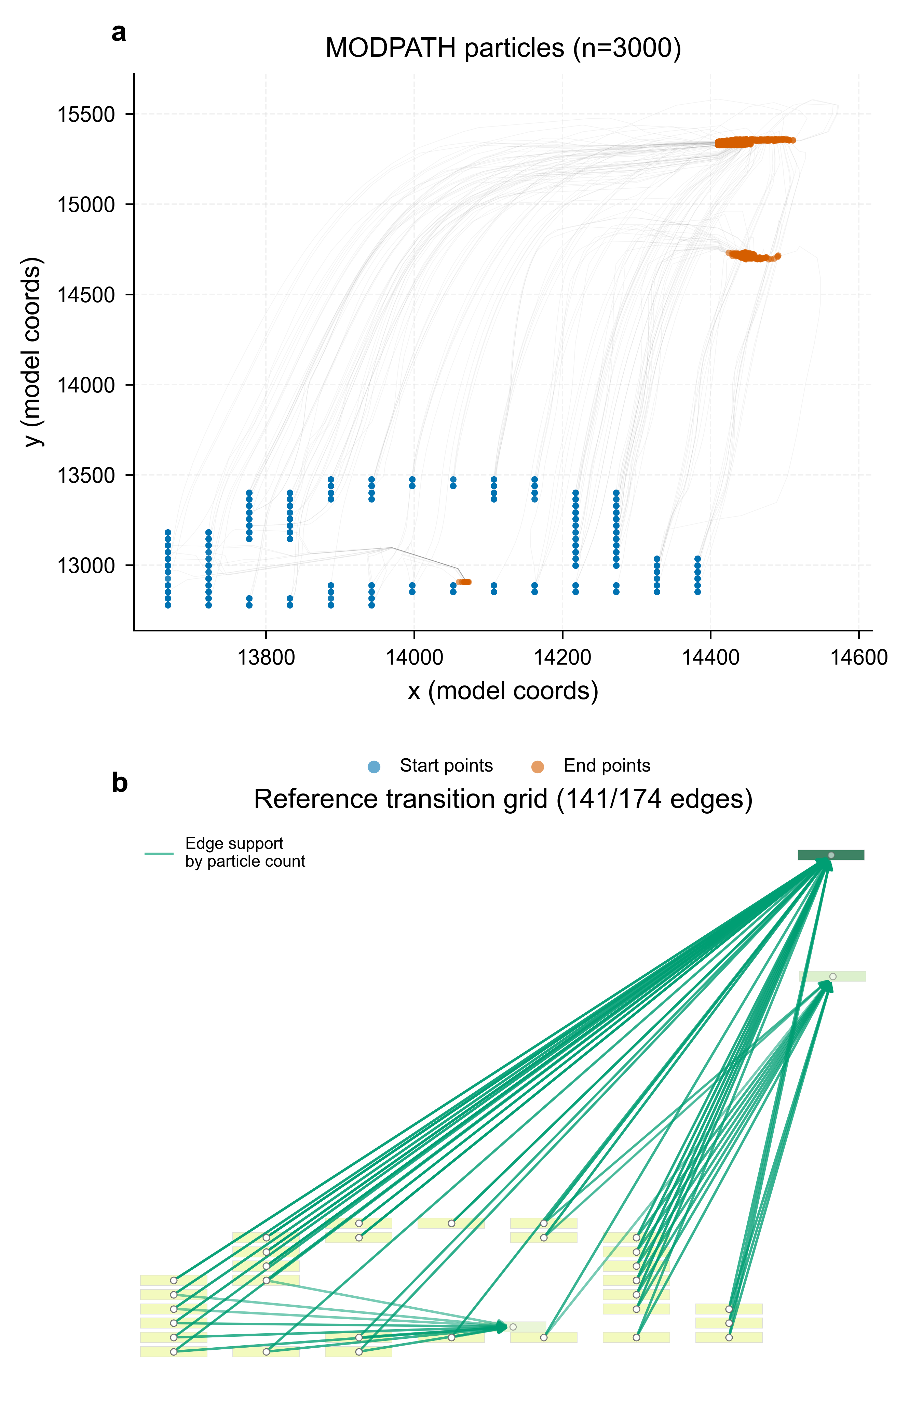
DIRECTED CONNECTIVITY
Topology skill was conditional, not perfect
Head-gradient inference
P 0.49 · R 0.84 · F1 0.62
Independent scenarios
1 perfect · 3 with FP/FN · 2 scale mismatches
Guardrail
Model-conditioned MODPATH topology ≠ field connectivity truth
Results
10
Notes:
Timing: 10:25-12:00
MEMORY ANCHOR: Inference was useful but conditional and imperfect.
SAY THIS:
For topology, MODPATH particle tracks supplied a model-conditioned reference network. The head-gradient inference achieved precision 0.49, recall 0.84 and F1 0.62, while negative controls were close to zero. This shows useful directional information, but false positives remained substantial and performance changed across evidence levels and spatial scales. It is essential to separate this from the perfect archive-conversion result. Conversion asks whether known paths are represented correctly. Inference asks whether an unknown graph can be reconstructed from indirect evidence. The supported conclusion is conditional topology skill against MODPATH-derived reference transitions, not independently measured field connectivity.
TRANSITION:
Topology was not the only non-unique component; the reaction benchmark revealed an even more direct fit-versus-mechanism problem.
DELIVERY CUE: Point to the particle paths, then to the three metrics. End by looking at the examiners, not the slide.
AVOID SAYING: Do not call MODPATH model output field truth or claim full pathline-shape validation.
[Sources]
- C:\Users\ThinkPad P1 G4\Documents\July_2026\NeutroProject\Groundwater\Hydrosheaf\M4\m4_topology_benchmark\docs\02_figures.md
- C:\Users\ThinkPad P1 G4\Documents\July_2026\NeutroProject\Groundwater\Hydrosheaf\M4\m4_topology_benchmark\docs\m4_results_summary.md
[/Sources]

Slide 11
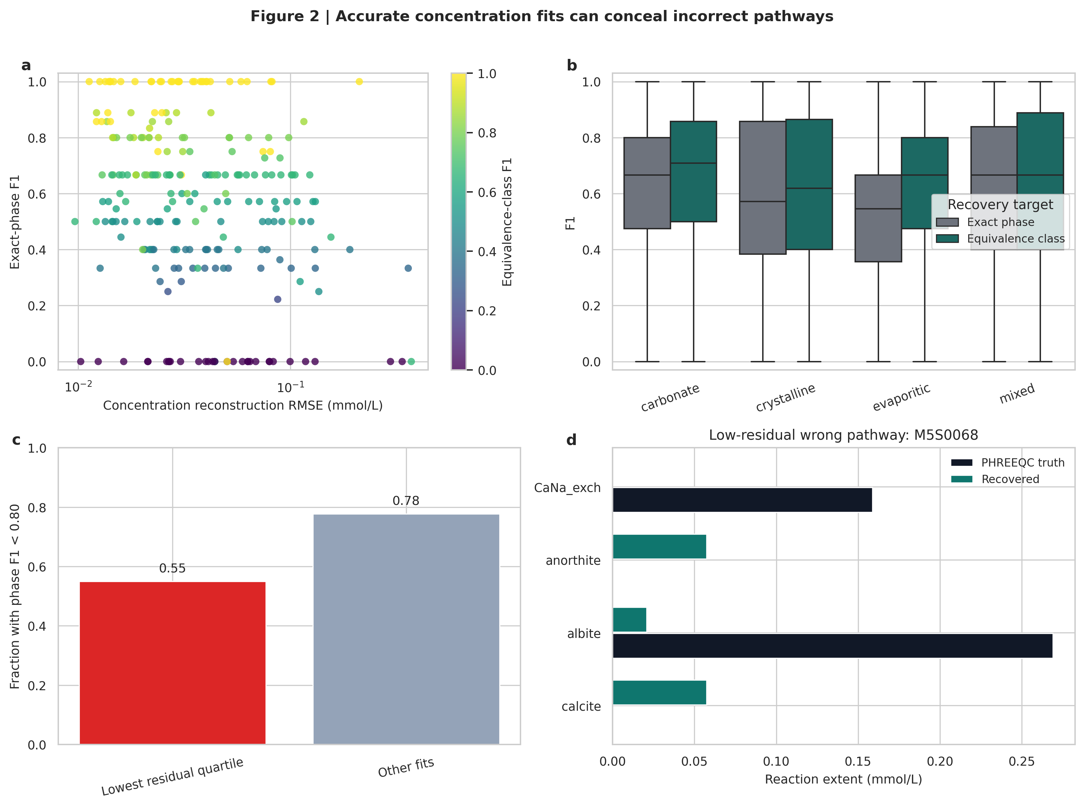
INVERSE HYDROGEOCHEMISTRY
Low residuals did not identify unique reaction mechanisms
185.78
mean feasible PHREEQC models / scenario
6.79
mean minimal models / scenario
Primary guarded result
Phase F1 0.563
Equivalence-class F1 0.609
FDR 0.361
Results
11
Notes:
Timing: 12:00-14:00
MEMORY ANCHOR: A low residual does not identify a unique mechanism.
SAY THIS:
The reaction benchmark used 240 live-PHREEQC scenarios and 21,600 inverse fits. The key result is that concentration fit and mechanism recovery are not the same. Conventional inverse PHREEQC produced, on average, 185.78 feasible models and 6.79 minimal models per scenario. Fifty-five percent of the lowest-residual fits still had phase F1 below 0.80. The guarded HydroSheaf result gave exact-phase F1 of 0.563, equivalence-class F1 of 0.609 and a false-discovery rate of 0.361. These values are not perfect, but they support a more defensible reporting target. Instead of selecting one apparently best mineral pathway, the method reports reaction families or equivalence classes and preserves the alternatives that the chemistry cannot distinguish.
TRANSITION:
That identifiability logic was then transferred to the Ghana field data.
DELIVERY CUE: Pause after 'fit and mechanism recovery are not the same'. Let the multiplicity numbers do the work.
AVOID SAYING: Do not claim exact mineral identification or unique reaction truth in Ghana.
[Sources]
- C:\Users\ThinkPad P1 G4\Documents\July_2026\NeutroProject\Groundwater\Hydrosheaf\M5\m5_inverse_reaction_benchmark\docs\m5_results_summary.md
[/Sources]

Slide 12
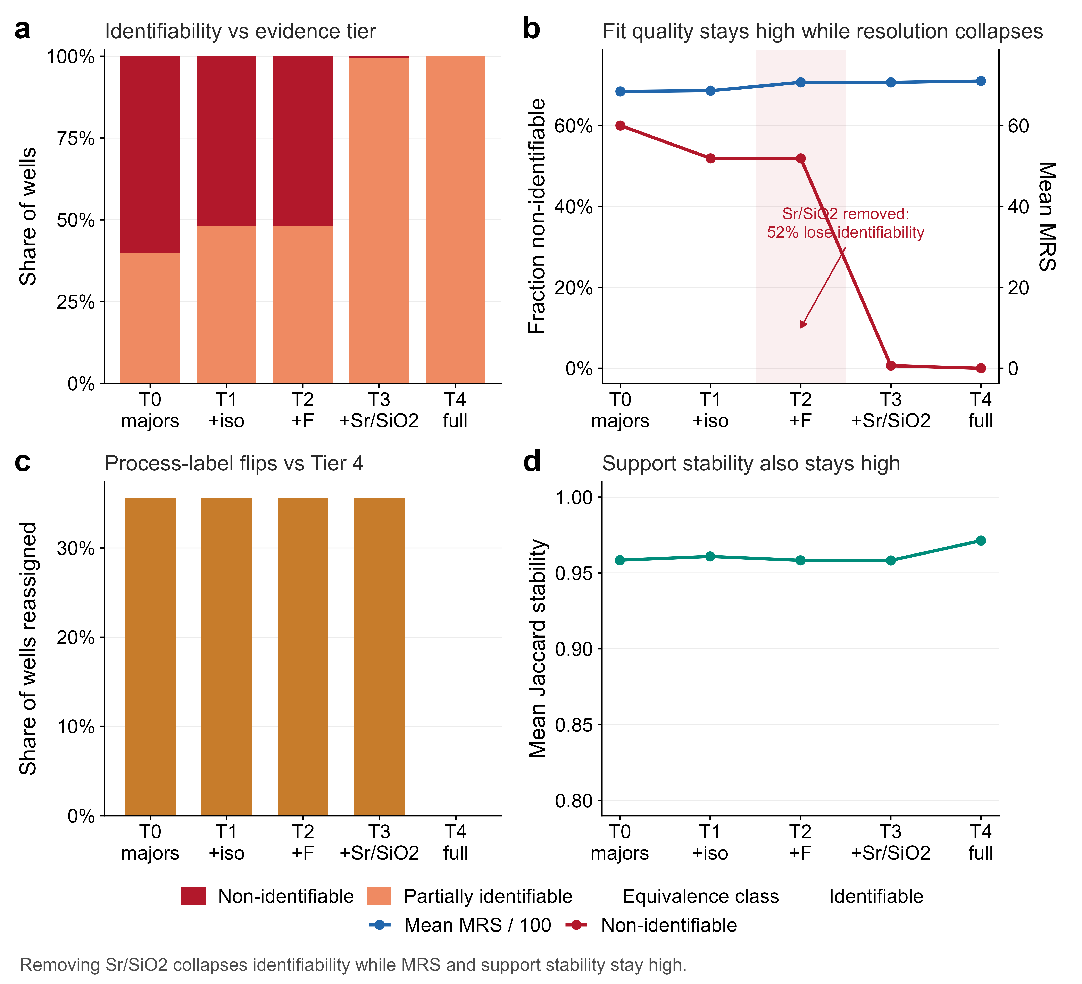
FIELD SUPPORTABILITY
Ghana field transfer identified the evidence ceiling
294 / 320
Northern Ghana quantitative records
52%
wells lose identifiability without Sr/SiO₂
The warning
Mean fit score stayed ≈68–71 while process labels flipped in 35.6% of wells.
Predeclared evidence gate; not observed field truth
Results
12
Notes:
Timing: 14:00-16:00
MEMORY ANCHOR: Fit stayed stable while identifiability collapsed.
SAY THIS:
Northern Ghana provided 320 records, of which 294 met the quantitative quality tier. The field question was not whether exact reactions could be validated, because independent reaction truth was unavailable. The question was which measurements controlled interpretive resolution. Under the predeclared evidence gate, removing strontium and silica moved approximately 52 percent of wells into the non-identifiable category. At the same time, the mean fit score remained around 68 to 71, bootstrap support remained high, and process labels changed in 35.6 percent of wells. A synthetic check supported the direction of this result, but the 52 percent value is an operational classification, not independently observed field truth. The scientific implication is important: a model can continue to fit the available observations while losing the information needed to distinguish processes.
TRANSITION:
The integration benchmark then tested directly whether additional evidence improved the inference or merely increased confidence.
DELIVERY CUE: Emphasise the contrast: 'fit stayed stable' versus 'identifiability collapsed'.
AVOID SAYING: Do not describe the 52 percent as measured geological truth or exact Ghana reaction failure.
[Sources]
- C:\Users\ThinkPad P1 G4\Documents\July_2026\NeutroProject\Groundwater\Hydrosheaf\M6\m6_field_transfer_benchmark\docs\m6_results_summary.md
[/Sources]

Slide 13
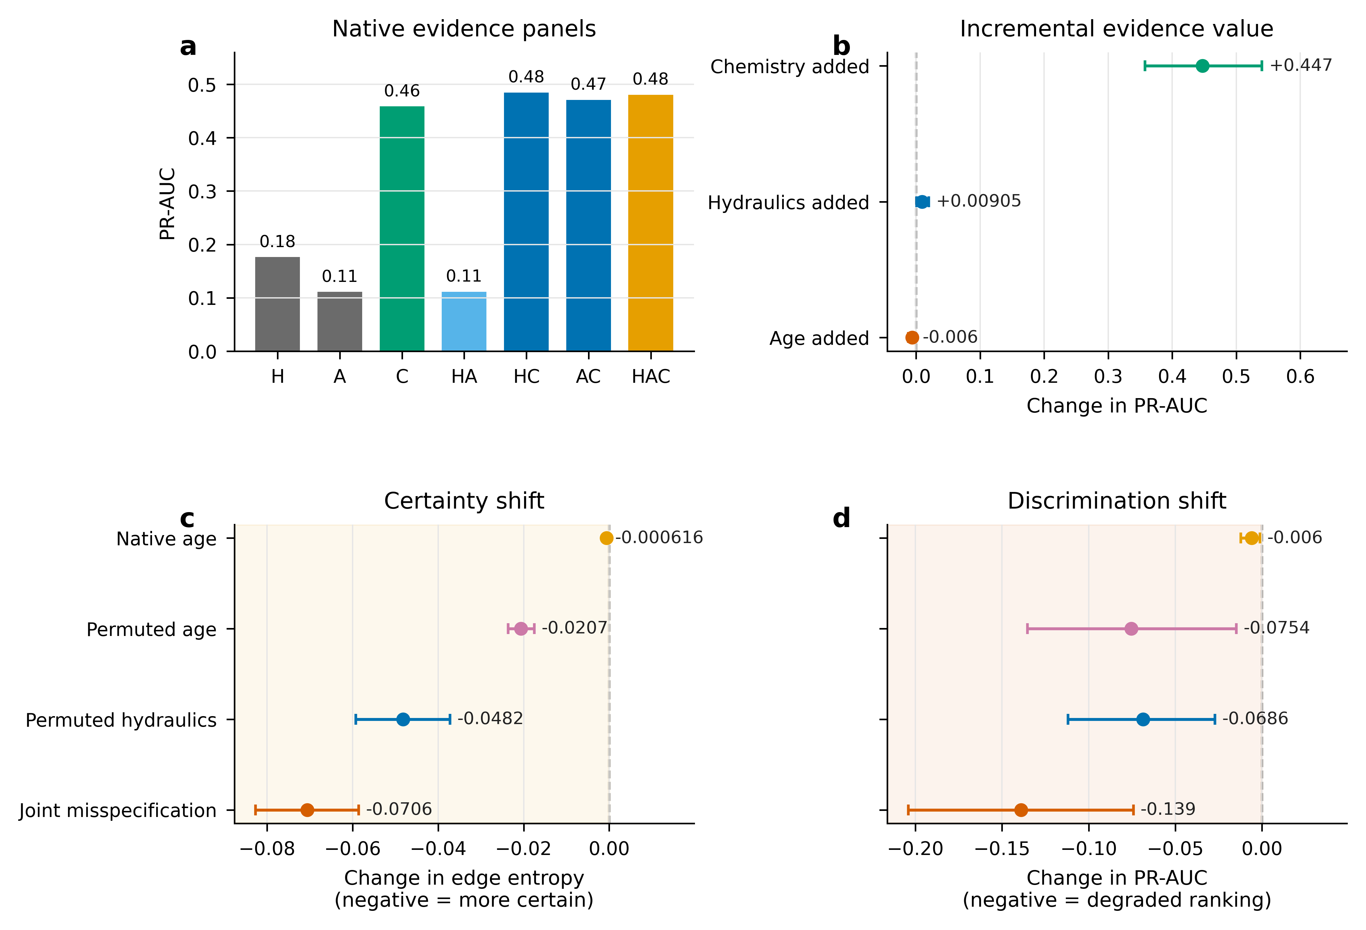
CONDITIONAL INTEGRATION
Only chemistry delivered a robust topology-ranking gain
CHEMISTRY ADDED · SURVIVES CORRECTION
+0.447 PR-AUC
HYDRAULICS ADDED
+0.0091 PR-AUC
not multiplicity-significant (adjusted p = 0.070)
AGE ADDED
−0.0060 PR-AUC
not multiplicity-significant (adjusted p = 0.070)
Added data ≠ added information
Results
13
Notes:
Timing: 16:00-17:50
MEMORY ANCHOR: More data helped only when it supplied independent information.
SAY THIS:
In the independent integration generator, I tested each evidence stream by adding it to the others. Chemistry produced the clear topology-ranking gain: plus 0.447 PR-AUC, and this survived family-wise multiplicity correction. Hydraulics had a smaller point estimate of plus 0.0091. Its ranking contrast was not multiplicity-significant, with adjusted p equal to 0.070, although its Brier-score and log-loss improvements survived. Adding age gave a point estimate of minus 0.0060 and also did not survive multiplicity correction. Therefore the evidence streams were not equally informative. Chemistry carried strong independent ranking information in this generator. Hydraulics contributed mainly through calibration. Age added no positive topology-ranking value beyond hydraulics and chemistry. The broader lesson is that added data are not automatically added information.
TRANSITION:
The information flow also worked in the opposite direction: when topology was correct, it could condition age inference.
DELIVERY CUE: Use the phrase 'after multiplicity correction'. Do not rush the difference between ranking and calibration.
AVOID SAYING: Do not say that all three nominal confidence intervals had the same inferential status.
[Sources]
- C:\Users\ThinkPad P1 G4\Documents\July_2026\NeutroProject\Groundwater\Hydrosheaf\M7\m7_nonuniqueness_benchmark\docs\m7_3_results.md
- C:\Users\ThinkPad P1 G4\Documents\July_2026\NeutroProject\Groundwater\Hydrosheaf\M7\m7_nonuniqueness_benchmark\manuscript\sections\03-results\section.md
[/Sources]

Slide 14
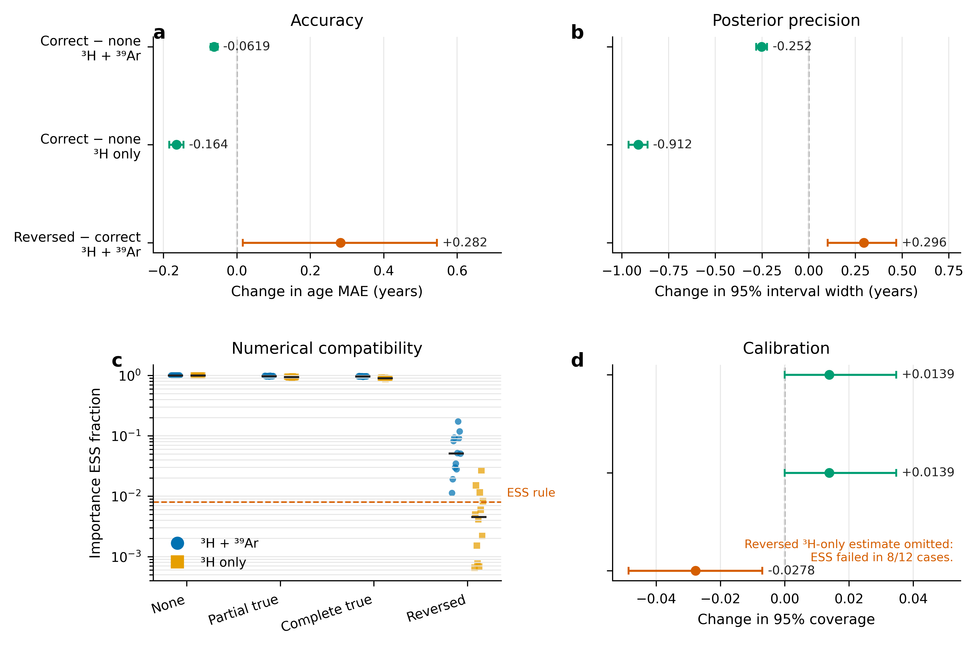
DIRECTION OF INFORMATION
Correct topology reduced age non-uniqueness—especially with weak tracers
−0.0619 y
MAE: correct graph vs no graph, two tracers
−0.1642 y
MAE: correct graph vs no graph, ³H only
Wrong direction
Reversed topology increased error and created negative transfer.
Practical MAE change: 2.24% and 3.46% of baseline
Results
14
Notes:
Timing: 17:50-19:10
MEMORY ANCHOR: Correct topology helped slightly; reversed topology harmed.
SAY THIS:
When correct topology was supplied to the age model, mean absolute error decreased by 0.0619 years with two tracers and by 0.1642 years with tritium alone. The uncertainty intervals also narrowed without a coverage penalty. These changes were statistically precise but practically small: approximately 2.24 and 3.46 percent of the respective baseline errors. The practical planning margins were added after review and were not prespecified. The result should therefore be described as a small conditional improvement, strongest under the weaker tracer panel. Reversing the topology increased error, reduced coverage and caused numerical instability in several tritium-only cases. Correct topology can reduce age non-uniqueness, but an unsupported graph can make age inference worse.
TRANSITION:
I then isolated the central methodological question: what does the sheaf add beyond a competence-matched weighted graph?
DELIVERY CUE: Say 'statistically precise but practically small' clearly. This demonstrates mature interpretation.
AVOID SAYING: Do not present the age improvement as large or transformative.
[Sources]
- C:\Users\ThinkPad P1 G4\Documents\July_2026\NeutroProject\Groundwater\Hydrosheaf\M7\m7_nonuniqueness_benchmark\docs\m7_3_results.md
[/Sources]

Slide 15
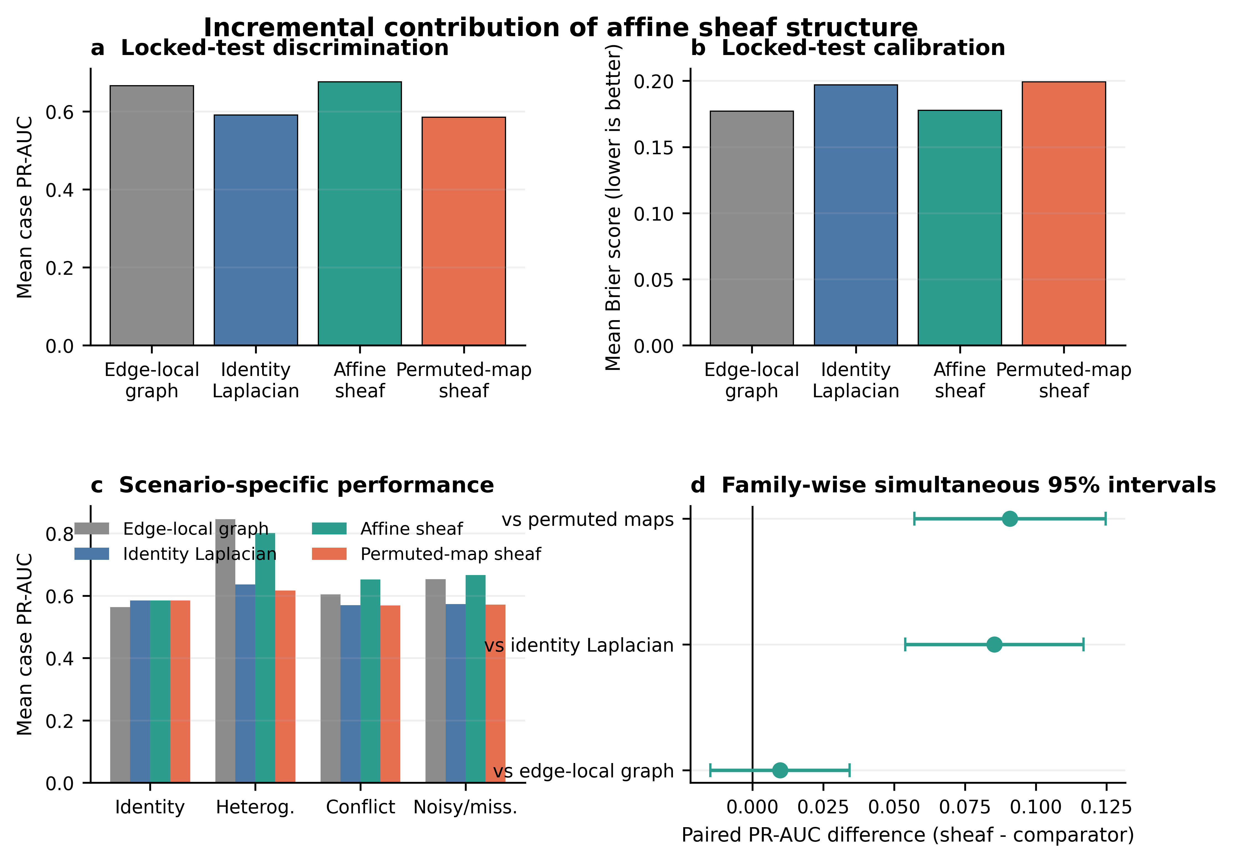
SHEAF VERSUS GRAPH
The sheaf adds representation and conflict localisation—not universal superiority
VS IDENTITY GRAPH
+0.0854 PR-AUC
NATIVE VS PERMUTED MAPS
+0.0909 PR-AUC
VS STRONG EDGE-LOCAL GRAPH
+0.0097 · CI crosses 0
GENERAL SUPERIORITY: NOT ESTABLISHED
Results
15
Notes:
Timing: 19:10-21:30
MEMORY ANCHOR: Map semantics and conflict localisation, not universal superiority.
SAY THIS:
This is the central sheaf-versus-graph result. The affine sheaf improved PR-AUC by 0.0854 relative to an identity graph Laplacian. Native affine maps also beat permuted maps by 0.0909, showing that the learned map semantics mattered. The identity-limit cases matched exactly, so the sheaf properly reduced to the graph baseline when the restrictions were identity maps. However, the stronger edge-local weighted graph was a much more demanding comparator. Against it, the overall PR-AUC difference was only plus 0.0097 and the simultaneous confidence interval crossed zero. The complete superiority gate therefore failed. The supported contribution is narrower but real: edge-specific gain and offset relations, global compatibility testing, and improved localisation of planted cycle conflicts. HydroSheaf did not establish that a sheaf is universally more predictive than a strong weighted graph.
TRANSITION:
I also tested whether a more robust local-plus-global estimator could turn that conditional advantage into general superiority.
DELIVERY CUE: This is a high-stakes slide. State the positive evidence first, then volunteer the failed overall gate before anyone asks.
AVOID SAYING: Do not hide the edge-local comparator or describe the affine sheaf as the overall winner.
[Sources]
- C:\Users\ThinkPad P1 G4\Documents\July_2026\NeutroProject\Groundwater\Hydrosheaf\M7\m7_nonuniqueness_benchmark\docs\m7_sheaf_vs_graph_results.md
- C:\Users\ThinkPad P1 G4\Documents\July_2026\NeutroProject\Groundwater\Hydrosheaf\M7\m7_nonuniqueness_benchmark\M7_SHEAF_VS_GRAPH_CLAIM_DECISION.md
[/Sources]

Slide 16
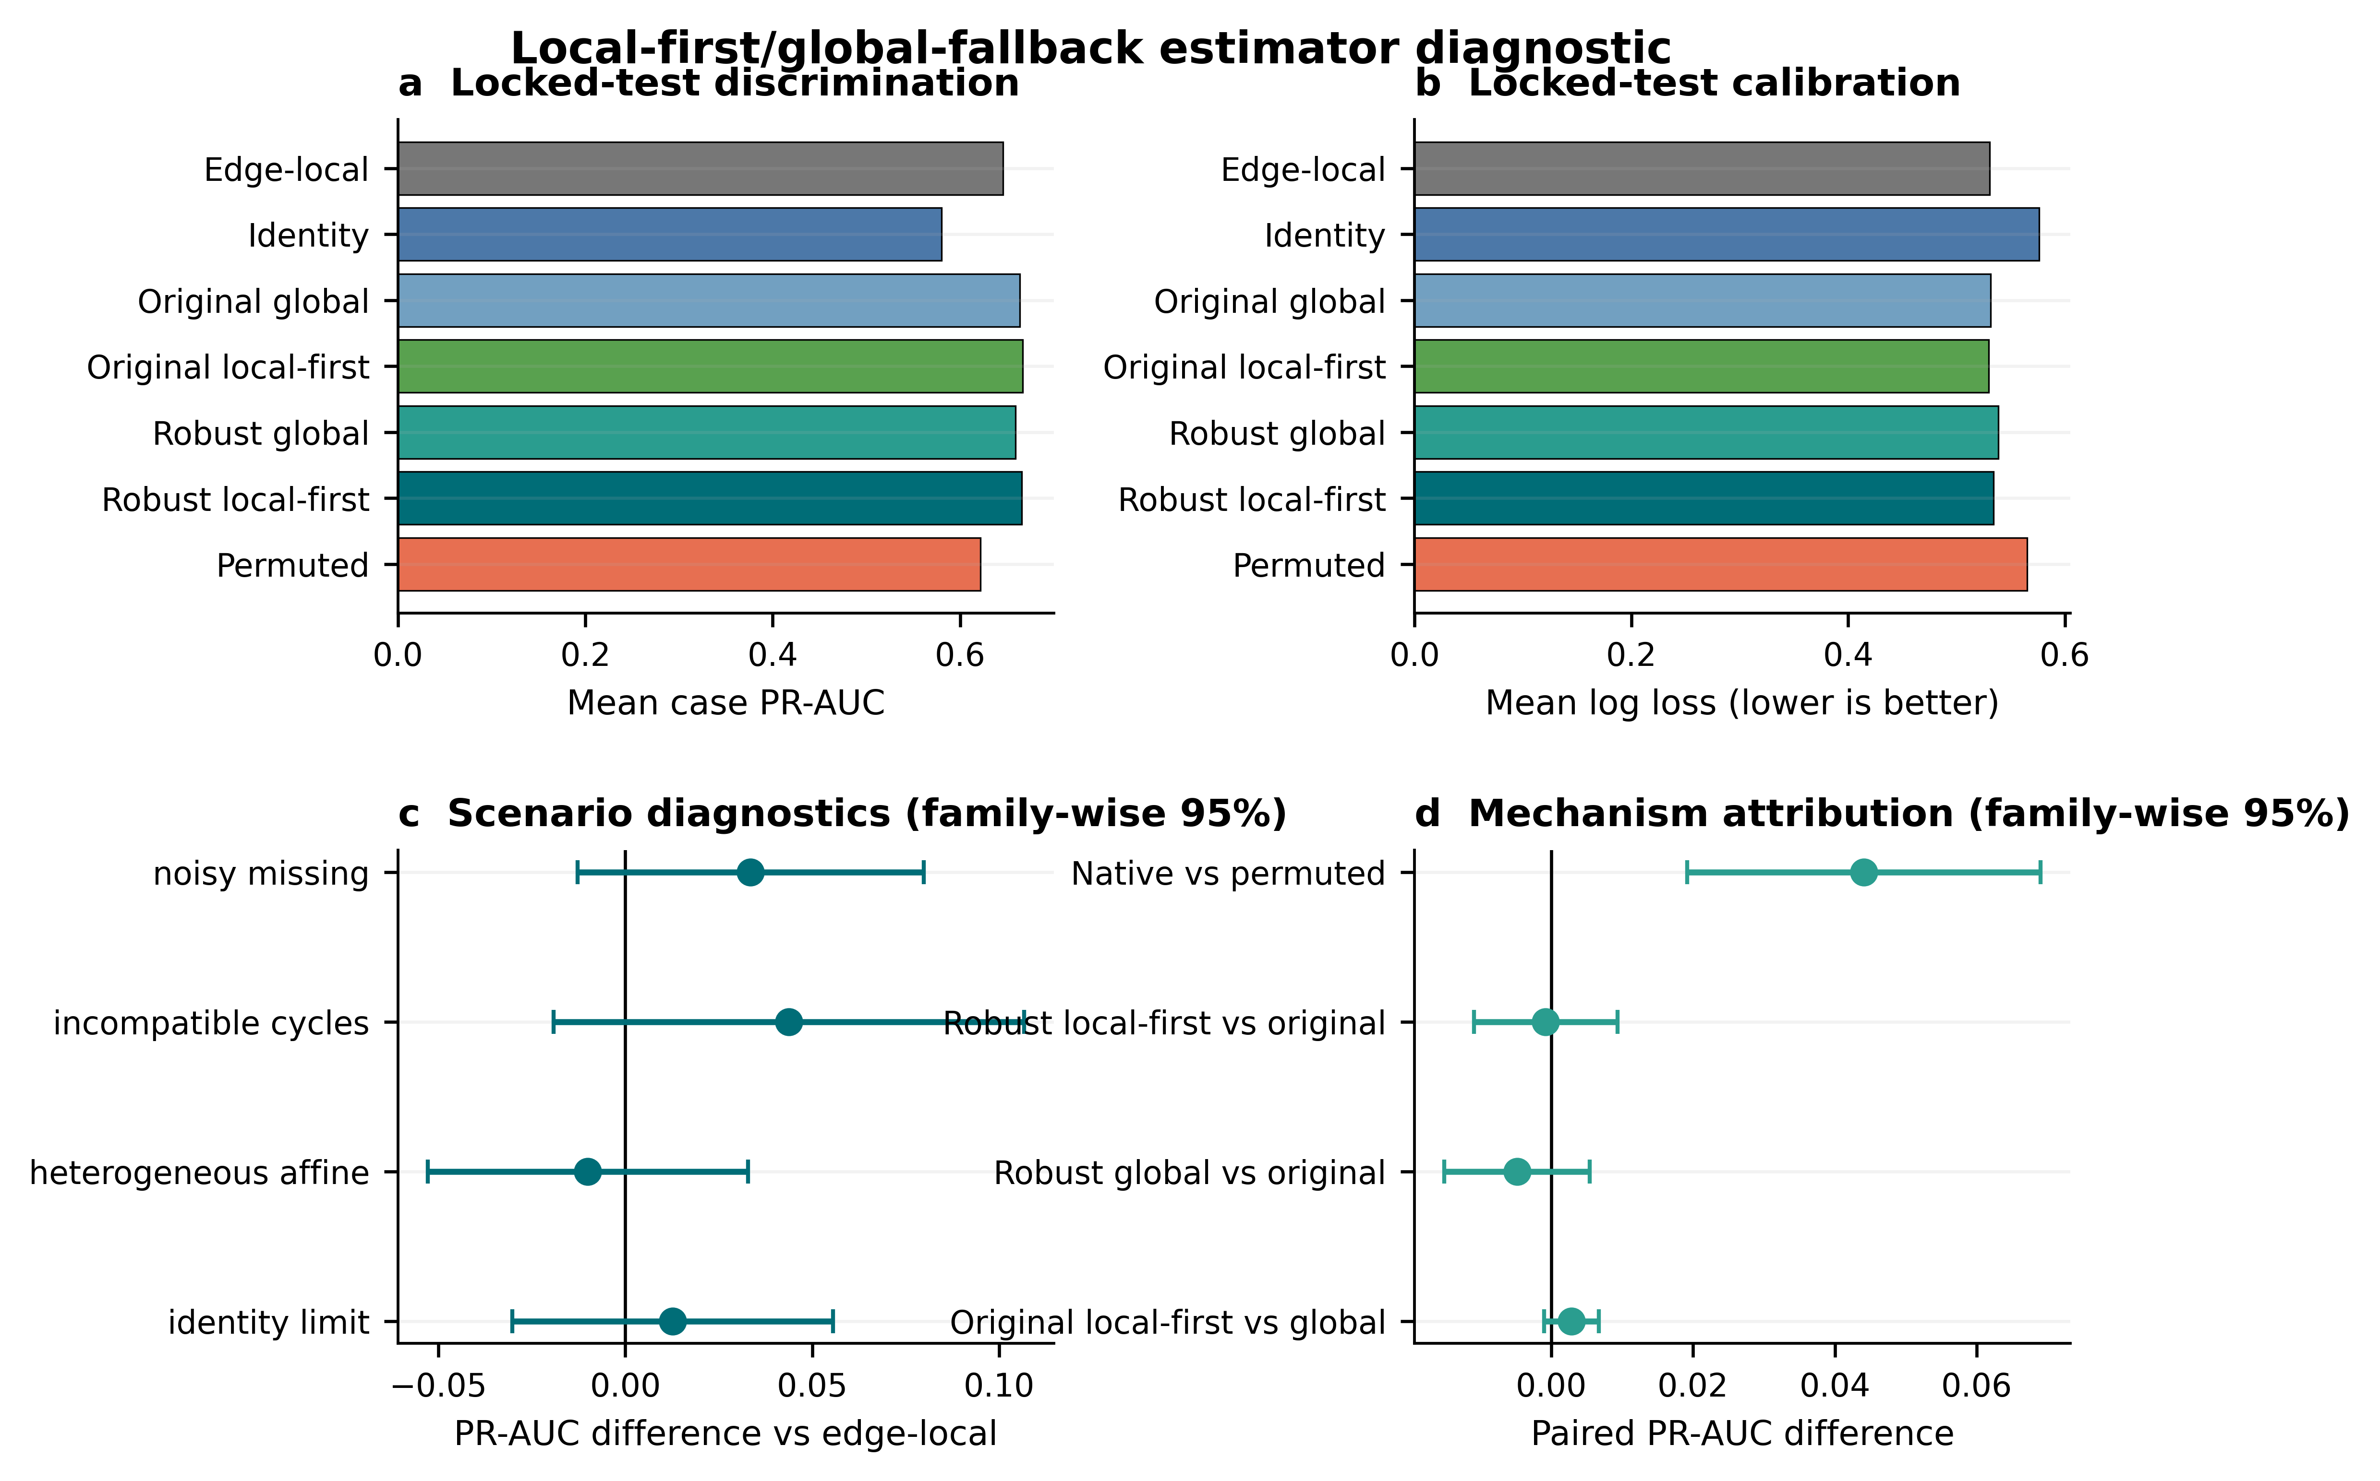
ESTIMATOR DIAGNOSTIC
The local-first estimator did not earn general superiority
LOCKED TEST: 128 CASES
+0.0200 PR-AUC
simultaneous CI [−0.0055, 0.0454]
COMPLETE GATE
Brier: inconclusive
Log loss: inconclusive
CONDITIONAL METHOD · NOT UNIVERSAL WINNER
Results
16
Notes:
Timing: 21:30-22:45
MEMORY ANCHOR: Higher point estimate, corrected interval crosses zero, no general win.
SAY THIS:
Development selected a local-first, global-fallback estimator, and it was evaluated once on 128 fresh locked cases. The PR-AUC point estimate was 0.0200 higher than the edge-local graph, but the family-wise simultaneous interval ranged from minus 0.0055 to plus 0.0454. Brier score and log loss were also inconclusive, so the complete superiority gate failed. The leave-one-edge-out robust global method actually worsened calibration. Native maps still beat permuted maps, and conflict localisation remained useful, but this experiment did not convert the sheaf into a universal winner. I therefore report it as an estimator diagnostic and a direction for future refinement.
TRANSITION:
Taken together, the failures are not side notes; they define the scientific boundary of the thesis.
DELIVERY CUE: Keep the explanation calm. A failed gate strengthens the credibility of the locked workflow.
AVOID SAYING: Do not call this a proven robust-hybrid superiority result. Development selected local weight one.
[Sources]
- C:\Users\ThinkPad P1 G4\Documents\July_2026\NeutroProject\Groundwater\Hydrosheaf\M7\m7_nonuniqueness_benchmark\manuscript\sections\03-results\section.md
- C:\Users\ThinkPad P1 G4\Documents\July_2026\NeutroProject\Groundwater\Hydrosheaf\M7\m7_nonuniqueness_benchmark\M7_ROBUST_HYBRID_CLAIM_DECISION.md
[/Sources]

Slide 17
WHAT DID NOT WORK
The failures define the scientific boundary
Weak graph prior for age
NO ROBUST GAIN
Topology did not contain independent age information
Old-water prior
WITHDRAWN
RMSE 1.310; R² 0.004
Carbonate reaction families
NOT RECOVERED
0/36 scored edges per tested panel
Overall sheaf > edge-local graph
GATE FAILED
Ranking gain did not extend to calibration
Active learning
NOT VALIDATED
0 recommendations from 0 scored edges
Synthesis
17
Notes:
Timing: 22:45-23:35
MEMORY ANCHOR: The method was allowed to fail and the claims were withdrawn.
SAY THIS:
Five negative findings define the boundary. The weak graph prior did not improve age inference. The old-water prior was withdrawn because its performance was poor. Carbonate families were not recovered under either tested indicator panel, although this does not prove that they are non-identifiable under every possible panel. The overall sheaf-versus-edge-local superiority gate failed. Finally, the active-learning implementation produced zero recommendations from zero scored edges, so active-learning excellence is not a thesis result. These are not hidden failures. They show that the workflow can reject unsupported claims.
TRANSITION:
This allows the thesis conclusions to be stated as a clear ledger of what is supported and what is not.
DELIVERY CUE: Use a factual tone. Do not apologise for negative results.
AVOID SAYING: Do not call carbonate universally non-identifiable or active learning validated.
[Sources]
- C:\Users\ThinkPad P1 G4\Documents\July_2026\NeutroProject\Groundwater\Hydrosheaf\M3\m3_age_benchmark\M3_FINAL_ACCURACY_AUDIT.md
- C:\Users\ThinkPad P1 G4\Documents\July_2026\NeutroProject\Groundwater\Hydrosheaf\M7\m7_nonuniqueness_benchmark\docs\m7_3_results.md
- C:\Users\ThinkPad P1 G4\Documents\July_2026\NeutroProject\Groundwater\Hydrosheaf\HYDROSHEAF_REMAINING_CAPABILITIES_DECISION_20260728.md
[/Sources]

Slide 18
CLAIM LEDGER
What the thesis supports—and does not support
SUPPORTED
NOT ESTABLISHED
✓
Close agreement with reported age-model configurations
×
Universal superiority over strong baselines
✓
Conditional topology and evidence value
×
Exact Ghana ages, paths or mineral truth
✓
Reaction equivalence-class reporting
×
End-to-end field validation
✓
Affine-map and conflict-localisation value
×
Validated vector-stalk / 3-D / temporal / vadose claims
✓
Ghana measurement-value diagnosis
×
Excellent active-learning performance
Synthesis
18
Notes:
Timing: 23:35-24:35
MEMORY ANCHOR: Conditional support on the left; prohibited claims on the right.
SAY THIS:
The thesis supports close agreement with reported age-model configurations, conditional topology and evidence value, reaction equivalence-class reporting, affine-map and conflict-localisation value, and a Ghana measurement-value diagnosis. It does not establish universal superiority over strong baselines, exact Ghana ages or paths or mineral truth, end-to-end field validation, validated vector-stalk, three-dimensional, temporal or vadose performance, or excellent active-learning performance. This boundary is central to the contribution. HydroSheaf is valuable because it makes these distinctions explicit and auditable.
TRANSITION:
Within that boundary, the thesis makes four contributions to knowledge.
DELIVERY CUE: Do not read every line. Summarise the left column, then the right column, then state why the boundary matters.
AVOID SAYING: Do not weaken the right-hand limitations with phrases such as 'but probably'.
[Sources]
- C:\Users\ThinkPad P1 G4\Documents\July_2026\NeutroProject\Groundwater\Hydrosheaf\draftbychapter\PhDChapter1_refined.docx
- C:\Users\ThinkPad P1 G4\Documents\July_2026\NeutroProject\Groundwater\Hydrosheaf\M7\m7_nonuniqueness_benchmark\manuscript\revision\FINAL_VERIFICATION_20260730.md
[/Sources]

Slide 19
ANSWER TO THE THESIS
Four contributions to knowledge
01
FORMALISATION
02
DIAGNOSTICS
A groundwater-specific graph/sheaf representation linking age, flow and reactions
Identifiability, calibration and conflict localisation as primary outputs
03
EVIDENCE LOGIC
04
FIELD DESIGN
Locked tests, adverse controls and explicit claim-decision gates
Evidence-ceiling and measurement-value diagnosis for data-limited aquifers
Contribution
19
Notes:
Timing: 24:35-25:35
MEMORY ANCHOR: Representation, diagnostics, evidence logic, field design.
SAY THIS:
The first contribution is a groundwater-specific graph and sheaf formalisation linking age, directed flow and reaction evidence. The second is diagnostic: identifiability, calibration and conflict localisation become primary outputs rather than afterthoughts. The third is an evidence logic based on locked tests, adverse controls and explicit claim-decision gates. The fourth is a field-design contribution: the framework identifies the evidence ceiling and reveals which additional measurements are most likely to improve interpretive resolution. Together, these contributions concern how groundwater interpretations are constructed, tested, limited and improved.
TRANSITION:
I will close by returning to the problem of plausible but incompatible aquifer stories.
DELIVERY CUE: Count the four contributions on your fingers discreetly. Keep the pace steady.
AVOID SAYING: Do not describe software volume or number of modules as the primary scholarly contribution.
[Sources]
- C:\Users\ThinkPad P1 G4\Documents\July_2026\NeutroProject\Groundwater\Hydrosheaf\draftbychapter\PhDChapter1_refined.docx
[/Sources]

Slide 20
THE DEFENSIBLE CONCLUSION
HydroSheaf does not promise one correct aquifer story.
It tests whether cross-domain relations compose globally, quantifies when they add information, and exposes when plausible integration becomes confidently wrong.
NEXT CLAIM-BEARING TEST
Independent replication with a different generator—or matched field data containing age tracers, repeated heads, chemistry and independently measured connectivity.
Thank you
Notes:
Timing: 25:35-27:00
MEMORY ANCHOR: HydroSheaf tests compatibility; the next step is independent matched truth.
SAY THIS:
I began with the problem that separate analyses can produce plausible but incompatible groundwater stories. The thesis shows that HydroSheaf can bring those relations into one auditable framework. It can test whether the relations compose globally, quantify whether an added evidence stream contributes information, localise conflict, and reveal when apparently precise integration is confidently wrong. Its contribution is not universal superiority and it is not a fully validated Ghana aquifer model. The decisive next test is independent replication using a different generator family, or a matched field dataset containing environmental age tracers, repeated hydraulic observations, chemistry and independently measured connectivity. In summary, HydroSheaf provides a defensible way to integrate groundwater evidence while preserving the uncertainty and non-uniqueness that the data cannot resolve. Thank you.
TRANSITION:
Stop. Look at the examiners. Invite questions.
DELIVERY CUE: Slow down for the final three sentences. End cleanly and do not add an improvised apology.
AVOID SAYING: Do not end by saying that more work is needed without first stating the achieved contribution.
[Sources]
- C:\Users\ThinkPad P1 G4\Documents\July_2026\NeutroProject\Groundwater\Hydrosheaf\M7\m7_nonuniqueness_benchmark\manuscript\sections\05-conclusion\section.md
[/Sources]

Slide 21
SHEAF VERSUS GRAPH
Backup · What exactly does the sheaf add?
IDENTITY GRAPH
EDGE-LOCAL GRAPH
AFFINE SHEAF
Scalar similarity
Flexible edge score
Edge-specific Aₑ and bₑ
One shared coordinate system
Strong local comparator
Global compatibility residuals
Baseline limit
No global map consistency
Conflict localisation
Examiner answer: the sheaf adds relation-specific transformations and global conflict localisation; it did not establish general superiority over the strongest edge-local comparator.
Examiner backup
21
Notes:
Timing: Examiner backup - use only if asked
EXAMINER QUESTION: What exactly does the sheaf add?
ANSWER:
It adds edge-specific affine relations and a global compatibility test. In the locked benchmark, native affine maps beat identity and permuted-map controls, and conflict localisation improved in planted-cycle cases. However, it did not outperform the strongest edge-local weighted graph overall, so the contribution is representational and diagnostic rather than universal predictive superiority.
DELIVERY CUE: Answer the question in the first sentence, then give the evidence and limitation.
[Sources]
- C:\Users\ThinkPad P1 G4\Documents\July_2026\NeutroProject\Groundwater\Hydrosheaf\M7\m7_nonuniqueness_benchmark\docs\m7_sheaf_vs_graph_results.md
[/Sources]

Slide 22
AGE BENCHMARK
Backup · Why HydroSheaf did not need to beat TracerLPM
QUESTION ACTUALLY TESTED
QUESTION NOT TESTED
Can HydroSheaf reproduce the reported configuration—and does topology add independent information?
Which model is closer to the unknown true groundwater-age distribution?
Answer: close agreement achieved; incremental graph value not established.
The public reference outputs are emulation targets—not error-free truth.
Examiner backup
22
Notes:
Timing: Examiner backup - use only if asked
EXAMINER QUESTION: Why did HydroSheaf not beat TracerLPM?
ANSWER:
That benchmark tested close reproduction of reported USGS and TracerLPM configurations and whether topology added independent information. Close agreement was achieved on 329 reportable fits, but the available graph proxy did not improve the locked outcomes. HydroSheaf therefore does not replace TracerLPM; it shows when added topology is uninformative or harmful.
DELIVERY CUE: Answer the question in the first sentence, then give the evidence and limitation.
[Sources]
- C:\Users\ThinkPad P1 G4\Documents\July_2026\NeutroProject\Groundwater\Hydrosheaf\M3\m3_age_benchmark\M3_FINAL_ACCURACY_AUDIT.md
[/Sources]

Slide 23
REPRODUCIBILITY
Backup · What a locked test means
1
2
3
4
DEVELOP
→
FREEZE
→
OPEN ONCE
→
DECIDE
Tune on declared development cases
Generator, code, seeds, primary metrics and decision rules
Evaluate untouched locked cases
Apply the frozen gate, including negative outcomes
Locked comparisons were not rerun; practical planning margins were post-review diagnostics.
Examiner backup
23
Notes:
Timing: Examiner backup - use only if asked
EXAMINER QUESTION: What is a locked test?
ANSWER:
Development cases are used to select the method, code, seeds, primary metrics and decision rules. These are frozen before the held-out cases are opened once. Practical planning margins were introduced after review and were diagnostics, not prespecified confirmatory criteria.
DELIVERY CUE: Answer the question in the first sentence, then give the evidence and limitation.
[Sources]
- C:\Users\ThinkPad P1 G4\Documents\July_2026\NeutroProject\Groundwater\Hydrosheaf\M7\m7_nonuniqueness_benchmark\manuscript\revision\FINAL_VERIFICATION_20260730.md
[/Sources]

Slide 24
EVIDENCE MATRIX
Backup · No single field dataset contains all three truths
DATASET
AGE TRACERS
REPEATED HYDRAULICS
CHEMISTRY
CONNECTIVITY TRUTH
Public age archive
✓
direct heads unavailable
not used
—
MODFLOW / MODPATH
modelled
✓
—
model-conditioned
Northern Ghana
—
—
✓
—
Talensi / Lower Anayari
—
—
✓
—
Controlled integration generator
✓
✓
✓
✓ planted
Therefore: controlled known-truth integration + field supportability, not end-to-end field validation.
Examiner backup
24
Notes:
Timing: Examiner backup - use only if asked
EXAMINER QUESTION: How can the thesis be valid without one complete field dataset?
ANSWER:
It cannot claim end-to-end field validation. The thesis triangulates component reference checks, controlled known-truth integration and claim-limited field transfer. These establish capability and supportability, while the missing matched field dataset remains the decisive next validation.
DELIVERY CUE: Answer the question in the first sentence, then give the evidence and limitation.
[Sources]
- C:\Users\ThinkPad P1 G4\Documents\July_2026\NeutroProject\Groundwater\Hydrosheaf\draftbychapter\PhDChapter1_refined.docx
- C:\Users\ThinkPad P1 G4\Documents\July_2026\NeutroProject\Groundwater\Hydrosheaf\M7\m7_nonuniqueness_benchmark\docs\m7_3_results.md
[/Sources]

Slide 25
ADVERSE CONTROLS
Backup · Reduced uncertainty can mean confident error
PERMUTED AGE
PERMUTED HYDRAULICS
JOINT MISSPECIFICATION
MORE CERTAIN
MORE CERTAIN
MORE CERTAIN
Entropy −0.0207
Entropy −0.0482
Entropy −0.0706
BUT WORSE
BUT WORSE
BUT WORSE
PR-AUC −0.0754
Log loss +0.0745
PR-AUC −0.139
Calibration and discrimination must accompany entropy or interval width.
Examiner backup
25
Notes:
Timing: Examiner backup - use only if asked
EXAMINER QUESTION: Can lower uncertainty still be wrong?
ANSWER:
Yes. Permuted evidence reduced entropy while worsening ranking and calibration. This is why HydroSheaf evaluates discrimination and calibration alongside interval width or entropy. Greater confidence is not validation unless the predictions also become better.
DELIVERY CUE: Answer the question in the first sentence, then give the evidence and limitation.
[Sources]
- C:\Users\ThinkPad P1 G4\Documents\July_2026\NeutroProject\Groundwater\Hydrosheaf\M7\m7_nonuniqueness_benchmark\docs\m7_3_results.md
[/Sources]

Slide 26
CAPABILITY STATUS
Backup · Active learning is implemented, not yet validated
CURRENT STATUS
WHAT WOULD EARN STATUS
0 recommendations
from 0 scored edges
1 Jacobian-aware value of information
2 explicit costs and decision loss
3 prospective locked comparison
4 independent replication
NOT A CLAIM-BEARING RESULT
Do not call the current method ‘excellent active learning’ in the viva.
Examiner backup
26
Notes:
Timing: Examiner backup - use only if asked
EXAMINER QUESTION: Is the active-learning method excellent?
ANSWER:
No claim-bearing evidence supports that conclusion. The current report contains zero recommendations from zero scored edges, and the transport-time interface lacks the required candidate-time Jacobians. Active learning remains an implemented capability that needs a prospective cost-aware locked benchmark.
DELIVERY CUE: Answer the question in the first sentence, then give the evidence and limitation.
[Sources]
- C:\Users\ThinkPad P1 G4\Documents\July_2026\NeutroProject\Groundwater\Hydrosheaf\M4\m4_topology_benchmark\results\active_learning_report.md
- C:\Users\ThinkPad P1 G4\Documents\July_2026\NeutroProject\Groundwater\Hydrosheaf\HYDROSHEAF_REMAINING_CAPABILITIES_DECISION_20260728.md
[/Sources]

Slide 27
AUDITABILITY
Backup · Reproducibility status
PASS
Locked-case separation
PASS
Frozen hashes and artifact regeneration gates
PASS
10,000-resample post-review audit
PASS
14 focused tests
PENDING
Versioned public release and persistent identifiers
PENDING
CRediT, funding and conflict-of-interest declarations
Examiner backup
27
Notes:
Timing: Examiner backup - use only if asked
EXAMINER QUESTION: Is the work fully reproducible?
ANSWER:
Milestone-level provenance, locked-case separation and focused verification are available. The remaining release actions are a clean-checkout reproduction, a repository-wide green test state, a versioned public release and persistent identifiers. I therefore describe the work as locally auditable, not yet fully archived for independent reproduction.
DELIVERY CUE: Answer the question in the first sentence, then give the evidence and limitation.
[Sources]
- C:\Users\ThinkPad P1 G4\Documents\July_2026\NeutroProject\Groundwater\Hydrosheaf\M7\m7_nonuniqueness_benchmark\manuscript\revision\FINAL_VERIFICATION_20260730.md
[/Sources]

Slide 28
RAPID RESPONSES
Backup · Five one-sentence viva answers
Why is this a PhD?
It contributes a falsifiable integration formalism, evidence logic and field supportability diagnosis—not merely software.
Did it beat TracerLPM?
It closely reproduced reported configurations; graph value was not established and harmful topology was detectable.
What does the sheaf add?
Edge-specific transformations and global conflict localisation, conditionally—not universal superiority.
Is Ghana validated?
No end-to-end truth; the field result identifies evidence ceilings and priority measurements.
What is the decisive next test?
Independent replication under another generator or matched field connectivity truth.
Examiner backup
28
Notes:
Timing: Examiner backup - use only if asked
EXAMINER QUESTION: Why is this sufficient for a PhD?
ANSWER:
The thesis contributes a formal integration framework, controlled evidence about when cross-domain information helps or harms, explicit falsification and claim-decision procedures, and a field evidence-ceiling diagnosis. The contribution is strengthened, not weakened, by the locked negative results because the method was allowed to reject its own hypotheses.
DELIVERY CUE: Answer the question in the first sentence, then give the evidence and limitation.
[Sources]
- C:\Users\ThinkPad P1 G4\Documents\July_2026\NeutroProject\Groundwater\Hydrosheaf\draftbychapter\PhDChapter1_refined.docx
- C:\Users\ThinkPad P1 G4\Documents\July_2026\NeutroProject\Groundwater\Hydrosheaf\M7\m7_nonuniqueness_benchmark\manuscript\revision\FINAL_VERIFICATION_20260730.md
[/Sources]

