Slide 1
UNIVERSITY OF GHANA · SCHOOL OF NUCLEAR AND ALLIED SCIENCES
40-MINUTE DEFENCE
HydroSheaf
Graph-constrained environmental and nuclear tracer modelling with inverse hydrogeochemistry for diagnosing groundwater residence time and evolution in data-limited semi-arid aquifers: development and application of HydroSheaf
PhD viva defence · Dickson Abdul-Wahab · 11004418
August 2026
One-sentence thesis
Integration is scientifically useful only when it exposes—not hides—non-uniqueness.
Notes:
Timing: 0:00-0:30
MEMORY ANCHOR: Integrate the evidence without hiding uncertainty.
SAY THIS:
Good morning, and thank you for the opportunity to present my doctoral research. This thesis develops, benchmarks and applies HydroSheaf, an uncertainty-aware framework for integrating groundwater-age evidence, directed connectivity and hydrogeochemical reactions. The central scientific position is that integration is useful only when it exposes non-uniqueness rather than hiding it. I will organise the presentation into the introduction, methodology, results and discussion for each objective, and finally the conclusions and recommendations.
TRANSITION:
I will begin with the groundwater setting that makes this integration necessary.
DELIVERY CUE: Stand still, look at the panel and speak slowly. Pause after the central scientific position.
AVOID SAYING: Do not begin with software modules, milestone labels or a claim of universal superiority.
[Sources]
- C:\Users\ThinkPad P1 G4\Documents\July_2026\NeutroProject\Groundwater\Hydrosheaf\draftbychapter\PhDChapter1_refined.docx
[/Sources]

Slide 2
BACKGROUND
Background: groundwater decisions rely on incomplete evidence
WHY IT MATTERS
WHAT WE OBSERVE
WHAT WE MUST INFER
Water supply, irrigation and water-quality decisions depend on how groundwater moves, mixes and reacts.
Environmental and nuclear tracers, hydraulic observations and hydrochemistry provide partial views.
Residence-time distributions, directed flow paths and reaction histories are not observed directly.
In data-limited semi-arid aquifers, the scientific challenge is not simply fitting each dataset—it is deciding which combined interpretation remains defensible.
Introduction
02
Notes:
Timing: 0:30-1:40
MEMORY ANCHOR: Important decisions depend on quantities that are inferred indirectly.
SAY THIS:
Groundwater supplies drinking water, irrigation and economic activity, particularly in semi-arid regions where monitoring is limited. Yet the quantities needed for management are rarely observed directly. We need to know how long water has been underground, which locations are connected along flow paths, and which reactions control water quality. Environmental and nuclear tracers provide information about residence time. Hydraulic observations constrain flow direction and connectivity. Hydrochemistry records mixing and reaction. Each evidence stream is valuable, but each provides only a partial view. The scientific challenge is therefore not simply to fit each dataset. It is to determine which combined groundwater interpretation remains defensible when observations are sparse, heterogeneous and uncertain.
TRANSITION:
That background leads to the specific problem addressed by the thesis.
DELIVERY CUE: Use the sequence: management need, partial observations, hidden quantities, integration challenge.
AVOID SAYING: Do not imply that every study area contains all three evidence streams.
[Sources]
- C:\Users\ThinkPad P1 G4\Documents\July_2026\NeutroProject\Groundwater\Hydrosheaf\draftbychapter\PhDChapter1_refined.docx
- C:\Users\ThinkPad P1 G4\Documents\July_2026\NeutroProject\Groundwater\Hydrosheaf\M1\M1_draftv2\Manuscript- Water and Ecology.docx
[/Sources]

Slide 3
WHY THE WORK WAS NECESSARY
Problem statement: plausible results can still conflict
COUPLED SYSTEM
CONSEQUENCE
Age, connectivity and reactions describe the same aquifer
Several individually plausible—but mutually incompatible—aquifer stories
SPARSE EVIDENCE
Each inverse problem admits several plausible answers
SEPARATE WORKFLOWS
Confidence may increase while accuracy falls.
Upstream uncertainty is often passed forward as fixed truth
WHAT WAS NEEDED
A framework that couples uncertain evidence, tests global compatibility, measures incremental information and reports non-identifiability.
Problem
03
Notes:
Timing: 1:40-3:10
MEMORY ANCHOR: Coupled system, sparse evidence, separate workflows, conflicting stories.
SAY THIS:
The problem is that groundwater residence time, flow-path connectivity and chemical evolution describe the same physical aquifer, but they are commonly analysed as separate inverse problems. In data-limited aquifers, each problem is already non-unique. Several age distributions may fit the same tracer signal. Several directed networks may fit sparse hydraulic evidence. Several reaction pathways may reproduce the same chemistry. When the analyses are performed separately, uncertainty from one stage is often passed forward as fixed truth in the next. The result can be several individually plausible but mutually incompatible aquifer stories. Even worse, combining evidence can make uncertainty appear smaller while the interpretation becomes less accurate. What was needed was a framework that couples uncertain evidence, tests global compatibility, measures incremental information and reports when the problem remains non-identifiable.
TRANSITION:
The source of that problem becomes clearer when the three unknowns are considered together.
DELIVERY CUE: Use four verbal signposts: coupled system, sparse evidence, separate workflows, conflicting stories.
AVOID SAYING: Do not say conventional methods are wrong; say their separate use leaves cross-domain consistency untested.
[Sources]
- C:\Users\ThinkPad P1 G4\Documents\July_2026\NeutroProject\Groundwater\Hydrosheaf\M5\m5_inverse_reaction_benchmark\docs\m5_results_summary.md
- C:\Users\ThinkPad P1 G4\Documents\July_2026\NeutroProject\Groundwater\Hydrosheaf\M7\m7_nonuniqueness_benchmark\docs\m7_3_results.md
[/Sources]

Slide 4
SCIENTIFIC GAP
The unknowns are coupled—but usually inferred separately
AGE
TOPOLOGY
CHEMISTRY
↔
↔
Tracer history and mixing
Directed flow paths
Reaction families and extents
HydroSheaf asks whether locally plausible relations compose into a globally compatible groundwater interpretation.
Problem
04
Notes:
Timing: 3:10-4:10
MEMORY ANCHOR: Age, topology and chemistry constrain one another.
SAY THIS:
Age, topology and chemistry cannot be interpreted independently. Tracer evidence constrains plausible travel times and mixing. Topology determines which samples can reasonably be compared along a directed flow path. Chemistry constrains which reactions are plausible between connected locations. A sequential workflow often estimates one domain first and then treats that estimate as known. HydroSheaf instead treats the relations themselves as uncertain. It asks whether locally plausible tracer, hydraulic and chemical relations can be assembled into a globally compatible interpretation. If they cannot, the conflict should remain visible rather than being averaged away. This local-to-global question is the conceptual thread connecting all six objectives.
TRANSITION:
With that scientific gap established, I can state the overall aim.
DELIVERY CUE: Point once from age to topology to chemistry, then return your hands to a neutral position.
AVOID SAYING: Do not imply that the Ghana dataset itself contains all three evidence domains.
[Sources]
- C:\Users\ThinkPad P1 G4\Documents\July_2026\NeutroProject\Groundwater\Hydrosheaf\draftbychapter\PhDChapter1_refined.docx
[/Sources]

Slide 5
AIM
Aim of the study
Develop, benchmark and apply HydroSheaf, an uncertainty-aware framework that integrates environmental and nuclear tracers, directed groundwater topology and inverse hydrogeochemistry to diagnose groundwater residence time and evolution in data-limited semi-arid aquifers.
One aim · six distinct objectives · one falsifiable integration question
Introduction
05
Notes:
Timing: 4:10-5:10
MEMORY ANCHOR: Develop, benchmark and apply an uncertainty-aware integration framework.
SAY THIS:
The aim of this study is to develop, benchmark and apply HydroSheaf, an uncertainty-aware framework that integrates environmental and nuclear tracers, directed groundwater topology and inverse hydrogeochemistry to diagnose groundwater residence time and evolution in data-limited semi-arid aquifers. Three verbs matter here. Develop means constructing the formal and executable framework. Benchmark means testing the components and the integration claims against evidence that can genuinely challenge them. Apply means transferring the diagnostic logic to Ghanaian aquifer datasets while respecting their evidential limits. The aim is therefore methodological, evaluative and applied.
TRANSITION:
I separated that broad aim into six objectives with distinct scientific roles.
DELIVERY CUE: Read the aim deliberately. Emphasise develop, benchmark and apply.
AVOID SAYING: Do not shorten the aim in a way that removes uncertainty, topology or inverse hydrogeochemistry.
[Sources]
- C:\Users\ThinkPad P1 G4\Documents\July_2026\NeutroProject\Groundwater\Hydrosheaf\draftbychapter\PhDChapter1_refined.docx
[/Sources]

Slide 6
OBJECTIVES
Specific objectives 1–3: establish, build and benchmark
01
REVIEW
To critically review the methods for groundwater residence time estimation, connectivity and hydrogeochemical evolution in data-limited aquifers.
02
DEVELOP
To develop a computational framework (HydroSheaf) to integrate tracer, groundwater-connectivity and inverse hydrogeochemical modelling.
03
BENCHMARK COMPONENTS
To benchmark the residence-time, connectivity and reaction-inference components of the framework.
Introduction
06
Notes:
Timing: 5:10-6:25
MEMORY ANCHOR: Review, develop, then benchmark the components.
SAY THIS:
The first three objectives establish the foundation. Objective one critically reviews environmental- and nuclear-tracer residence-time methods, groundwater-connectivity approaches and inverse hydrogeochemical modelling in data-limited aquifers. Objective two develops HydroSheaf to integrate tracer-based residence-time inference, directed groundwater topology and sparse inverse hydrogeochemical modelling. Objective three benchmarks the residence-time, topology and reaction-inference components against public, reference and controlled synthetic datasets. The sequence is intentional. The review defines the unresolved problem. Development translates that problem into a formal workflow. Component benchmarking then tests whether the individual parts are operational before any claim is made about the value of integration.
TRANSITION:
The remaining objectives challenge the framework, test integration directly and examine field transfer.
DELIVERY CUE: Count the objectives visibly but do not read them as one long sentence.
AVOID SAYING: Do not merge development and benchmarking into one objective; their evidence requirements differ.
[Sources]
- C:\Users\ThinkPad P1 G4\Documents\July_2026\NeutroProject\Groundwater\Hydrosheaf\draftbychapter\PhDChapter1_refined.docx
- C:\Users\ThinkPad P1 G4\Documents\July_2026\NeutroProject\Groundwater\Hydrosheaf\draftbychapter\Chapter_Two_Literature_Review_Refined.docx
[/Sources]

Slide 7
OBJECTIVES
Specific objectives 4–6: challenge, integrate and apply
04
TEST ROBUSTNESS
To assess the uncertainty and robustness of the framework under different assumptions and data limitations.
05
EVALUATE INTEGRATION
To determine when integrating hydraulic, tracer and chemical evidence improve, adds no value to, or weakens groundwater inference.
06
APPLY TO GHANA
To apply the framework to Ghanaian aquifers and determine which interpretations are supported by the available data.
Review → develop → benchmark components → test robustness → evaluate integration → apply to Ghana
Introduction
07
Notes:
Timing: 6:25-7:45
MEMORY ANCHOR: Test robustness, evaluate integration and apply to Ghana.
SAY THIS:
Objective four assesses robustness and identifiability under alternative model assumptions, conflicting evidence, measurement uncertainty and missing data. Objective five determines when integrating hydraulic, tracer and chemical evidence improves inference, is redundant or causes negative transfer using independent benchmarks and adverse controls. Objective six applies HydroSheaf to Ghanaian aquifer datasets to evaluate transferability and identify which interpretations are supportable or non-identifiable under data scarcity. Objective five is the central integration test because it does not assume that more data must help. It requires added evidence to demonstrate independent information. Together, the six roles are review, develop, benchmark components, test robustness, evaluate integration and apply to Ghana.
TRANSITION:
These objectives also clarify what is genuinely novel about the thesis.
DELIVERY CUE: Slow down for Objective five and state that integration is tested, not assumed.
AVOID SAYING: Do not describe robustness testing as another component benchmark or Ghana transfer as end-to-end validation.
[Sources]
- C:\Users\ThinkPad P1 G4\Documents\July_2026\NeutroProject\Groundwater\Hydrosheaf\draftbychapter\PhDChapter1_refined.docx
[/Sources]

Slide 8
WHAT IS NEW
The novelty is the coupling and the validation logic
Inherited foundations
Thesis contributions
Tracer dating and lumped-parameter models
Groundwater-specific executable coupling
Directed weighted graphs
Uncertainty and identifiability as outputs
Sheaf-theoretic compatibility
Adverse controls for false confidence
PHREEQC inverse modelling
Locked claim-decision protocols
MODFLOW / MODPATH reference transport
Field evidence-ceiling diagnostics
Contribution
08
Notes:
Timing: 7:45-8:55
MEMORY ANCHOR: The novelty is coupling plus falsification, not inventing the ingredients.
SAY THIS:
The individual scientific ingredients are established. This thesis does not claim to invent tracer dating, directed graphs, sheaf theory, PHREEQC, MODFLOW or MODPATH. The novelty is the way those foundations are made operational together for groundwater inference. HydroSheaf provides a groundwater-specific executable coupling, treats uncertainty and identifiability as outputs, uses adverse controls to detect false confidence, and applies locked claim-decision rules. Its significance is that integration becomes falsifiable. The framework can show that evidence is informative, redundant or harmful. It can also diagnose which field interpretations cannot be supported. That changes integration from an assumption into a scientific question.
TRANSITION:
I will now explain the methodology used to test that question.
DELIVERY CUE: State the inherited foundations first, then the exact thesis contribution.
AVOID SAYING: Never say that you invented sheaf theory or that HydroSheaf is the first groundwater graph model.
[Sources]
- C:\Users\ThinkPad P1 G4\Documents\July_2026\NeutroProject\Groundwater\Hydrosheaf\draftbychapter\PhDChapter1_refined.docx
[/Sources]

Slide 9
RESEARCH DESIGN
Methodology: a staged, adversarial evaluation design
1
REVIEW
2
FORMALISE
3
BENCHMARK
Define the scientific gap and claim boundaries
Represent age, topology and chemistry as uncertain relations
Test each component against public or controlled references
4
STRESS TEST
5
INTEGRATE
6
TRANSFER
Perturb assumptions, remove evidence and introduce conflicts
Measure incremental value, redundancy and negative transfer
Apply evidence-ceiling diagnostics to Ghana datasets
Primary principle: every claim is matched to the strongest evidence that can actually test it.
Methodology
09
Notes:
Timing: 8:55-10:15
MEMORY ANCHOR: Each objective has its own evidence and failure test.
SAY THIS:
The methodology is a staged and adversarial evaluation design. The review first defines the gap and the boundaries of defensible claims. Formalisation represents the three evidence domains as uncertain relations. Component benchmarks test residence time, topology and reaction inference separately. Robustness experiments then perturb assumptions, remove measurements and introduce conflicting evidence. Integration experiments measure incremental value, redundancy and negative transfer. Finally, field transfer applies evidence-ceiling diagnostics to Ghanaian datasets. This sequence prevents a common error: using one successful experiment to support every claim about the framework. Each claim is matched to the strongest evidence that can actually test it.
TRANSITION:
The central mathematical distinction is between scoring an edge and transforming evidence across it.
DELIVERY CUE: Present the six stages as scientific decisions, not software packages.
AVOID SAYING: Do not present synthetic benchmarks and field transfer as interchangeable forms of validation.
[Sources]
- C:\Users\ThinkPad P1 G4\Documents\July_2026\NeutroProject\Groundwater\Hydrosheaf\draftbychapter\Chapter_Three_Methodology.docx
- C:\Users\ThinkPad P1 G4\Documents\July_2026\NeutroProject\Groundwater\Hydrosheaf\M7\m7_nonuniqueness_benchmark\manuscript\revision\FINAL_VERIFICATION_20260730.md
[/Sources]

Slide 10
MECHANISM
A sheaf represents how evidence changes across an edge
Weighted graph
Affine sheaf
Scalar-affine benchmark evidence
NODE A
—— w ——
NODE B
xᵤ
xᵥ ≈ αₑxᵤ + bₑ
xᵥ
Edge-specific gain and offset; global inconsistency localises conflict.
One scalar edge weight says how strongly nodes are related.
Multivariate vector-stalk performance remains unvalidated.
Method
10
Notes:
Timing: 10:15-11:35
MEMORY ANCHOR: A weight scores a relation; an affine map transforms it and tests compatibility.
SAY THIS:
An ordinary weighted graph describes which nodes are connected and assigns a scalar strength to each edge. That is useful, but it does not specify how a state measured at one node should be translated into the state expected at another node. In the tested scalar-affine representation, each edge has a gain and offset. Different edges can therefore express different relations. HydroSheaf then asks whether these locally plausible transformations compose into a global section. Inconsistent cycles produce residuals that can localise conflict. The tested contribution is scalar affine representation and conflict localisation. The software can represent broader multivariate stalks, but multivariate vector-stalk performance was not validated in this thesis.
TRANSITION:
Because representation alone does not validate performance, claims were placed on an explicit evidence ladder.
DELIVERY CUE: Explain the equation once, then immediately state the scientific meaning and limitation.
AVOID SAYING: Do not claim that full age-chemistry-head vectors were validated.
[Sources]
- C:\Users\ThinkPad P1 G4\Documents\July_2026\NeutroProject\Groundwater\Hydrosheaf\hydrosheaf\sheaf\directed_section.py
- C:\Users\ThinkPad P1 G4\Documents\July_2026\NeutroProject\Groundwater\Hydrosheaf\M7\m7_nonuniqueness_benchmark\docs\m7_sheaf_vs_graph_results.md
[/Sources]

Slide 11
LOCKED EVALUATION
Claims were matched to an evidence ladder
1
Unit and conversion verification
Does the implementation reproduce its declared input?
2
Reference emulation
Does it agree with an established public workflow?
3
Controlled known-truth benchmarks
Can it recover planted topology, age and reactions?
4
Field transfer and supportability
What do real data permit without known truth?
5
Matched end-to-end field truth
Still missing: age + repeated heads + chemistry + connectivity
Validation
11
Notes:
Timing: 11:35-12:55
MEMORY ANCHOR: Different evidence levels support different claims.
SAY THIS:
The validation architecture has five levels. Unit and conversion checks establish that declared inputs are represented correctly. Reference emulation asks whether HydroSheaf can closely reproduce an established public workflow. Controlled known-truth benchmarks test recovery when the answer is planted externally. Field transfer asks what real observations can support when truth is unavailable. The missing highest level is a matched field dataset containing age tracers, repeated hydraulic observations, chemistry and independently measured connectivity. I also used locked tests. Development cases selected methods and decision rules. Held-out cases were opened once for confirmatory evaluation. This protects negative results from being tuned away, although the protocol was Git-locked rather than externally preregistered.
TRANSITION:
I will now present the results and discussion objective by objective.
DELIVERY CUE: Move down the evidence ladder slowly and pause at the missing highest level.
AVOID SAYING: Do not call reference emulation independent truth or call the locked protocol externally preregistered.
[Sources]
- C:\Users\ThinkPad P1 G4\Documents\July_2026\NeutroProject\Groundwater\Hydrosheaf\M7\m7_nonuniqueness_benchmark\manuscript\revision\FINAL_VERIFICATION_20260730.md
- C:\Users\ThinkPad P1 G4\Documents\July_2026\NeutroProject\Groundwater\Hydrosheaf\draftbychapter\PhDChapter1_refined.docx
[/Sources]

Slide 12
OBJECTIVE 1 · REVIEW
Objective 1: the review identified an integration-and-validation gap
FRAGMENTED INFERENCE
NON-UNIQUENESS
Age, connectivity and reaction models were commonly assessed in separate workflows.
Several parameterisations or mechanisms could explain the same sparse observations.
FIT ≠ TRUTH
INTEGRATION ASSUMED
Agreement with observations did not necessarily identify the correct process or pathway.
Additional evidence was often treated as automatically beneficial rather than tested.
Discussion: the missing contribution was not another isolated model, but a falsifiable way to test whether uncertain relations remain globally compatible.
Results & discussion
12
Notes:
Timing: 12:55-14:10
MEMORY ANCHOR: The missing link was falsifiable integration.
SAY THIS:
Objective one identified four recurring limitations. First, residence-time, connectivity and reaction models were commonly interpreted in separate workflows. Second, non-uniqueness was often treated as a nuisance rather than a primary result. Third, good observational fit was sometimes allowed to stand in for correct process identification. Fourth, additional evidence was frequently assumed to improve inference without an explicit incremental-value test. The literature therefore supplied mature component methods but not a complete solution to cross-domain compatibility. The discussion arising from the review is that the missing contribution was not simply another isolated model. It was a falsifiable way to test whether uncertain local relations remain mutually compatible when combined.
TRANSITION:
Objective two converted that conceptual requirement into an executable framework.
DELIVERY CUE: Use the four findings as signposts, then state the gap in one sentence.
AVOID SAYING: Do not claim that earlier tracer, graph or geochemical methods had no uncertainty analysis.
[Sources]
- C:\Users\ThinkPad P1 G4\Documents\July_2026\NeutroProject\Groundwater\Hydrosheaf\M1\M1_draftv2\Manuscript- Water and Ecology.docx
- C:\Users\ThinkPad P1 G4\Documents\July_2026\NeutroProject\Groundwater\Hydrosheaf\draftbychapter\Chapter_Two_Literature_Review_Refined.docx
[/Sources]

Slide 13
OBJECTIVE 2 · DEVELOP
Objective 2: HydroSheaf made the coupling executable and auditable
DOMAIN INFERENCE
RELATIONAL LAYER
DIAGNOSTICS
EVALUATION
Tracer residence time
Directed topology
Inverse reactions
Directed edges
Affine restriction maps
Global sections
Uncertainty
Identifiability
Conflict localisation
Locked tests
Adverse controls
Claim decisions
→
→
→
Development result: one framework can carry relations and uncertainty across domains. Capability alone does not establish predictive superiority.
Results & discussion
13
Notes:
Timing: 14:10-15:25
MEMORY ANCHOR: HydroSheaf carries relations, uncertainty and diagnostics across domains.
SAY THIS:
Objective two produced the HydroSheaf workflow. Domain-specific modules infer tracer residence time, directed topology and reaction alternatives. Their outputs are expressed as uncertain node states and directed edge relations. The sheaf layer represents edge-specific transformations and tests whether local relations compose globally. Diagnostic outputs include uncertainty, identifiability, calibration and conflict localisation. The evaluation layer then applies locked tests, adverse controls and explicit claim decisions. The development objective is therefore achieved at the level of an executable and auditable framework. However, capability is not the same as scientific performance. The framework's existence does not prove that every component is accurate or that integration is superior. Those questions belong to the remaining objectives.
TRANSITION:
Objective three therefore tested the components before testing the integration claim.
DELIVERY CUE: Describe the architecture from left to right and end with the capability-versus-validation distinction.
AVOID SAYING: Do not use code volume or number of modules as evidence of scientific contribution.
[Sources]
- C:\Users\ThinkPad P1 G4\Documents\July_2026\NeutroProject\Groundwater\Hydrosheaf\hydrosheaf\inference\network_fit.py
- C:\Users\ThinkPad P1 G4\Documents\July_2026\NeutroProject\Groundwater\Hydrosheaf\hydrosheaf\sheaf\directed_section.py
- C:\Users\ThinkPad P1 G4\Documents\July_2026\NeutroProject\Groundwater\Hydrosheaf\hydrosheaf\calibration\validation_workflow.py
[/Sources]

Slide 14
OBJECTIVE 3 · BENCHMARK COMPONENTS
Objective 3: controlled foundations worked before novelty was tested
100
0.058
0.112
controlled transport–reaction realisations
median transport absolute error
median reaction error
What this establishes
What this does not establish
• controlled recovery is operational
• MODPATH archives can be converted into reference graphs
• PHREEQC-compatible proxy executed; live PHREEQC validated later
F1 = 1.00 for archive conversion is verification of conversion—not perfect inference of an unknown topology.
Results & discussion
14
Notes:
Timing: 15:25-16:20
MEMORY ANCHOR: Verify basic recovery before testing novelty.
SAY THIS:
The controlled foundation used one hundred transport-reaction realisations. Median transport absolute error was 0.058 and median reaction error was 0.112. This established that the basic architecture could recover planted behaviour and convert MODPATH archives into reference graphs. A crucial distinction is that an F1 of one for the 174-edge archive conversion verifies conversion of known paths. It does not show perfect inference of an unknown topology. The early chemistry experiment used a PHREEQC-compatible deterministic proxy, while the later reaction benchmark supplied the live-PHREEQC evidence. These checks support operational capability, not universal validity.
TRANSITION:
The residence-time benchmark then compared HydroSheaf with reported public configurations.
DELIVERY CUE: Keep this slide brief and give more emphasis to the red guardrail than the three numbers.
AVOID SAYING: Do not describe perfect archive conversion as perfect topology inference.
[Sources]
- C:\Users\ThinkPad P1 G4\Documents\July_2026\NeutroProject\Groundwater\Hydrosheaf\M2\m2_benchmark\docs\m2_results_summary.md
- C:\Users\ThinkPad P1 G4\Documents\July_2026\NeutroProject\Groundwater\Hydrosheaf\M5\m5_inverse_reaction_benchmark\docs\m5_results_summary.md
[/Sources]

Slide 15
RESIDENCE-TIME BENCHMARK
Objective 3: age inference closely reproduced reported configurations
329
0.0279
0.937
87.5%
strict reportable fits
median |Δ log₁₀ age|
R² against reported configuration
within factor two
Topology stress test
Weak hydraulic proxy
−0.00135 RMSE
factor-two agreement worsened
NO ROBUST GAIN
Wrong direction
+0.1008 RMSE
clear negative transfer
HARMFUL
Random graph
+0.6550 RMSE
severe negative transfer
HARMFUL
Results & discussion
15
Notes:
Timing: 16:20-18:10
MEMORY ANCHOR: Close reference agreement; no robust gain from the available graph proxy.
SAY THIS:
The public age archive contained 1,272 harmonised rows, of which 329 passed the strict reportability guard. Against the reported USGS and TracerLPM configurations, HydroSheaf achieved a median absolute log-ten age discrepancy of 0.0279, an R-squared of 0.937 and 87.5 percent agreement within a factor of two. This is close reference agreement, not formal equivalence and not independently observed age truth. The important integration stress test was whether topology added value. The weak hydraulic proxy changed RMSE by only minus 0.00135 and worsened factor-two agreement, so it failed the improvement rule. Wrong-direction and random graphs worsened RMSE substantially. HydroSheaf therefore reproduced the reported outputs closely and detected harmful topology, but it did not beat TracerLPM or establish useful graph information in that dataset.
TRANSITION:
The next component question was whether directed connectivity itself could be inferred.
DELIVERY CUE: Say close reference agreement twice. Slow down when distinguishing emulation from truth.
AVOID SAYING: Do not say reference-equivalent, parity proven or true field age.
[Sources]
- C:\Users\ThinkPad P1 G4\Documents\July_2026\NeutroProject\Groundwater\Hydrosheaf\M3\m3_age_benchmark\M3_FINAL_ACCURACY_AUDIT.md
[/Sources]

Slide 16
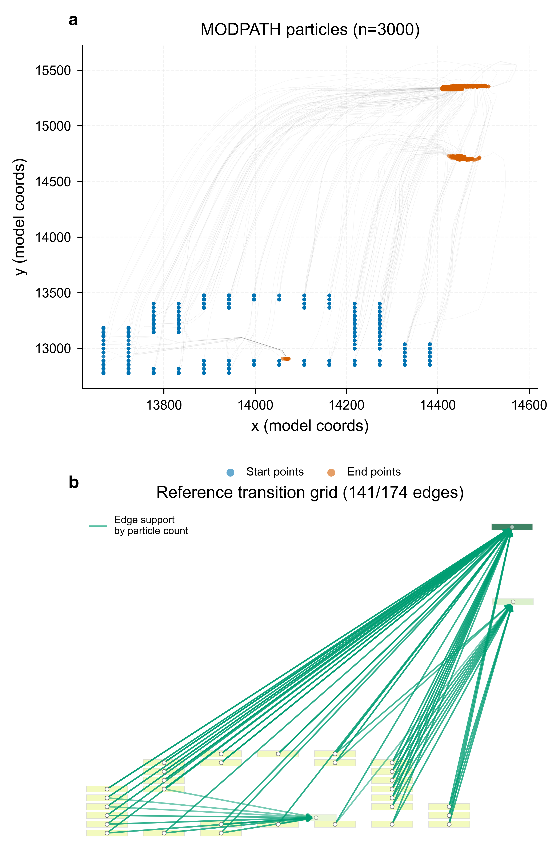
DIRECTED-CONNECTIVITY BENCHMARK
Objective 3: topology skill was conditional, not perfect
Head-gradient inference
P 0.49 · R 0.84 · F1 0.62
Independent scenarios
1 perfect · 3 with FP/FN · 2 scale mismatches
Guardrail
Model-conditioned MODPATH topology ≠ field connectivity truth
Results & discussion
16
Notes:
Timing: 18:10-19:45
MEMORY ANCHOR: Topology inference was useful but conditional and imperfect.
SAY THIS:
For topology, MODPATH particle tracks supplied a model-conditioned reference network. Head-gradient inference achieved precision 0.49, recall 0.84 and F1 0.62, while negative controls were near zero. The relatively high recall shows that much of the directed structure was detected, but precision shows that false positives remained substantial. Independent scenarios also varied across evidence levels and spatial scales. It is essential to separate reference construction from unknown-graph inference. Conversion asks whether known particle paths are represented correctly. Inference asks whether an unknown graph can be reconstructed from indirect observations. The supported conclusion is conditional topology skill against MODPATH-derived reference transitions, not independently measured field connectivity.
TRANSITION:
The reaction benchmark exposed an even clearer distinction between fit and mechanism.
DELIVERY CUE: Point to the particle paths, then the metrics, and finish by looking at the examiners.
AVOID SAYING: Do not call MODPATH output field truth or claim full pathline-shape validation.
[Sources]
- C:\Users\ThinkPad P1 G4\Documents\July_2026\NeutroProject\Groundwater\Hydrosheaf\M4\m4_topology_benchmark\docs\02_figures.md
- C:\Users\ThinkPad P1 G4\Documents\July_2026\NeutroProject\Groundwater\Hydrosheaf\M4\m4_topology_benchmark\docs\m4_results_summary.md
[/Sources]

Slide 17
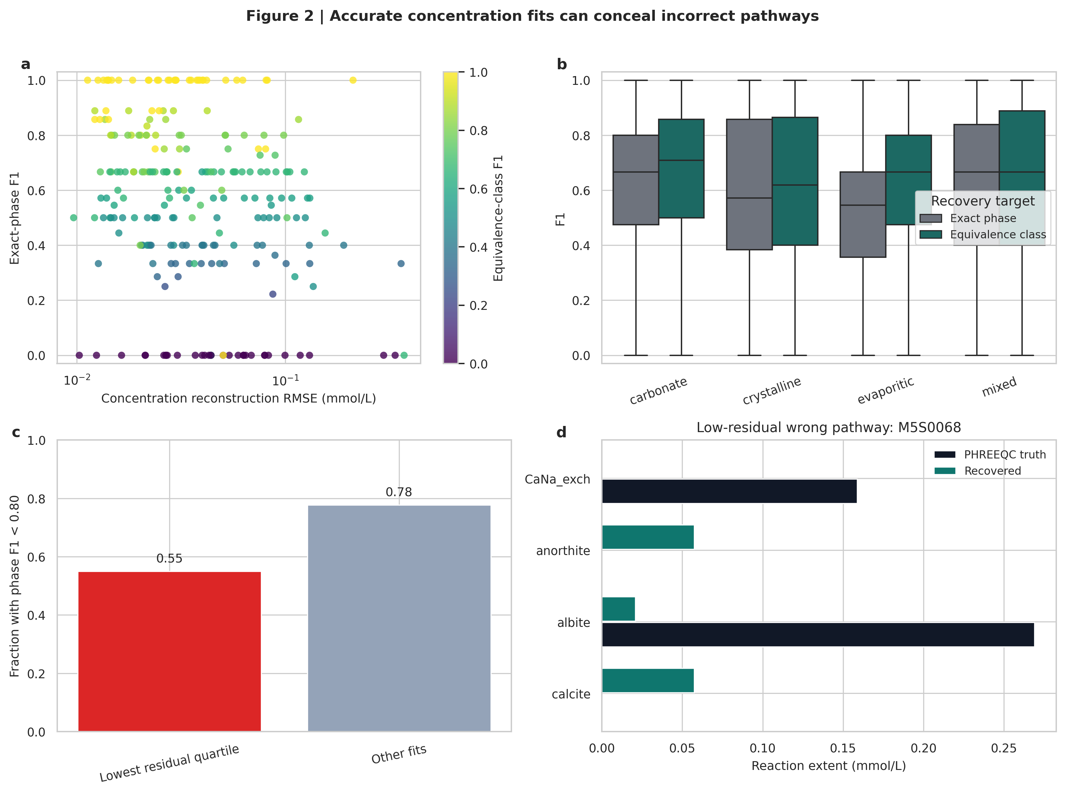
REACTION-INFERENCE BENCHMARK
Objective 3: low residuals did not identify unique reaction mechanisms
185.78
mean feasible PHREEQC models / scenario
6.79
mean minimal models / scenario
Primary guarded result
Phase F1 0.563
Equivalence-class F1 0.609
FDR 0.361
Results & discussion
17
Notes:
Timing: 19:45-21:45
MEMORY ANCHOR: A low residual does not identify a unique reaction mechanism.
SAY THIS:
The reaction benchmark used 240 live-PHREEQC scenarios and 21,600 inverse fits. The key finding is that concentration fit and mechanism recovery are not the same. Conventional inverse PHREEQC produced, on average, 185.78 feasible models and 6.79 minimal models per scenario. Fifty-five percent of the lowest-residual fits still had phase F1 below 0.80. The guarded HydroSheaf result gave exact-phase F1 of 0.563, equivalence-class F1 of 0.609 and a false-discovery rate of 0.361. These values are not perfect, but they support a more defensible reporting target. Instead of selecting one apparently best mineral pathway, the method reports reaction families or equivalence classes and preserves alternatives that the chemistry cannot distinguish.
TRANSITION:
Objective four then asked whether attractive results survived adverse assumptions, conflicts and missing data.
DELIVERY CUE: Pause after saying that fit and mechanism recovery are not the same.
AVOID SAYING: Do not claim exact mineral identification or unique reaction truth in Ghana.
[Sources]
- C:\Users\ThinkPad P1 G4\Documents\July_2026\NeutroProject\Groundwater\Hydrosheaf\M5\m5_inverse_reaction_benchmark\docs\m5_results_summary.md
[/Sources]

Slide 18
OBJECTIVE 4 · ROBUSTNESS AND IDENTIFIABILITY
Objective 4: robustness depended on evidence quality
ALTERNATIVE ASSUMPTIONS
Old-water prior withdrawn; estimator choice changed calibration.
CONFLICTING EVIDENCE
Wrong, random and permuted relations produced measurable negative transfer.
MEASUREMENT UNCERTAINTY
Intervals and resampling quantified uncertainty but did not guarantee correctness.
MISSING DATA
Removing key chemical tracers collapsed identifiability while fit remained stable.
Discussion: narrower uncertainty is valuable only when discrimination and calibration also improve.
Results & discussion
18
Notes:
Timing: 21:45-23:05
MEMORY ANCHOR: Robustness depends on evidence quality, not fit alone.
SAY THIS:
Objective four challenged the outputs in four ways. Alternative assumptions included weak priors and different estimator choices. Conflicting evidence included wrong, random and permuted relations. Measurement uncertainty was evaluated using intervals, resampling and calibration metrics. Missing-data experiments removed evidence that might control interpretive resolution. Across these tests, the recurring lesson was that good fit or narrower uncertainty did not guarantee a better scientific interpretation. A model could remain numerically stable while becoming non-identifiable, poorly calibrated or confidently wrong. Robustness must therefore be judged jointly through discrimination, calibration, adverse controls and identifiability, rather than through residuals or interval width alone.
TRANSITION:
Objective five tested that principle directly by measuring the incremental value of each evidence stream.
DELIVERY CUE: Use the four stress-test categories and then state the shared lesson.
AVOID SAYING: Do not equate a narrow interval with validated certainty.
[Sources]
- C:\Users\ThinkPad P1 G4\Documents\July_2026\NeutroProject\Groundwater\Hydrosheaf\M6\m6_field_transfer_benchmark\docs\m6_results_summary.md
- C:\Users\ThinkPad P1 G4\Documents\July_2026\NeutroProject\Groundwater\Hydrosheaf\M7\m7_nonuniqueness_benchmark\docs\m7_3_results.md
[/Sources]

Slide 19
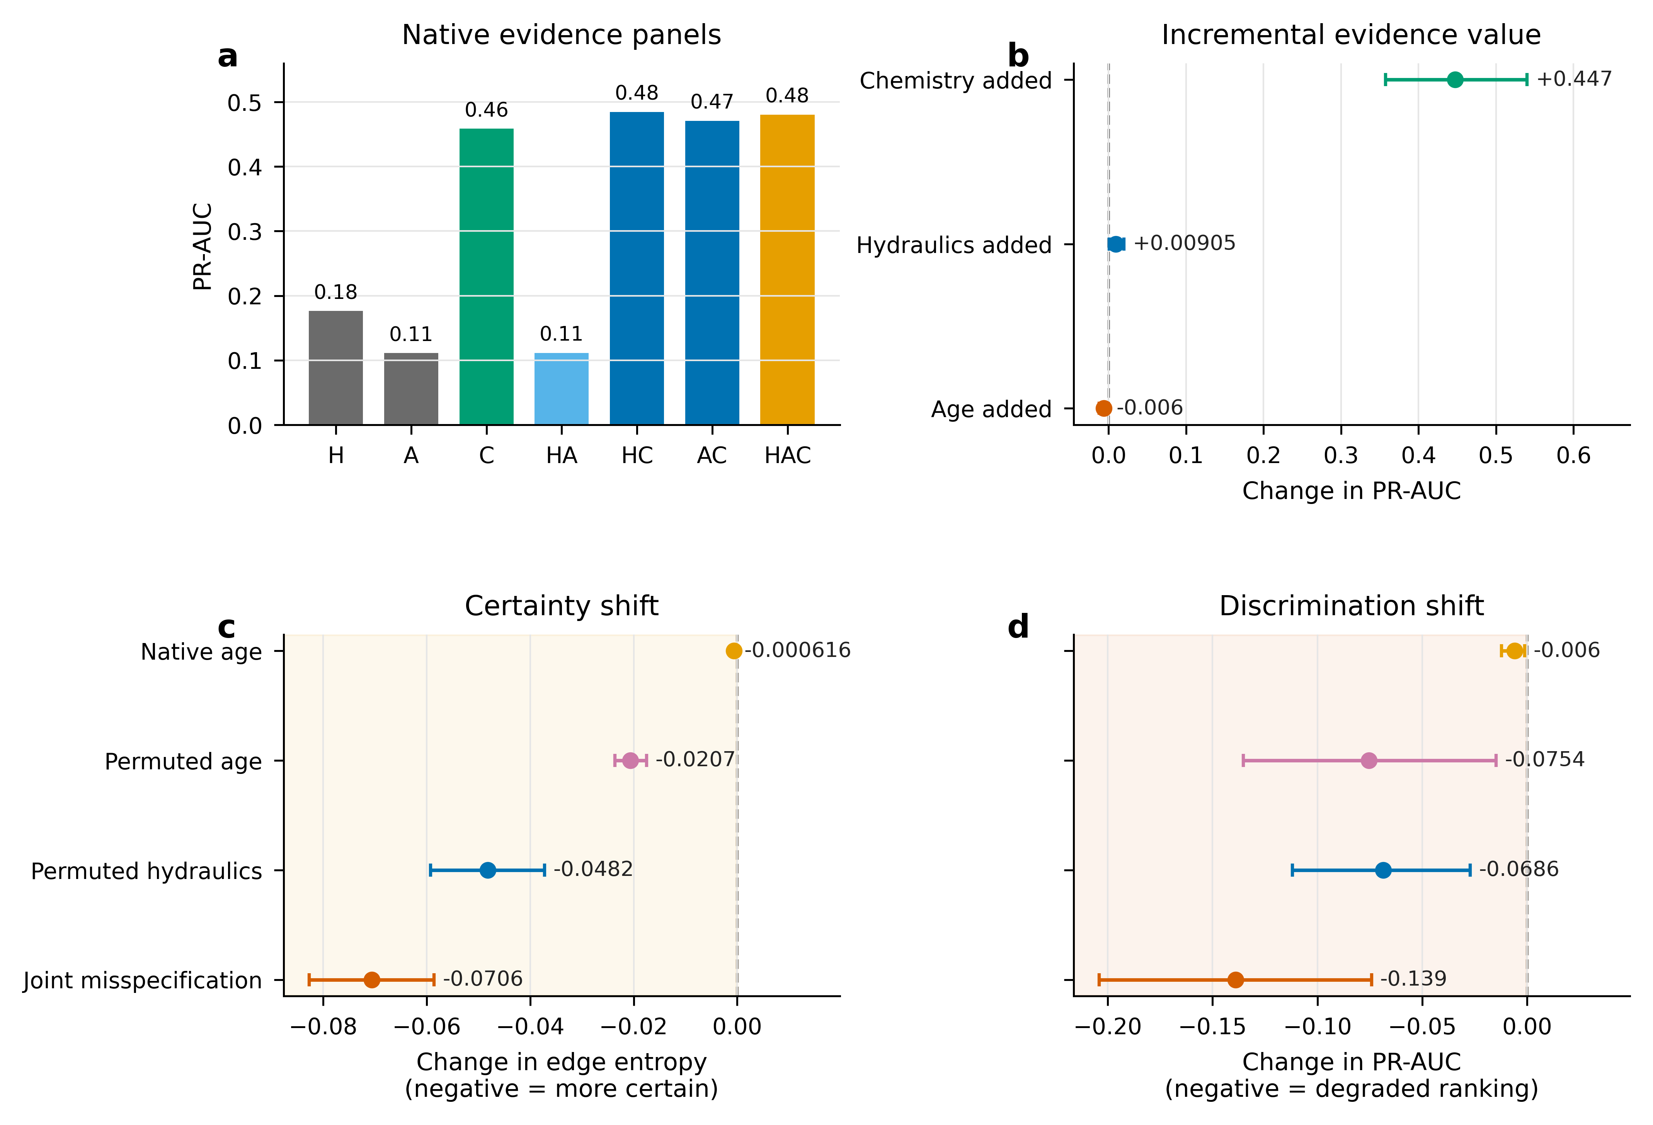
OBJECTIVE 5 · EVALUATE INTEGRATION
Objective 5: only chemistry delivered a robust topology-ranking gain
CHEMISTRY ADDED · SURVIVES CORRECTION
+0.447 PR-AUC
HYDRAULICS ADDED
+0.0091 PR-AUC
not multiplicity-significant (adjusted p = 0.070)
AGE ADDED
−0.0060 PR-AUC
not multiplicity-significant (adjusted p = 0.070)
Added data ≠ added information
Results & discussion
19
Notes:
Timing: 23:05-24:55
MEMORY ANCHOR: Added data became useful only when it supplied independent information.
SAY THIS:
In the independent integration generator, I added each evidence stream to the others. Chemistry produced the clear topology-ranking gain: plus 0.447 PR-AUC, and this survived family-wise multiplicity correction. Hydraulics had a smaller PR-AUC point estimate of plus 0.0091. Its ranking contrast did not survive correction, with adjusted p equal to 0.070, although its Brier-score and log-loss improvements did survive. Adding age produced a PR-AUC point estimate of minus 0.0060 and also did not survive multiplicity correction. The evidence streams were therefore not equally informative. Chemistry carried strong independent ranking information in this generator. Hydraulics contributed mainly through calibration. Age added no positive topology-ranking value beyond hydraulics and chemistry. Added data are not automatically added information.
TRANSITION:
Information also flowed in the opposite direction, from topology into age inference.
DELIVERY CUE: Say after multiplicity correction clearly and distinguish ranking from calibration.
AVOID SAYING: Do not say that all nominal confidence intervals had the same inferential status.
[Sources]
- C:\Users\ThinkPad P1 G4\Documents\July_2026\NeutroProject\Groundwater\Hydrosheaf\M7\m7_nonuniqueness_benchmark\docs\m7_3_results.md
- C:\Users\ThinkPad P1 G4\Documents\July_2026\NeutroProject\Groundwater\Hydrosheaf\M7\m7_nonuniqueness_benchmark\manuscript\sections\03-results\section.md
[/Sources]

Slide 20
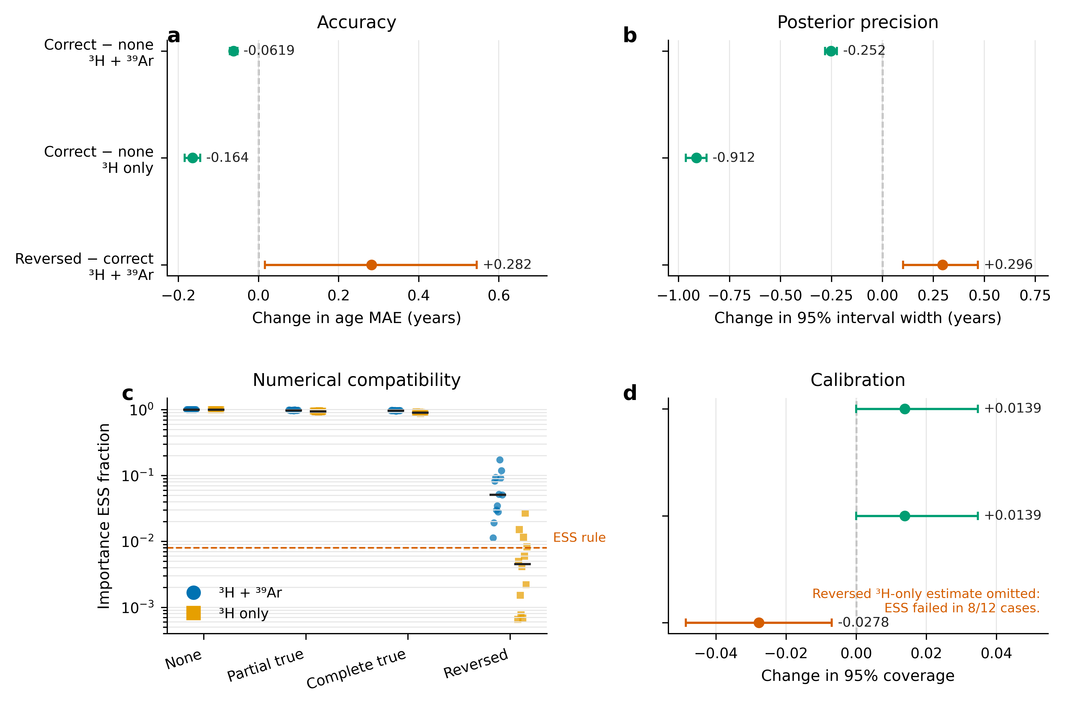
INTEGRATION IN THE REVERSE DIRECTION
Objective 5: correct topology reduced age non-uniqueness
−0.0619 y
MAE: correct graph vs no graph, two tracers
−0.1642 y
MAE: correct graph vs no graph, ³H only
Wrong direction
Reversed topology increased error and created negative transfer.
Practical MAE change: 2.24% and 3.46% of baseline
Results & discussion
20
Notes:
Timing: 24:55-26:15
MEMORY ANCHOR: Correct topology helped slightly; reversed topology harmed.
SAY THIS:
When correct topology was supplied to the age model, mean absolute error decreased by 0.0619 years with two tracers and by 0.1642 years with tritium alone. The uncertainty intervals also narrowed without a coverage penalty. These changes were statistically precise but practically small: approximately 2.24 and 3.46 percent of the respective baseline errors. The practical planning margins were introduced after review and were not prespecified. Reversing the topology increased error, reduced coverage and caused numerical instability in several tritium-only cases. The result is therefore conditional. Correct topology can reduce age non-uniqueness, especially when tracer evidence is weak, but an unsupported graph can make age inference worse.
TRANSITION:
I then isolated what the sheaf representation contributed beyond weighted graphs.
DELIVERY CUE: State statistically precise but practically small without defensiveness.
AVOID SAYING: Do not present the age improvement as large or transformative.
[Sources]
- C:\Users\ThinkPad P1 G4\Documents\July_2026\NeutroProject\Groundwater\Hydrosheaf\M7\m7_nonuniqueness_benchmark\docs\m7_3_results.md
[/Sources]

Slide 21
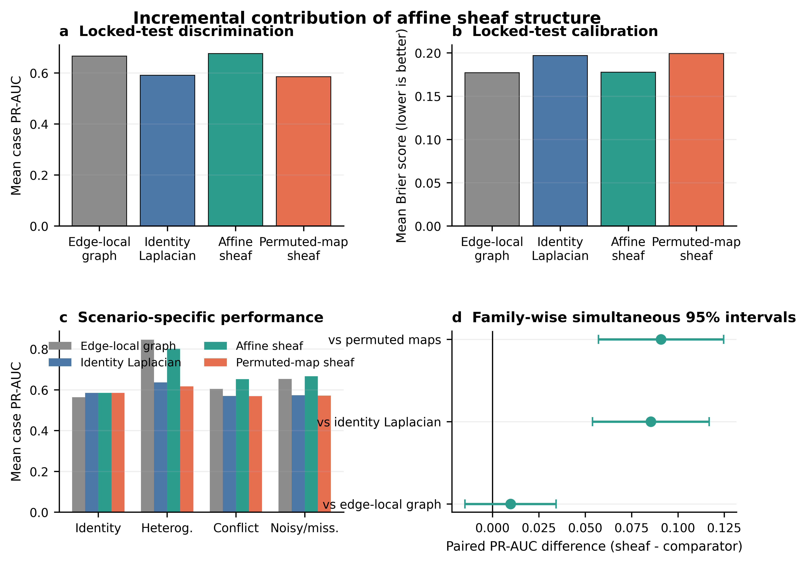
SHEAF VERSUS GRAPH
Objective 5: the sheaf added representation and conflict localisation
VS IDENTITY GRAPH
+0.0854 PR-AUC
NATIVE VS PERMUTED MAPS
+0.0909 PR-AUC
VS STRONG EDGE-LOCAL GRAPH
+0.0097 · CI crosses 0
GENERAL SUPERIORITY: NOT ESTABLISHED
Results & discussion
21
Notes:
Timing: 26:15-28:35
MEMORY ANCHOR: Map semantics and conflict localisation, not universal superiority.
SAY THIS:
This is the central sheaf-versus-graph result. The affine sheaf improved PR-AUC by 0.0854 relative to an identity graph Laplacian. Native affine maps also beat permuted maps by 0.0909, showing that the learned map semantics mattered. Identity-limit cases matched exactly, so the sheaf reduced correctly to the graph baseline when restriction maps were identities. However, the stronger edge-local weighted graph was the decisive comparator. Against it, the overall PR-AUC difference was only plus 0.0097 and the simultaneous confidence interval crossed zero. The complete superiority gate therefore failed. The supported contribution is narrower but real: edge-specific gain and offset relations, global compatibility testing and improved localisation of planted-cycle conflicts. HydroSheaf did not establish universal predictive superiority over a strong weighted graph.
TRANSITION:
A fresh estimator experiment tested whether stronger local and global weighting changed that conclusion.
DELIVERY CUE: Give the positive comparisons first, then volunteer the failed strongest comparison.
AVOID SAYING: Do not hide the edge-local comparator or call the affine sheaf the overall winner.
[Sources]
- C:\Users\ThinkPad P1 G4\Documents\July_2026\NeutroProject\Groundwater\Hydrosheaf\M7\m7_nonuniqueness_benchmark\docs\m7_sheaf_vs_graph_results.md
- C:\Users\ThinkPad P1 G4\Documents\July_2026\NeutroProject\Groundwater\Hydrosheaf\M7\m7_nonuniqueness_benchmark\M7_SHEAF_VS_GRAPH_CLAIM_DECISION.md
[/Sources]

Slide 22
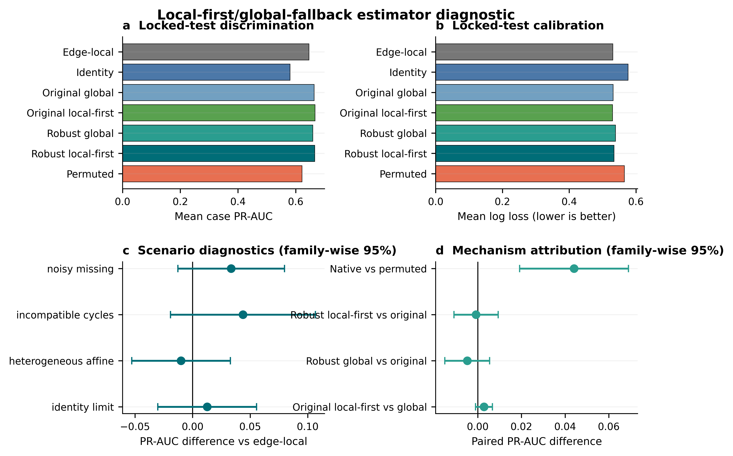
ROBUST-ESTIMATOR DIAGNOSTIC
Objective 5: the refined estimator remained conditional
LOCKED TEST: 128 CASES
+0.0200 PR-AUC
simultaneous CI [−0.0055, 0.0454]
COMPLETE GATE
Brier: inconclusive
Log loss: inconclusive
CONDITIONAL METHOD · NOT UNIVERSAL WINNER
Results & discussion
22
Notes:
Timing: 28:35-29:50
MEMORY ANCHOR: A higher point estimate did not pass the complete superiority gate.
SAY THIS:
Development selected a local-first, global-fallback estimator and it was evaluated once on 128 fresh locked cases. The PR-AUC point estimate was 0.0200 higher than the edge-local graph, but the family-wise simultaneous interval ranged from minus 0.0055 to plus 0.0454. Brier score and log loss were also inconclusive, so the complete superiority gate failed. The leave-one-edge-out robust global method actually worsened calibration. Native maps still beat permuted maps and conflict localisation remained useful, but the refined estimator did not convert the sheaf into a universal winner. I therefore report this as an estimator diagnostic and a direction for future refinement, not as a confirmed superiority result.
TRANSITION:
Objective six then asked what the framework could support in Ghanaian field data.
DELIVERY CUE: Keep a calm tone. The failed gate demonstrates that the method was allowed to fail.
AVOID SAYING: Do not call this a confirmed robust-hybrid superiority result.
[Sources]
- C:\Users\ThinkPad P1 G4\Documents\July_2026\NeutroProject\Groundwater\Hydrosheaf\M7\m7_nonuniqueness_benchmark\manuscript\sections\03-results\section.md
- C:\Users\ThinkPad P1 G4\Documents\July_2026\NeutroProject\Groundwater\Hydrosheaf\M7\m7_nonuniqueness_benchmark\M7_ROBUST_HYBRID_CLAIM_DECISION.md
[/Sources]

Slide 23
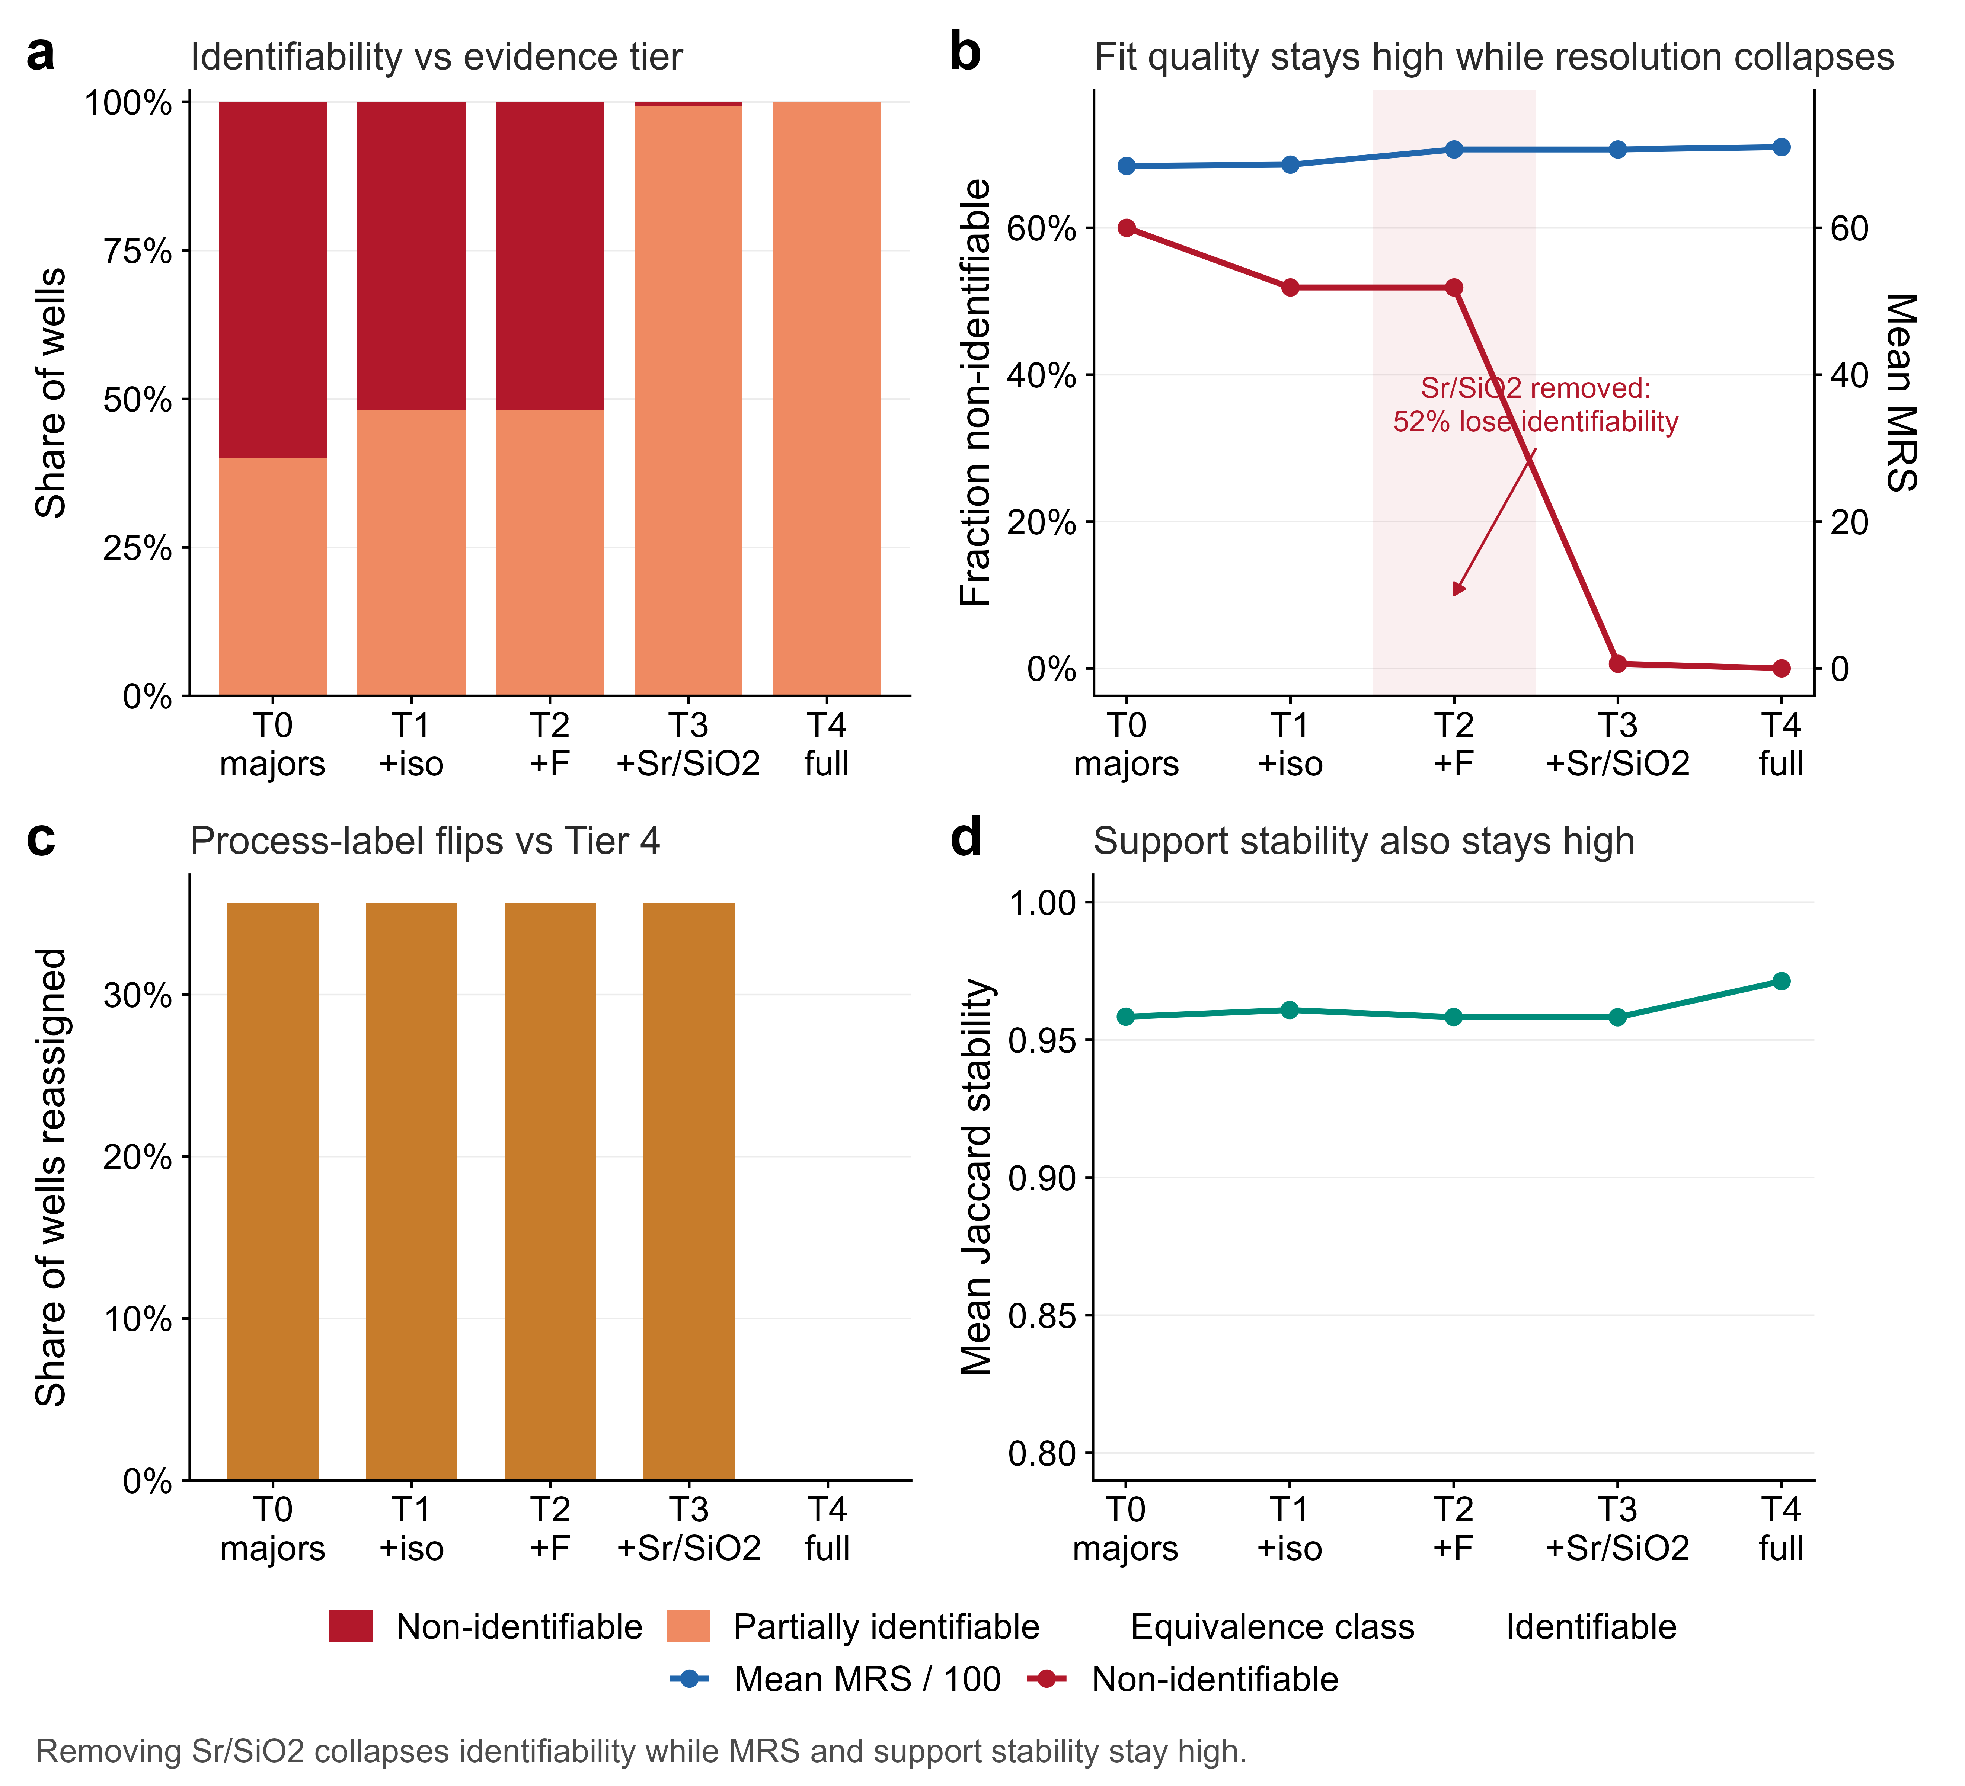
OBJECTIVE 6 · APPLY TO GHANA
Objective 6: Ghana application identified the field evidence ceiling
294 / 320
Northern Ghana quantitative records
52%
wells lose identifiability without Sr/SiO₂
Transferability result
Fit stayed ≈68–71 while labels flipped in 35.6% of wells.
Supportability diagnosis—not field truth
Results & discussion
23
Notes:
Timing: 29:50-31:50
MEMORY ANCHOR: The Ghana result identifies an evidence ceiling, not exact field truth.
SAY THIS:
Northern Ghana provided 320 records, of which 294 met the quantitative quality tier. The field question was not whether exact reactions could be validated, because independent reaction truth was unavailable. The question was which measurements controlled interpretive resolution. Under the predeclared evidence gate, removing strontium and silica moved approximately 52 percent of wells into the non-identifiable category. At the same time, mean fit remained around 68 to 71, bootstrap support remained high, and process labels changed in 35.6 percent of wells. A synthetic check supported the direction of the result, but the 52 percent is an operational classification, not independently observed field truth. The transferability result is that HydroSheaf can diagnose supportability and evidence ceilings in field chemistry while preserving the boundary on exact ages, paths and reactions.
TRANSITION:
The negative and inconclusive findings across the objectives define the overall claim boundary.
DELIVERY CUE: Emphasise the contrast between stable fit and collapsed identifiability.
AVOID SAYING: Do not describe the 52 percent as measured geological truth or end-to-end Ghana validation.
[Sources]
- C:\Users\ThinkPad P1 G4\Documents\July_2026\NeutroProject\Groundwater\Hydrosheaf\M6\m6_field_transfer_benchmark\docs\m6_results_summary.md
[/Sources]

Slide 24
WHAT DID NOT WORK
Cross-objective failures define the scientific boundary
Weak graph prior for age
NO ROBUST GAIN
Topology did not contain independent age information
Old-water prior
WITHDRAWN
RMSE 1.310; R² 0.004
Carbonate reaction families
NOT RECOVERED
0/36 scored edges per tested panel
Overall sheaf > edge-local graph
GATE FAILED
Ranking gain did not extend to calibration
Active learning
NOT VALIDATED
0 recommendations from 0 scored edges
Results & discussion
24
Notes:
Timing: 31:50-33:00
MEMORY ANCHOR: The workflow rejected claims that the evidence did not support.
SAY THIS:
Five negative findings define the scientific boundary. The weak graph prior did not improve age inference. The old-water prior was withdrawn because its performance was poor. Carbonate reaction families were not recovered under either tested indicator panel, although this does not prove universal non-identifiability under every possible panel. The overall sheaf-versus-edge-local superiority gate failed. Finally, the active-learning implementation produced zero recommendations from zero scored edges, so excellent active-learning performance is not a thesis result. These are not hidden failures. They show that the evaluation workflow can reject its own hypotheses and distinguish implemented capability from validated scientific performance.
TRANSITION:
That evidence can now be expressed as a clear ledger of supported and unsupported claims.
DELIVERY CUE: Use a factual tone and do not apologise for negative results.
AVOID SAYING: Do not call carbonate universally non-identifiable or active learning validated.
[Sources]
- C:\Users\ThinkPad P1 G4\Documents\July_2026\NeutroProject\Groundwater\Hydrosheaf\M3\m3_age_benchmark\M3_FINAL_ACCURACY_AUDIT.md
- C:\Users\ThinkPad P1 G4\Documents\July_2026\NeutroProject\Groundwater\Hydrosheaf\M7\m7_nonuniqueness_benchmark\docs\m7_3_results.md
- C:\Users\ThinkPad P1 G4\Documents\July_2026\NeutroProject\Groundwater\Hydrosheaf\HYDROSHEAF_REMAINING_CAPABILITIES_DECISION_20260728.md
[/Sources]

Slide 25
CLAIM LEDGER
What the thesis supports—and does not support
SUPPORTED
NOT ESTABLISHED
✓
Close agreement with reported age-model configurations
×
Universal superiority over strong baselines
✓
Conditional topology and evidence value
×
Exact Ghana ages, paths or mineral truth
✓
Reaction equivalence-class reporting
×
End-to-end field validation
✓
Affine-map and conflict-localisation value
×
Validated vector-stalk / 3-D / temporal / vadose claims
✓
Ghana measurement-value diagnosis
×
Excellent active-learning performance
Synthesis
25
Notes:
Timing: 33:00-34:10
MEMORY ANCHOR: Conditional support on the left; prohibited claims on the right.
SAY THIS:
The thesis supports close agreement with reported age-model configurations, conditional topology and evidence value, reaction equivalence-class reporting, affine-map and conflict-localisation value, and a Ghana measurement-value diagnosis. It does not establish universal superiority over strong baselines, exact Ghana ages, paths or mineral truth, end-to-end field validation, validated vector-stalk, three-dimensional, temporal or vadose performance, or excellent active-learning performance. This boundary is not a weakness to hide. It is a central output of the research because it identifies exactly which conclusions the evidence permits and which conclusions require further tests.
TRANSITION:
I can now answer each of the six objectives directly.
DELIVERY CUE: Summarise the supported column, then the unsupported column, then explain why the boundary matters.
AVOID SAYING: Do not weaken the limitations with phrases such as but probably.
[Sources]
- C:\Users\ThinkPad P1 G4\Documents\July_2026\NeutroProject\Groundwater\Hydrosheaf\draftbychapter\PhDChapter1_refined.docx
- C:\Users\ThinkPad P1 G4\Documents\July_2026\NeutroProject\Groundwater\Hydrosheaf\M7\m7_nonuniqueness_benchmark\manuscript\revision\FINAL_VERIFICATION_20260730.md
[/Sources]

Slide 26
OBJECTIVE SYNTHESIS
The six objectives produced six bounded answers
01 REVIEW
Integration and validation were the unresolved methodological gap.
02 DEVELOP
HydroSheaf made cross-domain relations and diagnostics executable.
03 BENCHMARK
Components showed usable but conditional reference recovery.
04 ROBUSTNESS
Fit and precision could remain high while identifiability failed.
05 INTEGRATION
Evidence helped only when it supplied independent information.
06 GHANA
Field transfer identified supportable claims and the evidence ceiling.
Central answer: integration is a testable condition—not an automatic benefit.
Results & discussion
26
Notes:
Timing: 34:10-35:20
MEMORY ANCHOR: Six objectives produced six bounded answers.
SAY THIS:
Objective one identified integration and validation as the unresolved methodological gap. Objective two made cross-domain relations and diagnostics executable. Objective three found usable but conditional component performance: close age-reference agreement, imperfect topology inference and non-unique reactions. Objective four showed that fit and precision could remain attractive while robustness or identifiability failed. Objective five demonstrated that evidence helped only when it supplied independent information and that unsupported evidence could cause negative transfer. Objective six transferred the supportability diagnosis to Ghanaian data without claiming unavailable field truth. Together, these results answer the thesis aim: HydroSheaf can integrate the evidence, but the benefit of that integration remains a testable condition.
TRANSITION:
Within those boundaries, the thesis makes four contributions to knowledge.
DELIVERY CUE: Move through the six objectives briskly and end on the central answer.
AVOID SAYING: Do not introduce new statistics or claims on the synthesis slide.
[Sources]
- C:\Users\ThinkPad P1 G4\Documents\July_2026\NeutroProject\Groundwater\Hydrosheaf\draftbychapter\PhDChapter1_refined.docx
- C:\Users\ThinkPad P1 G4\Documents\July_2026\NeutroProject\Groundwater\Hydrosheaf\M7\m7_nonuniqueness_benchmark\manuscript\revision\FINAL_VERIFICATION_20260730.md
[/Sources]

Slide 27
ANSWER TO THE THESIS
Four contributions to knowledge
01
FORMALISATION
02
DIAGNOSTICS
A groundwater-specific graph/sheaf representation linking age, flow and reactions
Identifiability, calibration and conflict localisation as primary outputs
03
EVIDENCE LOGIC
04
FIELD DESIGN
Locked tests, adverse controls and explicit claim-decision gates
Evidence-ceiling and measurement-value diagnosis for data-limited aquifers
Contribution
27
Notes:
Timing: 35:20-36:20
MEMORY ANCHOR: Representation, diagnostics, evidence logic and field design.
SAY THIS:
The first contribution is a groundwater-specific graph and sheaf formalisation linking age, directed flow and reaction evidence. The second is diagnostic: identifiability, calibration and conflict localisation become primary outputs rather than afterthoughts. The third is an evidence logic based on locked tests, adverse controls and explicit claim-decision gates. The fourth is a field-design contribution: the framework identifies the evidence ceiling and reveals which additional measurements are most likely to improve interpretive resolution. These contributions concern how groundwater interpretations are constructed, tested, limited and improved. They are contributions to inference and evidence evaluation, not merely to software implementation.
TRANSITION:
I will conclude by returning to the original problem of plausible but incompatible aquifer stories.
DELIVERY CUE: Count the four contributions discreetly and keep the pace steady.
AVOID SAYING: Do not describe the number of modules or lines of code as the primary scholarly contribution.
[Sources]
- C:\Users\ThinkPad P1 G4\Documents\July_2026\NeutroProject\Groundwater\Hydrosheaf\draftbychapter\PhDChapter1_refined.docx
[/Sources]

Slide 28
CONCLUSION
HydroSheaf does not promise one correct aquifer story.
It tests whether cross-domain relations compose globally, measures when evidence adds information, and exposes when apparently precise integration becomes confidently wrong.
THESIS POSITION
The contribution is conditional integration, identifiability diagnosis and conflict localisation—not universal predictive superiority.
Notes:
Timing: 36:20-37:30
MEMORY ANCHOR: HydroSheaf tests compatibility and preserves unresolved uncertainty.
SAY THIS:
The thesis began with the problem that separate analyses can produce individually plausible but mutually incompatible groundwater stories. HydroSheaf brings uncertain relations into one auditable framework. It can test whether those relations compose globally, measure whether an added evidence stream contributes information, localise conflict, and reveal when apparently precise integration is confidently wrong. The contribution is not universal predictive superiority and it is not a fully validated Ghana aquifer model. The defensible conclusion is that HydroSheaf provides a falsifiable approach to integrating groundwater evidence while preserving the uncertainty and non-uniqueness that the available data cannot resolve.
TRANSITION:
The recommendations follow directly from the remaining evidence gaps.
DELIVERY CUE: Slow down and look at the examiners for the final two sentences.
AVOID SAYING: Do not conclude with only the limitations; state the achieved contribution first.
[Sources]
- C:\Users\ThinkPad P1 G4\Documents\July_2026\NeutroProject\Groundwater\Hydrosheaf\M7\m7_nonuniqueness_benchmark\manuscript\sections\05-conclusion\section.md
[/Sources]

Slide 29
RECOMMENDATIONS
Recommendations: the next tests should target missing information
01
MATCHED FIELD VALIDATION
Acquire age tracers, repeated heads, chemistry and independently measured connectivity in the same aquifer.
02
INDEPENDENT REPLICATION
Repeat the locked integration benchmark with a different generator family and external implementation.
03
MEASUREMENT DESIGN
Prioritise tracers and observations that improve identifiability, not merely fit or interval width.
04
CAPABILITY VALIDATION
Evaluate active learning prospectively; treat temporal, 3-D and vadose capabilities as future work until data exist.
Priority: independent matched truth before expanding the headline claim.
Conclusion and recommendations
29
Notes:
Timing: 37:30-38:25
MEMORY ANCHOR: Prioritise matched truth and independent replication.
SAY THIS:
I make four recommendations. First, the decisive next validation should use a matched field dataset containing environmental age tracers, repeated hydraulic observations, chemistry and independently measured connectivity. Second, the integration benchmark should be replicated using a different generator family and an external implementation. Third, future measurement design should prioritise evidence that improves identifiability and calibration, rather than measurements that only improve fit or narrow intervals. Fourth, active learning should be evaluated prospectively with explicit costs and decision loss. Temporal, three-dimensional and vadose capabilities should remain future work until suitable data permit claim-bearing validation. The priority is independent matched truth before expanding the headline claim.
TRANSITION:
I will stop there and welcome your questions.
DELIVERY CUE: Give the recommendations in priority order and finish cleanly.
AVOID SAYING: Do not promise that unvalidated capabilities will necessarily improve performance.
[Sources]
- C:\Users\ThinkPad P1 G4\Documents\July_2026\NeutroProject\Groundwater\Hydrosheaf\HYDROSHEAF_REMAINING_CAPABILITIES_DECISION_20260728.md
- C:\Users\ThinkPad P1 G4\Documents\July_2026\NeutroProject\Groundwater\Hydrosheaf\draftbychapter\PhDChapter1_refined.docx
[/Sources]

Slide 30
Thank you
Questions and discussion
HydroSheaf: test integration · preserve uncertainty · expose non-identifiability
Notes:
Timing: 38:25-38:35
MEMORY ANCHOR: Stop, look up and invite questions.
SAY THIS:
Thank you for listening. I welcome your questions and discussion.
TRANSITION:
Stop speaking.
DELIVERY CUE: Look at the examiners, smile briefly and wait. The remaining time protects against pauses and interruptions.
AVOID SAYING: Do not continue summarising or apologise for the limitations.
[Sources]
- C:\Users\ThinkPad P1 G4\Documents\July_2026\NeutroProject\Groundwater\Hydrosheaf\draftbychapter\PhDChapter1_refined.docx
[/Sources]

Slide 31
SHEAF VERSUS GRAPH
Backup · What exactly does the sheaf add?
IDENTITY GRAPH
EDGE-LOCAL GRAPH
AFFINE SHEAF
Scalar similarity
Flexible edge score
Edge-specific Aₑ and bₑ
One shared coordinate system
Strong local comparator
Global compatibility residuals
Baseline limit
No global map consistency
Conflict localisation
Examiner answer: the sheaf adds relation-specific transformations and global conflict localisation; it did not establish general superiority over the strongest edge-local comparator.
Examiner backup
31
Notes:
Timing: Examiner backup - use only if asked
EXAMINER QUESTION: What exactly does the sheaf add?
ANSWER:
It adds edge-specific affine relations and a global compatibility test. Native affine maps beat identity and permuted-map controls, and conflict localisation improved in planted-cycle cases. However, the sheaf did not outperform the strongest edge-local weighted graph overall, so the contribution is representational and diagnostic rather than universal predictive superiority.
DELIVERY CUE: Answer the question in the first sentence, then give the evidence and limitation.
[Sources]
- C:\Users\ThinkPad P1 G4\Documents\July_2026\NeutroProject\Groundwater\Hydrosheaf\M7\m7_nonuniqueness_benchmark\docs\m7_sheaf_vs_graph_results.md
[/Sources]

Slide 32
AGE BENCHMARK
Backup · Why HydroSheaf did not need to beat TracerLPM
QUESTION ACTUALLY TESTED
QUESTION NOT TESTED
Can HydroSheaf reproduce the reported configuration—and does topology add independent information?
Which model is closer to the unknown true groundwater-age distribution?
Answer: close agreement achieved; incremental graph value not established.
The public reference outputs are emulation targets—not error-free truth.
Examiner backup
32
Notes:
Timing: Examiner backup - use only if asked
EXAMINER QUESTION: Why did HydroSheaf not beat TracerLPM?
ANSWER:
That benchmark tested close reproduction of reported USGS and TracerLPM configurations and whether topology added independent information. Close agreement was achieved on 329 reportable fits, but the available graph proxy did not improve the locked outcomes. HydroSheaf therefore does not replace TracerLPM; it shows when added topology is uninformative or harmful.
DELIVERY CUE: Answer the question in the first sentence, then give the evidence and limitation.
[Sources]
- C:\Users\ThinkPad P1 G4\Documents\July_2026\NeutroProject\Groundwater\Hydrosheaf\M3\m3_age_benchmark\M3_FINAL_ACCURACY_AUDIT.md
[/Sources]

Slide 33
REPRODUCIBILITY
Backup · What a locked test means
1
2
3
4
DEVELOP
→
FREEZE
→
OPEN ONCE
→
DECIDE
Tune on declared development cases
Generator, code, seeds, primary metrics and decision rules
Evaluate untouched locked cases
Apply the frozen gate, including negative outcomes
Locked comparisons were not rerun; practical planning margins were post-review diagnostics.
Examiner backup
33
Notes:
Timing: Examiner backup - use only if asked
EXAMINER QUESTION: What is a locked test?
ANSWER:
Development cases select the method, code, seeds, primary metrics and decision rules. These are frozen before held-out cases are opened once. The protocol protects the confirmatory result from repeated tuning, but it was prospectively Git-locked rather than externally preregistered.
DELIVERY CUE: Answer the question in the first sentence, then give the evidence and limitation.
[Sources]
- C:\Users\ThinkPad P1 G4\Documents\July_2026\NeutroProject\Groundwater\Hydrosheaf\M7\m7_nonuniqueness_benchmark\manuscript\revision\FINAL_VERIFICATION_20260730.md
[/Sources]

Slide 34
EVIDENCE MATRIX
Backup · No single field dataset contains all three truths
DATASET
AGE TRACERS
REPEATED HYDRAULICS
CHEMISTRY
CONNECTIVITY TRUTH
Public age archive
✓
direct heads unavailable
not used
—
MODFLOW / MODPATH
modelled
✓
—
model-conditioned
Northern Ghana
—
—
✓
—
Talensi / Lower Anayari
—
—
✓
—
Controlled integration generator
✓
✓
✓
✓ planted
Therefore: controlled known-truth integration + field supportability, not end-to-end field validation.
Examiner backup
34
Notes:
Timing: Examiner backup - use only if asked
EXAMINER QUESTION: How can the thesis be valid without one complete field dataset?
ANSWER:
It cannot claim end-to-end field validation. The thesis triangulates component reference checks, controlled known-truth integration and claim-limited field transfer. These establish capability and supportability, while the missing matched field dataset remains the decisive next validation.
DELIVERY CUE: Answer the question in the first sentence, then give the evidence and limitation.
[Sources]
- C:\Users\ThinkPad P1 G4\Documents\July_2026\NeutroProject\Groundwater\Hydrosheaf\draftbychapter\PhDChapter1_refined.docx
- C:\Users\ThinkPad P1 G4\Documents\July_2026\NeutroProject\Groundwater\Hydrosheaf\M7\m7_nonuniqueness_benchmark\docs\m7_3_results.md
[/Sources]

Slide 35
ADVERSE CONTROLS
Backup · Reduced uncertainty can mean confident error
PERMUTED AGE
PERMUTED HYDRAULICS
JOINT MISSPECIFICATION
MORE CERTAIN
MORE CERTAIN
MORE CERTAIN
Entropy −0.0207
Entropy −0.0482
Entropy −0.0706
BUT WORSE
BUT WORSE
BUT WORSE
PR-AUC −0.0754
Log loss +0.0745
PR-AUC −0.139
Calibration and discrimination must accompany entropy or interval width.
Examiner backup
35
Notes:
Timing: Examiner backup - use only if asked
EXAMINER QUESTION: Can lower uncertainty still be wrong?
ANSWER:
Yes. Permuted evidence reduced entropy while worsening ranking and calibration. HydroSheaf therefore evaluates discrimination and calibration alongside interval width or entropy. Greater confidence is not validation unless the predictions also become better.
DELIVERY CUE: Answer the question in the first sentence, then give the evidence and limitation.
[Sources]
- C:\Users\ThinkPad P1 G4\Documents\July_2026\NeutroProject\Groundwater\Hydrosheaf\M7\m7_nonuniqueness_benchmark\docs\m7_3_results.md
[/Sources]

Slide 36
CAPABILITY STATUS
Backup · Active learning is implemented, not yet validated
CURRENT STATUS
WHAT WOULD EARN STATUS
0 recommendations
from 0 scored edges
1 Jacobian-aware value of information
2 explicit costs and decision loss
3 prospective locked comparison
4 independent replication
NOT A CLAIM-BEARING RESULT
Do not call the current method ‘excellent active learning’ in the viva.
Examiner backup
36
Notes:
Timing: Examiner backup - use only if asked
EXAMINER QUESTION: Is the active-learning method excellent?
ANSWER:
No claim-bearing evidence supports that conclusion. The current report contains zero recommendations from zero scored edges, and the transport-time interface lacks the required candidate-time Jacobians. Active learning remains an implemented capability that needs a prospective cost-aware locked benchmark.
DELIVERY CUE: Answer the question in the first sentence, then give the evidence and limitation.
[Sources]
- C:\Users\ThinkPad P1 G4\Documents\July_2026\NeutroProject\Groundwater\Hydrosheaf\M4\m4_topology_benchmark\results\active_learning_report.md
- C:\Users\ThinkPad P1 G4\Documents\July_2026\NeutroProject\Groundwater\Hydrosheaf\HYDROSHEAF_REMAINING_CAPABILITIES_DECISION_20260728.md
[/Sources]

Slide 37
AUDITABILITY
Backup · Reproducibility status
PASS
Locked-case separation
PASS
Frozen hashes and artifact regeneration gates
PASS
10,000-resample post-review audit
PASS
14 focused tests
PENDING
Versioned public release and persistent identifiers
PENDING
CRediT, funding and conflict-of-interest declarations
Examiner backup
37
Notes:
Timing: Examiner backup - use only if asked
EXAMINER QUESTION: Is the work fully reproducible?
ANSWER:
Milestone-level provenance, locked-case separation and focused verification are available. The remaining release actions are a clean-checkout reproduction, a repository-wide green test state, a versioned public release and persistent identifiers. I therefore describe the work as locally auditable, not yet fully archived for independent reproduction.
DELIVERY CUE: Answer the question in the first sentence, then give the evidence and limitation.
[Sources]
- C:\Users\ThinkPad P1 G4\Documents\July_2026\NeutroProject\Groundwater\Hydrosheaf\M7\m7_nonuniqueness_benchmark\manuscript\revision\FINAL_VERIFICATION_20260730.md
[/Sources]

Slide 38
RAPID RESPONSES
Backup · Five one-sentence viva answers
Why is this a PhD?
It contributes a falsifiable integration formalism, evidence logic and field supportability diagnosis—not merely software.
Did it beat TracerLPM?
It closely reproduced reported configurations; graph value was not established and harmful topology was detectable.
What does the sheaf add?
Edge-specific transformations and global conflict localisation, conditionally—not universal superiority.
Is Ghana validated?
No end-to-end truth; the field result identifies evidence ceilings and priority measurements.
What is the decisive next test?
Independent replication under another generator or matched field connectivity truth.
Examiner backup
38
Notes:
Timing: Examiner backup - use only if asked
EXAMINER QUESTION: Why is this sufficient for a PhD?
ANSWER:
The thesis contributes a formal integration framework, controlled evidence about when cross-domain information helps or harms, explicit falsification and claim-decision procedures, and a field evidence-ceiling diagnosis. The contribution is strengthened by the locked negative results because the method was allowed to reject its own hypotheses.
DELIVERY CUE: Answer the question in the first sentence, then give the evidence and limitation.
[Sources]
- C:\Users\ThinkPad P1 G4\Documents\July_2026\NeutroProject\Groundwater\Hydrosheaf\draftbychapter\PhDChapter1_refined.docx
- C:\Users\ThinkPad P1 G4\Documents\July_2026\NeutroProject\Groundwater\Hydrosheaf\M7\m7_nonuniqueness_benchmark\manuscript\revision\FINAL_VERIFICATION_20260730.md
[/Sources]

