Slide 1
City compare Venues and Car Fatality
Prep by: Daniel Abebe
IBM Data Science Professional Certificate
12/16/2019

Slide 2
Background
It’s statistically known that approximately 33,000 to 35,000 persons die due to vehicle accident in United States annually.
The reporting system that supports these reporting is called FARS (Fatality Analysis Reporting System) under DOT (Department of Transportation).
Popular Maryland cities neighboring Washington DC and Baltimore city are going to be used for this paper.
These cities reside a high number of population and its a center for professionals and people flow from all over the world as a visitor or as a permanent stay.

Slide 3
Datasets
County and State data is scrapped from here
http://www.statsamerica.org/CityCountyFinder/Default.aspx
Fatality crash is from:
https://www-fars.nhtsa.dot.gov/Main/index.aspx

Slide 4
Data Cleaning
variables that affects to the number of fatalities such as travel speed, weather state traffic lows and so on.
FARS data portal is 2018 fatality
Population of State of
Maryland is close to 5.8million,
Baltimore County is around 800 thousand and
Maryland Cities near to Washington DC areas population is close to 2 million.
Baltimore and DMV-Maryland cities are around 30miles apart
Missing values are all removed if any of the variables are missing.

Slide 5

Total Cities by County

Slide 6
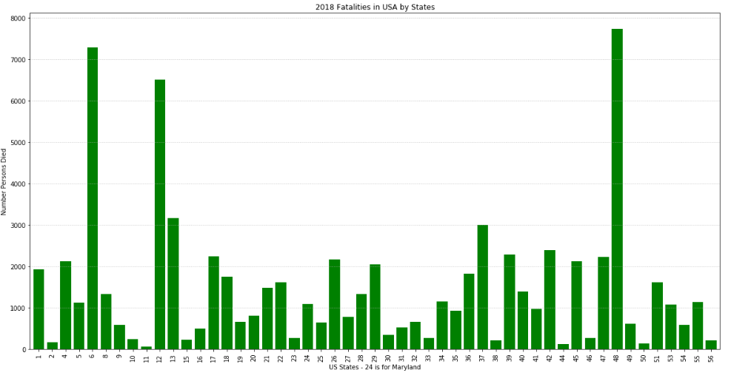
US states by fatality

Slide 7
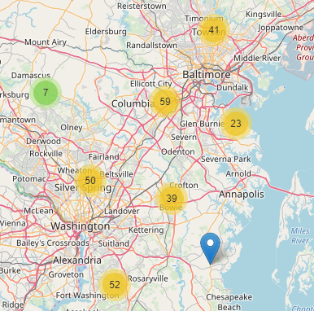
Fatality counts

Slide 8
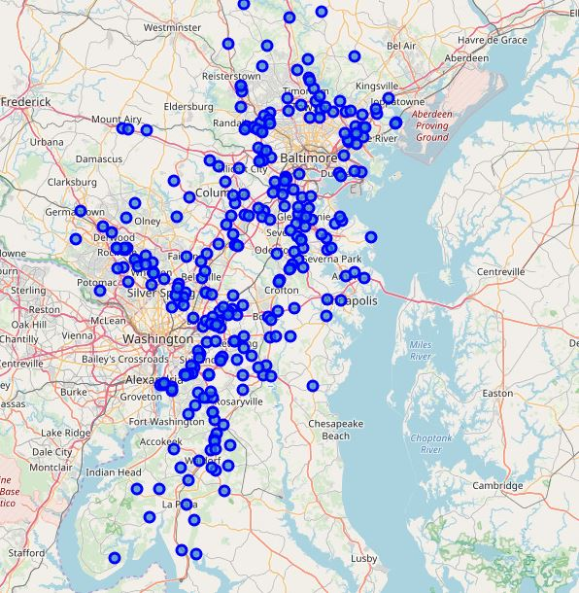
Fatality mapped

Slide 9
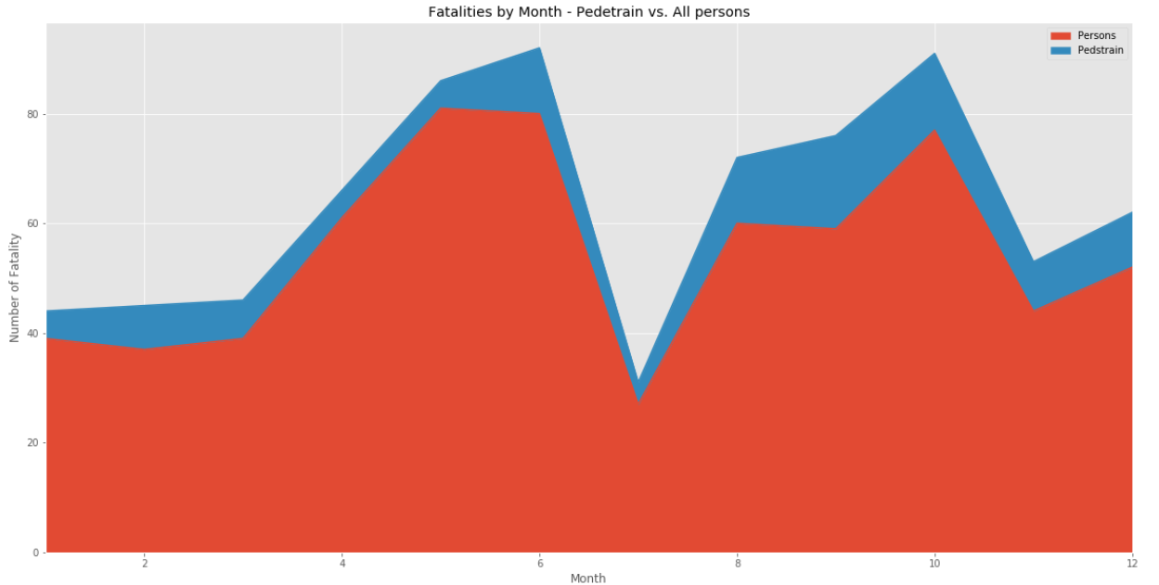
Total pedestrian vs. Total person fatality person also includes drivers ,passengers

Slide 10
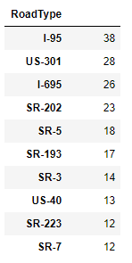
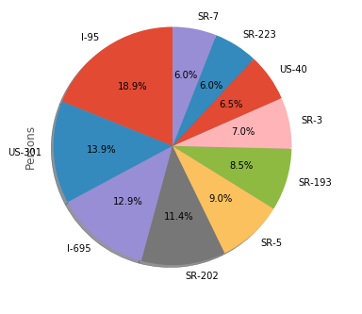
Total Fatality vs. major roads

Slide 11
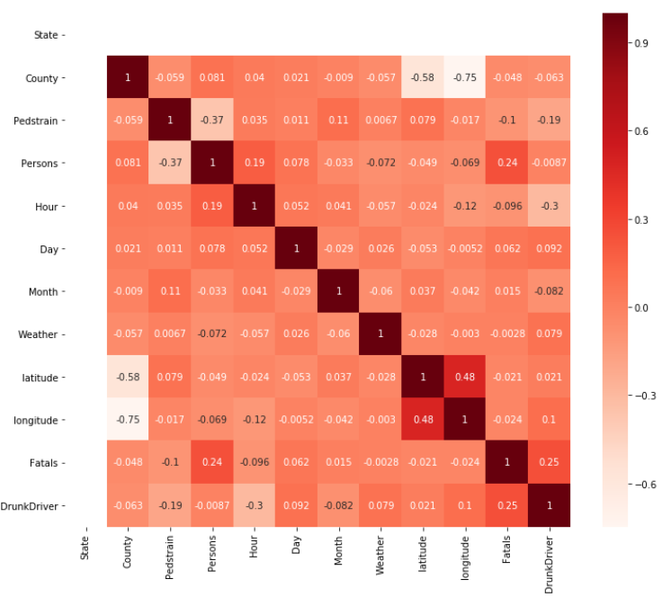
Pearson correlation between variables

Slide 12
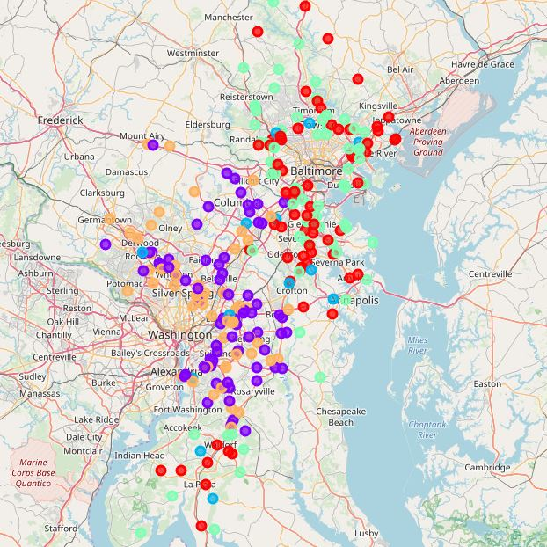
K 3 clustering – Fatality Data

Slide 13
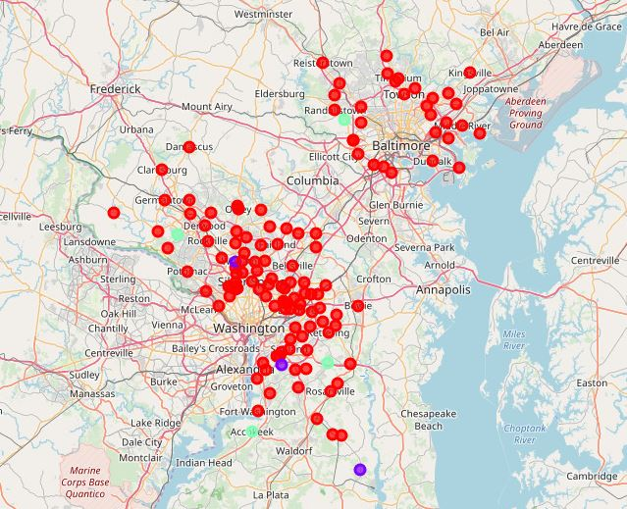
K 3 clustering – Venues Data

