Slide 1
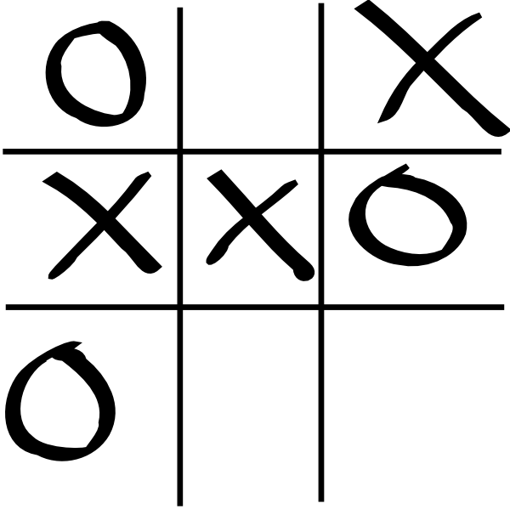
Tic Tac Toe – Enterprise version
github.com/dav98b

Slide 2
Basics – OOP
Object-oriented programming (OOP) is a computer programming model that organizes software design around data, or objects, rather than functions and logic.
Key Principles
Encapsulation
Is the mechanism that binds together code and the data it manipulates, and keeps both safe from outside interference and misuses
Inheritance
Is the process by which one object acquires the property of another object
Polymorphism
Is a feature that allows one interface to be used for a general class of actions.

Slide 3
Tools
Angular
Angular is an application-design framework and development platform for creating efficient and sophisticated single-page apps.
Spring
The Spring Framework provides a comprehensive programming and configuration model for modern Java-based enterprise applications
Docker
Docker is an open platform for developing, shipping, and running applications. Docker enables you to separate your applications from your infrastructure so you can deliver software quickly

Slide 4
1. Drawing the board
SVG
Scalable Vector Graphics (SVG) is an XML-based markup language for describing two-dimensional based vector graphics.
Svg.js
A lightweight library for manipulating and animating SVG.
* SVG()
* rect(width, height)
* move(x, y)
* fill(color)
* find(selector)

Slide 5
1.1 Steps
Draw board lines
Draw squares
Define “Square” type
Handle click event
Display images (X, O)
Talk to Back-End

Slide 6
2. HTTP API
POST /status/check
  Request Body {
    x_indexes = [],
    o_indexes = []
  }
  Response Body {
    status = VICTORY_X | VICTORY_O | DRAW | NONE
  }

