Slide 1
ExquisiteNet-YoloY5

Slide 2
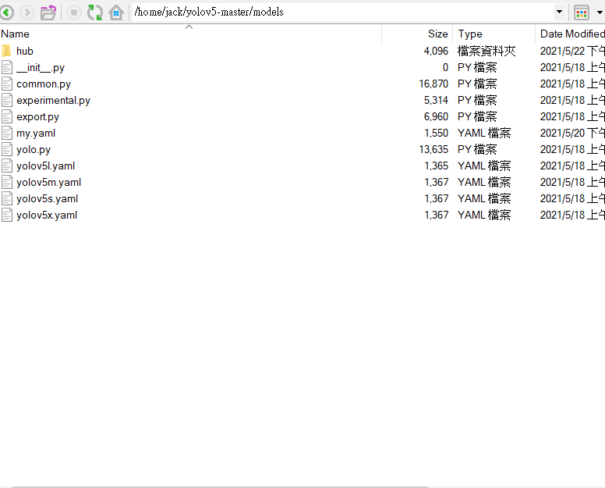
Put my.yaml into /models/

Slide 3
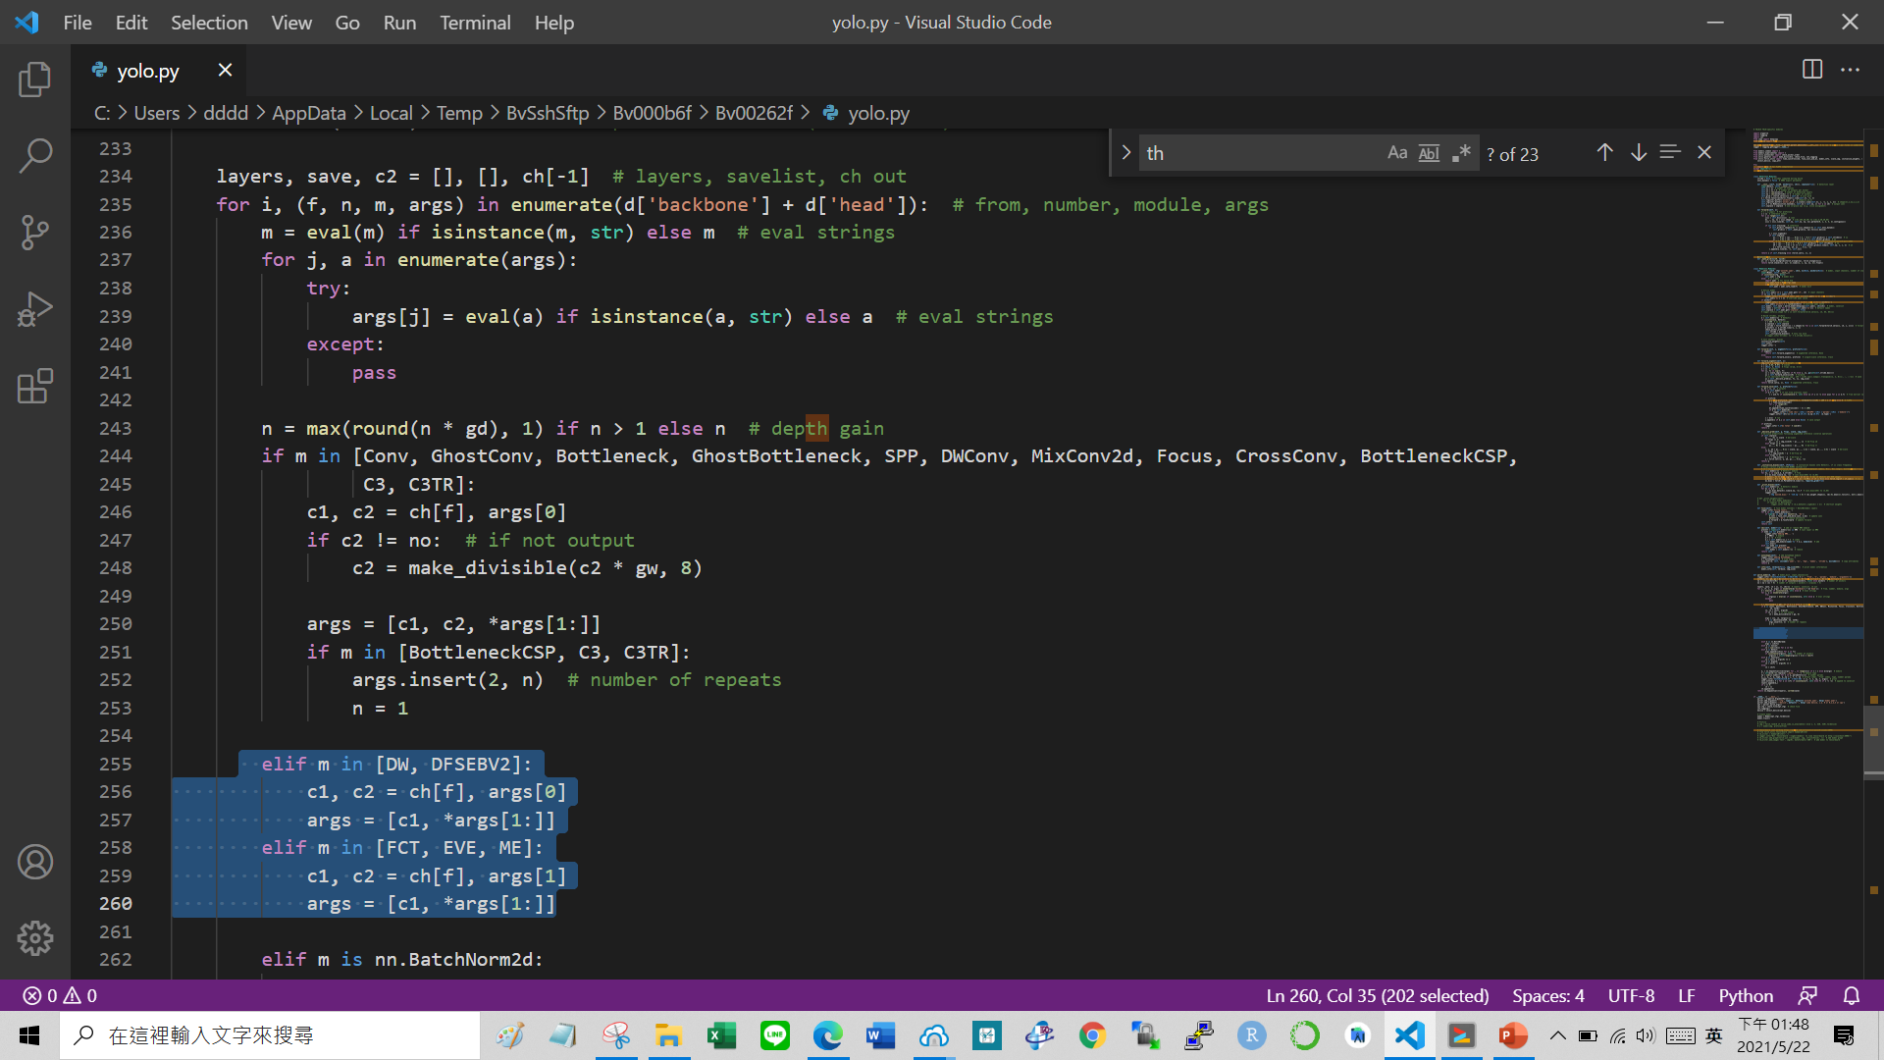
Add all the lines in parse.py into yolo.py like this

Slide 4
Add all the lines in parse.py into yolo.py like this

Slide 5
Now you can run ExquisiteNetV2-YOLOV5

Slide 6
Alert the width or depth of model
you can alert the “depth_multiple” and “width_multiple” in my.yanl
I don’t know which are best values for ExquisiteNetV2-YOLOV5, I just set them casually.
Have fun!!!

Slide 7
My experimental setting (optional)
Optimizer : RangerQH()
End condition : train loss < 0.05 or epoch +1 >= 1300

