Slide 1
LatticeFold & its Applications
Binyi Chen, Dan Boneh
Stanford University

Slide 2

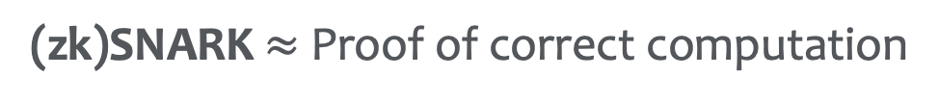



Succinct Non-Interactive Argument of Knowledge
(zk)SNARK $≈$ Proof of correct computation
Given circuit $C$, instance $x$, I know witness $w$ s.t. $C\left(x,w\right)=0$
E.g. knowledge of secret key/hash preimage
$$\left(pk_{C},vk_{C}\right)←Setup\left(C\right)$$
$$Prove\left(pk_{C},x,w\right)→π$$
$$Verify\left(vk_{C},x,π\right)→0/1$$
Succinctness:$π$ is small and cheap to verify
Notes:
Even if C is expensive, pi should still be small and cheap…

Slide 3

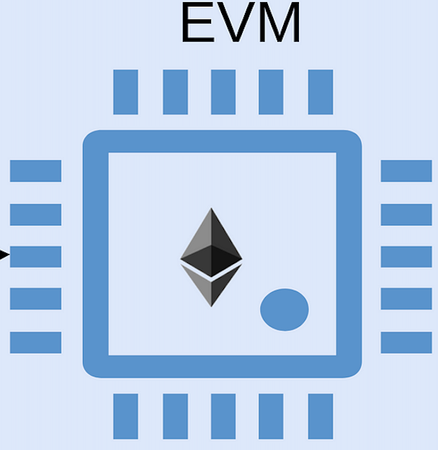
























Scaling Blockchains
Smart-contract Blockchain: (oversimplified)
$$tx_{1}$$
$$tx_{1}$$
$$tx_{2}$$
$$tx_{2}$$
$$…$$
$$…$$
$$tx_{n}$$
$$tx_{n}$$
VM state
$$st$$
$$st′$$
$$st$$
$$st′$$
$$tx_{1}$$
$$tx_{1}$$
$$tx_{2}$$
$$tx_{2}$$
$$…$$
$$…$$
$$tx_{n}$$
$$tx_{n}$$
$$st$$
$$st′$$
$$st$$
$$st′$$
Redundant execution $⇒$ poor throughput/latency
Notes:
Explain this quickly

Slide 4
























Scaling Blockchains
Based Rollup: (oversimplified)
How to compute $π$ efficiently?
Prover
$$π,st′$$
$$π,st′$$
Commit($txs)$
Commit($txs)$
$$st$$
$$→st′$$
Verify proof
$$st$$
$$→st′$$
Verify proof
$$st$$
$$st′$$
$$π,st′$$
$$tx_{1}$$
$$…$$
$$tx_{n}$$
$$π,st′$$
Commit($txs)$
SNARK $π$
Commit($txs)$
$$st$$
$$→st′$$
Verify proof
$$st$$
$$→st′$$
Verify proof
Much cheaper!
Notes:
Explain this quickly

Slide 5

















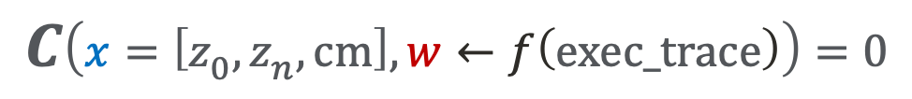
Monolithic SNARKs
Huge circuit
VM execution:
$$F$$
$$F$$
……
$$F$$
$$z_{n}=st′$$
$$z_{0}=st$$
$$z_{1}$$
$$z_{2}$$
$$z_{n−1}$$
$$($$
$$)$$
$$cm=Commit$$
$$tx_{1}$$
$$tx_{2}$$
$$tx_{n}$$
Can’t support dynamic $n$
Fix $n$
transform to a circuit
Large, can’t start proving without it
$$C\left(x=\left[z_{0},z_{n},cm\right],w←f\left(exec_trace\right)\right)=0$$
Memory/computation intensive
Run a SNARK (e.g., Plonk/STARK)
E.g., FFTs, MSMs
Proof $π$
Subsequent work [CFFZ24]:
Mem-efficient & fast Sumcheck
Other SNARK components still expensive
LatticeFold benefits from it!

Slide 6












Piecemeal SNARKs (IVC/PCD)
[Valiant08, BCCT12]
Stmnt
$${tx}_{i−1}$$
$${tx}_{i}$$
$$z_{i−1}$$
$$F$$
$$z_{i}$$
$$F$$
$$z_{i+1}$$
$$SNARK.V$$
$$SNARK.V$$
Steps 1..i-2
correct
$$π_{i−1}$$
$$π_{i}$$
$$π_{i+1}$$
SNARK
First i steps
executed correctly
Pros:
Pipeline proving/witness-gen
Small memory overhead
Parallelizable using PCD
Cons:
Expensive SNARK.V circuit
SNARK proving still not that cheap
Any better way to construct IVC?
E.g., Mangrove [NDCTB24]

Slide 7

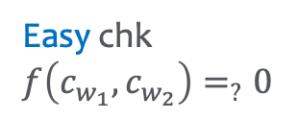

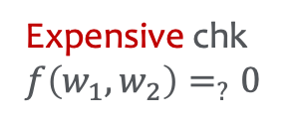




IVC/PCD from Folding [BCLMS20,KST21]
Homomorphic commitment:
$$Commit:$$
long vector
$$w$$
short
$$c_{w}$$
Homomorphism:
$$w_{1}+w_{2}$$
$$c_{w_{1}+w_{2}}=c_{w_{1}}+c_{w_{2}}$$
Why useful?
Expensive chk
$f\left(w_{1},w_{2}\right)=_{?}0$
Easy chk
$f\left(c_{w_{1}},c_{w_{2}}\right)=_{?}0$
$$\left(u_{1},w_{1}\right),\left(u_{2},w_{2}\right)∈R_{com}⇒\left(\tilde{u},\tilde{w}\right)∈R_{com}$$
$P^{∗}$ out $(\tilde{u},\tilde{w},π)$ s.t. $\left(\tilde{u},\tilde{w}\right)∈R_{com}$ & $V\left(u_{1},u_{2},\tilde{u},π\right)=1$
$⇒P^{∗}$ knows witnesses for $u_{1},u_{2}$

Slide 8













IVC/PCD from Folding [BCLMS20,KST21]
Folding scheme:
$≈$ Compress multiple NP statements into one
$$R_{com}≔\left\{\left(u=\left(x,c_{w}\right), w\right) :\left(x,w\right)∈R_{NP}∧c_{w}=Comm(w)\right\}$$
$$\left(x,w\right)∈R_{NP}$$
$≈$LinComb 2 witnesses
$≈$LinComb 2 commitments
$$u_{1}, w_{1}$$
$$\tilde{u}, \tilde{w}∈R_{com}$$
$$u_{1}, u_{2}$$
$$Fold.P$$
$$Fold.V$$
$$0/1$$
$$u_{2}, w_{2}$$
$$π$$
$$\tilde{u}, π$$
Faster than SNARK.P!
Cheaper than SNARK.V!
Completeness
+ Knowledge soundness
[BCLMS20,KST21]: We can construct IVC/PCD from folding schemes!
$$\left(u_{1},w_{1}\right),\left(u_{2},w_{2}\right)∈R_{com}⇒\left(\tilde{u},\tilde{w}\right)∈R_{com}$$
$P^{∗}$ out $(\tilde{u},\tilde{w},π)$ s.t. $\left(\tilde{u},\tilde{w}\right)∈R_{com}$ & $V\left(u_{1},u_{2},\tilde{u},π\right)=1$
$⇒P^{∗}$ knows witnesses for $u_{1},u_{2}$

Slide 9




















IVC/PCD from Folding [BCLMS20,KST21]
$$R_{NP}$$
$${tx}_{i−1}$$
$$R_{NP}$$
$$z_{i−1}$$
$$F$$
$$z_{i}$$
$$F$$
$$u_{i−1}$$
$$π_{i−1}$$
$$Fold.V$$
$$Fold.V$$
$${\tilde{u}}_{i−1}$$
$${\tilde{u}}_{i}$$
build inst-witness
“step i-1 is correct”
$$u_{i−1}, w_{i−1}$$
$$π_{i}$$
$$u_{i},w_{i}$$
$$π_{i+1}$$
$$Fold.P$$
$$Fold.P$$
$${\tilde{u}}_{i−1}, {\tilde{w}}_{i−1}$$
$${\tilde{u}}_{i}, {\tilde{w}}_{i}$$
$${\tilde{u}}_{i+1}, {\tilde{w}}_{i+1}$$
“steps 1..i-2 are correct”
“steps 1..i-1 are correct”

Slide 10



IVC/PCD from Folding [BCLMS20,KST21]
IVC from folding vs IVC from SNARK:
Proving algorithm:
Extra embedded circuit:
SNARK.P
$$SNARK.V$$
$$Fold.P$$
Much faster
$$Fold.V$$
Much smaller
Which homomorphic commitment to use?

Slide 11


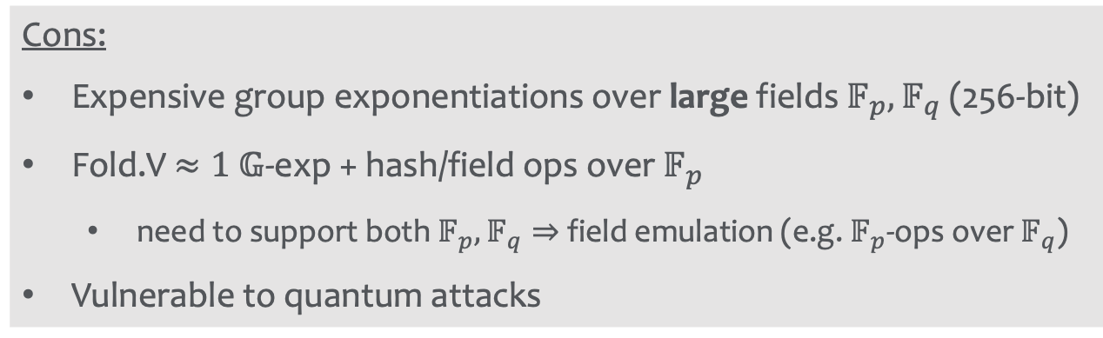


Homomorphic Commitment
Option 1: Pedersen
$p,q:≈$256-bit primes
$$w≔\left(w_{1},w_{2}…,w_{n}\right)∈𝔽_{p}^{n}$$
$$c_{w}≔g_{1}^{w_{1}}g_{2}^{w_{2}}⋯g_{n}^{w_{n}}∈𝔾$$
$$≈𝔽_{q}×𝔽_{q}$$
Cons:
Expensive group exponentiations over large fields $𝔽_{p},𝔽_{q}$ (256-bit)
Fold.V $≈1 𝔾$-exp + hash/field ops over $𝔽_{p}$
need to support both $𝔽_{p},𝔽_{q}⇒$ field emulation (e.g. $𝔽_{p}$-ops over $𝔽_{q}$)
Vulnerable to quantum attacks

Slide 12
LatticeFold: Contributions
The first folding scheme from lattice-based commitments
Fast & small fields arithmetics (e.g., 64-bit or 32-bit prime fields)
Eliminate non-native field emulation in Fold.V
Messages and commitments live in the same space
Quantum attacks resistant (based on Lattice assumptions)
Support high-degree constraint systems (e.g., CCS [STW23])

Slide 13






Ajtai Binding Commitments [Ajtai96]
E.g., $q$ $≈$64-bit prime, $β=2^{16}$, $n≫λ$
$$A←ℤ_{q}^{λ×n}$$
long vector
$$w∈{[−β,β]}^{n}$$
short
$$c_{w}=Aw mod q∈ℤ_{q}^{λ}$$
Essential for binding
Homomorphic Property:
Assumption: $w_{1}+w_{2}∈{\left[−β,β\right]}^{n}$
$$c_{w_{1}}+c_{w_{2}}=\left(Aw_{1}+Aw_{2}\right) mod q=A\left(w_{1}+w_{2}\right) mod q=c_{w_{1}+w_{2}}$$
Cons: committing complexity = $O(λn)$ $𝔽$-ops

Slide 14

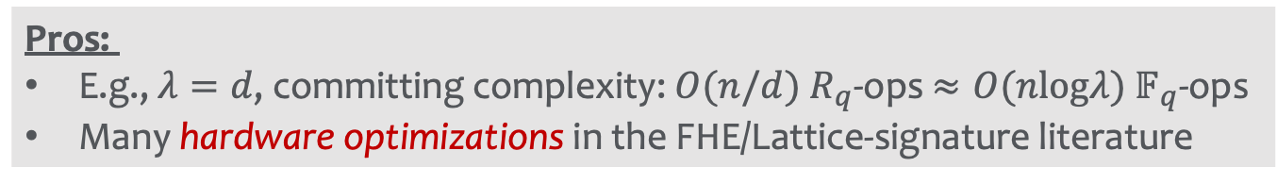






Ring/Module-based Ajtai [LM07,PR07]
E.g., $R_{q}=ℤ_{q}\left[X\right]/(X^{d}+1)$ (Polynomials with deg $<d$ and $ℤ_{q}$-coefficients)
$$A←ℤ_{q}^{λ×n}$$
long vector
$$w∈{\left\{−β,…,β\right\}}^{n}$$
short
$$c_{w}=Aw mod q∈ℤ_{q}^{λ}$$
$$ℤ_{q}^{d}→R_{q}$$
$$\tilde{w}∈R_{q}^{n/d}$$
$${\tilde{c}}_{w}=\tilde{A}\tilde{w}∈R_{q}^{λ/d}$$
$$\tilde{A}←R_{q}^{λ/d×n/d}$$
Coefficients in $\left\{−β,…,β\right\}$
Pros:
E.g., $λ=d$, committing complexity: $O(n/d)$ $R_{q}$-ops $≈O(nlogλ)$ $𝔽_{q}$-ops
Many hardware optimizations in the FHE/Lattice-signature literature

Slide 15





Challenges of Folding with Ajtai
Naïve folding:
$$c_{w_{1}}, w_{1}$$
random $γ$
$$c_{w_{1}}+γc_{w_{2}}, w_{1}+γw_{2}$$
$∉{\left[−β,β\right]}^{n}$ anymore
$$c_{w_{2}}, w_{2}$$
Challenge: Keep folded witness stay in the bounded msg space
Essential for binding/soundness

Slide 16
















Re-represent witnesses w/ lower norms
Extend to the case where $a∈R_{q}$
split algorithm
Decomposition:
$$a∈(−β,β)$$
$$a_{1},…,a_{k}∈(−b,b)$$
($β=b^{k}$)
$$a=a_{1}+{b⋅a}_{2}+⋯+b^{k−1}⋅a_{k}$$
Folding:
(e.g., $k=2$ and $β=b^{2}$)
$$c_{w_{1}}^{1}, w_{1}^{1}∈{\left(−b,b\right)}^{n}$$
$$c_{w_{1}}, w_{1}$$
split
$$c_{w_{1}}^{2}, w_{1}^{2}$$
$$c^{∗}=combine(\left[γ_{i}\right],\left[c_{w_{1}}^{1}…c_{w_{2}}^{2}\right])$$
random $γ_{1},γ_{2},γ_{3},γ_{4}∈R_{q}$
$$c_{w_{2}}^{1}, w_{2}^{1}$$
with small coefficients!
$$w^{∗}=combine(\left[γ_{i}\right],\left[w_{1}^{1}…w_{2}^{2}\right])$$
$$c_{w_{2}}, w_{2}$$
$$∈{\left[−β,β\right]}^{n}$$
split
$$c_{w_{2}}^{2}, w_{2}^{2}$$
Complication: Fold.P must prove that witnesses are low-norm (i.e. in ${\left(−b,b\right)}^{n}$)
Novel range-proofs from Sumchecks
Knowledge soundness: Extract $w_{1}^{1}…w_{2}^{2}∈{\left(b,b\right)}^{n}$ from $w^{∗}∈{\left[β,β\right]}^{n}$
Notes:
More complication: CCS

Slide 17



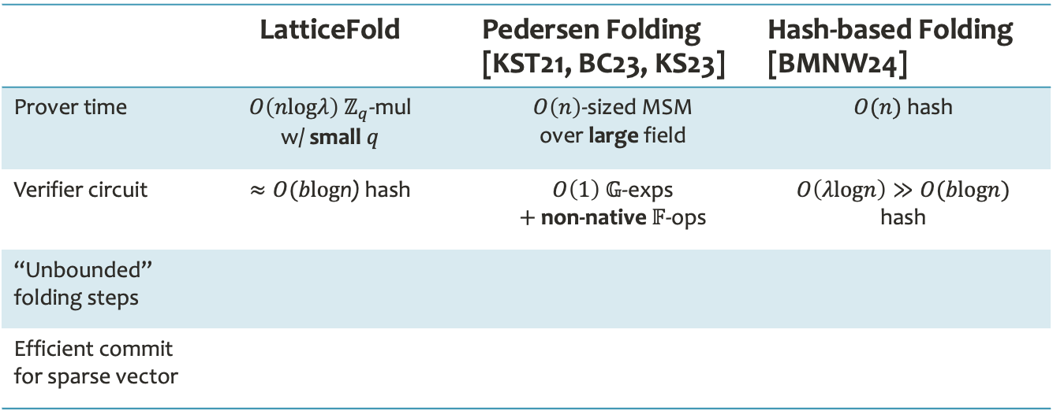
Performance
$n≈$ # of constraints
 | LatticeFold | Pedersen Folding [KST21, BC23, KS23] | Hash-based Folding [BMNW24]
Prover time | $O\left(nlogλ\right)$ $ℤ_{q}$-mul w/ small $q$ | $O\left(n\right)$-sized MSM over large field | $O(n)$ hash
Verifier circuit | $≈O(blog$n) hash | $O\left(1\right) 𝔾$-exps $+$ non-native $𝔽$-ops | $$O\left(λlogn\right)≫O(blogn)$$ hash
“Unbounded” folding steps
Efficient commit for sparse vector
✅
✅
❌
✅
✅
❌

Slide 18
Summary & Future Work
LatticeFold: the first lattice-based folding scheme
Fast & small field; efficient verifier circuit; quantum attacks resistant
Hardware optimization-friendly + Support high-deg constraint systems
Updated version
Optimized folding for high-degree constraint systems (CCS)
2 sequential Sumchecks previously, now only 1!
Future work
Integrate with Lasso to support table lookups
Remove the need for witness decomposition/range-check

Slide 19
Thank You
https://eprint.iacr.org/2024/257.pdf

Slide 20





How to Fold with Ajtai
Extend to the case where $a∈R_{q}$
split algorithm
Decomposition:
$$a∈(−β,β)$$
$$a_{1},…,a_{k}∈(−b,b)$$
($β=b^{k}$)
$$a=a_{1}+{b⋅a}_{2}+⋯+b^{k−1}⋅a_{k}$$
Folding:
(e.g., $k=2$ and $β=b^{2}$)
$$c_{w_{1}}^{1}, w_{1}^{1}∈{\left(−b,b\right)}^{n}$$
$$c_{w_{1}}, w_{1}$$
split
$$c_{w_{1}}^{2}, w_{1}^{2}$$
$$c^{∗}=combine(\left[γ_{i}\right],\left[c_{w_{1}}^{1}…c_{w_{2}}^{2}\right])$$
random $γ_{1},γ_{2},γ_{3},γ_{4}∈R_{q}$
$$c_{w_{2}}^{1}, w_{2}^{1}$$
with small coefficients!
$$w^{∗}=combine(\left[γ_{i}\right],\left[w_{1}^{1}…w_{2}^{2}\right])$$
$$c_{w_{2}}, w_{2}$$
$$∈{\left[−β,β\right]}^{n}$$
split
$$c_{w_{2}}^{2}, w_{2}^{2}$$
Complication: Fold.P must prove that witnesses are low-norm (i.e. in ${\left(−b,b\right)}^{n}$)
Novel range-proofs from Sumchecks
Knowledge soundness: Extract $w_{1}^{1}…w_{2}^{2}∈{\left(b,b\right)}^{n}$ from $w^{∗}∈{\left[β,β\right]}^{n}$
Notes:
More complication: CCS

Slide 21

Roadmap
SNARKs for zkVMs: Background
Memory/computation-efficient zkVMs from Folding
LatticeFold
Summary & Future work

Slide 22

IVC/PCD from Folding
$$R_{NP}$$
$${tx}_{i−1}$$
$$R_{NP}$$
$$z_{i−1}$$
$$F$$
$$z_{i}$$
$$F$$
$$u_{i−1}$$
$$π_{i−1}$$
$$Fold.V$$
$$Fold.V$$
$${\tilde{u}}_{i−1}$$
$${\tilde{u}}_{i}$$
build inst-witness
“step i-1 is correct”
$$u_{i−1}, w_{i−1}$$
$$π_{i}$$
$$u_{i},w_{i}$$
$$π_{i+1}$$
$$Fold.P$$
$$Fold.P$$
$${\tilde{u}}_{i−1}, {\tilde{w}}_{i−1}$$
$${\tilde{u}}_{i}, {\tilde{w}}_{i}$$
$${\tilde{u}}_{i+1}, {\tilde{w}}_{i+1}$$
“steps 1..i-2 are correct”
Final check: $\left({\tilde{u}}_{n},{\tilde{w}}_{n}\right), \left(u_{n},w_{n}\right)∈_{?}R_{com}$
Pros:
Fast Fold.P + inst-witness generation
Small circuit for Fold.V
Which commitment to use?

Slide 23












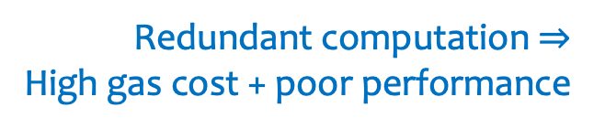









Scaling Blockchains
Smart-contract-based Blockchain: (oversimplified)
Nodes maintain:
VM state
$${st}_{1}$$
$${st}_{2}$$
……
……
$${st}_{i}$$
$${hd}_{1}$$
$${hd}_{2}$$
$${hd}_{i}$$
block header
$${tx}_{1}$$
$${tx}_{2}$$
$$……$$
$${tx}_{n}$$
Every node computes:
Redundant computation $⇒$
High gas cost + poor performance
VM state transition
$$F$$
$$F$$
……
$$F$$
$$z_{n}=st_{i}$$
$$z_{0}=st_{i−1}$$
$$z_{1}$$
$$z_{2}$$
$$z_{n−1}$$
$$tx_{1}$$
$$tx_{2}$$
$$tx_{n}$$
Notes:
Explain this quickly

Slide 24





















Scaling Blockchains
Based Rollup: (oversimplified)
How to compute $π_{i}$ efficiently?
$${st}_{1}$$
$${st}_{2}$$
……
……
$${st}_{i}$$
$${hd}_{1}$$
$${hd}_{2}$$
$${hd}_{i}$$
A prover gen proof $π_{i}$ for state transition $(st_{i−1},hd_{i},st_{i})$ and publish $(π_{i},st_{i})$:
$${tx}_{1}$$
$${tx}_{2}$$
$$……$$
$${tx}_{n}$$
$$F$$
$$F$$
……
$$F$$
$$z_{n}=st_{i}$$
$$z_{0}=st_{i−1}$$
$$z_{1}$$
$$z_{2}$$
$$z_{n−1}$$
Each node checks $Verify\left(\left[st_{i−1},hd_{i},st_{i}\right],π_{i}\right)=1$
and update to $st_{i}$
Much cheaper!

