Slide 1
Live stream on conference web site
Hashtag: #sbc25
SBC 2025
The 8th Science of Blockchain Conference
[ SBC 2025 ]
Hosted by the Berkeley Center for Responsible Decentralized Intelligence In collaboration with IC3 and Stanford CBR

Slide 2
The Science of Blockchain Conference
Technical topics in blockchain research:
New ideas and research challenges
Bring together the research community and engineers
Registrations:
≈ 4000 in 2022 ≈ 3500 in 2023
≈ 2000 in 2025
Notes:
Technical talks: speakers are asked to be as technical as possible

Slide 3
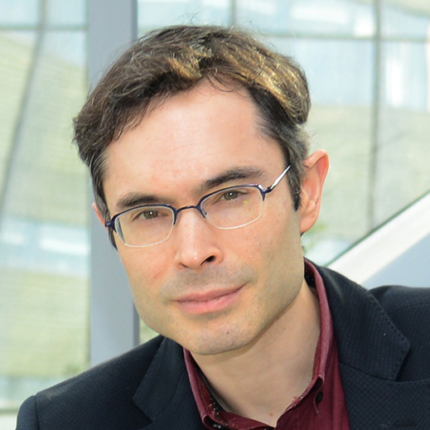
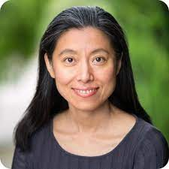
The program
Program chairs: Dan Boneh, Ari Juels, Dawn Song
2024 stats: 208 submissions, 29 accepted, rate = 14%
2025 stats: 202 submissions, 30 accepted, rate = 15%
+ 3 invited talks
SBC 2026: July 27-31, 2026. Submission site: sbc26.hotcrp.com
Notes:
Talk proposals, tutorials

Slide 4
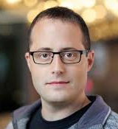
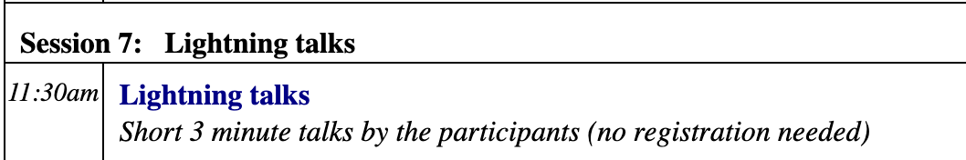
Lightning talks tomorrow
Session 7: Tuesday at 11:30am
Anyone can speak for 2-3 minutes
Line up in front of the stage, Joachim will call speakers up on stage
Joachim Neu

Slide 5
Thanks to the Program Committee
Aggelos Kiayias
Alin Tomescu
Andrew Lewis-Pye
Aniket Kate
Ari Juels
Ariel Gabizon
Arnab Roy
Arthur Gervais
Balaji Palanisamy
Benedikt Bünz
C. Papamanthou
Christian Cachin
C. Stathakopoulou
Ciamac Moallemi
Clara Schneidewind
Dahlia Malkhi
Dan Boneh
Davide Crapis
Dawn Song
Deepak Maram
Dionysis Zindros
Fan Zhang
Ghassan Karame
Giulia Fanti
Ittai Abraham
Ittay Eyal
J. Decouchant
Jeremy Clark
Joachim Neu
Joseph Bonneau
Justin Drake
Kartik Nayak
Ling Ren
Liyi Zhou
Mario Larangeira
Patrick McCorry
Sourav Das
Tanusree Sharma
Ted Yin
Tim Roughgarden
V. Estrada-Galiñanes
Will Scott
Yupeng Zhang
Zeta Avarikioti
Notes:
Talk proposals, tutorials

Slide 6
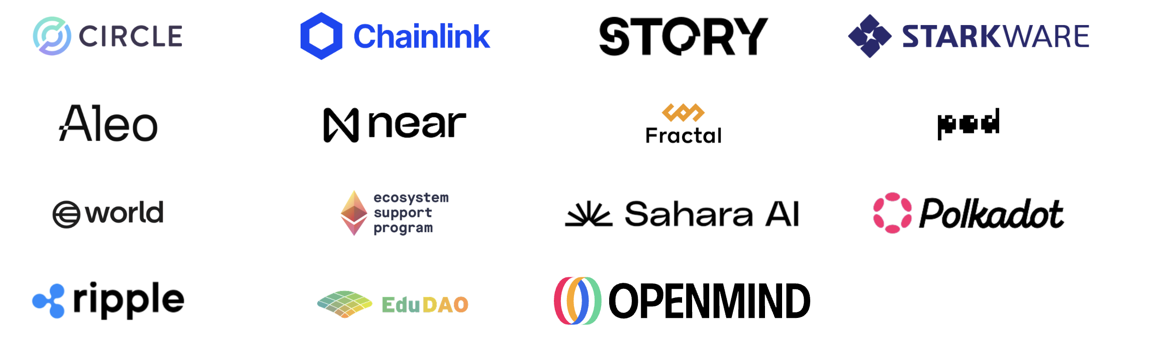
Thanks to our Sponsors !!

Slide 7
Special Thanks !!
Local arrangements:
Jocelyn Weber, Karin Bauer, Jennifer Liu, and other RDI staff members & volunteers
Berkeley Event Services, AV & Catering

Slide 8
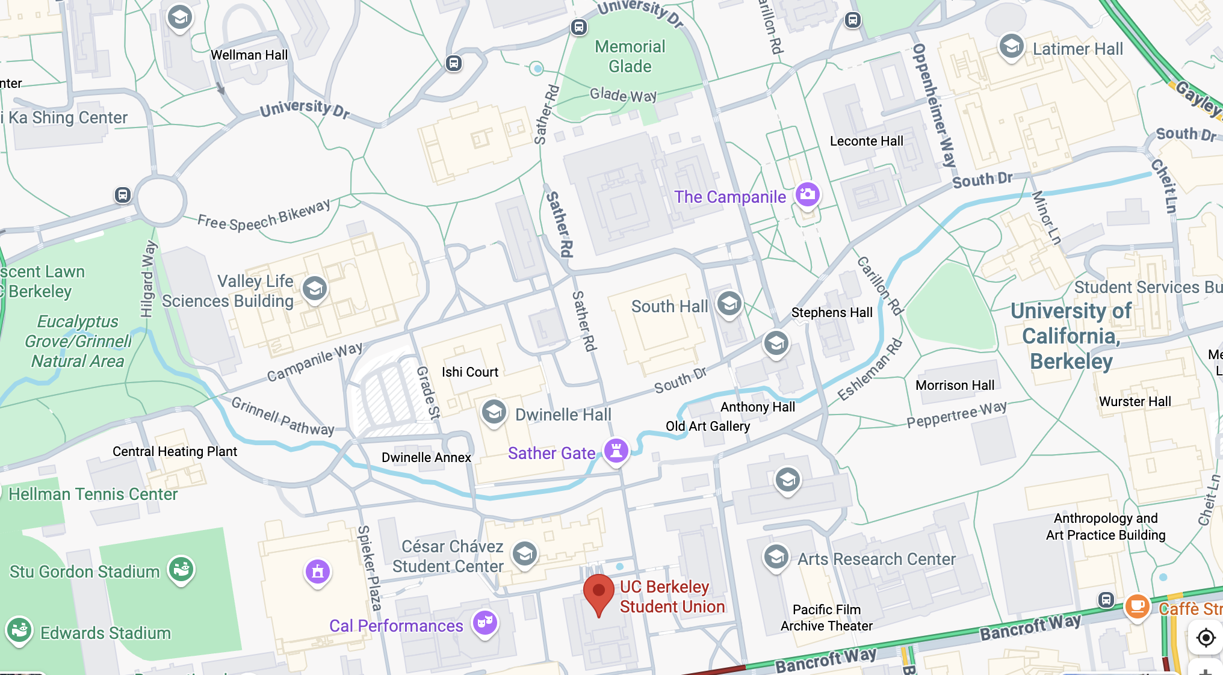
Things to
see on campus

Slide 9


Mission: Advance the science and technology at the intersection of responsible innovation, decentralization, and AI, and make it universally accessible.
Campus-wide, Multidisciplinary Innovation Center
One of only a few research centers funded by the State of California

Slide 10

THREE PILLARS OF BERKELEY RDI,
AN INNOVATION CENTER

Slide 11
SINCE 2021 RDI HAS —
Research:
~10 Best/Top Paper Awards in top conferences
Supported RDI Frontier Research Fellows with 25 at UC Berkeley and 7 across the UC campuses in diverse disciplines
Education:
Offered the world’s first MOOCs in LLM Agents & Advanced LLM Agents
Offered the world’s first DeFi & Zero Knowledge Proofs MOOCs
Attracting 1M+ views on the RDI Channel
~7K hackathon participants from 100+ countries, thousands of universities and companies
Entrepreneurship & Community
Incubated 110 global teams in 7 cohorts, with follow-on funding over $650M+
Organized 10+ events with ~10K attendees and ~100K online views

Slide 12
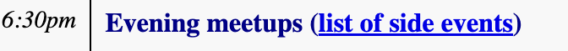
Schedule
Main program: Mon – Wed. 9:00 – 5:00pm.
Lunch at around 12:10pm: adjacent patio on the west side
Tonight: reception at 5pm, same place as the lunch
Evening activities: sign up on the conference web site
Lightning talks tomorrow at noon

Slide 13
Administrative
We are currently on the 3rd floor. Restrooms are located on the 2nd, 4th and 5th floors.
Hallway track: downstairs at the outdoor plazas; benches & picnic tables on the west side.

Slide 14
Enjoy the conference …
Session 1: Infrastructure security
Aniket Kate, session chair

