Slide 1

Automated Variance Reduction for SCALE Shielding Calculations
Douglas E. Peplow
and John C. Wagner
Nuclear Science and Technology Division
Oak Ridge National Laboratory
14th Biennial Topical Meeting of the ANS
Radiation Protection and Shielding Division
April 3-6, 2006
Carlsbad, New Mexico, USA

Slide 2
Motivation
Codes need to solve increasingly difficult problems
Need accurate and fast answers
Monte Carlo with importance sampling is the best variance reduction
Codes need to be simple and as automated as possible

Slide 3
Background
SCALE (Standardized Computer Analyses for Licensing Evaluation)
Collection of codes for performing criticality safety, radiation shielding, spent fuel characterization and heat transfer analyses
Control modules or sequences automate the execution and data exchange of individual codes to perform various types of analyses
SAS4 – Shielding Analysis Sequence
Automated 1-D variance reduction capability for more than a decade, with limitations
Effective for cask midplane and top center dose
Not well suited to cask corners and very heterogeneous geometries
Hence, need for Monte Carlo tool with automated 3-D variance reduction (AVR) for general shielding applications

Slide 4
CADIS Methodology - Consistent Adjoint Driven Importance Sampling
Use Discrete Ordinates to find approximate adjoint flux
From the adjoint flux
Importance map for MC transport (weight windows for splitting and roulette)
Biased source distribution
Biased source and importance map work together

Slide 5
SCALE Implementation of CADIS
Cross sections
Multi-group SCALE libraries – many choices
Create adjoint and forward cross section sets
Find the approximate adjoint flux
GRTUNCL3-D – first collision code
TORT – three dimensional DO transport code
Monaco
Descendant of MORSE – still in progress
Uses SCALE general geometry (KENOVI)
Automate as much as possible

Slide 6
SCALE Sequence: MAVRIC
Monaco with Automated Variance Reduction using Importance Calculations
SCALE
Driver
and
MAVRIC
Input
BONAMI / NITAWL or
BONAMI / CENTRM / PMC
Resonance cross-section
processing
ICE
Optional: TORT adjoint cross sections
GRTUNCL-3D
Optional: first-collision source calculation
TORT
Optional: 3-D discrete ordinates calculation
Monaco
3-D Monte Carlo
End

Slide 7
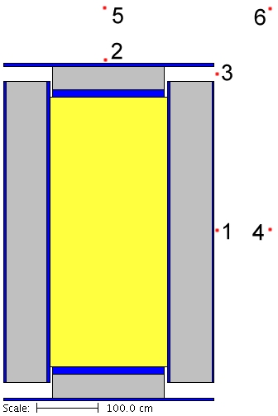
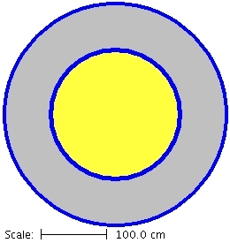
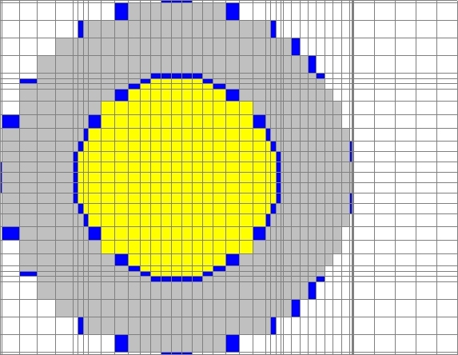
SCALE Sequence: MAVRIC
Monaco with Automated Variance Reduction using Importance Calculations
Input:
Physical Problem
Materials
Geometry
Source
Det. Positions
Det. Responses
Monte Carlo info
Histories, max time, etc
Adjoint DO info
Adjoint source
Spacial discretization

Slide 8
Example
Simple cask with ventports
Spent fuel:
UO2 (20%), air
Uniform source
Steel, Concrete

Slide 9
Example
Source: photons
Response: photon dose

Slide 10

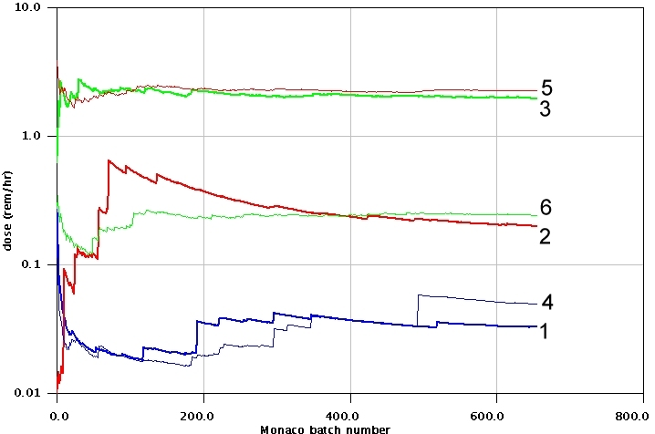
Analog Monaco

Slide 11
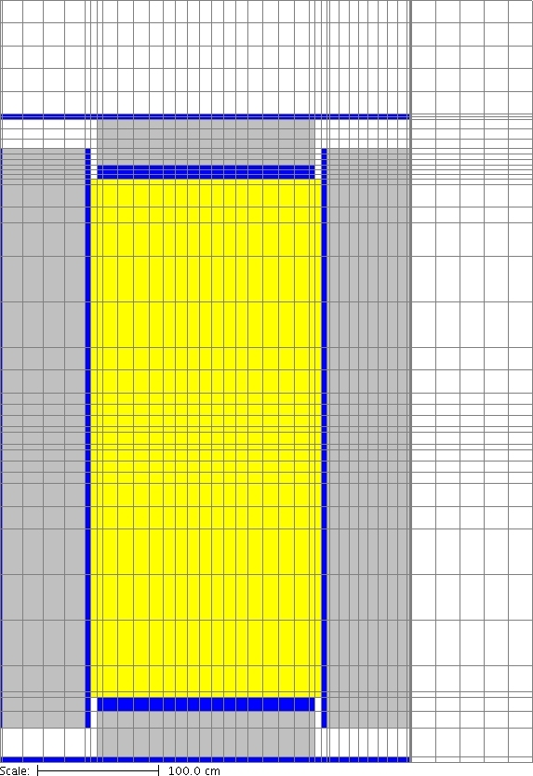
Example - Discretization

Slide 12
Example – Adjoint Flux

Slide 13
Example – Imp. Map/Biased Source

Slide 14
Example – Biased source distribution

Slide 15
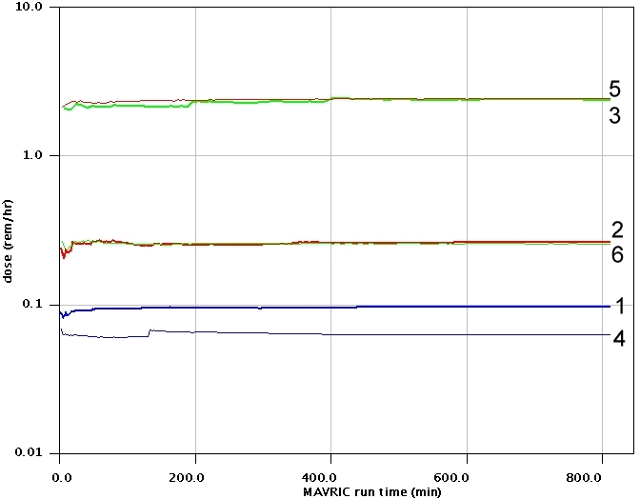
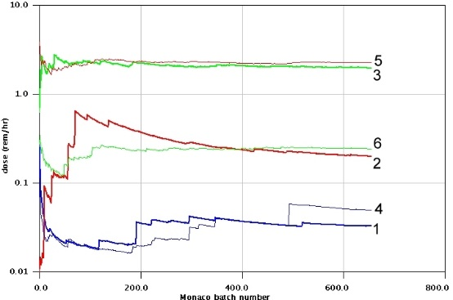
Results

Slide 16
Results
Compare MAVRIC and Analog

Slide 17
Results
Compare MAVRIC and SAS4

Slide 18
Results
Compare MAVRIC and others: FOM ratios to analog Monaco

Slide 19
Results
Compare MAVRIC and ADVANTG: FOM ratios to analog

Slide 20
Future Work
MAVRIC Sequence
Automatic homogenization in importance map
Determine standard set of TORT parameters
Monaco
Flux tallies for regions
Mesh tally
Testing, Testing, then a bit more Testing

Slide 21
Discussion & Questions

