Slide 1
Introduction to Computational Nuclear Engineering
NENG 685 – Fall 2017
Capt James Bevins
Air Force Institute of Technology
02 October 2017

Slide 2
Outline
Introductions
Syllabus
Computational Resources
What are we doing here?
Neutral Particle Transport Approaches
Course Preview & Context
Numerical Error

Slide 3
Introductions
Name:
Go by:
Undergrad Degree:
Previous assignments:
Family/Hobbies/Follow-on assignment:
Master’s Research Interest:
Surprising fact about me is _____.

Slide 4
Bevins Research Interests
Solve interesting national security problems
Direct tie to applications
Both computational and experimental
ETA
Detector response
Neutron spectroscopy
Optimization
Nuclear data
Post detonation forensics
RSM
NWE
Policy

Slide 5
Syllabus
Bevins Teaching Philosophy
I am not “the expert”…
But I do know something about the subject…
As do you…
So we will learn together!
This material, much like math is best learned by doing
Preflight quizzes (i.e. “flipped classroom”)
Allows me to modify daily lectures to needs of students
Allows us to focus on the more “difficult” material in class
Allows class time for working examples and some HW
Regurgitation on tests tells me very little about your ability to solve problems
Learning should be fun and relevant to your goals
Notes:
Course documents
Blackboard?
Flexibility in schedule

Slide 6


Which language is best?
F90
Why teach Python?
When would I ever use it?
Why can’t we learn _________?
What language can I learn and never have to worry about another language?
C++
Computational Engineering

Slide 7


Your approach?

Slide 8

Post NENG 685

Slide 9
The (AFIT) NE Computational Toolbox
FORTRAN (MS vStudio)
MATLAB
Python (version is up to you)
C++ (MS vStudio)
Root
Mathematica
Nuclear Engineering Codes (relevant to NENG 685)
MCNP (FORTRAN)
PENTRAN (FORTRAN 90)
GEANT (C++)
Denovo/ADVANTG (C++)

Slide 10
Ethics
National Society of Professional Engineers: http://courses.cs.vt.edu/professionalism/WorldCodes/NSPE.code.html
Engineers, in the fulfillment of their professional duties, shall:
Hold paramount the safety, health, and welfare of the public in the performance of their professional duties.
Perform services only in the areas of their competence.
Issue public statements only in an objective and truthful manner.
Act in professional matters for each employer or client as faithful agents or trustees.
Avoid deceptive acts in the solicitation of professional employment.

Slide 11
Ethics
American Nuclear Society: http://www.ans.org/about/coe/
Fundamental Principle
ANS members as professionals are dedicated to improving the understanding of nuclear science and technology, appropriate applications, and potential consequences of their use.
To that end, ANS members uphold and advance the integrity and honor of their professions by using their knowledge and skill for the enhancement of human welfare and the environment; being honest and impartial; serving with fidelity the public, their employers, and their clients; and striving to continuously improve the competence and prestige of their various professions.

Slide 12
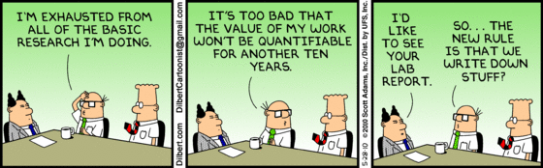
Final Projects
We’ll talk about final projects about half way through the semester.
The project will be code-based, but you can do analysis if there is a compelling reason to.
I encourage you to choose a project that is useful to your research.
Keep this in the back of your mind…

Slide 13
Computational Resources
Windows machines (those with EN Image)
Linux machines
Blg 470
640/242
HPC
DSRC
Savio – Berkeley
LLNL
RSICC
GitHub – Course_References
GitHub – “Surviving_AFIT” (coming soon)

Slide 14
Categories of Research
Experiment: Experimental scientists work by observing how nature behaves
Theory: Theoretical scientists use the language of mathematics to explain and predict the behavior of nature
Computation: Computational scientists use theoretical and
experimental knowledge to create (and use) computer-based models of aspects of nature
Notes:
Computational Science seeks to gain understanding principally through the analysis of mathematical models on high performance computers.
The term computational scientists has been coined to describe scientists, engineers, and mathematicians who apply HPC technology in innovative and essential ways to advance the state of knowledge in their respective disciplines.
Thus, we distinguish it from computer science, which is the study of computer and computation and theory and experiment, the traditional form of science.

Slide 15
Solving Problems
Identify the problem
Pose the problem in terms of a mathematical model
Identify a computational method for solving the model
Implement the computational method on a computer
Assess the answer in the context of the
Implementation (computer language and architecture)
Method (discrete or continuous)
Model (symbolic or numerical)
Using
Visualization and interpretation
Experimental comparisons
Analytical comparisons
Engineering judgement
Notes:
Solving (Computational) Problems

Slide 16
Big Challenges
Science
Global climate modeling
Astrophysical modeling
Biology: genomics; protein folding; drug design
Computational Material Sciences and Nano-sciences
Engineering
Semiconductor design
Earthquake and structural modeling
Computational fluid dynamics
Analysis and design of nuclear reactors
Business
Financial and economic modeling
Transaction processing, web services and search engines
Defense
Nuclear weapons – test by simulations
Cryptography
Notes:
(Computational) Big Challenges
Ideally, one would like to base these choices on theory rather than experimental trial and error - This is where computational science fits in!

Slide 17
What Are We Trying to Accomplish?
From 2010 NPR, 5 key objectives for nuclear weapons policies and posture
1. Preventing nuclear proliferation and nuclear terrorism;
2. Reducing the role of U.S. nuclear weapons in U.S. national security strategy;
3. Maintaining strategic deterrence and stability at reduced nuclear force levels;
4. Strengthening regional deterrence and reassuring U.S. allies and partners; and
5. Sustaining a safe, secure, and effective nuclear arsenal.
* Monitoring international treaty compliance
Notes:
Get students to come up with ideas how computational science plays a role. For example,
Modeling of detector systems and networks; modeling of safeguard controls and systems (i.e. PU reprocessing); nuclear forensics
International relation models; force on force modeling (i.e. wargaming); targeting exercises (nuclear is all modeled)
Deterrence and international models; game theory; mutli-polar deterrence models?
Deterrence and international models; war gaming
We can’t test our systems fully; limited ability to test reliability; forget doing “effectiveness” testing
Analysis of gaps; system performance

Slide 18
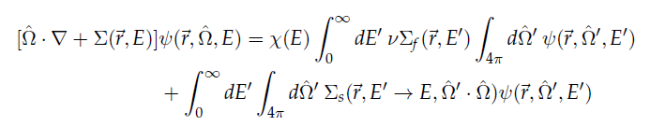
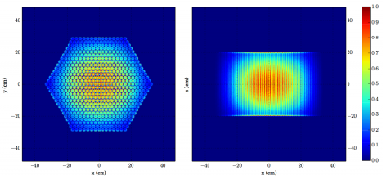
How Will We Accomplish It?
Notes:
Learn methods to translate equations like the Boltzmann Transport equation into computer-generated solutions

Slide 19
Transport Approaches
Notes:
See course notes 01-2

Slide 20
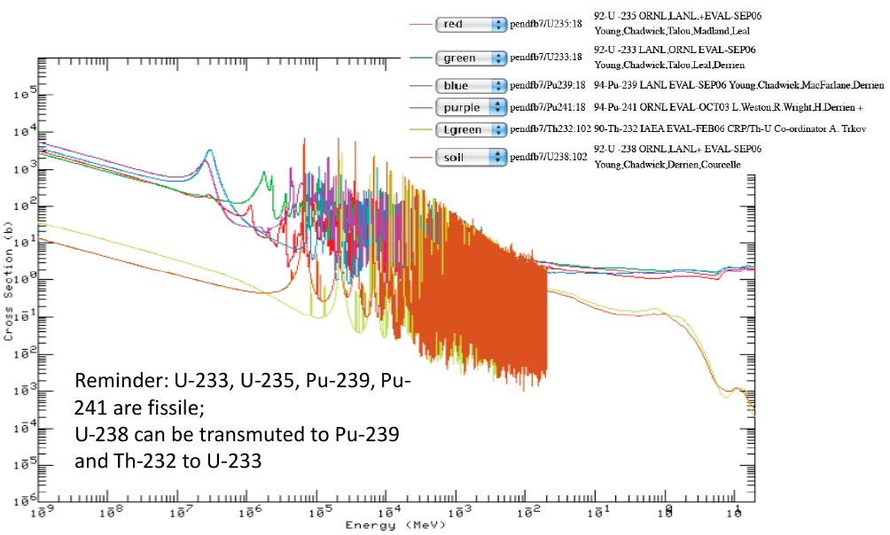
Quick Note on Cross-Sections

Slide 21
Context
Notes:
See course notes 01-3

Slide 22
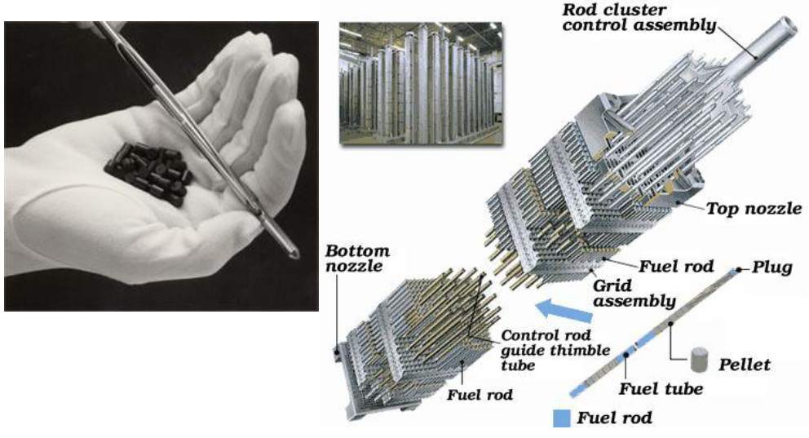
PWR Assembly

Slide 23
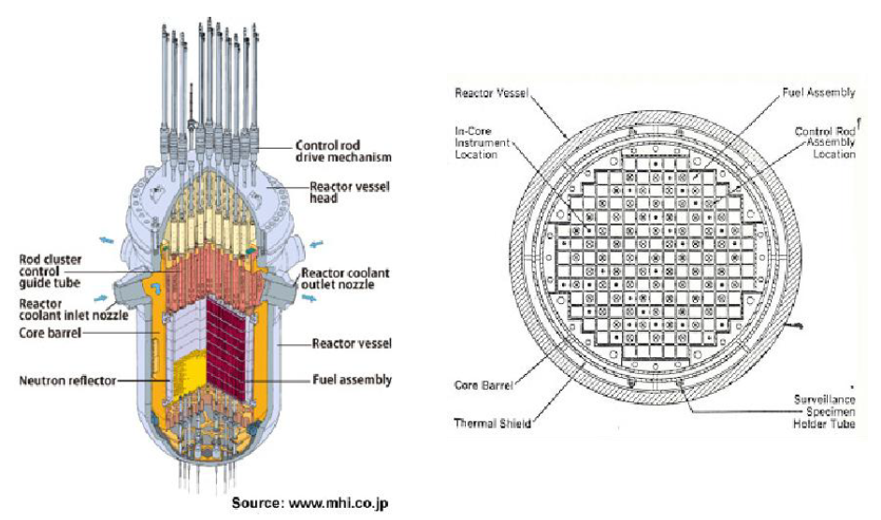
PWR

Slide 24
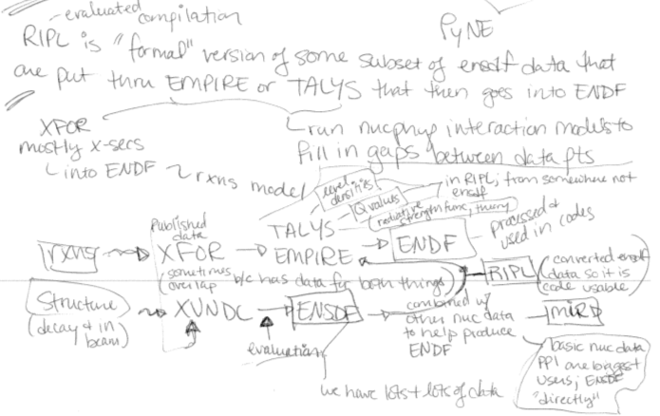
Nuclear Data Processing

