Slide 1
Imaging Fast Neutron Sources Using Rotating Scatter Masks (RSM)
Presentation to the FRC
Capt James Bevins
Air Force Institute of Technology
01 November, 2017

Slide 2
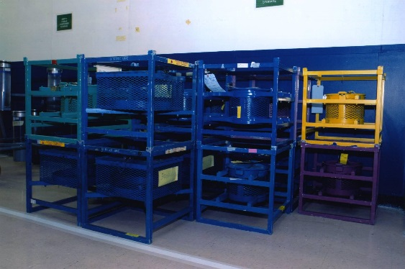
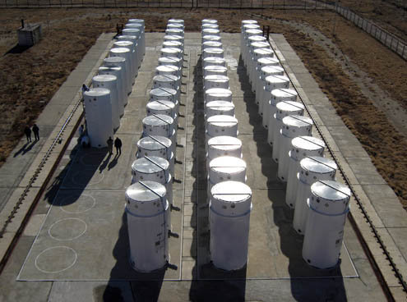
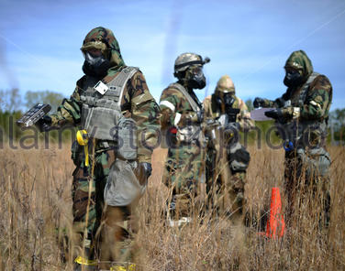
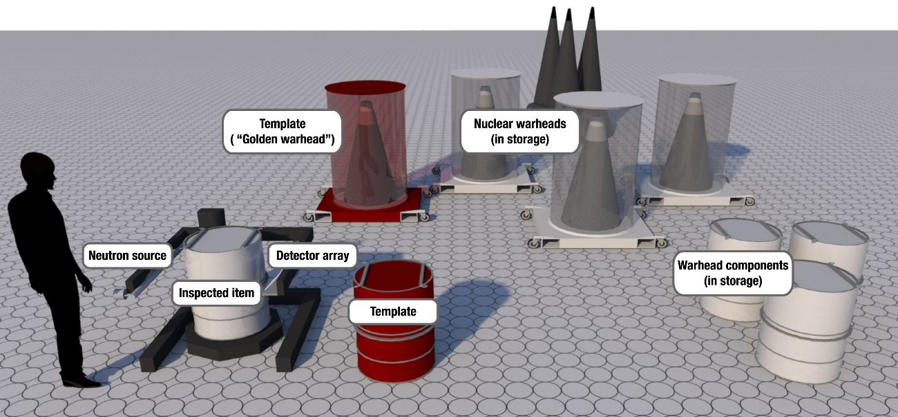
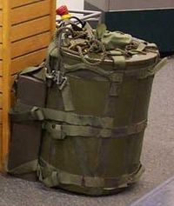
Motivation
Nuclear Materials Security/Monitoring
Nuclear Materials Search
Zero Knowledge Warhead Verification
Develop innovative method combining target location, characterization, and tracking.
Notes:
Emphasize mixed radiation fields and their importance for applications of interest to national security.

Slide 3
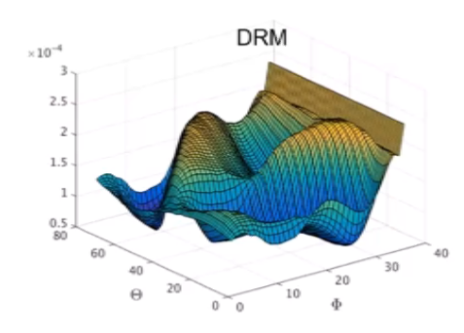
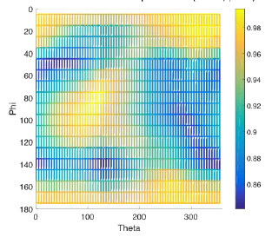
Background
Gamma Response
Gamma Location
Gamma RSM

Slide 4
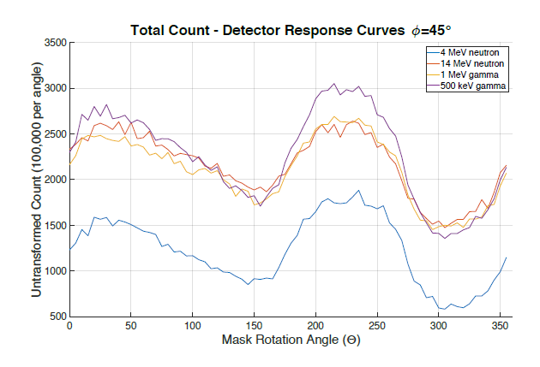
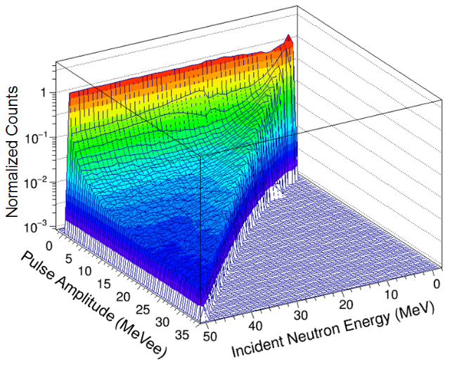
Background
+
PSD Det
Neutron Response
Neutron RSM
Neutron Location

Slide 5
Research Objectives
Development of neutron RSM design
Develop proof of concept using existing designs with modified material
Optimize using Coeus
Bounding the localization characteristics
Capture nuclear data uncertainties
Provide feedback for design of experiments
Conduct initial validation of modeled detector response functions

Slide 6
Resources
AFIT “In-House”
PI
Developed optimization software for radiation transport problems
Characterized a EJ-309 detector response
Performed unfolding of neutron energy spectra in mixed radiation fields
Master’s student
Equipment
Sponsor Funded
Student MCNP training - $3800
Small volume neutron detector - $3000
ORISE Summer Faculty support - $24,200
Extensive modeling experience with gamma – RSM at AFIT
Accelerates proof of concept timeline to develop full proposal
Notes:
PI – Extensive modeling experience
Master’s Student – MCNP modeling experience
- Developing initial models for class project
Equipment – DAQ
- RSM motor
- gamma RSM to develop set-up
- Sources

