Slide 1
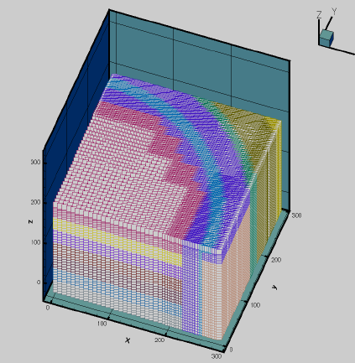
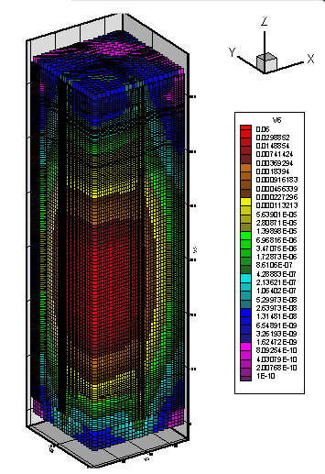
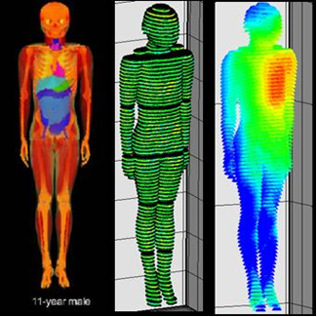
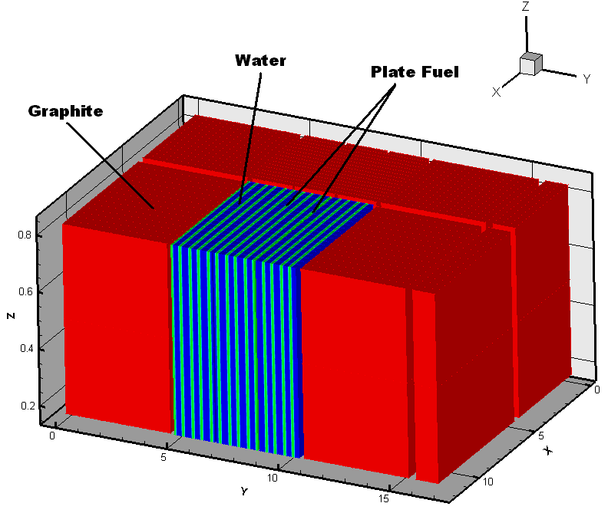
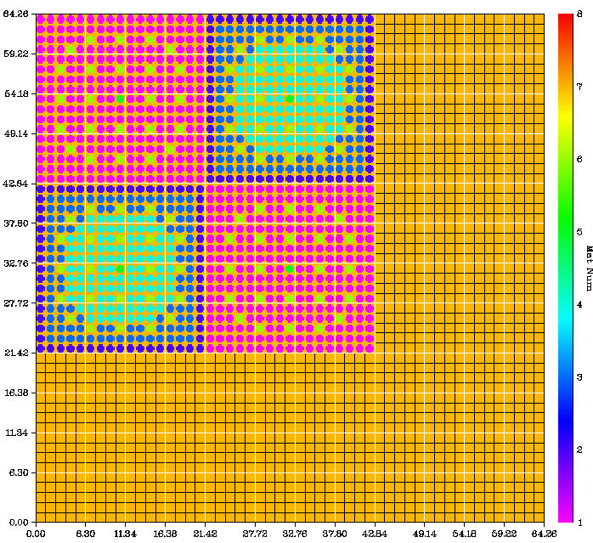
PENMSHXP Mesh Generation
AFIT
October 2015

Slide 2
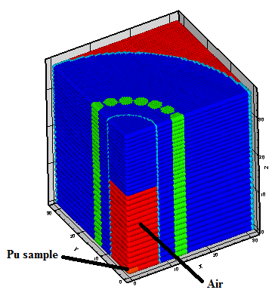
Overview
PENMSH-XP Fundamentals
Input generation
Material balance and volume/mass preservation
Numerous overlay shape options
Mesh density changes—on the fly
Data rendering—immediate analysis
Graphical visualization with DISLIN
Exercises and Exploration
PENMSH-XP GUI
2
Notes:
PENTRAN CODE SYSTEM
2

Slide 3
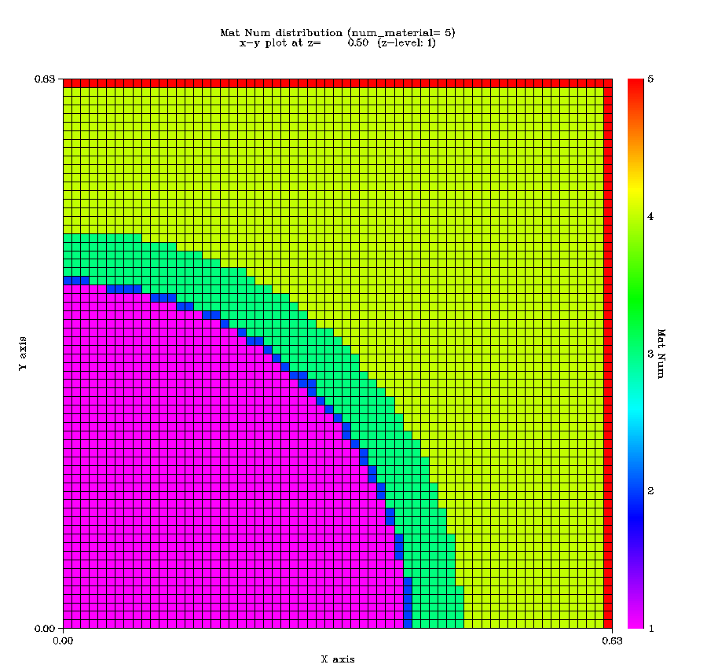
Westinghouse Pin

Slide 4
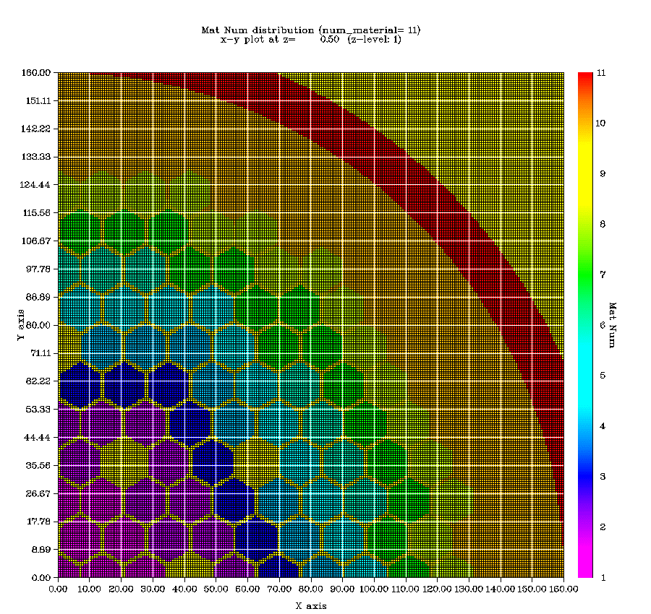
2-D Fast Reactor Model – HEX Geometry

Slide 5
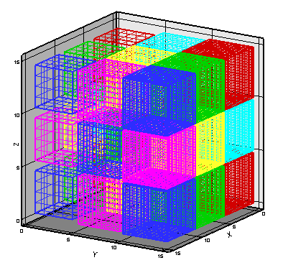
Coarse Mesh/Fine Mesh Scheme
Primary Two level meshing scheme for
Cartesian geometry
Model divided into coarse meshes (CMs)
Each CM filled with fine mesh grids
“Block adaptive” fine mesh structure,
No requirements on surrounding CMs; Higher order coupling with TPMC
Intermediate mesh level (“medium” grids ) for “/-multigrid” nested iteration
3 x 3 x 3 coarse mesh Model

Slide 6
PENMSH-XP input: “Z-level” basis
File names | Description | PENMSH XP
penmsh.inp | Meshing parameters | Required
prbname#.inp | Meshing per ‘z level’ | Required
prbname.src | Fixed source grid | Optional
prbname.spc | Source spectrum | Optional
prbname.chi | Fission spectrum | Optional
prbname.mba | Material balance | Optional
prbname#.flx or prb#.flx or .fjn files | Group fluxes (.flx) or current (.fjn) generated by PENDATA from PENTRAN calculation | Optional

Slide 7
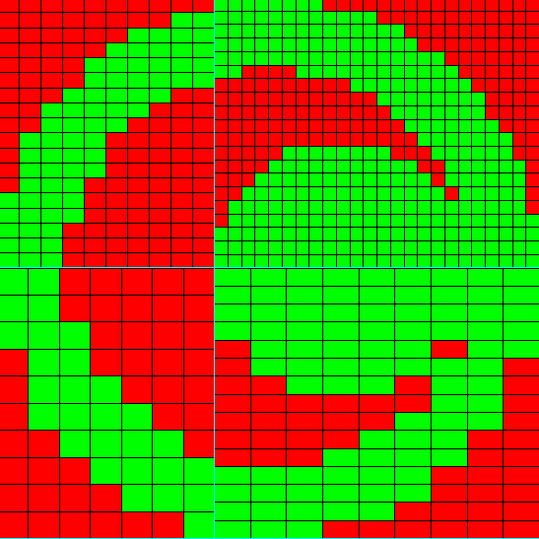
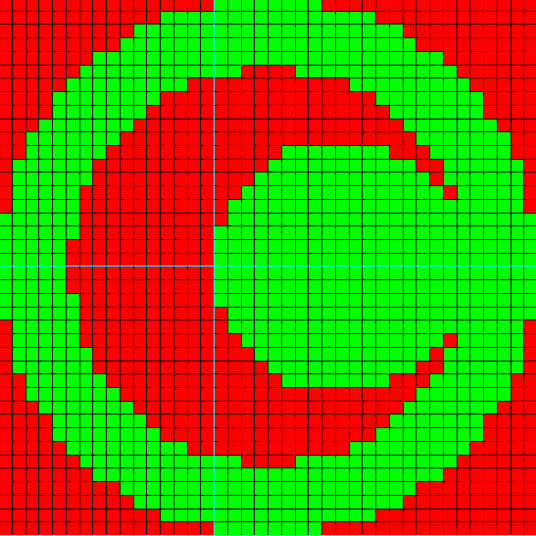
Block Adaptive Mesh Generation
PENMESH-XP- automatically sets up problem
You define shapes, 3-D intervals, it does the rest…
Coarse Mesh Structure
Fully discontinuous variable meshing among coarse meshes

Slide 8
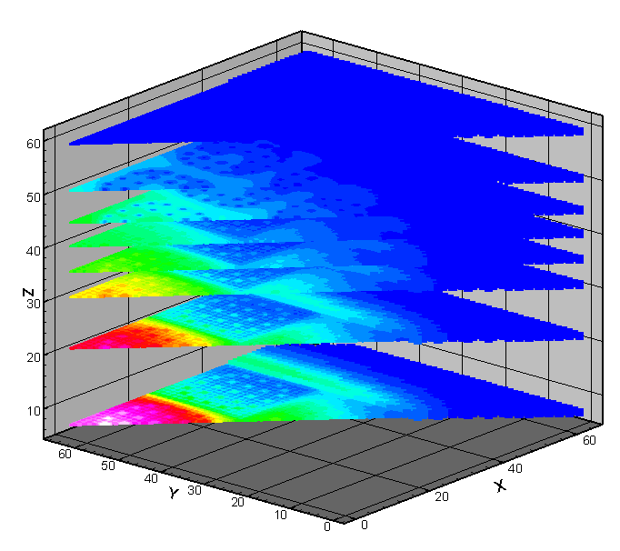
Sample Geometry Slice from PENMSH-XP
2-D Geometry, Flux Plots, nuclear reactor model

