Slide 1
PENTRAN -CRT Problem Exercises
AFIT Workshop
October 2015

Slide 2
Parallel Job Processing
Two Modes for Execution: Interactive or Batch
Interactive Mode
Interesting for debug, poor use of system
Scripts available
Batch Mode (e.g. PBS scheduler)
Allocates jobs to least used cores automatically
Scripts for pre- and post- parallel PENTRAN
ppen.post prbname pen #n #c
ppen.pre prbname pen #n #c
Post processing with PENDATA, PENMSHXP
2
Notes:
PENTRAN CODE SYSTEM
2

Slide 3
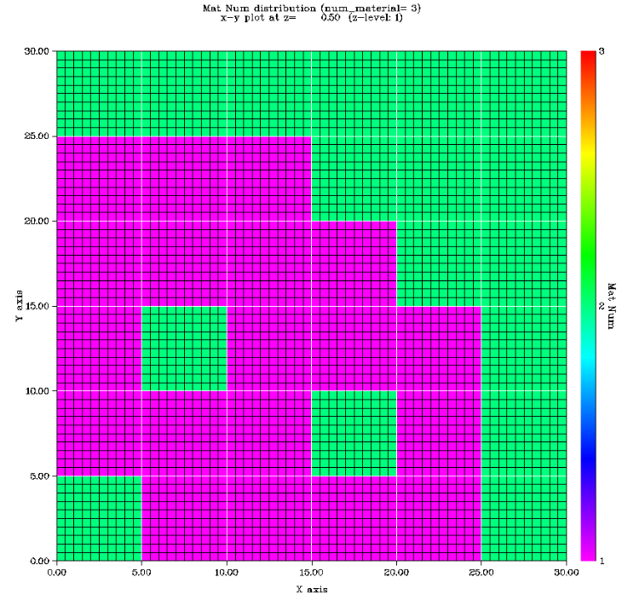
Sample Reactor Problem: zippy
Zippy reactor problem
6x6 Coarse Mesh problem with control rod /water flux traps
zippy.pen
Water(m2)
Fuel (m1)
Water or Control Rod (m3)
Reflective
3
Notes:
PENTRAN CODE SYSTEM
3

Slide 4
Sample Shielding Problem: pbshield
pbshield shielding problem 10x10x10 cm
~100,000 meshes, S12P1, 2G
3x3x3 Coarse Meshes,
pbshield.pen
Pb
Water
10 Ci CsCl
Stainless steel
Reflective
4
Notes:
PENTRAN CODE SYSTEM
4

Slide 5
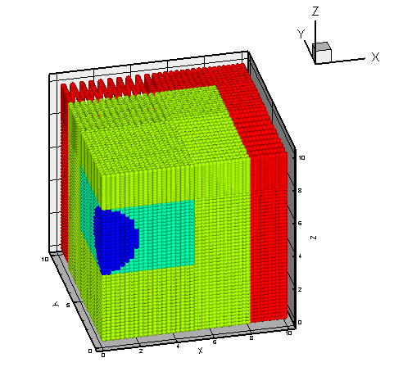
Sample Shielding Problem: pbshield
pbshield shielding problem 10x10x10 cm
~100,000 meshes, S12P1, 2G
3x3x3 Coarse Meshes,
pbshield.pen
10 Ci CsCl
Water
Pb
Stainless steel
Reflective
5
Notes:
PENTRAN CODE SYSTEM
5

Slide 6
Run zippy.pen
Prepare a 2 Parallel core Script for zippy.pen
Prefix: zippy Suffix: pen Nodes 1 Cores: 2
pen.pre zippy pen 1 2
Copies zippy.pen to prb.pen
Sets up script to execute
Submit to queue—script needed
Post process output: ppen.post zippy pen 1 2
6
Notes:
PENTRAN CODE SYSTEM
6

Slide 7
PENDATA Procedure
PENDATA
Data (to the highest degree possible) is stored in PENTRAN as PARALLEL memory—each processor contains data only LOCALLY
If requested, outputs will be in a number of files
zippy.1, zippy.2 … run output from proc. 1, 2, etc
Contains important run data and metrics
zipply.L1, zippy.L2 … logfile outputs, etc
zippy.f1, zippy.f2 … binary flux data, etc
zippy.j1, zippy.j2 … flux and net current, etc
7
Notes:
PENTRAN CODE SYSTEM
7

Slide 8
Run PENDATA, PENMSH-XP Plot
To run PENDATA
In the local problem directory, type PENDATA <enter>
Enter the options as desired
PENDATA will gather all files from the parallel run in a transparent manner
To use PENMSH to plot:
Go to crit directory
Type penmsh –i moddir –f flxdir -msf 4
Will reference model and run to plot fluxes
8
Notes:
PENTRAN CODE SYSTEM
8

