Slide 1
Introduction to PENMSH
Colorado School of Mines PENTRAN-CRT Workshop
March 18, 2014

Slide 2
Overview
Westinghouse Pin
Dual Range Coincidence Counter (DRCC)
2-D Fast Reactor Model – HEX Geometry

Slide 3
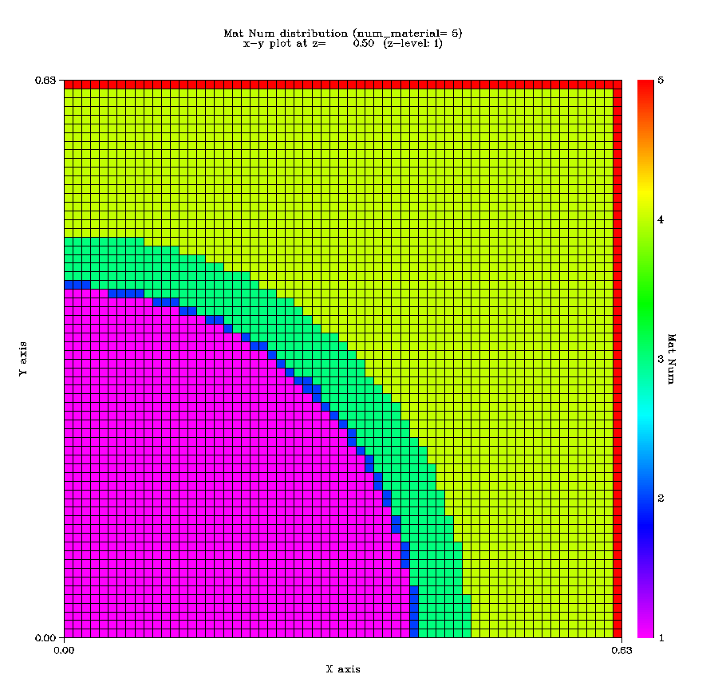
Westinghouse Pin

Slide 4
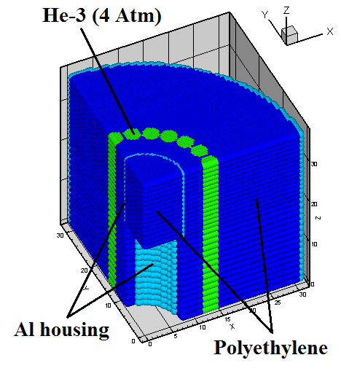
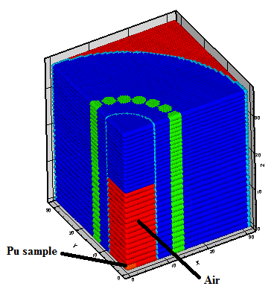
Dual Range Coincidence Counter (DRCC)

Slide 5
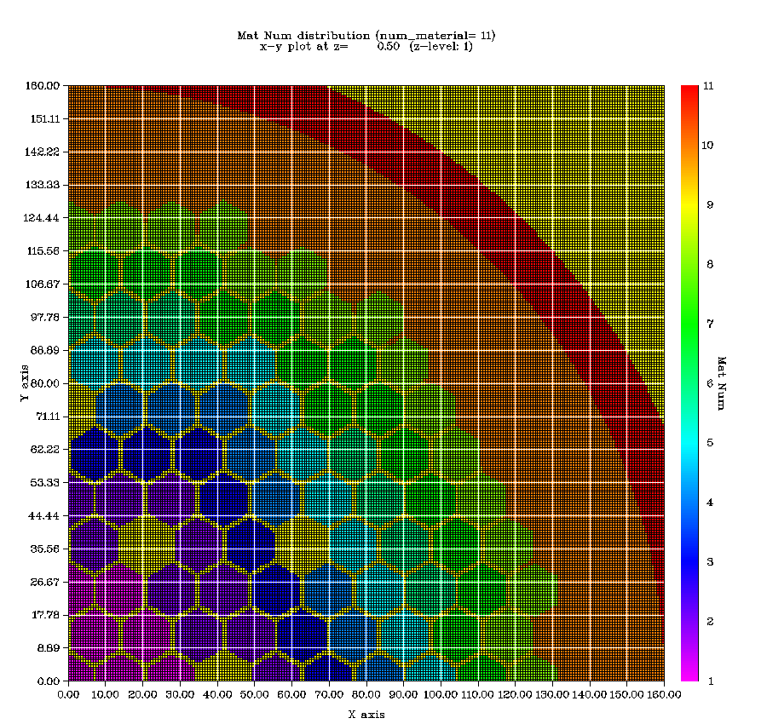
2-D Fast Reactor Model – HEX Geometry

