Slide 1
PENTRAN -CRT Problem Exercises
Colorado School of Mines
PENTRAN-CRT Workshop
March 2014

Slide 2
Parallel Job Processing
Two Modes for Execution: Interactive or Batch
Interactive Mode
Interesting for debug, poor use of system
Batch Mode in IBM Blue Gene
“sbatch” Batch Scheduler by IBM
Job “squeue” for Queue core use
Allocates jobs to least used cores automatically
Scripts for pre- and post- parallel PENTRAN
mpisub ppencrt prbname pen #n #c, ppen-post prbname pen #n #c
Post processing with PENDATA, PENMSH
2
Notes:
PENTRAN CODE SYSTEM
2

Slide 3
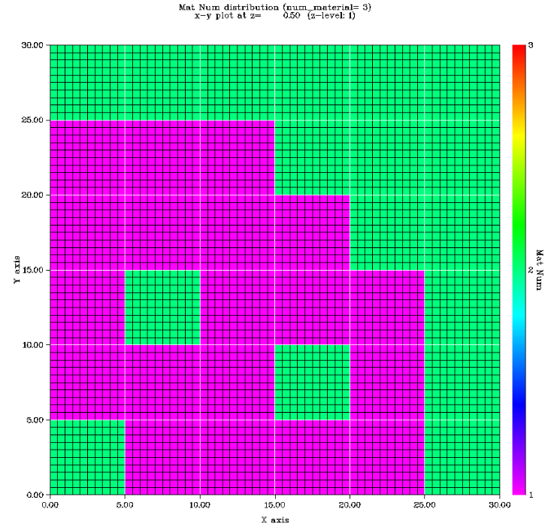
Sample Reactor Problem: zippy
Zippy reactor problem
6x6 Coarse Mesh problem with control rod /water flux traps
zippy.pen
Water(m2)
Fuel (m1)
Water or Control Rod (m3)
Reflective
3
Notes:
PENTRAN CODE SYSTEM
3

Slide 4
Sample Shielding Problem: pbshield
pbshield shielding problem 10x10x10 cm
~100,000 meshes, S12P1, 2G
3x3x3 Coarse Meshes,
pbshield.pen
Pb
Water
10 Ci CsCl
Stainless steel
Reflective
4
Notes:
PENTRAN CODE SYSTEM
4

Slide 5
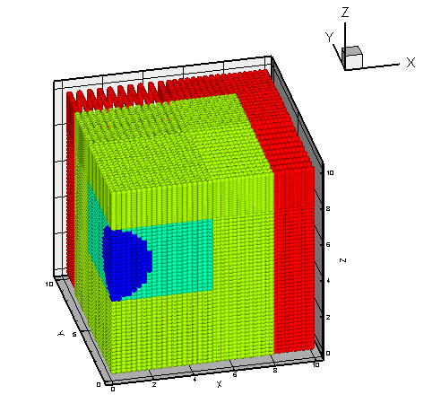
Sample Shielding Problem: pbshield
pbshield shielding problem 10x10x10 cm
~100,000 meshes, S12P1, 2G
3x3x3 Coarse Meshes,
pbshield.pen
10 Ci CsCl
Water
Pb
Stainless steel
Reflective
5
Notes:
PENTRAN CODE SYSTEM
5

Slide 6
Run zippy.pen
Prepare a 2 Parallel core Script for zippy.pen
Prefix: zippy Suffix: pen Nodes 1 Cores: 2
mpisub ppencrt zippy pen 1 2
Copies zippy.pen to prb.pen
Sets up zippy.scr script
Submit to queue: sbatch zippy_2_pbs.scr
Note the job number reported back
Check queue status: squeue <enter>
When in workdir, type “peek” to see parallel feedback of last submitted job
Post process output: ppen-post zippy pen 1 2
To Prepare Batch Mode via PBS
ppen-pre zippy pen 2
6
Notes:
PENTRAN CODE SYSTEM
6

Slide 7
PENDATA Procedure
PENDATA
Data (to the highest degree possible) is stored in PENTRAN as PARALLEL memory—each processor contains data only LOCALLY
If requested, outputs will be in a number of files
zippy.1, zippy.2 … run output from proc. 1, 2, etc
Contains important run data and metrics
zipply.L1, zippy.L2 … logfile outputs, etc
zippy.f1, zippy.f2 … binary flux data, etc
zippy.j1, zippy.j2 … flux and net current, etc
7
Notes:
PENTRAN CODE SYSTEM
7

Slide 8
Run PENDATA, PENMSH-XP Plot
To run PENDATA
In the local problem directory, type PENDATA <enter>
Enter the options as desired
PENDATA will gather all files from the parallel run in a transparent manner
To use PENMSH to plot:
Go to crit directory
Type penmsh –i moddir –f flxdir -msf 4
Will reference model and run to plot fluxes
8
Notes:
PENTRAN CODE SYSTEM
8

