Slide 1
GStreamer MPEG-DASH sink
MPEG-DASH sink plugin to complete the GStreamer offering
Stéphane Cerveau (dabrain34), software engineer @ Collabora

Slide 2
Agenda
    A brief introduction to adaptive streaming and MPEG-DASH
    GStreamer state of the art with adaptive streaming support
    GStreamer DASH sink
    Next steps

Slide 3
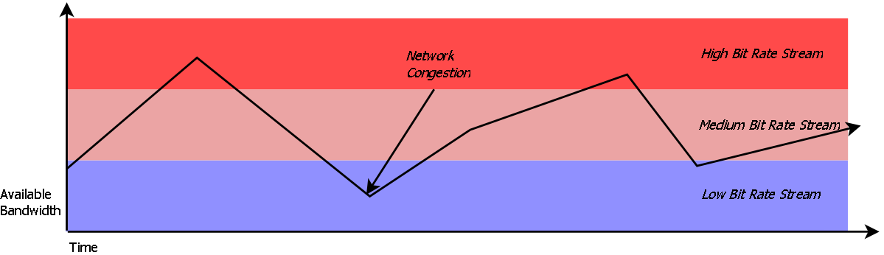
What is adaptive streaming?
Designed to work over HTTP
Streaming multimedia over computer network
Flexibility and scalability offering variable bitrate based streams according to the network bandwidth.
By Daseddon - Own work, CC BY-SA 3.0, https://commons.wikimedia.org/w/index.php?curid=20054919
Source: Wikipedia

Slide 4
What is adaptive streaming?
Adaptive streaming comparison
      HLS (Apple HTTP Live Streaming)
      MSS (Microsoft Smooth Streaming)
      ADS (Adobe HTTP Dynamic Streaming)
      MPEG-DASH (MPEG Dynamic Adaptive Streaming over HTTP)
Source: Wikipedia

Slide 5
DASH: Dynamic adaptive streaming over HTTP

Slide 6
What is MPEG-DASH ?
Dynamic Adaptive Streaming over HTTP
Open and international standard for adaptive streaming
XML Manifest based to describe media content
Audio/Video/Text/Event support
Source: Wikipedia

Slide 7
Who is using MPEG-DASH?
DASH Industry forum
Solutions using DASH:
  HbbTV (Hybrid Broadcast Broadband TV)
  Major streaming actors:
    YouTube
    Netflix
    Etc.

Slide 8


Who is using MPEG-DASH?

Slide 9

Who is using MPEG-DASH?

Slide 10
MPD: Media Presentation Description

Slide 11
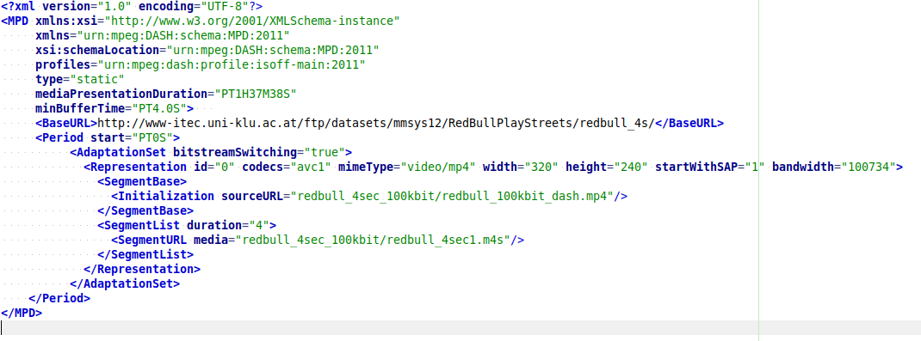
MPD: Media presentation description

Slide 12
GStreamer adaptive streaming

Slide 13
GStreamer adaptive streaming
HLS
  Demuxer since 2013
  HLSSink2 since 2017
DASH
  Demuxer since 2013
  No sink available but a first implementation by ylatuya and thiagoss in 2016 which has not been merged.

Slide 14
GStreamer DASH Sink

Slide 15
DASH sink
https://gitlab.freedesktop.org/gstreamer/gst-plugins-bad/merge_requests/704
Based on splitmuxsink and hlssink2
Support for static/dynamic MPD
Support multiple input streams (multiple audio/video inputs)
Support TS/MP4 encapsulation

Slide 16
DASH MPD base classes
Share the code between dashdemux and dashsink to read or generate MPD
MPD client class
  Reorganize nodes as gobject to let set/get property
  Reorganize xml helper methods (can be a gst-libs)
  Reorganize the parser

Slide 17
Issues
Code reorganization with mpd node in a separated files
Multiple audio/video support
Muxer support with transport stream or ISO

Slide 18
Demo
Grab a video only from my camera for 60s
  # gst-launch-1.0 -m dashsink name=dashsink mpd-root-path=/tmp target-duration=3 dynamic=false period-duration=60000 v4l2src ! video/x-raw, framerate=30/1,width=320,height=240 ! videoconvert ! queue ! x264enc bitrate=400 ! dashsink.video_0
Hope it will work:
  # gst-launch-1.0 playbin uri=file:///tmp/dash.mpd

Slide 19
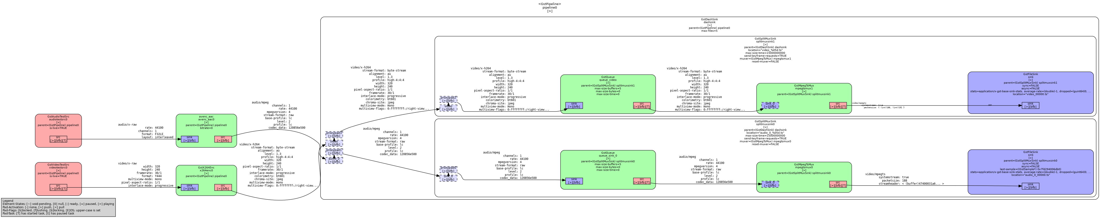
DASH sink pipeline

Slide 20
Next steps
First review the patch (only 23k lines of diff …)
Fragment support in mp4mux
Implement adaptive sink base class
Improve properties options to tackle DASH flexibility
Debug and a lot more, because DASH is so much fun ...

Slide 21
Thank you!
Any questions ?

