Slide 1
Can detector with gstreamer
How to detect a simple can with GStreamer and OpenFoodFacts
Stéphane Cerveau (dabrain34), Senior software engineer @ Collabora

Slide 2
Barcode detection

Slide 3
Introduction
Open solution to garbage collection
Free bus ticket for cans
Use of GStreamer data processing
Use of Open database to provide object matching

Slide 4

Open food facts
A free, online crowd-sourced database
Initiated in 2012
Based on barcode to detect food products
~ 1 Million of products
Apps available to check/add/edit products
Binding for many language and platforms

Slide 5



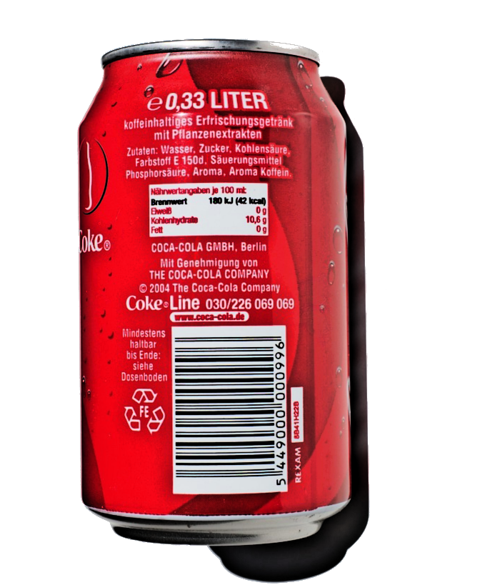
Detection

Slide 6
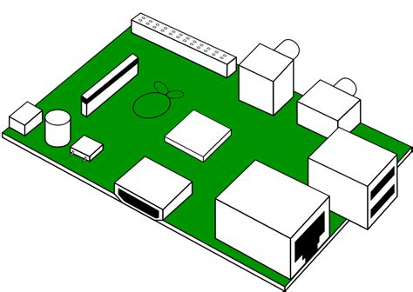
Can collector with raspberry pi
Barcode scanner with camera
Validate the can’s barcode with openfoodfacts
GPIO to control automatic doors ( any help is welcome)
Open design (in progress)
Materials:
  Raspberry PI + raspbian
  Camera(s)
  Automation signalling to grant access to user to throw the can
Software:
  Zbar/ZXing
  Gstreamer
  REST API client for OFF using Python

Slide 7
Implementation
Python code: https://github.com:dabrain34/gst-off-detector.git
Zxing plugin in Gstreamer (OpenFoodFacts). MR: https://gitlab.freedesktop.org/gstreamer/gst-plugins-bad/merge_requests/743
Finetuning using Gstreamer (Grayscale, image size, etc.)
Retrieve data from OpenFoodFacts with OFF API

Slide 8
Next steps
Enhance the barcode detection
Image for open hardware
Use of neural net for object detection
Automation for doors and object acceptance.

Slide 9
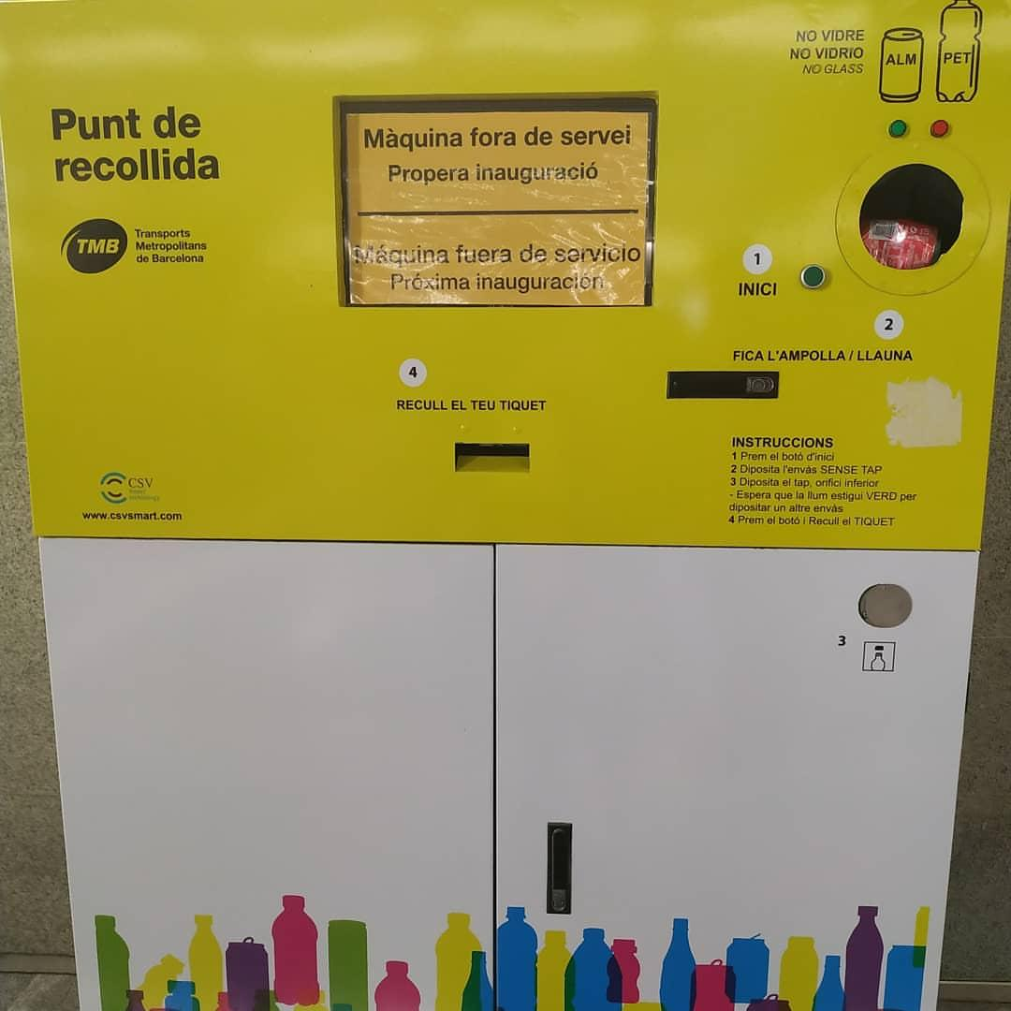
Breaking news 07/19/2019
Estacio Diagonal, Barcelona !

Slide 10
Thank you!

