Slide 1
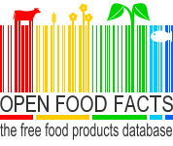
Open Food Facts
f
Stéphane Cerveau
@dabrain34

Slide 2
Who am I and why this presentation ?
  Senior software engineer in the multimedia team
  Open source and free knowledge advocate
  Human rights watchman :)

Slide 3
OpenFoodFacts:
A free, online crowd-sourced database of food products from around the world.

Slide 4
History
The project was initiated by Stephane Gigandet.
He wanted to have a better picture of food products
Officially started on the 19th of May 2012, during the Food Revolution Day by Jamie Oliver

Slide 5
Some key figures
Project kickstarted in 2012
83000 products by may 2016
6 years later: 326000 products in 2018!
Almost 1 Million in July 2019!

Slide 6
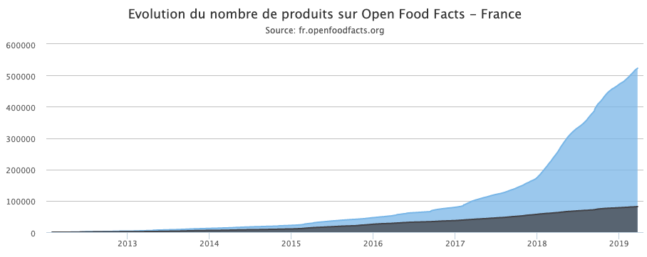
Products growth of the years...
Source: Open Food Facts.

Slide 7
What information?
Neutral and factual data!
Common product name
Barcodes as unique identifier
Product characteristics
  Quantity
  Brand
  Country
  Etc.
Ingredients
Nutrition facts
  Nutri-score

Slide 8
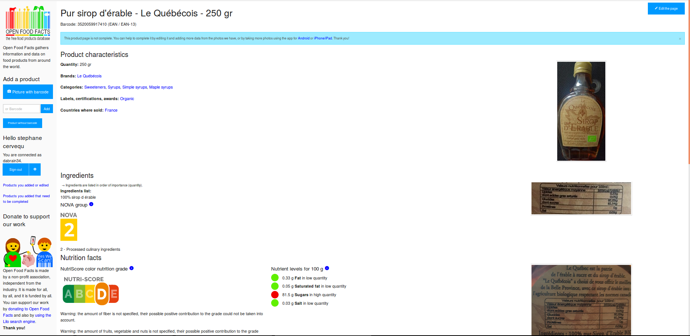

Slide 9
How does it work ?
Adding a new product:
  Check if the product exists
  Add the barcode as an ID
  Provide additional data such as photos, ingredients, etc.
Update an existing product:
  Enhance product accuracy

Slide 10
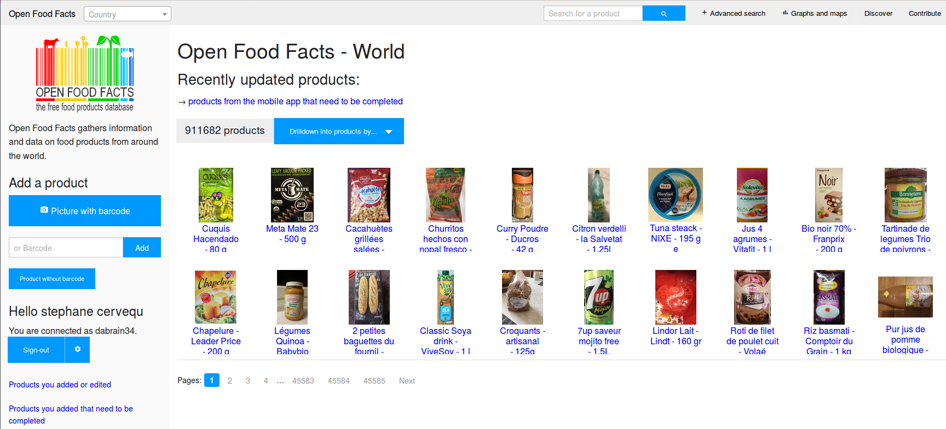

Slide 11


Open as a proof of liability
Open without any limitations except to be open
Contributions must follow open data license
OdBL license for the database
CC-BY-SA for the pictures
OFF non profit organisation to fight against industry lobbying
Open the data to lift up the industry

Slide 12
Who is using it ?
Single user can access and get nutritional information, ingredients, etc., from the openfoodfacts apps or API.
3rd party applications:
  El coco
  Fridge inventory
  100 projects more ...

Slide 13


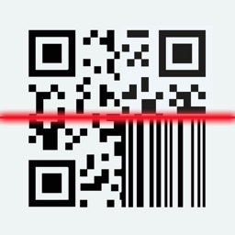











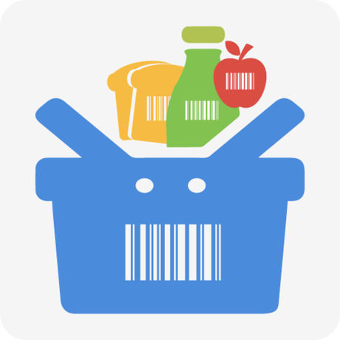








There are many apps for that...
What you will build next…
Source: Open Food Facts.

Slide 14

“Compra con cabeza, come sano”
Spanish application created in 2018
Mobile app to get product nutrition score, as Yuka does for France
Scan and analyze the products
Source: https://elcoco.es/

Slide 15
Why do I care ?
Engineer, father, nature admirer…
Environmental cause defender
Solution seeker
Open source advocate as a counter power tool

Slide 16
One of my projects with OFF ...

Slide 17
Can collector with Raspberry PI

Slide 18
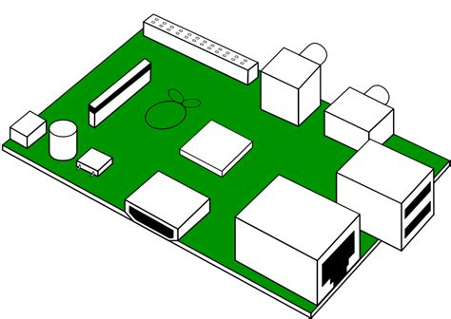
Can collector with raspberry pi
“Money” reward for cans (bus tickets, etc.)
Barcode scanner with camera
Validate the can’s barcode with openfoodfacts
GPIO to control automatic doors ( any help is welcome)
Open design (in progress)
Materials:
  Raspberry PI + raspbian
  Camera(s)
  Automation signalling to grant access to user to throw the can
Software:
  Zbar
  Gstreamer
  REST API client for OFF using Python

Slide 19
Can collector with Raspberry PI
Any help appreciated !

Slide 20
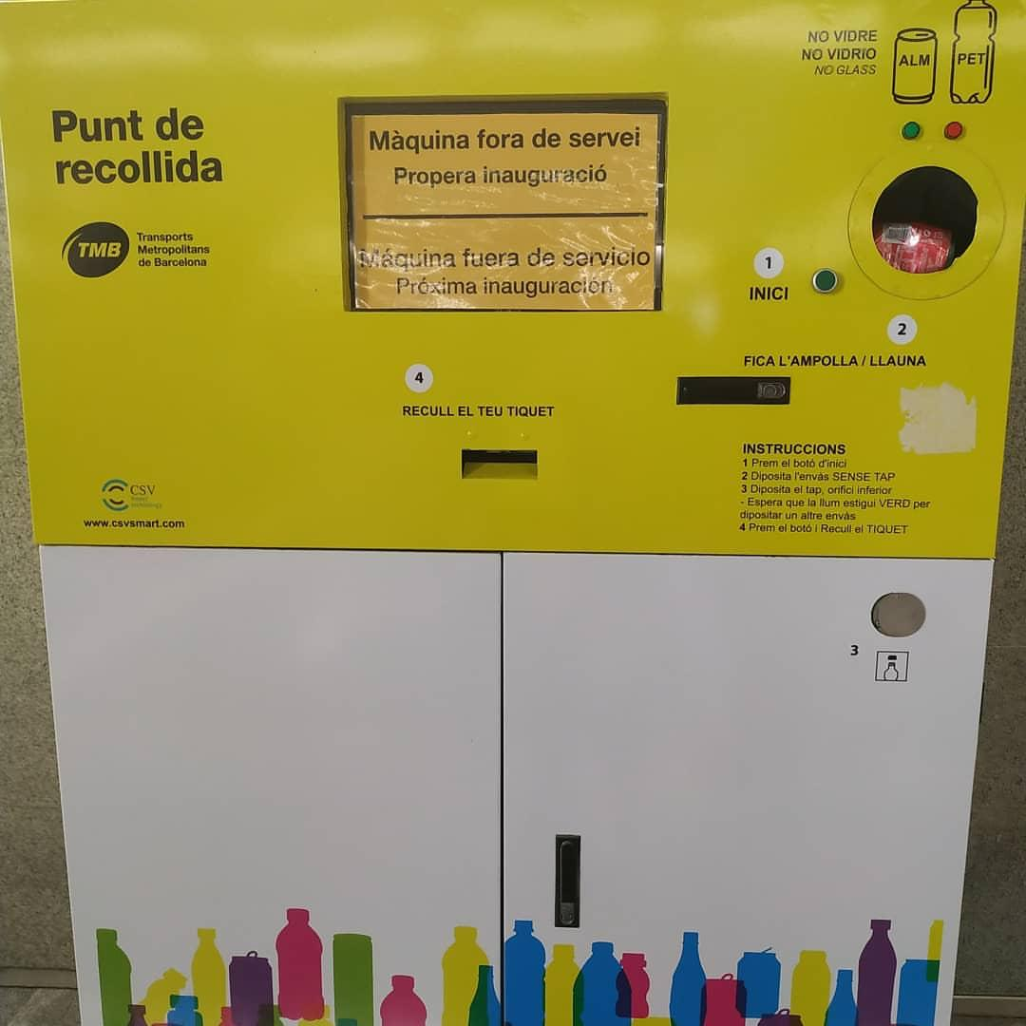
Breaking news 07/19/2019
Estacio Diagonal, Barcelona !

Slide 21
Collabora and Open Food Facts
Initial discussion with Pierre Slamlich about the presentation → Collabora’s work admirer
Same philosophy: Open First !
Computer vision projects
Barcode reader enhancement
Other projects…

Slide 22
Conclusion
That’s all folks !

