Slide 1
Solitaire for Python
“Weeks of programming can save
hours of planning.”
-- Unknown

Slide 2
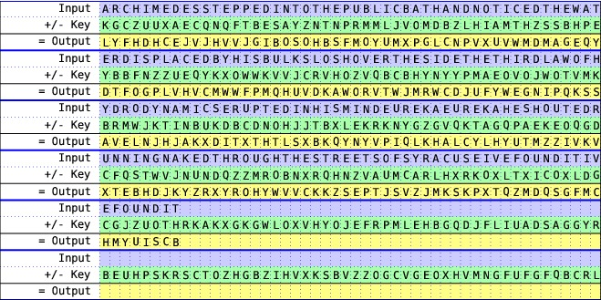
One-Time Pad

Slide 3
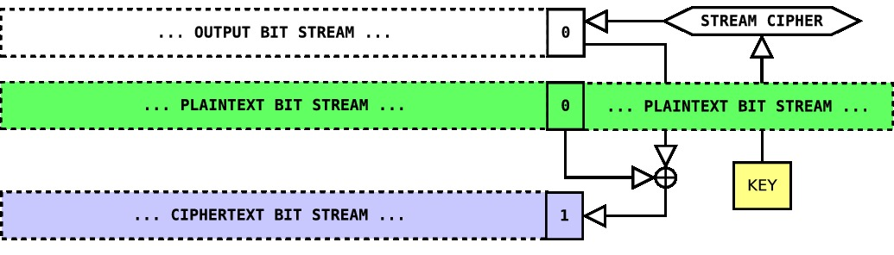
Stream Ciphers
Stream ciphers try to mimic one-time pads by producing a pseudo-random
number as long as the message.

Slide 4
Operations
Shift Jokers
  Move joker A down one
  Move joker B down two
Triple Cut
  Find the jokers, swap all cards above the top joker with all cards below the bottom joker
Count Cut
  Look at the bottom card, convert it to a number, set it aside
  Count this number of cards from the top
  Cut the deck at this point
  Return the bottom card to the bottom of the deck
Generate Output
  Convert top card to a number
  Count down this many cards. The first uncounted card is the output

