Slide 1
AZ-900 Study Group – Week 2
Mi

Slide 2
Introductions
Presenter 1
Title
Presenter 2
Title
Presenter 3
Title
Presenter 4
Title
Presenter 6
Title

Slide 3
Customer Specific intro Topics
Insert Slides Covering:
Customer specific learning management system links.
Survey information
Guidance on study group format

Slide 4
Azure Fundamentals Certification and the AZ-900 Exam

Slide 5
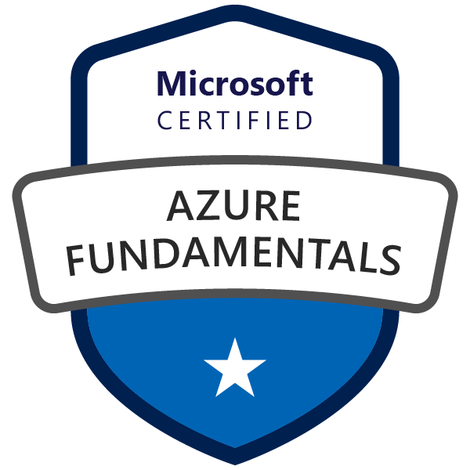
Microsoft Certified – Azure Fundamentals
Goal: Prove that you understand cloud concepts, core Azure Services, Azure pricing and support, the fundamentals of cloud security, privacy, compliance and trust.
Value: The knowledge gained by acquiring this certification will provide a valuable foundation for working with the platform and continuing on to more advanced role based Azure certifications.

Slide 6

Azure Role-based Certifications
Fundamentals
Associate
Expert
Azure Administrator Associate
Exam AZ-103
Azure DevOps Engineer Expert
Azure Developer Associate
Exams AZ-400
Exam AZ-203
Azure Security Engineer Associate
Azure Fundamentals
Exam AZ-500
Exam AZ-900
Azure Solutions Architect Expert
Azure AI Engineer Associate
Exams AZ-300 + AZ-301
Exam AI-100
Azure Data Engineer Associate
Exam DP-200
More roles to come ...
Azure Certification Exams: aka.ms/ExamsAzure

Slide 7
Exam Blueprint ( AZ-900 )
Study areas | Weights
Understanding cloud concepts | 15-20%
Understanding core Azure services | 30-35%
Understand security, privacy, compliance, and trust | 30-35%
Understand Azure pricing and support | 25-30%
Percentages indicate the relative weight of each area on the exam.
The higher the percentage, the more questions you are likely to see in that area.
Absolutely an accurate representation of what questions will show up.

Slide 8
Skills Measured – Understand Core Azure Services (30-35%)
Understand the core Azure architectural components
describe Regions
describe Availability Zones
describe Resource Groups
describe Azure Resource manager
describe the benefits and usage of core Azure architectural components
Describe some of the core products available in Azure
describe products available for Compute such as Virtual Machines, Virtual Machine Scale Sets, App Service and Functions
describe products available for Networking such as Virtual Network, Load Balancer, VPN Gateway, Application Gateway and Content Delivery Network
describe products available for Storage such as Blob Storage, Disk Storage, File Storage, and Archive Storage
describe products available for Databases such as CosmosDB, Azure SQL Database, Azure Database Migration service, and Azure SQL Data Warehouse
describe the Azure Marketplace and its usage scenarios
Describe some of the solutions available on Azure
describe Internet of Things (IoT) and products that are available for IoT on Azure such as IoT Fundamentals, IoT Hub and IoT Central
describe Big Data and Analytics and products that are available for Big Data and Analytics such as SQL Data Warehouse, HDInsight and Data Lake Analytics
describe Artificial Intelligence (AI) and products that are available for AI such as Azure Machine Learning Service and Studio
describe Serverless computing and Azure products that are available for serverless computing such as Azure Functions, Logic Apps and App grid
describe the benefits and outcomes of using Azure solutions
Understand Azure management tools
understand Azure tools such as Azure CLI, PowerShell, and the Azure Portal
understand Azure Advisor

Slide 9
Azure Fundamentals Learning - Prework
Core Cloud Services - Azure Architecture & Service Guarantees
Create an Azure Account
Core Cloud Services – Manage Services with the Azure Portal
Core Cloud Services – Azure Compute Options
Core Cloud Services – Azure Data Storage Options
Core Cloud Services – Azure Networking Options

Slide 10
Core Cloud Services Azure Architecture & Service Guarantees

Slide 11
Geographies
A geography is a discrete market typically containing two or more regions that preserves data residency and compliance boundaries
Geographies allow customers with specific data-residency and compliance needs to keep their data and applications close
Geographies are broadly grouped into: Americas, Europe, Asia Pacific, Middle East, and Africa
For example, United States, Azure Government, Canada and Brazil Geos all are grouped under the Americas.
https://azure.microsoft.com/en-us/global-infrastructure/geographies/

Slide 12
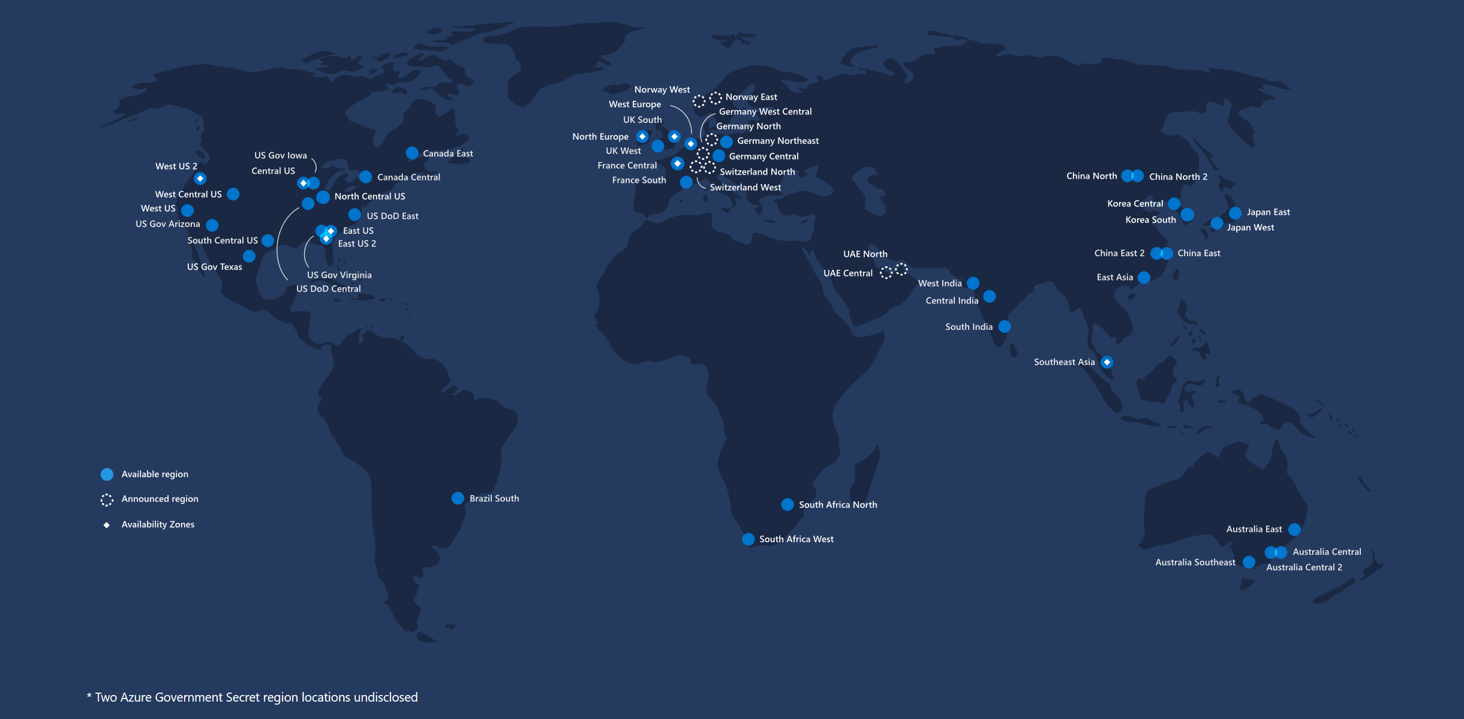
Regions
54 regions worldwide 2 Mil miles inter-datacenter fiber
100+ datacenters
Millions of servers

Slide 13
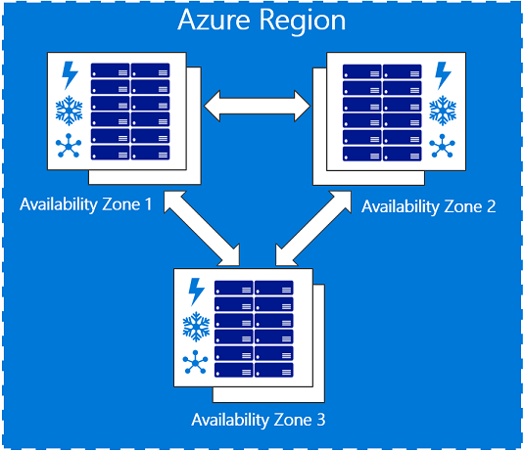
Availability zones
Availability zones are physically separate locations within an Azure region.
Each availability zone is made up of one or more datacenters equipped with independent power, cooling, and networking.
Availability Zones are set up to be an isolation boundary.
If one availability zone goes down, the other continues working.

Slide 14
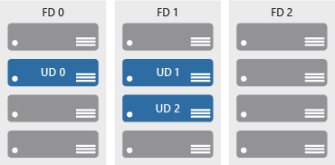
Availability sets
Availability sets are a way to help ensure applications remain online if a high-impact maintenance event is required, or a hardware failure occurs
Availability sets are made up of update domains and fault domains:
Update domains. When a maintenance event occurs (such as a performance update or critical security patch applied), the update is sequenced through update domains.
Fault domains. Fault domains provide for the physical separation of a workload across different hardware in the datacenter.

Slide 15
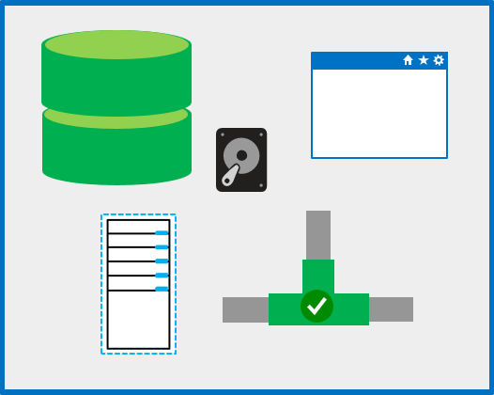
Resource groups
A resource group is a unit of management for resources in Azure.
Think of a resource group as a container that allows you to aggregate and manage all the resources required for an application in a single manageable unit

Slide 16
In summary
Cloud
Azure Subscription
Geo
Jurisdiction
Tax
Data Residency
Resource Group
Region
Customer Proximity
Disaster Isolation
Resource
Resource
Availability Zone (Preview)
DC Level Isolation Power, Network Cooling
Resource Group
Fault Domain
Inter-DC Fault Isolation
Resource
Resource

Slide 17
Review Question 1
Q: Which phrase best describes an Availability Zone?
Two datacenters in different regions
Two datacenters in different geographies
Two servers located in the same datacenter
Two datacenters located in the same region

Slide 18
Review Question 1
Q: Which phrase best describes an Availability Zone?
Two datacenters in different regions
Two datacenters in different geographies
Two servers located in the same datacenter
Two datacenters located in the same region

Slide 19
Review Question 2
Q: Which of the following statements about resource groups are true?
A resource group can contain resources from multiple regions.
When deploying a resource group you do not need to select a region
All resources must be deployed in a resource group.
Resources can interact w/ other resources in a different resource group.

Slide 20
Review Question 2
Q: Which of the following statements about resource groups are true?
A resource group can contain resources from multiple regions.
When deploying a resource group you do not need to select a region
All resources must be deployed in a resource group.
Resources can interact w/ other resources in a different resource group.

Slide 21
Create an Azure Account

Slide 22
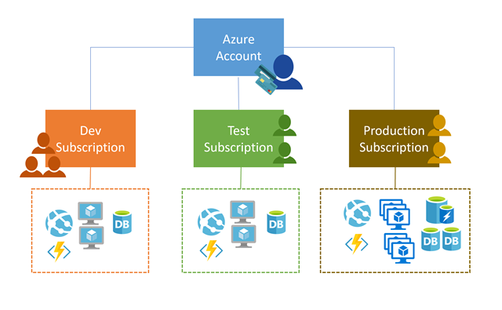
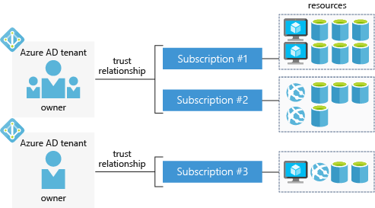
Azure Accounts and Subscriptions
Accounts and Subscriptions
Authentication / RBAC

Slide 23
Azure Support Options
Paid Support Plans
Developer
Trial / Non-Prod
Business Hrs
Standard
Production
24/7
Professional Direct
Business Critical
Premier
Enterprise
24/7
24/7
General Guidance
General Guidance
<8 Hr Response
<1 Hr Response
<1 hr Response
< 1 Hr or 15 Min Response
Arch Guidance
Customer Specific Arch Guidance
Simple Onboarding Support
TAM Service Reviews / Reporting

Slide 24
Review Question 1
Q: Which of the following statements are true about Azure Subscriptions?
Subscriptions and accounts are effectively the same thing.
Each subscription has it’s own billing configuration.
Resources are always deployed in an account.
Multiple subscriptions can live under a single account.

Slide 25
Review Question 1
Q: Which of the following statements are true about Azure Subscriptions?
Subscriptions and accounts are effectively the same thing.
Each subscription has it’s own billing configuration.
Resources are always deployed in an account.
Multiple subscriptions can live under a single account.

Slide 26
Core Cloud Services - Manage services with the Azure portal

Slide 27
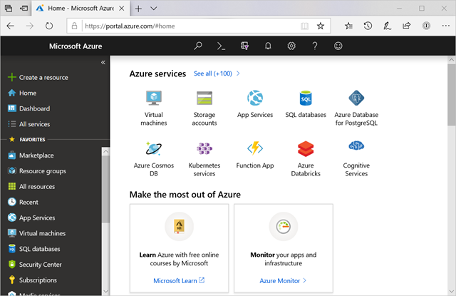
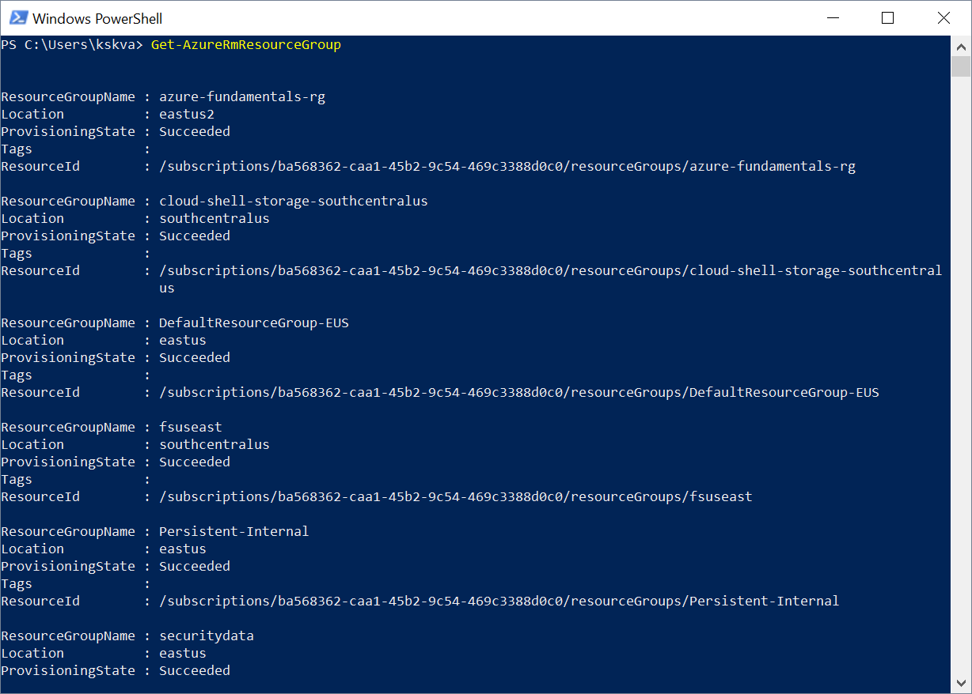
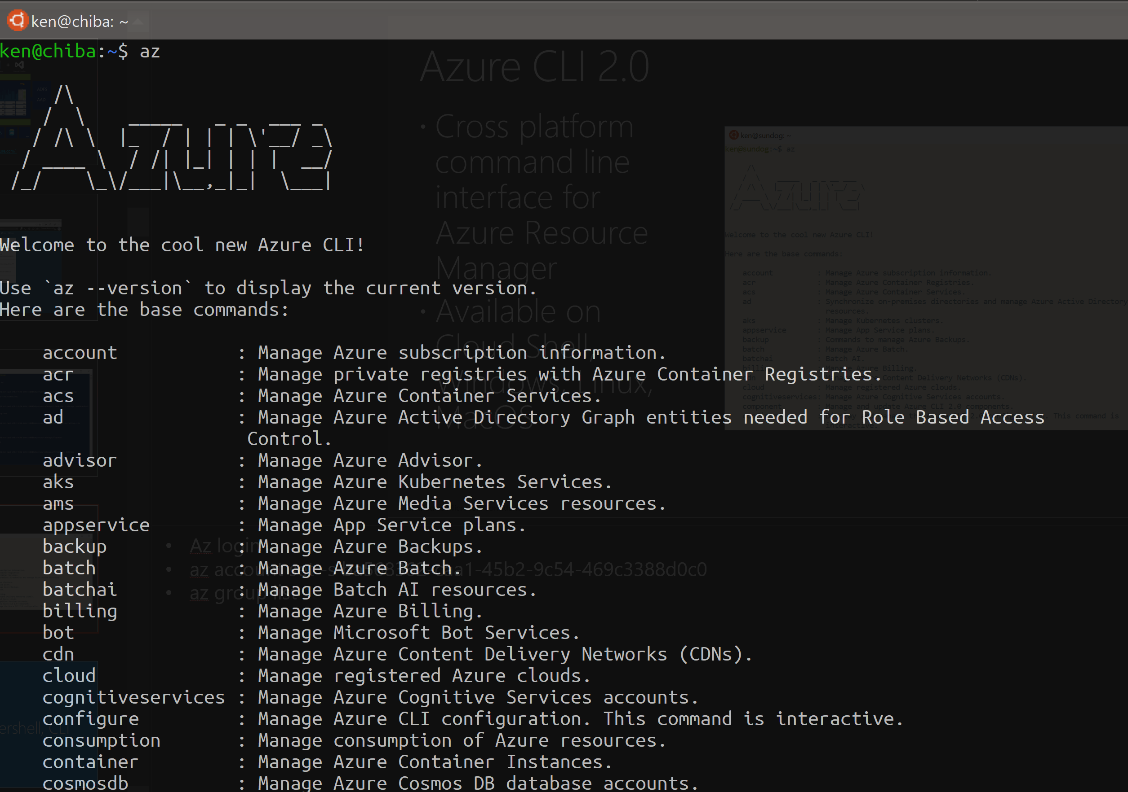
Management Options
Azure Portal
PowerShell
Azure CLI
Also worth noting: Arm Templates, Azure SDKs, CloudShell, Mobile App, REST API
These all hit the same underlying resource manager REST APIs!

Slide 28
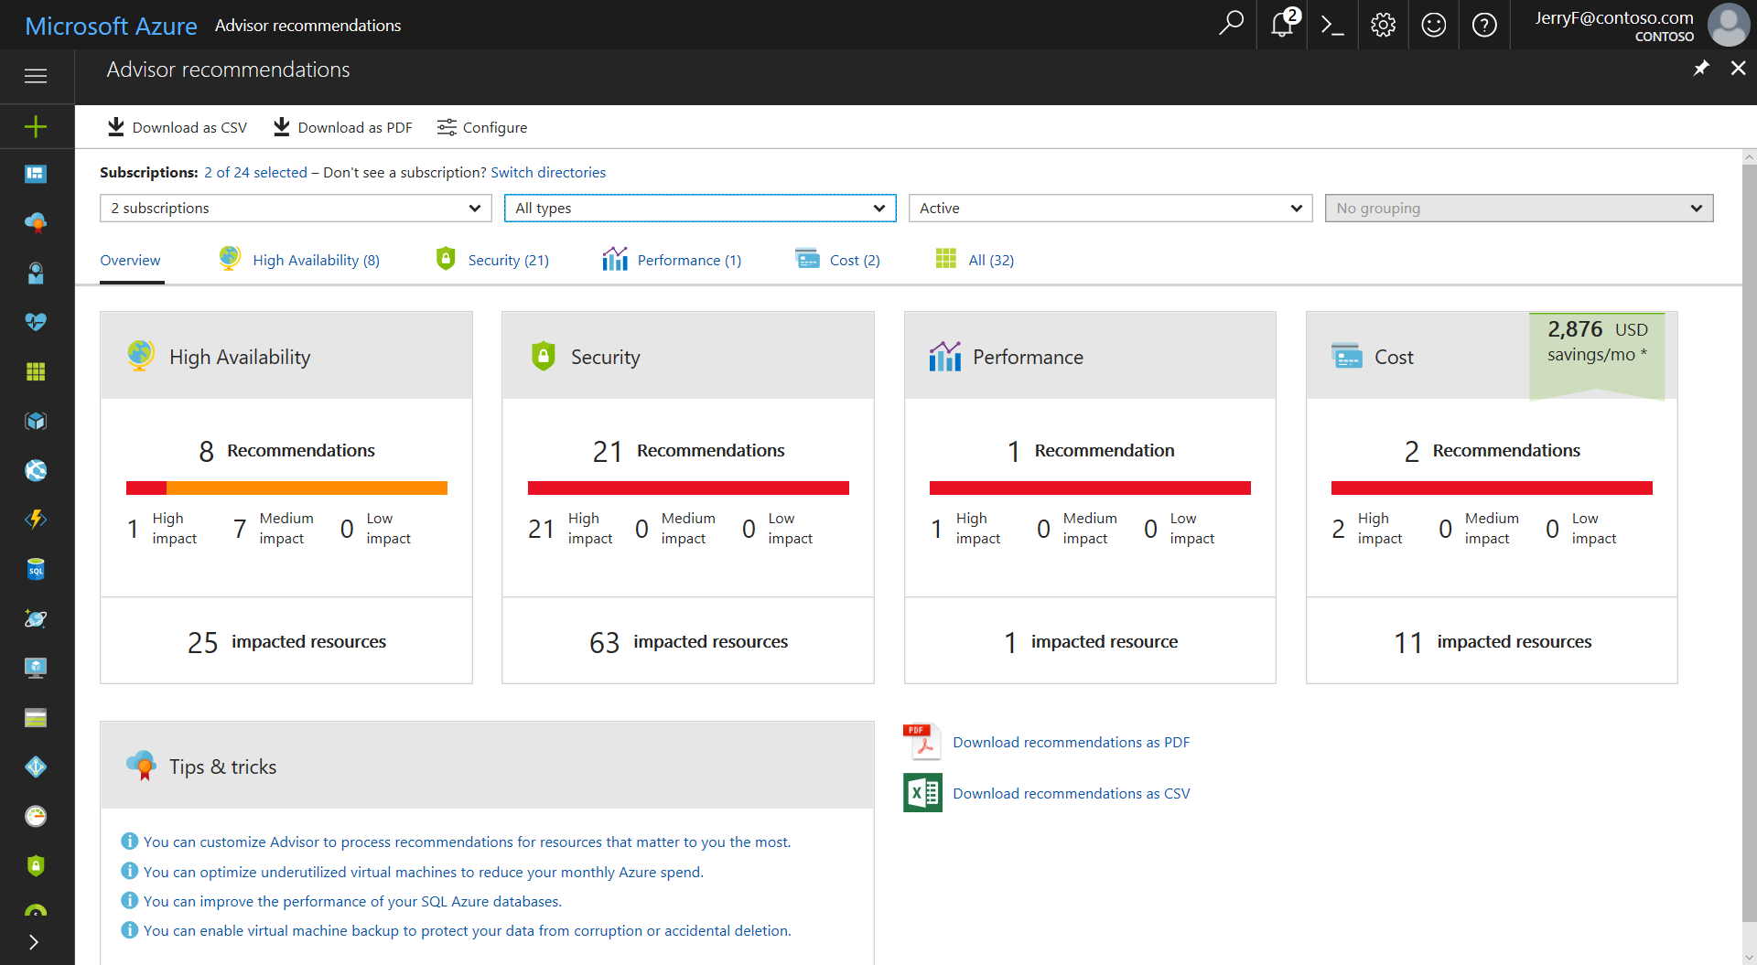
Azure Advisor

Slide 29
Review Question 1
Q: You need to manage a new Windows VM that you’ve deployed. Which of the following can be used to manage the VM?
Azure CLI
Azure Portal
PowerShell
Azure CloudShell
Azure SDK for Python

Slide 30
Review Question 1
Q: You need to manage a new Windows VM that you’ve deployed. Which of the following can be used to manage the VM?
Azure CLI
Azure Portal
PowerShell
Azure CloudShell
Azure SDK for Python

Slide 31
Core Cloud Services Azure Compute options

Slide 32
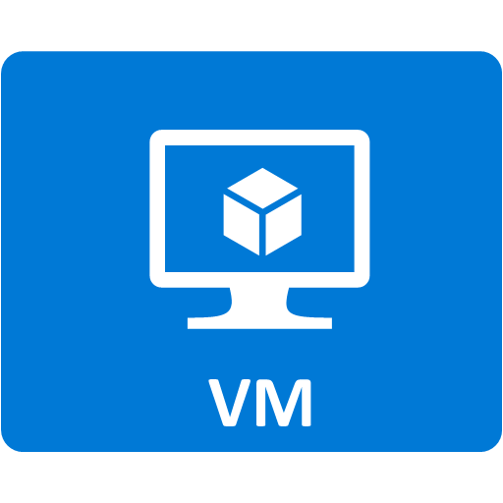
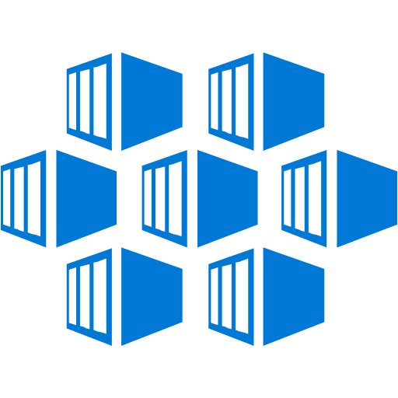





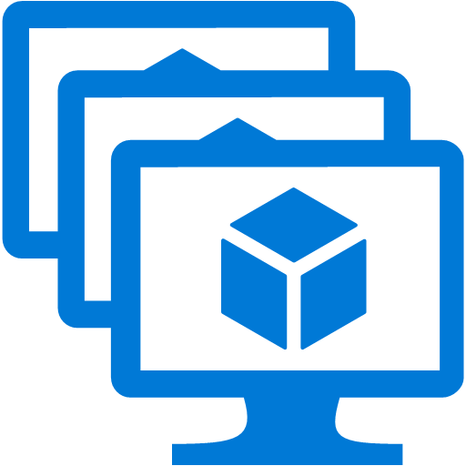

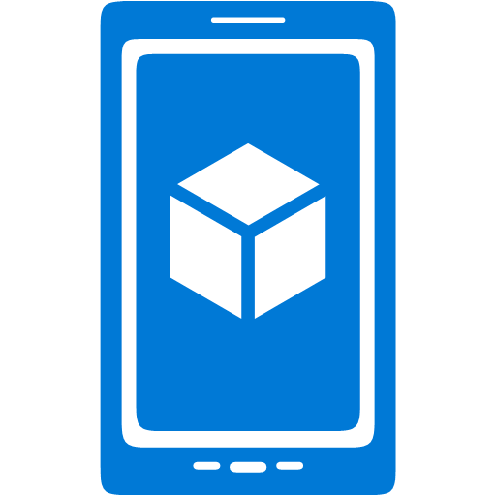
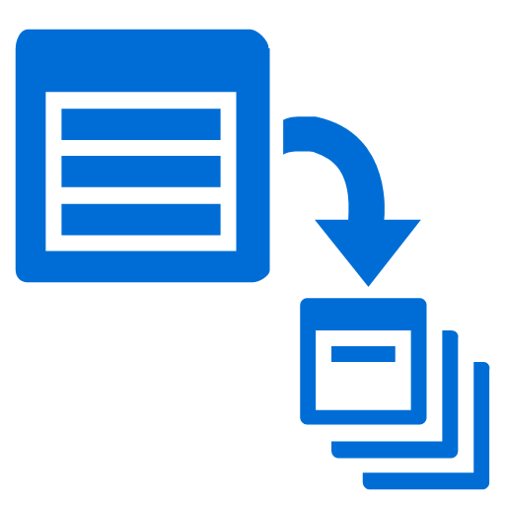
Core Azure Compute Services
Virtual Machines
Virtual Machines
Availability Sets
Virtual Machine Scale Sets
Azure Batch
Containers
Azure Container Instances
Azure Kubernetes Service
App Service
Web Apps
API Apps
Web Jobs
Mobile Apps
Serverless
Functions
Logic Apps

Slide 33
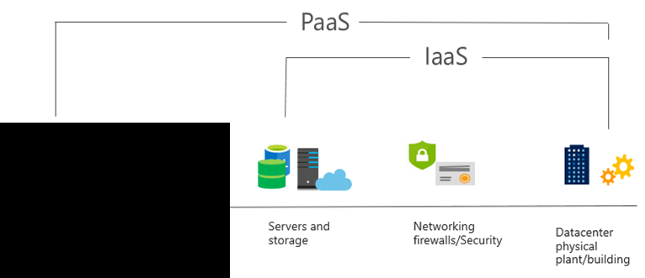
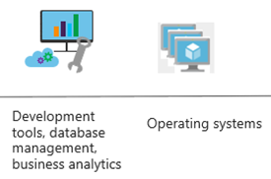
PaaS
PaaS provides an environment for building, testing, and deploying software applications. The goal of PaaS is to help create an application as quickly as possible without having to focus on managing the underlying infrastructure.
Notes:
Common usage scenarios:
Development framework. PaaS provides a framework that developers can build upon to develop or customize cloud-based applications. Similar to the way you create a Microsoft Excel macro, PaaS lets developers create applications using built-in software components. Cloud features such as scalability, high-availability, and multi-tenant capability are included, reducing the amount of coding that developers must do.
Analytics or business intelligence. Tools provided as a service with PaaS allow organizations to analyze and mine their data. They can find insights and patterns, and predict outcomes to improve business decisions such as forecasting, product design, and investment returns.
For more information on IaaS see What is PaaS?

Slide 34


What is serverless?
Full abstraction of servers
Developers can just focus on their code—there are no distractions around server management, capacity planning, or availability.
Instant, event-driven scalability
Application components react to events and triggers in near real-time with virtually unlimited scalability; compute resources are used as needed.
Pay-per-use
Only pay for what you use: billing is typically calculated on the number of function calls, code execution time, and memory used.*
*Supporting services, like storage and networking, may be charged separately.

Slide 35

What are the benefits?
Solve business problems—not technology problems related to undifferentiated heavy lifting
Focus
Shorter time to market
Fixed costs converted to variable costs
Better service stability
Better development and testing management
Less waste
Efficiency
Simplified starting experience
Easier pivoting means more flexibility
Easier experimentation
Scale at your pace—don’t bet the farm on Day 1
Natural fit for microservices
Flexibility

Slide 36

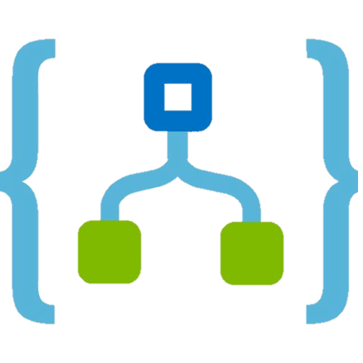
Azure
VMs / Scale Sets
Azure
Kubernetes Service
Azure
App Service
Azure
Functions
Azure
Logic Apps
Control ------------------------> Productivity
Notes:
Introducing App Service and Azure Functions from a team that obsesses about time to market and developer experience! Also, Functions as a PaaS growth

Slide 37
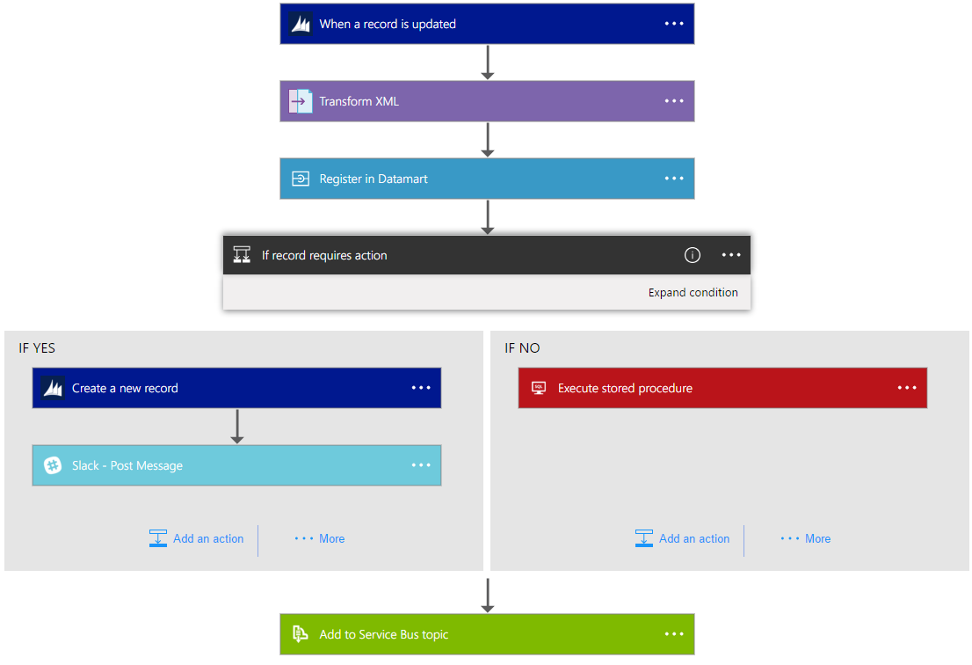
Logic Apps Workflow Designer
Workflow in the cloud
Powerful control flow
Connect disparate applications
No code designer for rapid creation
Also works within Visual Studio for added CI/CD

Slide 38
Review Question 1
Q: You’re building a solution in which you need to add metadata to images when they are uploaded to an azure storage account. You only want your code to run in response to new files showing up and you want as little management overhead as possible. What service should you use?

Slide 39
Review Question 1
Q: You’re building a solution in which you need to add metadata to images when they are uploaded to an azure storage account. You only want your code to run in response to new files showing up and you want as little management overhead as possible. What service should you use? A: Azure Functions will allow you to respond to events as new images are uploaded. You’ll pay only for your code execution and you have no VM’s to manage.

Slide 40
Review Question 2
Q: Which of the following statements accurately describe a virtual machine scale set (VMSS)?
Can create 100s of identical VMs.
Automatically distributes VMs across AZ’s, Fault Domains, Update Domains and Regions.
Integrates with both App Gateway and Azure Load Balancer.
Supports both marketplace and custom VM images.

Slide 41
Review Question 2
Q: Which of the following statements accurately describe a virtual machine scale set (VMSS)?
Can create 100s of identical VMs.
Automatically distributes VMs across AZ’s, Fault Domains, Update Domains and Regions.
Integrates with both App Gateway and Azure Load Balancer.
Supports both marketplace and custom VM images.

Slide 42
Core Cloud Services Azure compute options

Slide 43




Azure compute services - virtual machine services
VMs are software emulations of physical computers. Examples of Azure services for virtual machines include:
Azure VMs. Infrastructure as a service (IaaS) to create and use VMs in the cloud
VM scale sets. Designed for automatic scaling of identical VMs
App services. platform as a service (PaaS) offering to build, deploy, and scale enterprise-grade web, mobile, and API apps
Functions. Creates infrastructure based on an event

Slide 44
Core Cloud Services Azure data storage options

Slide 45
Azure storage services – data categories
Structured data. Data that adheres to a schema, so all of the data has the same fields or properties. Structured data can be stored in a database table with rows and columns. Examples of structured data include, sensor data or financial data.
Semi-structured data. Data is less organized than structured data, and is not stored in a relational format, meaning the fields do not neatly fit into tables, rows, and columns. Referred to as non-relational or NoSQL data.
Unstructured data. Data that has no designated structure to it. This also means that there are no restrictions on the kinds of data it can contain. For example, a blob can hold a PDF document, a JPG image, a JSON file, or video content.

Slide 46

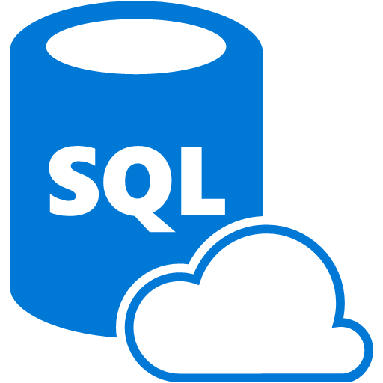

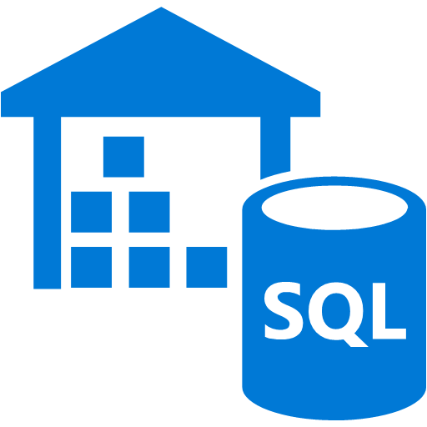




Core Azure Data Storage Services
Storage Account
Blob Storage
Data Lake Store G2
Azure Files
Azure Queue
Disk Storage
Databases
Azure SQL DB
Azure SQL DW
Azure Cosmos DB

Slide 47
Review Question 1
Q: You’re working with a company to deploy multiple IaaS and PaaS solutions to Azure. You need to discern what services to use for particular use cases. Which resources should you deploy in the below scenarios?
You need to store files on a network addressable share that can be accessed by multiple windows virtual machines
You have a global scale app that requires storage of semi-structured data
You’re looking for a simple way to decouple a data processing tier from your front end so that you don’t have job failures when incurring heavy load.

Slide 48
Review Question 1
Q: You’re working with a company to deploy multiple IaaS and PaaS solutions to Azure. You need to discern what services to use for particular use cases. Which resources should you deploy in the below scenarios?
You need to store files on a network addressable share that can be accessed by multiple windows virtual machines Azure Files
You have a global scale app that requires storage of semi-structured data Azure Cosmos DB
You’re looking for a simple way to decouple a data processing tier from your front end so that you don’t have job failures when incurring heavy load. Azure Queues

Slide 49
Review Question 2
Q: You have data that is arranged in a series of two dimensional tables with rows and columns. Every row in the table has the same set of columns. How would you classify this type of data?
Structured Data
Semi-Structured Data
Unstructured Data

Slide 50
Review Question 2
Q: You have data that is arranged in a series of two dimensional tables with rows and columns. Every row in the table has the same set of columns. How would you classify this type of data?
Structured Data
Semi-Structured Data
Unstructured Data

Slide 51
Core Cloud Services Azure networking options

Slide 52
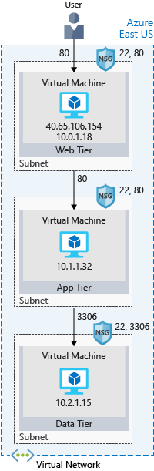
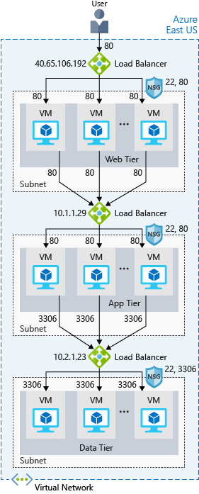

Core Azure Network Services
Virtual Network
VNet
Subnet
Network security Group
Scaling / HA / DR
Azure Load Balancer
Azure Application Gateway
Azure Traffic Manager
Content Delivery Network

Slide 53
Scaling Across Multiple Regions
Azure Traffic Manager
East US
Central US
West US

Slide 54
Review Question 1
Q: You’re deploying a solution based on VM’s and you’re leveraging three different AZ’s in the East US 2 Region. You need to distribute requests to the services evenly across the VM’s using specific URLs. What service would use ?
Load Balancer
Application Gateway
Web Application Firewall (WAF)
Content Delivery Network (CDN)

Slide 55
Review Question 1
Q: You’re deploying a solution based on VM’s and you’re leveraging three different AZ’s in the East US 2 Region. You need to distribute requests to the services evenly across the VM’s using specific URLs. What service would use ?
Load Balancer
Application Gateway
Web Application Firewall (WAF)
Content Delivery Network (CDN)

Slide 56
Review Question 2
Q: You’re deploying a three tier web application to Azure on Linux VM’s. You want to segment network traffic such that the front end can talk to the middle tier but not directly to back end. How would you implement this?
Create a Vnet with a single Subnet, place all VMs in the subnet. Don’t use NSGs.
Create a Vnet with three subnets, place each tier’s VMs into a seperate subnet. Use NSGs to control traffic between the subnets.
Create a Vnet with a single subnet. Place all VMs in the subnet. Use NSGs on each VM to control the flow of traffic between tiers.

Slide 57
Review Question 2
Q: You’re deploying a three tier web application to Azure on Linux VM’s. You want to segment network traffic such that the front end can talk to the middle tier but not directly to back end. How would you implement this?
Create a Vnet with a single Subnet, place all VMs in the subnet. Don’t use NSGs.
Create a Vnet with three subnets, place each tier’s VMs into a seperate subnet. Use NSGs to control traffic between the subnets.
Create a Vnet with a single subnet. Place all VMs in the subnet. Use NSGs on each VM to control the flow of traffic between tiers.

Slide 58
Open Q&A

