Slide 1
Re-thinking the Cultural Policy of Israel for the 21st Century
Robert Palmer

Slide 2
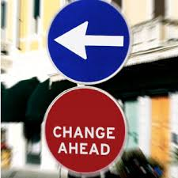
Why Re-think?

Slide 3
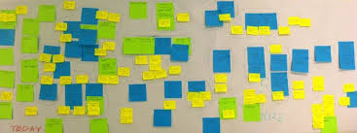
European and Global Cultural Trends

Slide 4
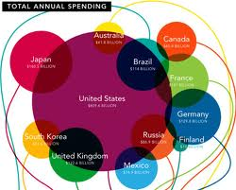
The Economy Different Economies Perform Differently

Slide 5
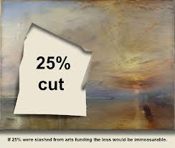
Restructuring of Public Spending

Slide 6
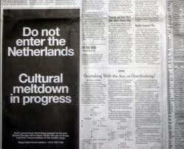
Impacts on many budgets – including culture

Slide 7

Some countries have completely revised cultural policy stimulated by the financial cuts and changes to government policy
United Kingdom (Arts Council, England)
New government priorities
25% cut in budget for culture
No longer a policy of « equal misery for all »
Shift in role from ‘funder’ to ‘developer, advocate, critical friend and advice service’
Providing ‘sensitive support to
allow arts organisations and
artists to fulfill their potential’

Slide 8
Goals
Talent and Artistic Excellence: establish a coherent nation-wide approach to the development of artistic talent, especially for emerging and mid-career artists.
More People Inspired by the Arts: more opportunities for those with least engagement, strengthen distribution, attracting new audiences
Sustainable, Resilient and Innovative Arts: promoting collaboration, strengthening business and financial models

Slide 9
4. Arts Leadership: improve leadership skills and develop new leaders
5. Children: Every child has the opportunity to experience the arts, and raising standards of arts education

Slide 10
Evaluated every single arts organisation against these goals
All given one year to review their plans
Every existing organisation evaluated
New organisations could apply
Result: 1330 organisations applied for funding
638 rejected (mostly existing institutions)
110 new organisations supported
Fewer symphony orchestras and theatres
National Theatre, Royal Opera House, Royal Shakespeare Company each cut by11%
Some companies increased by 60%-80%

Slide 11
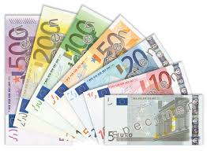
Israel has not suffered the extent of budget cuts as European countries

Slide 12
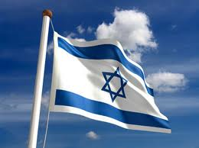
Does Israel need to wait for a crisis before it changes cultural priorities?

Slide 13
The 20th Century ( Western Europe)
1950’s – 60’s : post war reconstruction, rebuilding nationhood and national cultural symbols, reasserting identities, cultural diplomacy and exchange
1960’s – 70’s : democratisation of culture, new movements, expansion of cultural infrastructure, welfare state mentality
1980’s – 90’s : neo-liberal policies, market value, economic impact of arts, arts as investment, cultural industries and the creative economy

Slide 14
Expanded Meanings of Culture? Arts Policies are not Cultural Policies
What is Culture?
The Right to Cultural Life?

Slide 15
Universal Declaration of Human Rights: Article 15 (paragraph 1)
« The right of everyone to take part in cultural life »
The expression « cultural life » is an explicit reference to culture as a living process, historical. dynamic and evolving, with a past, a present and a future.
Culture is an interactive process

Slide 16
The right to take part in cultural life The right not to take part in cultural life The right to define and decide one’s own culture

Slide 17
What is Culture?
« Culture encompasses, inter alia, ways of life, language, oral and written literature, music and song, non-verbal communication, religion or belief systems, rites and ceremonies, sport and games, methods 0of production or technology, natural and man-made environments, food, clothing an shelter, and the arts, customs and traditions through which individuals, groups of individuals and communitiesexpress their humanity and the meaning they give to their existence, and build their world view representing their encounter wityh the external forces affecting their lives »
(United Nations)

Slide 18
Culture: A Shift of Meaning and Purpose
A way of life, a system of beliefs, a set of values
A practice (performing arts, visual arts, literary arts)
An industry (cultural industries)
An economy (the creative economy)

Slide 19
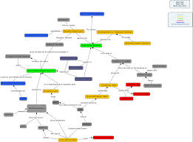
Culture is a system

Slide 20
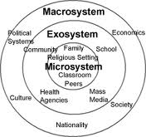
Culture is an Ecology

Slide 21
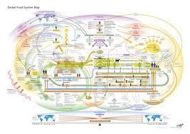
We should understand the system and the ecology before we start making changes to it

Slide 22
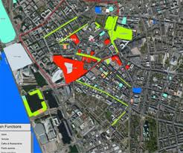
Analysis: New Forms of Cultural Resource Mapping

Slide 23
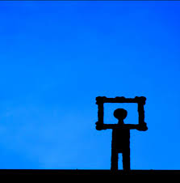
Macro Shifts in the Cultural System
Liquid Modernity
Culture of Risk
Networked Society

Slide 24

Liquid Modernity
(Zygmut Bauman, Scott Lash)
Classic structures are changing
Distinctions between high culture and popular culture are blurring
Increased deregulation and privatisation

Slide 25

Culture of Risk
(Ulrich Beck, Anthony Giddens)
Technical advances
Economic and cultural globalisation
New models of centres and peripheries
Democratic distribution

Slide 26
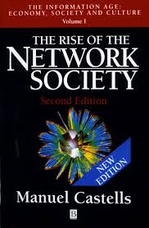
Networked Society
(Manuel Castells, Jan Van Dijk)
Networks are basic units of societies
Goes beyond technology and information
Power found within interlinked networks and knowledge communities

Slide 27
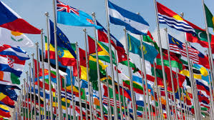
Changing Role of the State

Slide 28
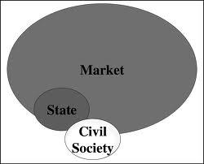
New Relationships: State, Market, Civil Society

Slide 29
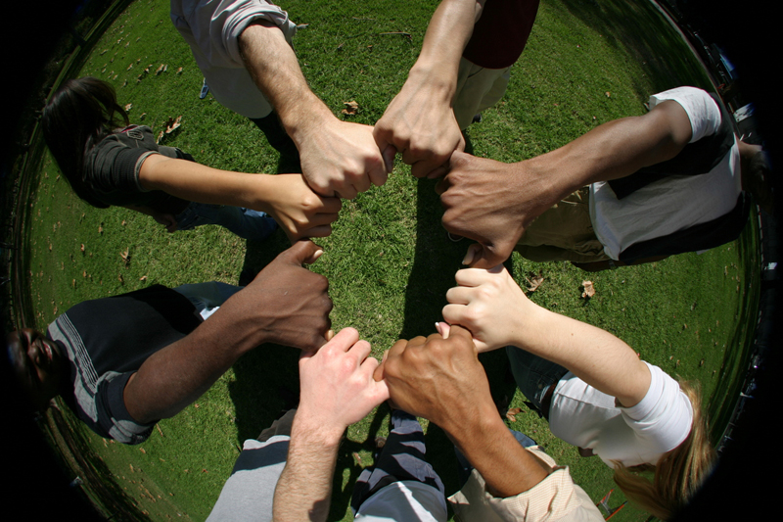
State moves from « Controller » to « Mediator and Facilitator » of Culture

Slide 30
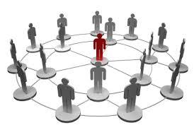
State as a strategic partner, working with the cultural community and the market to strengthen the entire cultural system

Slide 31
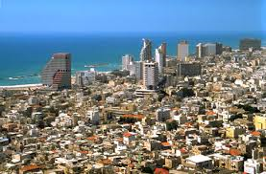
Another Trend:Decentralised Cultural Policy – Cities not States are the Motors

Slide 32
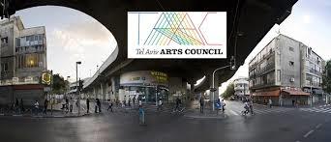
City Cultural Strategies

Slide 33

Need for coherence between state and municipal cultural policies and priorities

Slide 34
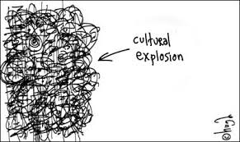
Another Trend: Global Cultural Explosion

Slide 35
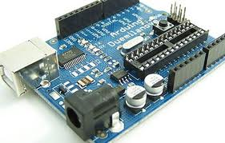
Technological Explosion Growing up Digital

Slide 36
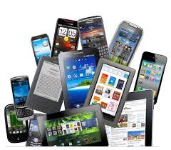
Mobile Devices

Slide 37
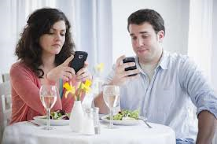
New Patterns of Communication

Slide 38
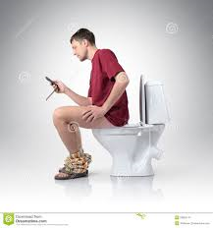

Slide 39
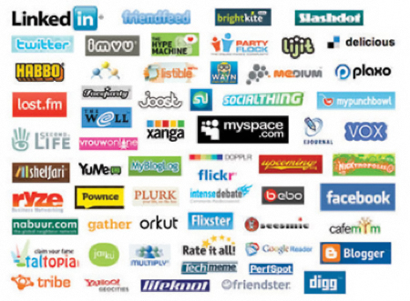
Social Media

Slide 40

Crowdfunding portals raise $3 billion

Slide 41
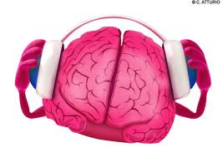
Another trend: New Patterns of Consumption

Slide 42
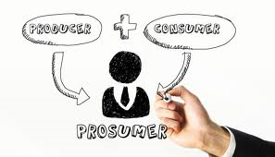
Pro-sumption
Consumers are also producers
Consumers are “co-creators”
Consumers are active
Producers consume what they themselves have created
Harnessing the power of prosumer communities

Slide 43

Music

Slide 44
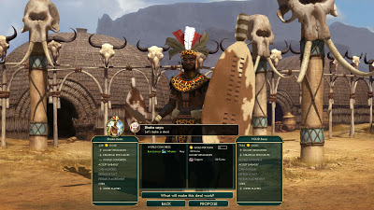
Impact of Gaming

Slide 45
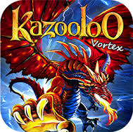
Gaming in Israel
Gaming in Israel is a $450 million business
Many companies in the global gaming market
( Funtactix, Plarium, Nordau, Side-Kick)
Is Gaming a Cultural Activity?

Slide 46
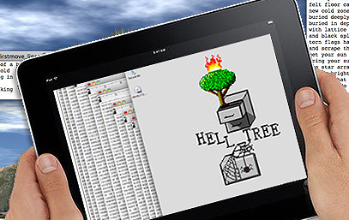
Reading

Slide 47

Film
Over I billion unique users visit YouTube each month
Over 6 billion hours of video are watched each month on YouTube
100 hours of video are uploaded to YouTube every minute
80% of YouTube traffic comes from outside the US
YouTube is localized in 61 countries and across 61 languages
In 2012 YouTube had more than 1 trillion views or around 140 views for every person on Earth

Slide 48
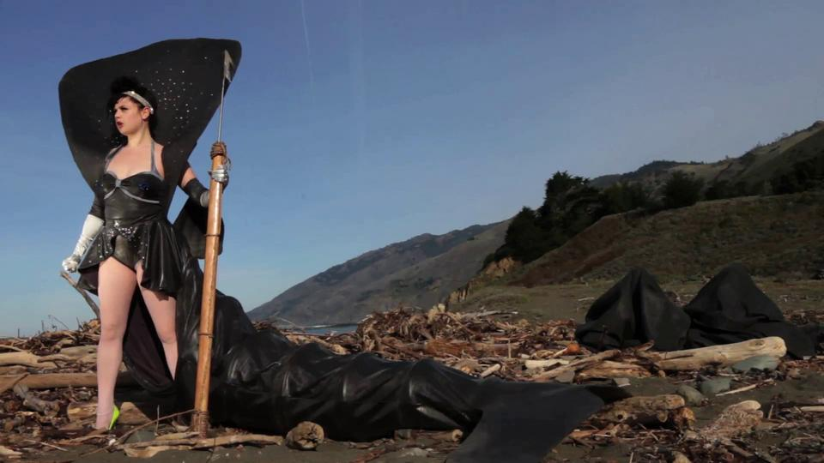
Culture in its own terms is changing. Forms of artistic expression are changing.

Slide 49

Twitter

Slide 50
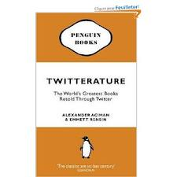
Twitterature (Literature)

Slide 51
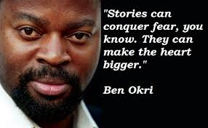
« History, despite its wrenching pain
Cannot be unlived, and if faced
With courage, need not be lived again »

Slide 52
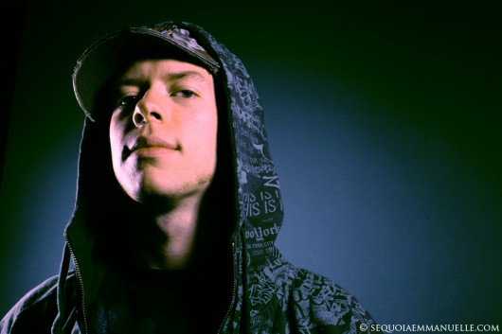
Musical Genres
Dubstyle
Psychobilly
Drone Doom
Slowcore

Slide 53
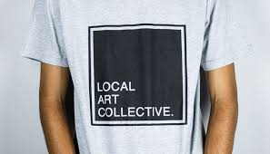
Another trend: New Processes of Creating
Collaborating, Partnering, Sharing, Collective

Slide 54
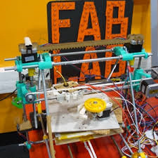
Fab Labs, Learning Communities, Open Networks, Creative Clusters, Spider Groups

Slide 55
Cultural Institutions need to learn to collaborate Departments in the Ministry need to learn to collaborate Different Ministries need to learn to collaborate

Slide 56
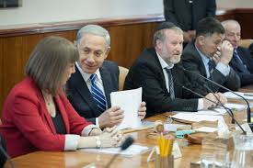
Trend: « Mainstreaming Culture » (EU)
Culture is a cross-cutting issue combining interests of many government ministries: Culture, Education, Tourism, Industry, Foreign Affairs, Finance, Social Affairs…….

Slide 57
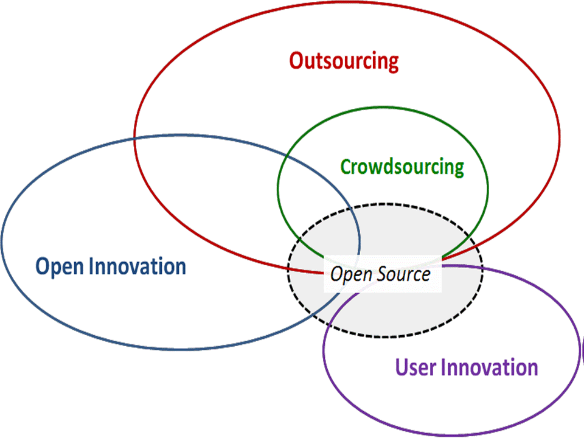
Another trend: Open Sourcing

Slide 58
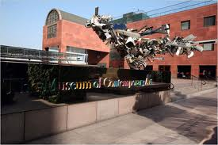
Another trend: Re-thinking cultural institutions

Slide 59
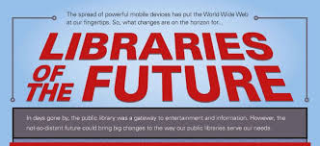

Slide 60
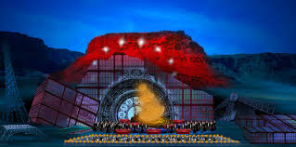

Slide 61

Another trend: Culture and Nature are connected
Biodiversity and Climate Change are Cultural Issues

Slide 62
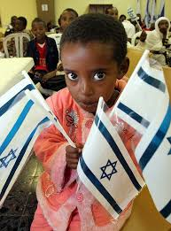
Challenges of multi-ethnic societies
Issues of multiple identities
Policy shift from multiculturalism
to interculturalism
« Multiculturalism reminds us
of difference; Interculturalism
focuses on exchange and
encounter »

Slide 63
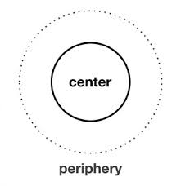
Another Trend: Policies of Access, Participation, Shifts from Centres to Peripheries

Slide 64
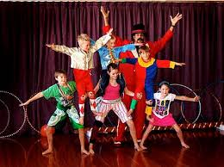
New Strategies for Peripheries
No longer about ‘distribution’
Working with communities through consultation and analysing barriers
More about engagement and new forms of participation than audience development for pre-determined cultural content

Slide 65

Centres and Peripheries are part of the same cultural system and are mutually interdependent

Slide 66
Many models
Culture for All (Finland)
Participatory Arts (Ireland)
Creative Nation (Canada)
Access to One’s Own Culture (Norway)
Culture in Working Life (Sweden)
Creative Partnerships (United Kingdom)
Museum Online (Austria)
New Territories for Art (France)

Slide 67
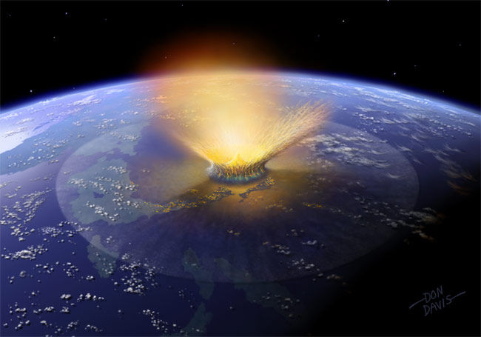
Impacts on Cultural Policy for Israel?

Slide 68
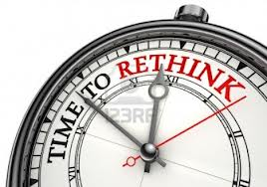

Slide 69
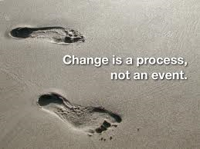

Slide 70
« The making and re-making of culture in our society is a long conversation »

Slide 71
