Slide 1

D.O.G.
Delusions of Grandeur Trading

Slide 2
Meet the Team
Max
Kelsey
Xianghan
Daniel
ADD PICS AND GITHUBS

Slide 3

PROJECT tRACKER
Kanbachi
Team Rating: 4/5

Slide 4

VCS repository
GitHub
Team Rating: 5/5

Slide 5

Database
PostgreSQL
Team Rating: 3/5

Slide 6
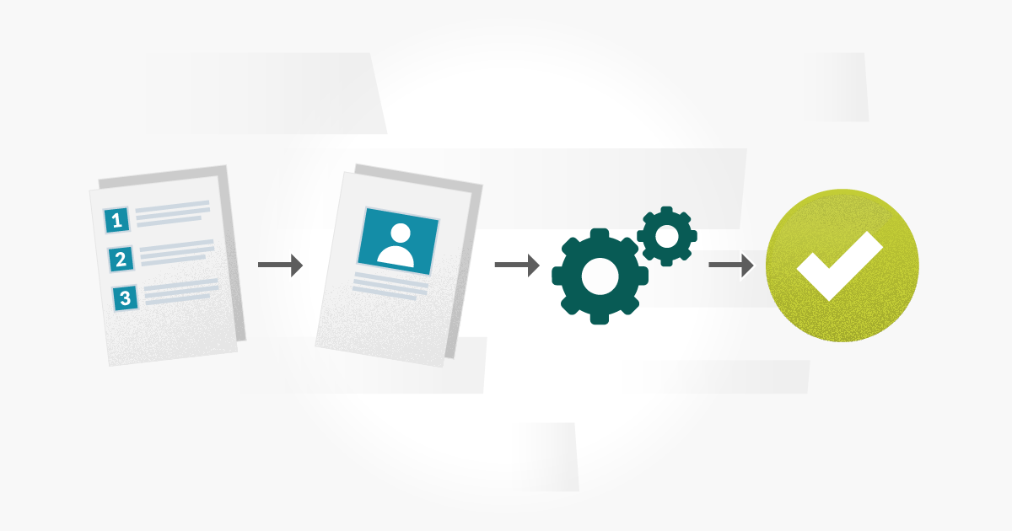
Testing tool
User Testing
Test Case Approach
Team Rating: 4/5

Slide 7

Auto-documenter
JavaDoc
Team Rating 4/5

Slide 8

Deployment Environment
AWS
Team Rating: 5/5

Slide 9

IDE
IntelliJ Idea
Team Rating: 5/5

Slide 10

Framework
Apache Tomcat
Java Servlets
Team Rating: 5/5

Slide 11
Challenges
Team Communication
Accessing Backend From front end
Server Space
Number of API requests limited functionality

