Slide 1
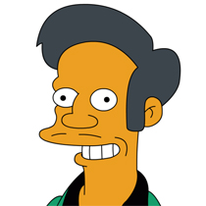

APPU
(Automatic Podcast Publisher)
https://github.com/dacacioa/appu
by David Acacio

Slide 2
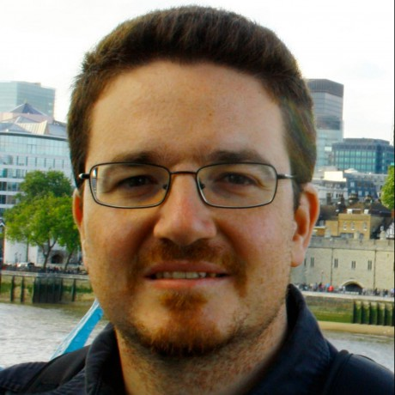
David Acacio Albareda
Father, IT manager with a sysadmin heart, geek, lover of Agile methodology and DevOps philosophy. I also write and do podcast in Entre Dev y Ops. Currently working as a Service Delivery Manager at CAPSiDE.
@david_acacio – david@acacio.cat – github.com/dacacioa

Slide 3
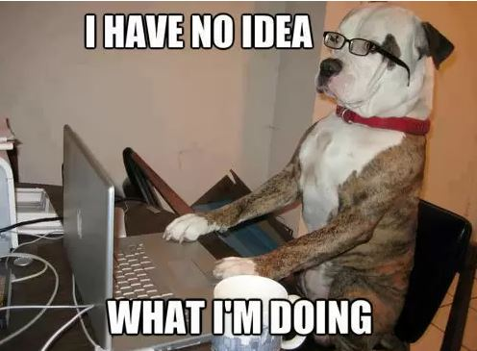

Slide 4
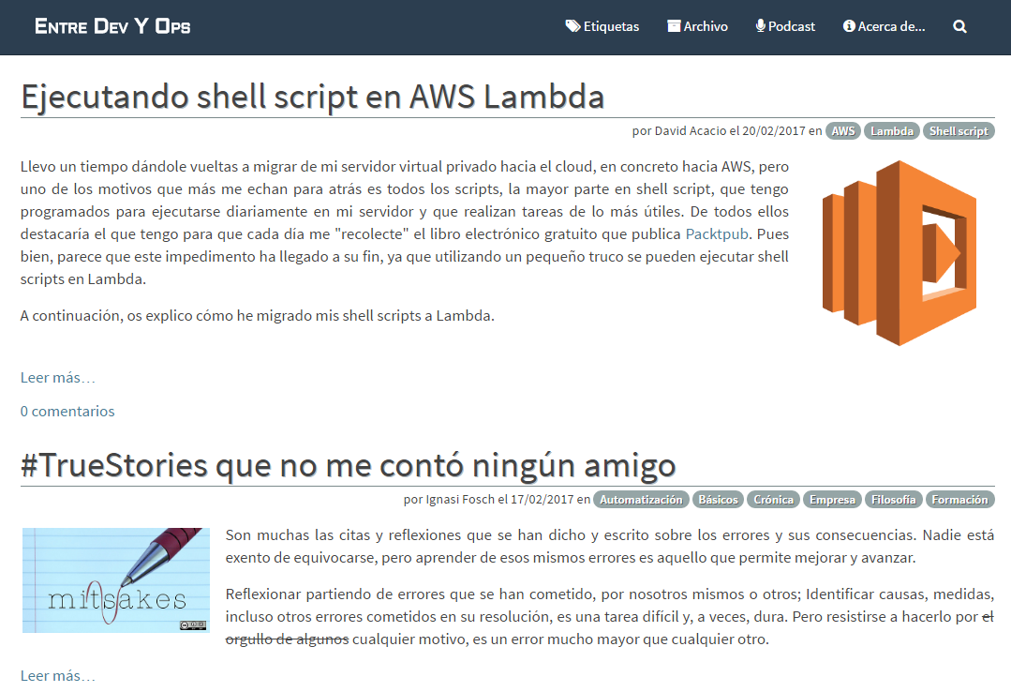
www.entredevyops.es

Slide 5
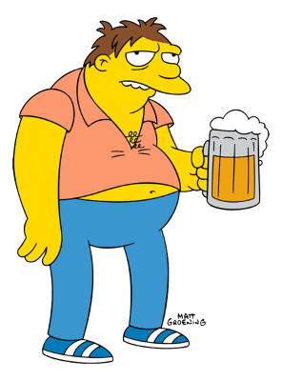
Never accept challenges while you’re drinking beer!!!

Slide 6
PROCESS TO EDIT PODCAST
Transform to mono
Insert intro music
Insert ending music
Normalize audio
Insert Id3 tags
Insert cover picture
Transform to mp3
Spended time: Around 2-3 hours

Slide 7
REQUIRENMENTS
Automatic
Free
Minimum software requirements

Slide 8
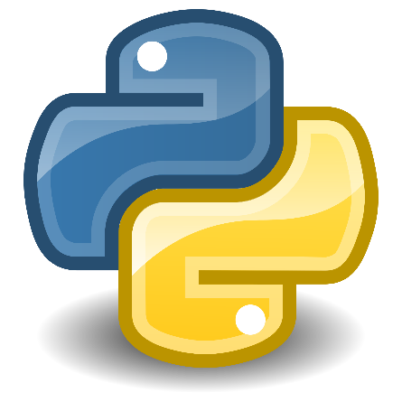
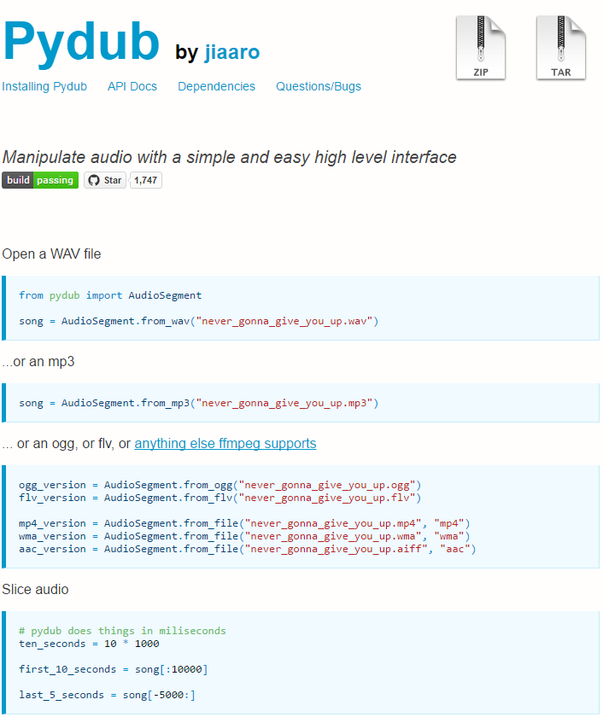
http://pydub.com/ - https://github.com/jiaaro/pydub/
Notes:
FFmpeg

Slide 9
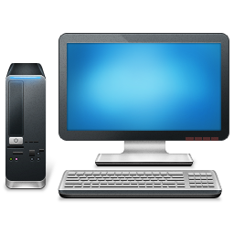



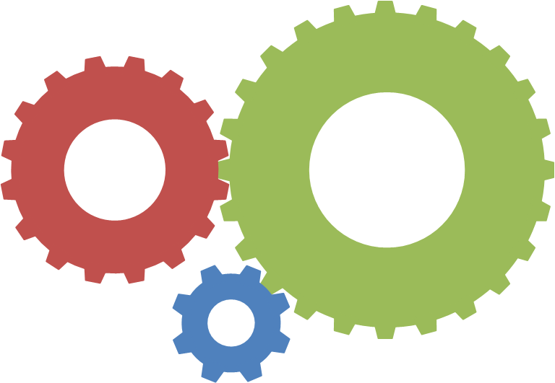

Slide 10
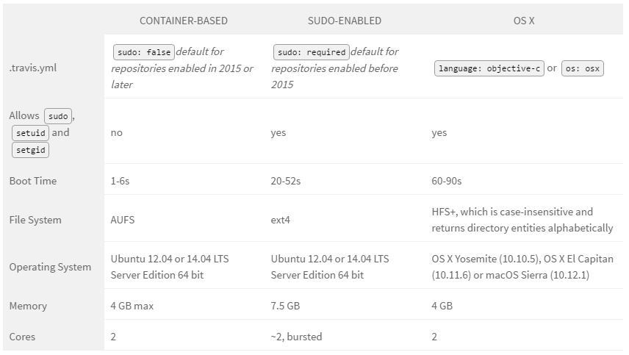
https://docs.travis-ci.com/user/ci-environment/

Slide 11
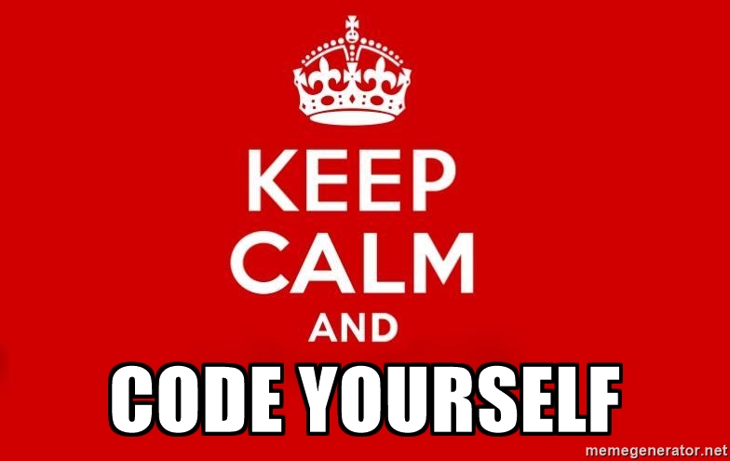
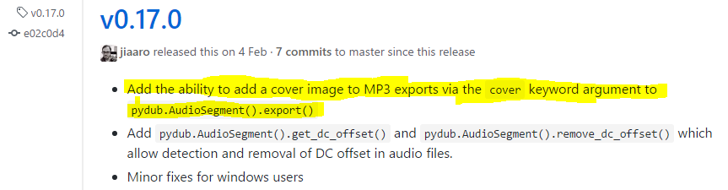

Slide 12
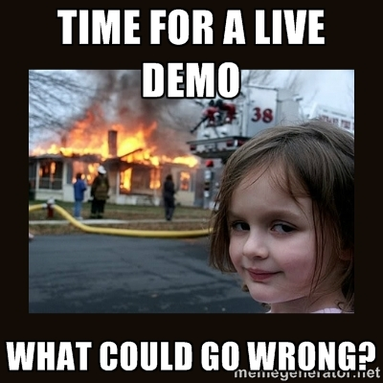

Slide 13
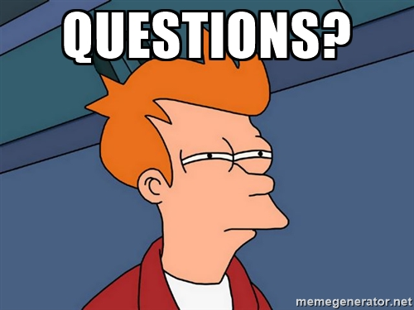

Slide 14


