Slide 1


Alternatives to work with CosmosDb in .NET
.net chapter meetup by David carrillo 02/24/2023

Slide 2
About me
I’m Mexican
Married with only one daughter
Software Developer for so long time (20+), most of the time with Microsoft technologies
Currently Technical Lead Full Stack assigned to American Airlines
Regular posting in .NET Chapter Community in Workplace
Interested on Data Science
Twitter LinkedIn GitHub @dacanetdev

Slide 3
Agenda
CosmosDb overview
CosmosDb SDK
Entity Framework Core for CosmosDb
Comparison
Exercises
Q & A

Slide 4
What is CosmosDb
Azure CosmosDb is Microsoft's fully managed and serverless distributed database for applications of any size or scale, with support for both relational and non-relational workloads. Developers can build and migrate applications fast using their preferred open source database engines, including PostgreSQL, MongoDB, and Apache Cassandra. When you provision a new Cosmos DB instance, you select the database engine that you want to use. The choice of engine depends on many factors including the type of data to be stored, the need to support existing applications, and the skills of the developers who will work with the data store.

Slide 5
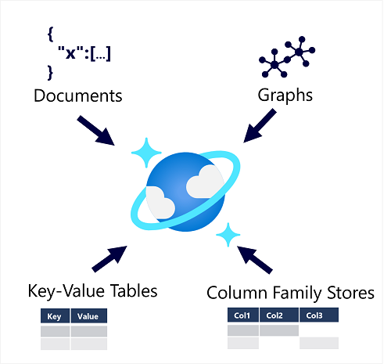
CosmosDb Databases Types

Slide 6
CosmosDb API options
Azure Cosmos DB for NoSQL
SELECT *
FROM customers c
WHERE c.id = "09224681-721b-44e3-bd8a-fe1d624dbc22“
{ "id": "joe@litware.com", "name": "Joe Jones", "address": { "street": "1 Main St.", "city": "Seattle" } }
Azure Cosmos DB for MongoDB
db.products.find({id: 123})
{ "id": 123, "name": "Hammer", "price": 2.99 }

Slide 7
CosmosDb API options
Azure Cosmos DB for PostgreSQL
SELECT ProductName, Price
FROM Products
WHERE ProductID = 123;
Azure Cosmos DB for Table
https://endpoint/Customers(PartitionKey='1',RowKey='124’)
PartitionKey | RowKey | Name | Email
1 | 124 | Samir Nadoy | samir@northwind.com
ProductName | Price
Hammer | 2.99

Slide 8
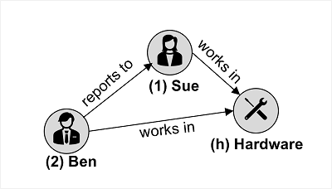
CosmosDb API options
Azure Cosmos DB for Apache Cassandra
SELECT * FROM Employees WHERE ID = 2
Azure Cosmos DB for Apache Gremlin
g.addV('employee').property('id', '3').property('firstName', 'Alice')
g.V('3').addE('reports to').to(g.V('1'))
ID | Name | Manager
2 | Ben Chan | Sue Smith

Slide 9
Alternatives for .NET SQL API
CosmosDb SDK
The Microsoft.Azure.Cosmos library is the latest version of the .NET SDK for Azure Cosmos DB for NoSQL.
Open source library in github https://github.com/Azure/azure-cosmos-dotnet-v3https://github.com/Azure/azure-cosmos-dotnet-v3
Install via nuget package dotnet add package Microsoft.Azure.Cosmos
Class | Description
Microsoft.Azure.Cosmos.CosmosClient | Client-side logical representation of an Azure Cosmos DB account and the primary class used for the SDK
Microsoft.Azure.Cosmos.Database | Logically represents a database client-side and includes common operations for database management
Microsoft.Azure.Cosmos.Container | Logically represents a container client-side and includes common operations for container management

Slide 10
Alternatives for .NET SQL API
Entity Framework Core for CosmosDb
Is a database provider that allows Entity Framework Core to be used with CosmosDb. This work
Install via nuget package dotnet add package Microsoft.EntityFrameworkCore.Cosmos
Leverage EF classes DbContext, DbSet
As any provider can be setup in OnConfiguring method
protected override void OnConfiguring(DbContextOptionsBuilder optionsBuilder) => optionsBuilder.UseCosmos( urlEndPoint, key);

Slide 11
Comparison – Initialize Client
CosmosDb SDK
CosmosClient client = new CosmosClient(endpointUrl, authorizationKey);
Entity Framework for CosmosDb

Slide 12
Questions?

Slide 13

Thanks
d.carrilloatondo@dxc.com

