Slide 1

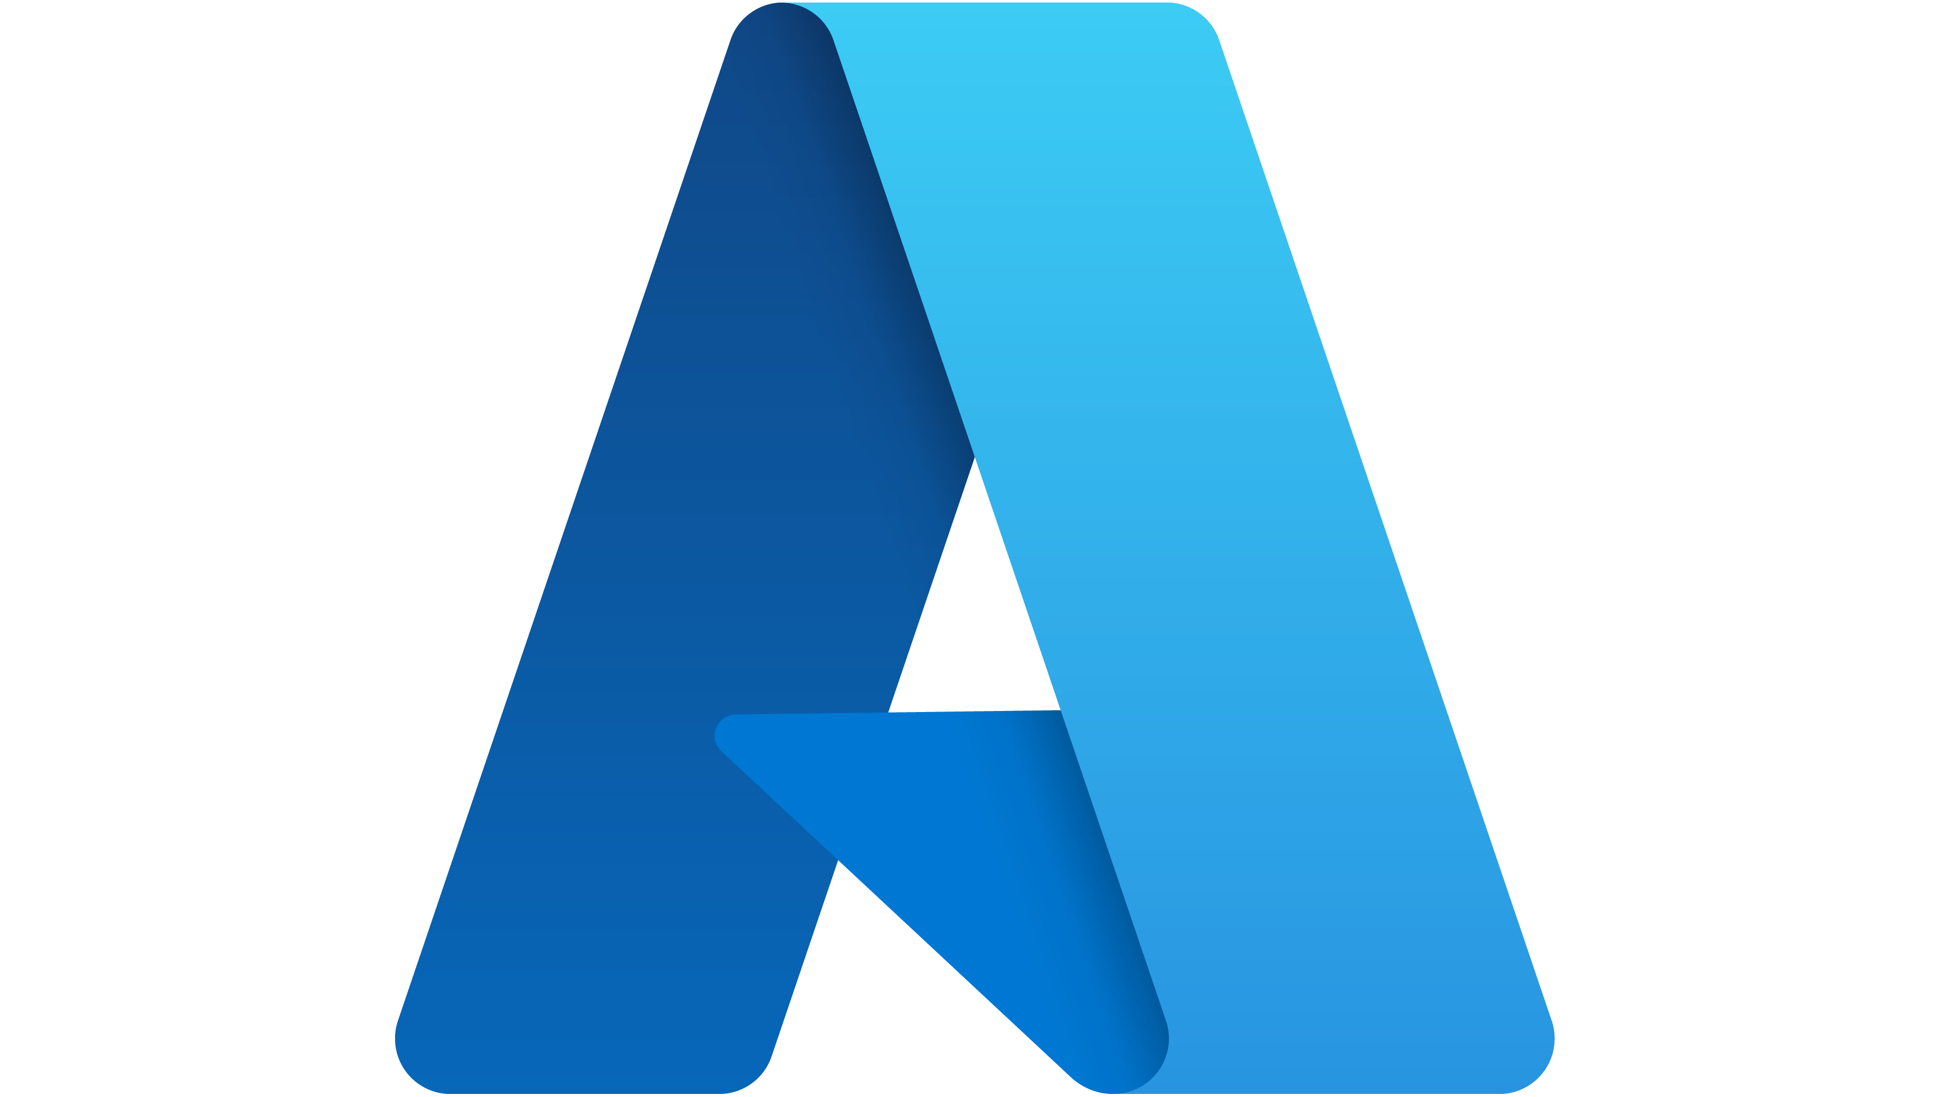
Build a Worker Service to Process Messages from Azure Service Bus
.NET Chapter Meetup

Slide 2
About myself
Full Stack Tech Lead with 20+ years as Software Developer mostly in .NET and Web Development
Passionate about coding and interested in Data Science

Slide 3
Agenda
Topic
Quick Introduction to Background Services
Problem and solution architecture
Overview of used technologies
Demo
Q & A

Slide 4
Quick Introduction to Background Services

Slide 5
Background Services
Sometimes we get the requirement of running certain operations that can o can not be memory intensive. Many times, those operations don't require a UI but a UI can be built around it. Those are called background processes or services.
Some reasons you want to build this kind of process are:
Long-running processes
Processing CPU-intensive data
Queueing work items in the background
Performing time-based operations or scheduled
In the early days of .NET Framework, we had the WIndow Services as a way to implement before that and sometimes that could also be achieved by having an always running either a console app or a Windows Forms with hidden UI exe program but that was not as controlled as the window services, but all these solutions have an inconvenient they can only run in Windows.
From .NET 3.0 Core and now in .NET there is a way to implement background processes in different platforms not only Windows and that was with the introduction of the BackgroundService abstract class.

Slide 6
Problem and Solution Architecture

Slide 7
Problem
The client is a Dentist clinic.
They want to have an application to make appointments for visits.
They want to save the appointments and send notification separately (asynchronously) managing a queue from a worker process
the clinic doesn’t want the worker to send the notification until the right time
The notifications should be sent only three hours before the appointment time.
Thus, the message cannot be sent to the queue directly.
To solve this problem, we need to build a solution to schedule a message—an appointment reminder in this case—three hours before the appointment time so that the message enqueues in the queue at the scheduled time and then the worker process picks it up to process it and sends the notification to the patient
We will be building an ASP.NET Core Web API to solve this problem by scheduling messages in the service bus queue by using the message deferral feature of Azure Service Bus.
Footnotes/references, if needed, appear here in Arial 9pt. Text grows up as lines are added. Copy and paste this box onto other slides where footnotes are needed.

Slide 8
Solution Architecture

Slide 9
Overview of Technologies Used

Slide 10
Service Bus
Is an Azure resource that is a message broker that enables the inter-application or service communication in a asynchronous manner.
Another alternatives are Apache Kafka, RabbitMQ, ActiveMQ and Amazon MQ.
Azure Service Bus is an enterprise-grade, multitenant cloud messaging service of Microsoft Azure. It is a Platform-as-a-Service (PaaS) offering of Azure and is fully managed by Microsoft.
Azure Service Bus allows applications to interact or transfer data with each other using messages. It supports data in different formats, such as JSON, XML, plain text, and so on, and provides client libraries in different languages to build solutions using it
When using Azure Service Bus
Increasing scalability of the application
Replacing RPCs• Integrating heterogeneous applications
Reducing the coupling between applications
Supports filtering with Topics, Message Sessions, Message auto-forwarding, Duplicate detection, Expiration, deferral and batching

Slide 11
Worker Service
16pt Arial Bold text goes here for a callout
Is a .NET Project Template.
Along with ASP.NET Core 3.0, a new application template was introduced, the Worker Service template. This template allows us to create an out-of-the-box project to create background services with .NET Core with some boilerplate code.
It creates a Worker class that inherits from BackgroundService and is added as hosted service using the AddHostedService method in program.cs. The functionality that we want to implement is going to be inside ExecuteAsync method in the Worker class. As with any other .NET Core and .NET you can specify dependency injection to any other services as ILogger to instrument the process for troubleshooting
Workser Service template can be created either using Visual Studio as a project template or with .NET Cli
dotnet new worker myWorkerService
A Worker Service can be deployed as:
Windows Service
Azure Container Instance (ACI)
Azure Web Job

Slide 12
Demo

Slide 13
Q & A

Slide 14
Thank you! As always Happy Coding!

