Slide 1
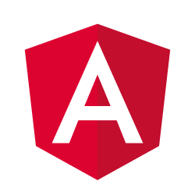
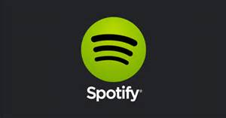
“Getting deep on Angular 2
and Spotify”
Based on Lecture from Udemy course:
Learn Angular 2 Development By Building 12 Apps
by Eduonix
Adaptation added for Angular 2 Final Release

Slide 2







Thanks to sponsors

Slide 3
About me
David Arturo Carrillo Atondo
Mexican, family guy and Mormon.
Web Developer for 13 years, worked in different companies including ACS Xerox.
Currently working for MSAG assigned to State Department Office
Twitter: @dacanetdev
Em@il: iscdavidcarrillo@gmail.com
Blog: https://weblogs.asp.net/davidcarrillo (in progress...)

Slide 4


Slide 5
Agenda
Angular 2 overview and History
Why Angular 2?
To get started
Main elements and features
Advanced topics
Spotify Explorer App (Practical Demo)
Resources and Conclusion
Questions and answers

Slide 6
Angular 2 Overview and History
What is Angular? : Is a development framework for web, mobile web, native mobile and native desktop.
History
AngularJS 1 was created in 2009 by Misko Hevery at Brat Tech, Misko became Google employee and Angular turned to an open source project
Angular 2 was announced during ng-Europe in September 2014
On December 2015 was released as Beta
Was moved to RC in May 2016 during ng-conf
Different iterations from RC1 to RC7, being RC5 and RC6 the ones with more breaking changes RC5 changed the router approach and RC6 added modules.
On September 14th 2016 we celebrated the first Angular 2 Release

Slide 7
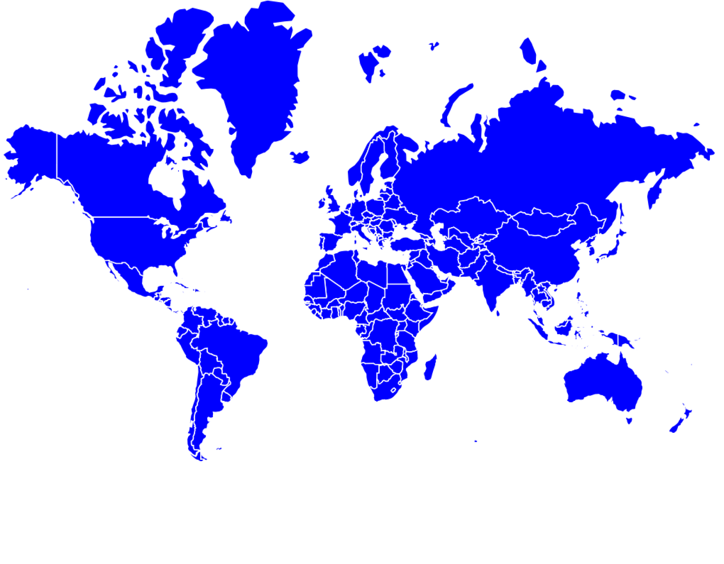
Why Angular 2
Its main goal is to improve performance
TypeScript as main coding option since Angular 2 has been built in Type Script
Stick to standards HTML and ECMA
Avoids confusion in the API:
Less directives
Every element has its own purpose
No more $scope, $scope.apply, $watch, $broadcast, no directive link function, transclude, etc.
Great Tooling (IDEs, angular-cli, Angular Universal, Augury)
UI Implementation: Angular Material 2, Ng Prime, Fuel UI, ng2-bootstrap
Great documentation with a very detailed style guide
The best is the growing community
Yay!!!

Slide 8
To get started
If not installed, Git (git bash) https://git-scm.com/downloads
If not installed, Node.js (newest version) https://nodejs.org/en/
Different ways to start
angular-cli
npm –g install angular-cli (it takes a few minutes)
ng new [yourprojectname]
ng serve (after run browse http://localhost:4200/)
github repository
git clone https://github.com/angular/quickstart [yourprojectname]
cd your [projectname]
npm install
npm start
Copy manually files from Angular 2 Quick Start
package.json, tsconfig.json, typings.json, systemjs.config.js
Web Pack
System.js

Slide 9
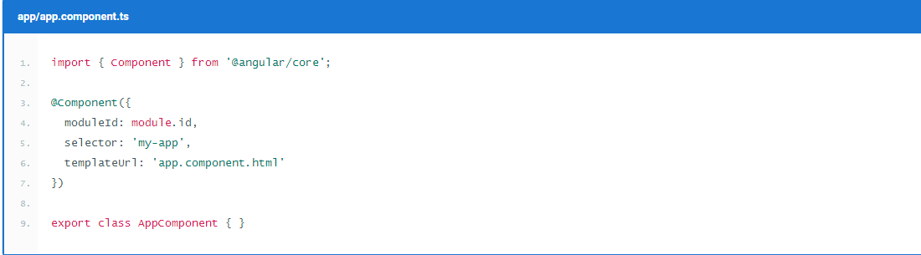
Main elements and features
Component: Fundamental building block.
Composed of:
Component decorator
View (Template)
Controller

Slide 10
Main elements and features
Binding
Angular Expression (string interpolation): {{ expression }}
Property Binding: value=‘expression’ [src]=‘expression’
Event Binding: (click)=‘openDialog()’ (nameChanged)=‘onNameChanged()’
Two way binding (banana in a box): [(ngModel)]=‘product.name’
Input to value: <input value=“title” #name> {{name.value}}

Slide 11
Main elements and features
Directives
Components are directives with a Template (View)
Attribute Directives
Structural Directives

Slide 12
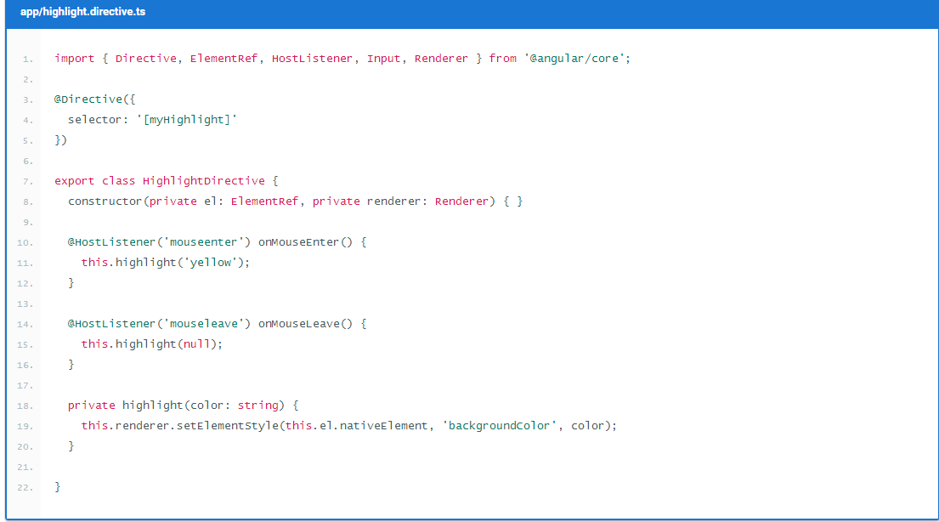
Main elements and features
Attribute Directives: changes the appearance or behavior of a DOM element. NgStyle

Slide 13
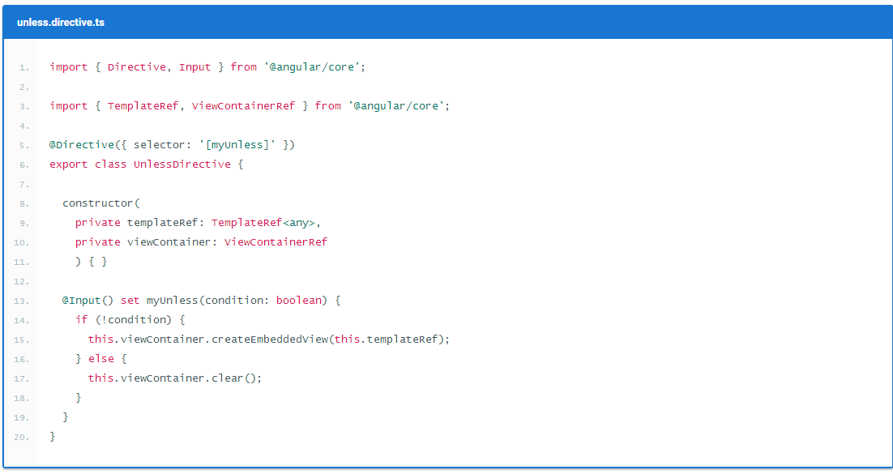
Main elements and features
Structural Directives: changes the DOM layout by adding and removing DOM elements. NgIf,NgSwitch, NgFor

Slide 14
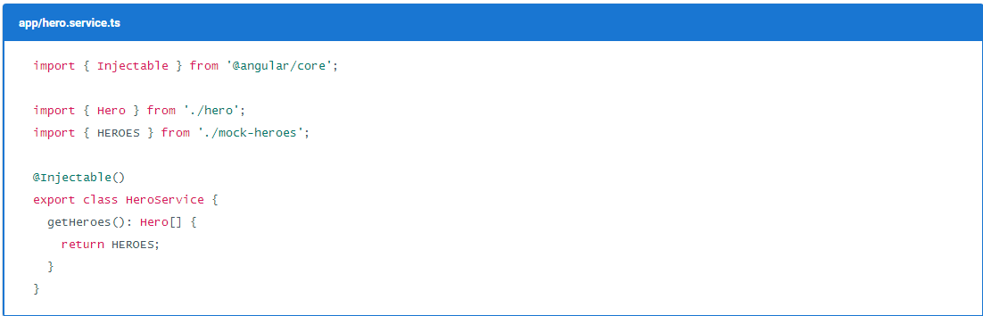
Main elements and features
Services: TypeScript classes that can be injected to components and direcives to mainly manage data.

Slide 15
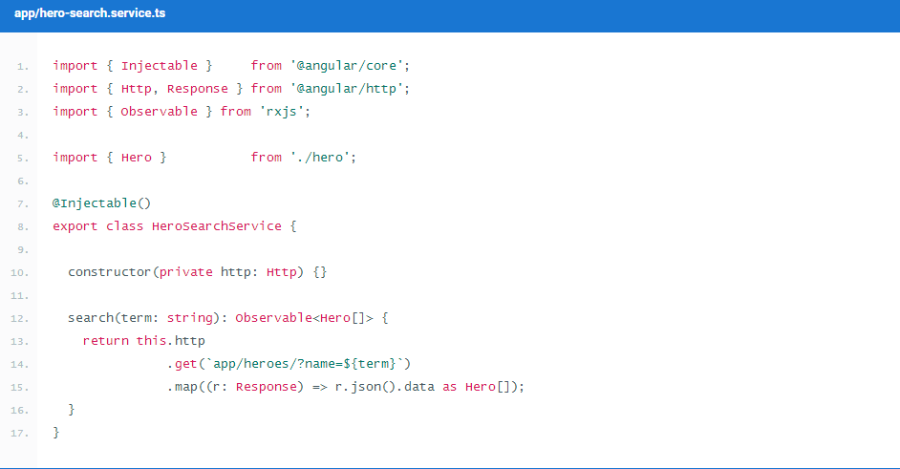
Main elements and features
Http : Angular has an additional module thas has a library to call external API’s.
Needs to be registered on main Module
Its main implementation is with Observables

Slide 16
Advanced Topics
Modules
Help organize an application into cohesive blocks of functionality.
An Angular Module is a class adorned with the @NgModule decorator function.
@NgModule takes a metadata object that tells Angular how to compile and run module code.
It identifies the module's own components, directives and pipes, making some of them public so external components can use them. It may add service providers to the application dependency injectors.

Slide 17

Advanced Topic
Rxjs and Observables: Using Observables to structure our data is called Reactive Programming.
Reactive Programming is a way to work with asynchronous streams of data.
Observables are the main data structure we use to implement Reactive Programming.
Rxjs contains some operators (functions) to handle
streams

Slide 18
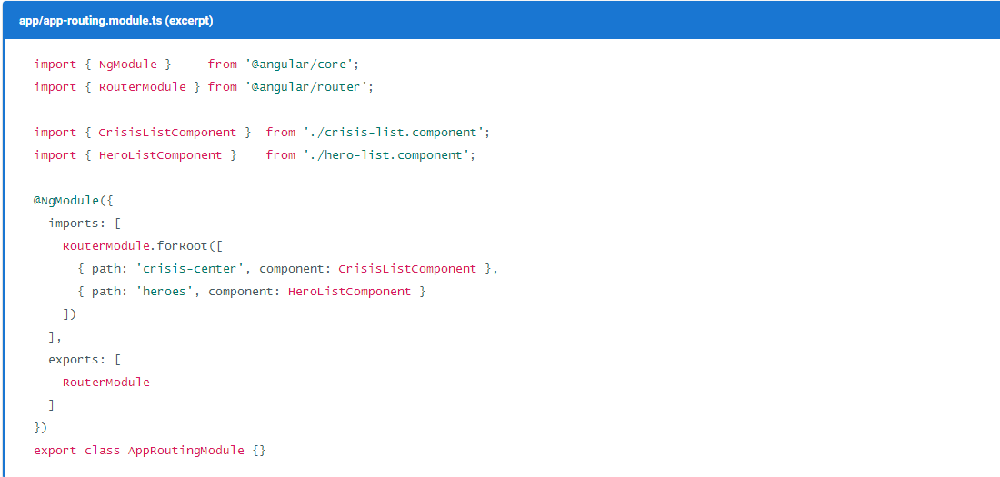
Advanced Topics
Routing: In Angular we configure routes by mapping paths to the component that will handle them.

Slide 19
Advanced Topics
Testing
There are two major ways to test you applications: end-to-end testing or unit testing.
Tools:
Jasmine: Is a behavior-driven development framework for testing JavaScript code.
Karma: Allows us to run JavaScript code within a browser
Angular cli creates by default .spec.ts files to set the tests when creating a component
With System.js configuration:
npm test
With angular cli configuration:
ng test

Slide 20

Practical Demo

Slide 21
Resources
Angular 2 Quick Start https://angular.io/docs/ts/latest/quickstart.html
Udemy Course: Angular 2 - The Complete Guide (Updated to Final Version!)
https://www.udemy.com/the-complete-guide-to-angular-2/learn/v4/overview
Udemy Course: Learn Angular 2 Development By Building 12 Apps
https://www.udemy.com/learn-angular-2-development-by-building-10-apps/learn/v4/overview
ng-book 2

Slide 22

Questions

