Slide 1
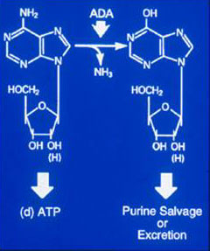
Adenosine-Deaminase (ADA) Deficiency
ADA is responsible gene in ~20% SCID.
Often fatal, if untreated, due to infections.
It was the first form of SCID where:
1. genetic cause was identified (1972),
2. responsible gene was cloned (1983),
3. gene therapy was approached (1990),
4. effective treatment (PEG-ADA) other
than HSCT was developed (1990).
PEG-ADA enzyme replacement therapy:
1. FDA approved orphan drug (1990),
2. Bi-weekly I.M.,
3. Can restore, sustain immunity,
4. Expensive ($200-500,000/yr).

Slide 2
ENZYME REPLACEMENT THERAPY WITH BOVINE ADA (PEG-ADA)
Correction of metabolic abnormalities.
Variable restoration of immune functions, with 20% non responders and >50% still on IVIG.
Last survey (Hershfield, ESID 2002) overall survival 83% (n=113) (73% including patients who underwent BMT).
10% developed neutralizing antibodies.
Autoimmune syndromes in 5 patients (fatal in 3).

Slide 3
Absolute CD3+ T Lymphocyte Counts
In 9 ADA (-) SCIDs on PEG-ADA 4-11 Yrs
1,600
Lower 5th %ile of normal range
Absolute CD3+
T Lymphocyte Count (/mm³)
1,200
800
Years on
PEG-ADA
6
11
400
6
5
9
10
9
4
0
8
Chan …Kohn
MS in Prep.
Pre- PEG-ADA
Maximal
Most Recent

Slide 4
Bone Marrow Transplantation for ADA-SCID
HLA-identical sibling BMT (treatment of choice)
  Survival 75-90%. Neurological and behavioral alterations observed in the long term follow-up.
Non HLA-identical BMT
  Without conditioning (haplo): 33% engraftment (n=15) (Buckley et al., presented at ESID 2002).
  With conditioning: overall survival 23% (n=29) (EBMT/ESID registry, Antoine et al., Lancet, 2003, 361:553-560).
Overall survival at Great Ormond Street Hospital (B. Gaspar/A. Thrasher), presented at EBMT, 2004
    HLA-id sibling/family donor (84%) (n=13)
    Matched unrelated donor or UCB (50%) (n=4)
    Haploidentical donor (23%) (n=13)
Notes:
But there is also a strong therapeutic rationale compared to other available options,
In the absence of an HLA-identical sibling domor, an event which occurs in the majority of cases,
BMT is associated with a high risk and poor survival
Enzyme replacement therapy can be an effective but in many patients the immune reconstitution is incomplete and the patients may develop autoimmunity or neutralizing antibodies.
Based on the initial studies which showed the feasbility and safety of gene therapy, but had limited therapeutic impact since the enzyme replavement therapy was maintaiend in all treated patients, we designed an improved clinical gene therapy trial is based

Slide 5
Survival after HLA-mismatched
Bone Marrow Transplantation for SCID
(EBMT/ESID registry, Antoine et al.,
Lancet, 2003, 361:553-560)
ADA-SCID
MUD + haploidentical 23%
SCID T-B+ (including X-SCID)
  MUD 66%
  Haploidentical 50%
Notes:
But there is also a strong therapeutic rationale compared to other available options,
In the absence of an HLA-identical sibling domor, an event which occurs in the majority of cases,
BMT is associated with a high risk and poor survival
Enzyme replacement therapy can be an effective but in many patients the immune reconstitution is incomplete and the patients may develop autoimmunity or neutralizing antibodies.
Based on the initial studies which showed the feasbility and safety of gene therapy, but had limited therapeutic impact since the enzyme replavement therapy was maintaiend in all treated patients, we designed an improved clinical gene therapy trial is based

Slide 6
Early ADA Gene Therapy Trials
# of patients
T cells
Blaese et al. 1993 2
Bordignon et al. 1992 6*
CD34+ cells
Bordignon et al. 1992 2*
Hoogerbrugge et al. 1992 3
Kohn et al. 1993 3
* same patients

Slide 7
1st CHLA/NIH ADA Gene Transfer Trial
In 1993, umbilical cord blood was collected from
three ADA-deficient SCID neonates.
CD34+ cells were isolated and transduced with
the human ADA cDNA by culture for 3 days with
the LASN retroviral vector and IL-3/IL-6/SCF.
The cells were reinfused I.V. on day 4 of life,
without prior cytoreduction.
Treatment with PEG-ADA was initiated.

Slide 8
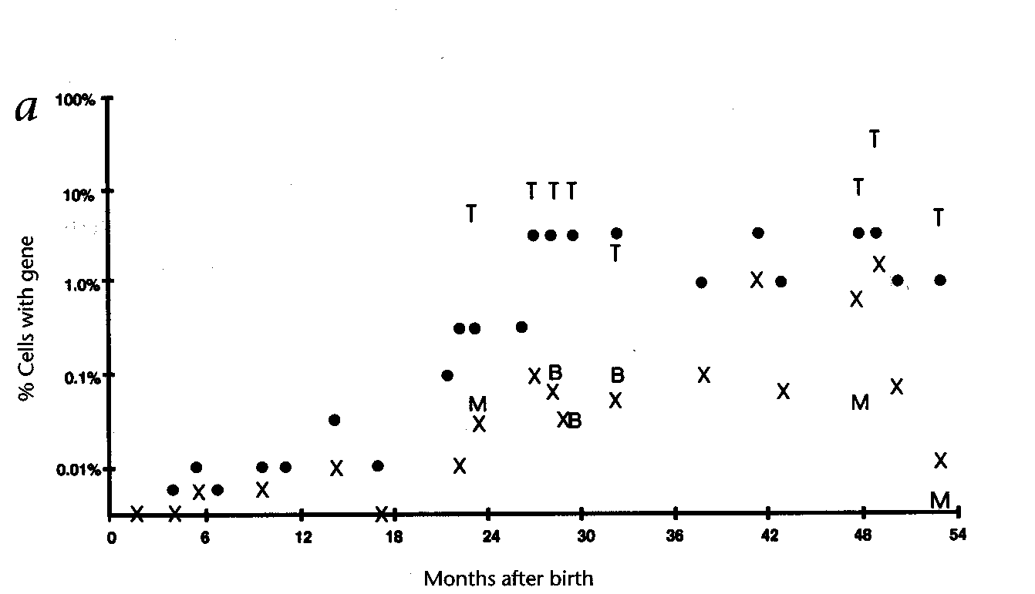
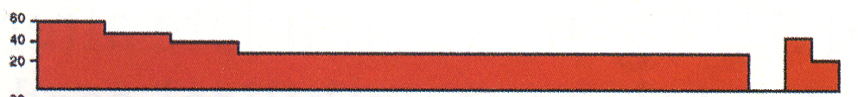
Frequency of Gene-Containing Leukocytes Measured Using Semi-Quantitative PCR
PEG-ADA (U/kg/wk)
UPN #ADA101
X=gran; = PBMC;
M=monocytic;
T= T cell; B= B cell
Months after birth
Kohn et al, Nat Med 4:775-780, 1998.

Slide 9
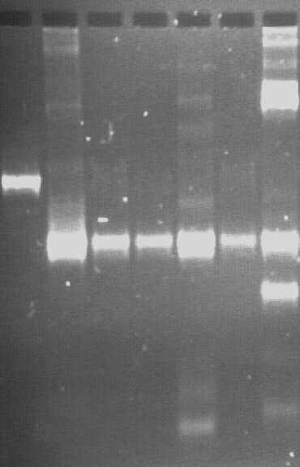
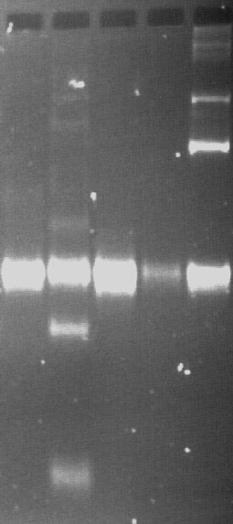
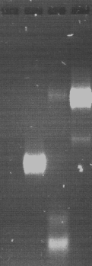

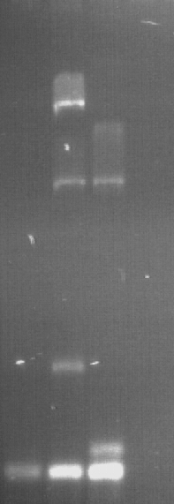
LAM-PCR analysis of PBMC,
T cells and myeloid cells
Patient 1
Patient 2
1
9
48*
53
63
80
94
28
32
48*
49
88
28
32
48*
49
94
94°
48
64
72
80
PBMC
CD 3+
CD 13/14
PBMC
From: Schmidt et al., Nat Med. 2003; 9(4):463-8

Slide 10
Summary
Schmidt et al., Nat Med. 2003; 9:463-8
LAM-PCR revealed the stable presence of a predominant
vector integrant in T and myeloid cells over the past 8 years.
T cell clones grown from peripheral blood 8 years after
neonatal CD34+ cell gene transduction indicated that:
a single pre-thymic stem or progenitor cell accounted
for the majority of gene marking in polyclonal T cell
production.

Slide 11
Frequency of Gene-Containing Leukocytes Measured Using Semi-Quantitative PCR
PEG-ADA (U/kg/wk)
UPN #ADA101
X=gran; = PBMC;
M=monocytic;
T= T cell; B= B cell
+11 yrs
↓
X
↑
+11 yrs
Months after birth
Kohn et al, Nat Med 4:775-780, 1998.

Slide 12
2nd CHLA/NIH ADA Gene Transfer Trial
Study parameters:
1. Phase 1 study
2. 10 patients - must be on PEG-ADA E.R.T.
3. ADA-deficient SCID neonates or children
4. Target cell: CD34+ cells from UCBC (neonates) or BM (children)
5. Gene transfer method: Ex vivo transduction with MLV-based RV in GALV-pseudotype using
SCF/MGDF/F3L on retronectin, serum-free.
6. Phased withdrawal of PEG-ADA after 1 year,
if gene marking present.
7. 2 year active phase follow-up.

Slide 13
2nd CHLA/NIH ADA Gene Transfer Trial
IND Application, Aug. 1999
IND Approval 2001
4 patients enrolled, Aug 2001 – Jan 2002
UPN Age (y/o) CD34+/kg % PCR+ CFU
201C 15 0.7 12*
202N 5 13.3 50
203N 20 1.3 1
204C 4 2.0 20
* GcSap vector only

Slide 14
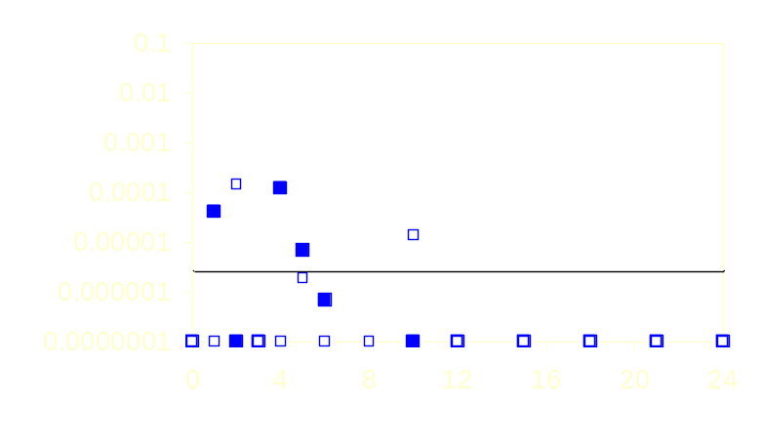
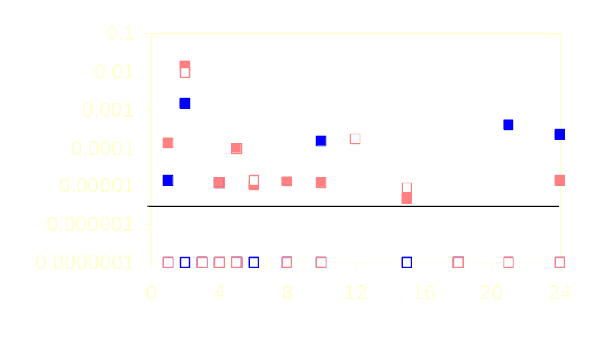
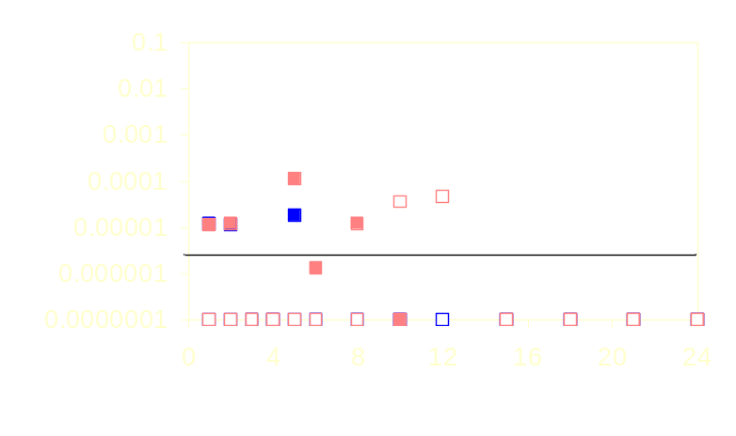
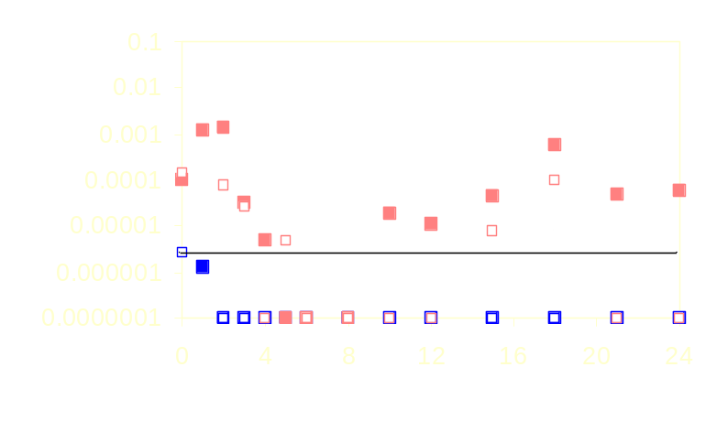
ADA Vector Marking
ADA 201C
ADA 202N
15 y/o
5 y/o
# Proviral Copies / Cell
MND - PBMC
MND - PMN
ADA 203N
GC-sap - PBMC
ADA 204C
GC-sap - PMN
4 y/o
20 y/o
Months Post-Infusion

Slide 15
Clinical Trial of Gene Therapy for ADA-Deficient SCID in Italy
Aiuti et al. (Milan). Science 296:2410-2413, 2002.
Two ADA-deficient SCID given busulfan (4/kg) prior to BM infusion (“non-myeloablative conditioning”).
Not treated with PEG-ADA therapy.
Immune reconstitution by 6 months.
T cells gene-marked at 100%
Myeloid cells gene-marked at 7-12%.
----------------------------------------------------------------------
4 more treated since then, with good immune recovery

Slide 16
ADA-SCID gene therapy: the Milan trial
H
SC
-
P
t
A
g
e
at
tr
e
atm
e
nt
C
D
34
+
ce
ll
s
(x10
6
)
/
K
g
C
D
34
+
ce
ll
s
(x10
6
)
/
K
g
c
ol
l
e
cte
d
i
nf
u
s
e
d
P
t1
7
4
.
1
8
.
6
P
t2
3
0
1
.
1
0
.
9
P
t3
1
2
3
.
5
5
.
4
P
t4
2
2
4
.
7
3
.
7
P
t5
1
9
7
.
7
9
.
4
P
t6
5
4
1
0
.
2
9
.
1
(Aiuti et al. Science, 2002, 296:2410-3 and unpublished data)

Slide 17
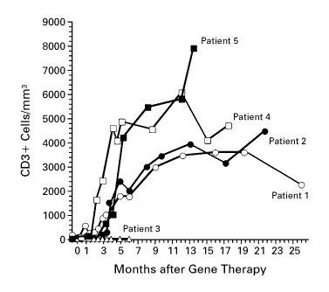
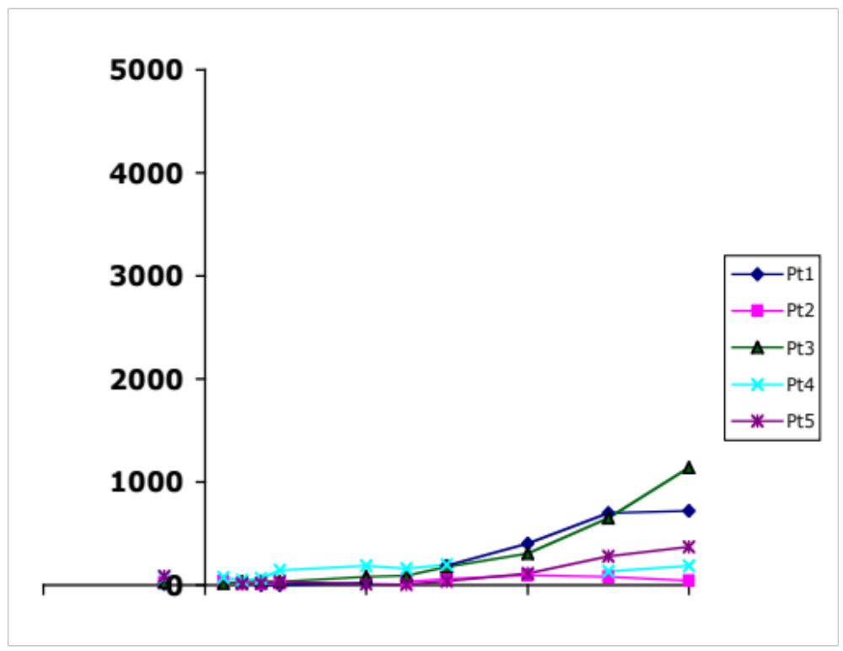
T-cell Reconstitution in early phase:
comparison of SCID trials
XSCID
X-SCID
ADA-SCID
T cells/microl
0
2
4
6
Months of follow up
(Hacein-Bey et al. Science,
2003, 302:415-9)
(Aiuti et al. Science, 296:2410-3
2002 and unpublished data)

Slide 18
2nd CHLA/NIH ADA Gene Transfer Trial
IND Application, Aug. 1999
IND Approval 2001
4 patients enrolled, Aug 2001 – Jan 2002
Clinical Hold, Sep. 2002
Clinical Hold lifted Dec 2003
IND changes, incl. Busulfan, PEG-ADA withdrawal, age and cell dose limit, final approval: Jan 2005
Clinical Hold, Jan. 2005

Slide 19
ADA (-) SCID: Summary
PEG-ADA palliative, but immune function is below normal
Poor outcome with haplo-BMT
No adverse events in at least 18 subjects, some with retroviral-transferred gene present >10 years
Good outcome from gene therapy in Milan study, using Busulfan and no PEG-ADA

