Slide 1

Bharat Teeka Portal
GroupNo: 22
Guided By:Bakul Joshi
Team Members:
Anurag Yadav | 250843020017
Digvijay Kapurkar | 250843020029
Sujit Wandre | 250843020115
Ajay Jadhav | 250843020006

Slide 2
Introduction To Project
PayPlate is an automated restaurant billing system designed to replace manual and outdated billing methods. It streamlines order processing, billing, and payment by integrating menu items, taxes, discounts, and invoices into a single platform.
The system improves accuracy, reduces billing delays, and supports faster customer service, especially during high-volume operations. PayPlate also provides real-time sales reports and performance insights to help restaurant owners track revenue efficiently.
Goals:
Automate billing and invoice generation
Improve speed, accuracy, and security
Enhance customer satisfaction through quick payments

Slide 3
Hardware And Software Requirements
Hardware Requirements:-
Processor: Intel i3
higher RAM: Minimum 4 GB
Browser: Google Chrome or
Mozilla Firefox
Software Requirements:-
Front End Tools:-
React.js – for building the user interface
Bootstrap – for responsive and styled components
Back End Tools:-
Spring Boot / .NET – for server-side development and business logic MySQL – for database management

Slide 4
Project Overview
PayPlate Portal is a full-stack restaurant billing management system designed to digitize and simplify the billing process for restaurants, staff, and customers.
Key Objectives
• Centralized order and billing management system
• Secure and accurate digital invoice generation
• Support for dine-in, take-away, and multiple payment modes
• Real-time sales tracking and revenue analytics

Slide 5
Users and Use Cases
Users
Customer (Dine-in )
Waiter / Cook
Restaurant Admin
Use Cases
• User registration & login
• Place and manage customer orders
• Fetch menu items with prices automatically
• Generate bills with tax & discounts
• View invoices
• Real-time sales & order tracking
• Admin monitoring

Slide 6
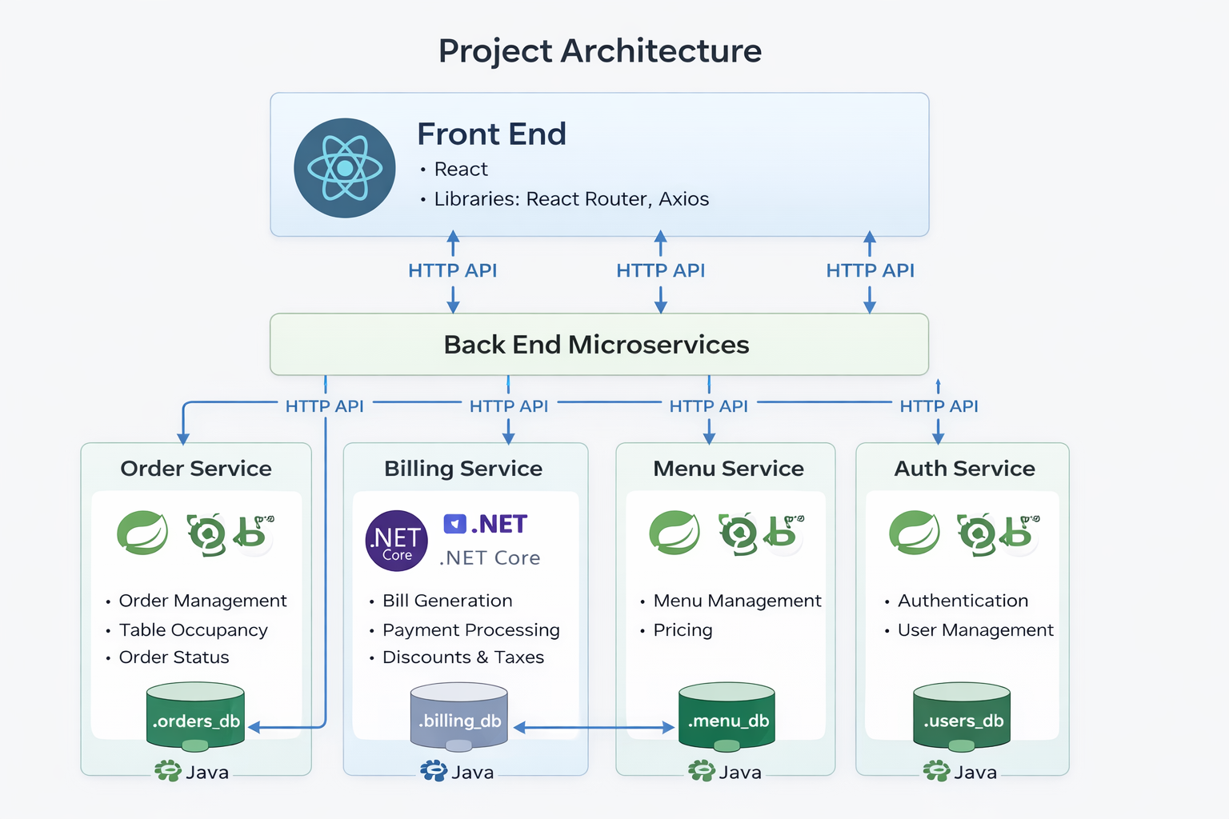
Project Architecture

Slide 7
Project Methodology
Agile-based incremental approach:
Requirement analysis UI & database design
Backend API development
Frontend integration Testing & bug fixing
Why Agile?
Continuous improvement Easy requirement changes Faster feedback cycles

Slide 8
Testing Approach
Types of Testing Used
Unit Testing – Service & Controller layers
Integration Testing – API & Database interaction
Functional Testing – Login, Order, Billing, Payment workflows
Manual UI Testing – Forms, validations, role-based access
Testing Tools
Postman – API testing
Web Browser (Chrome) – Manual UI testing

Slide 9
Future Scope
Online Payment Integration (UPI, Cards, Wallets) for seamless billing
Advanced Analytics Dashboard for sales, popular items, and revenue trends
Inventory Management with low-stock alerts and supplier integration
Loyalty & Offers System for returning customers
Cloud Deployment & Scalability for multi-branch restaurants
QR-Based Ordering System for contactless dining

Slide 10
Experience & Lessons Learnt
Key Learnings
Full-stack application development REST API design & integration Role-based access control
Handling real-world database constraints
Team collaboration using Git
Personal Growth
This project improved my problem-solving, debugging, and system design skills and gave me hands-on experience with enterprise-level architecture

Slide 11
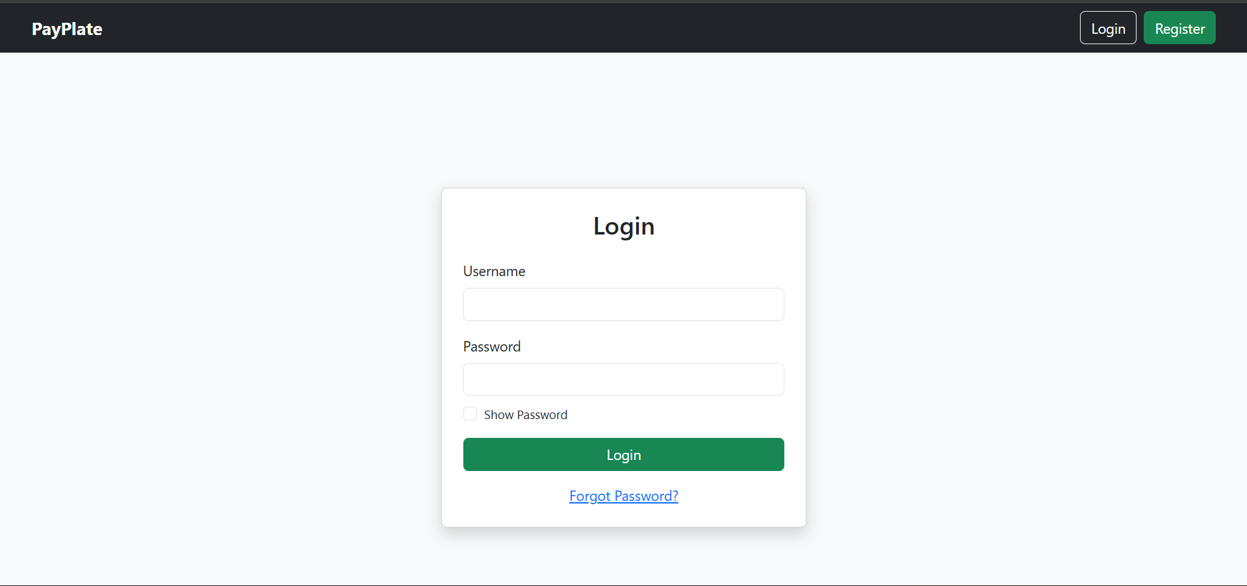
Login page

Slide 12
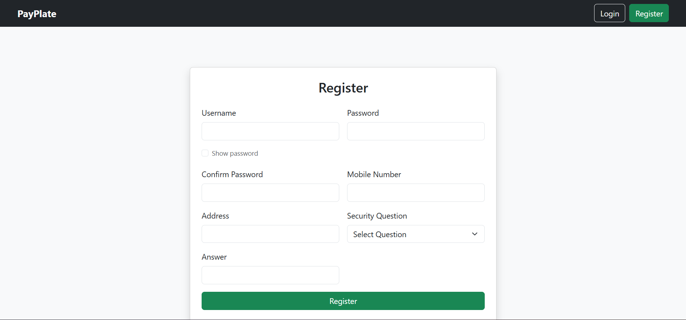
Login page

Slide 13
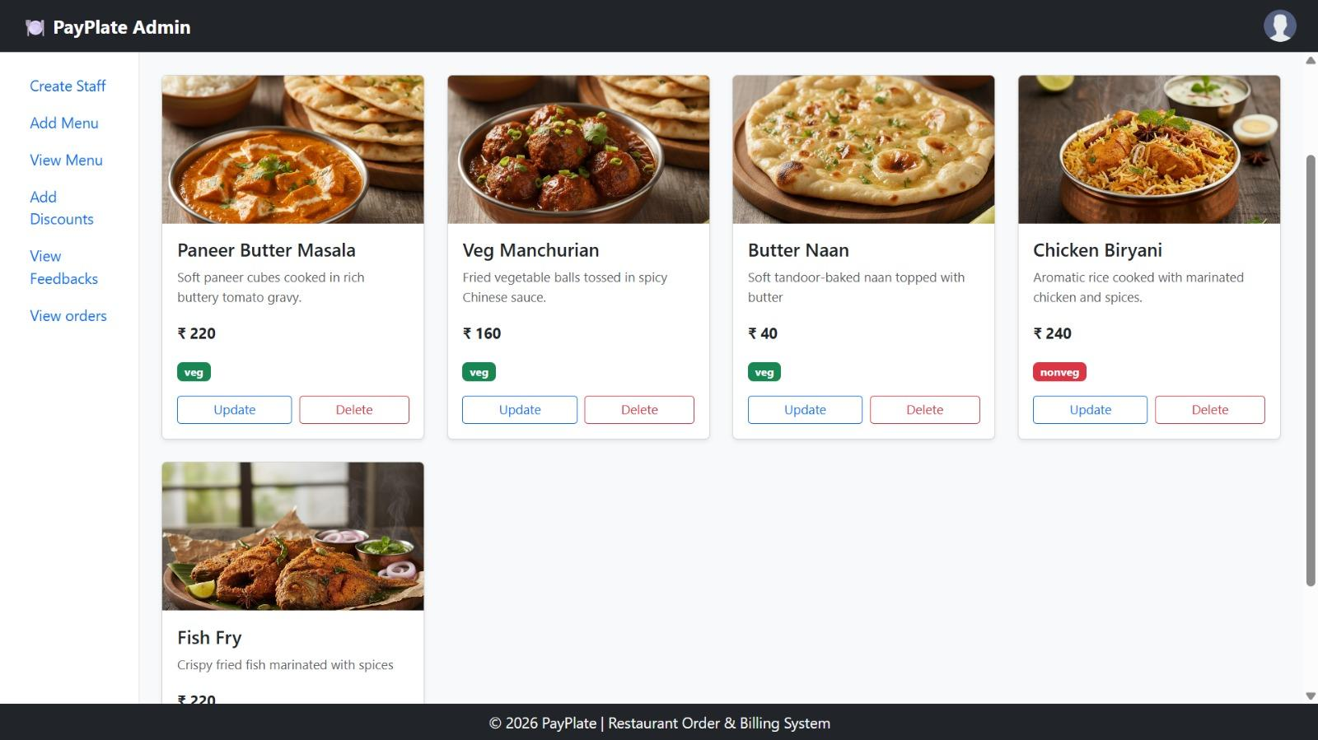
Admin Dashboard

Slide 14
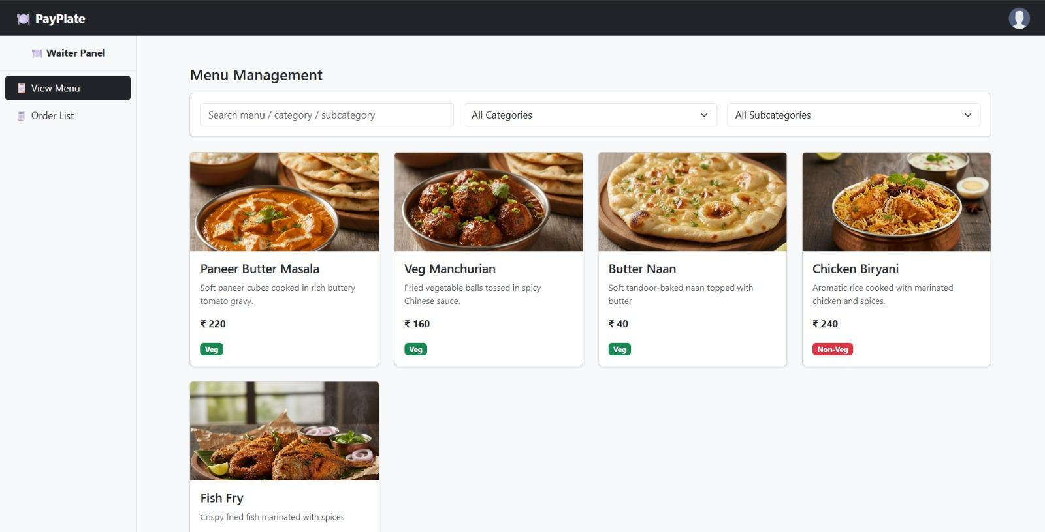
Waiter Dashboard

Slide 15
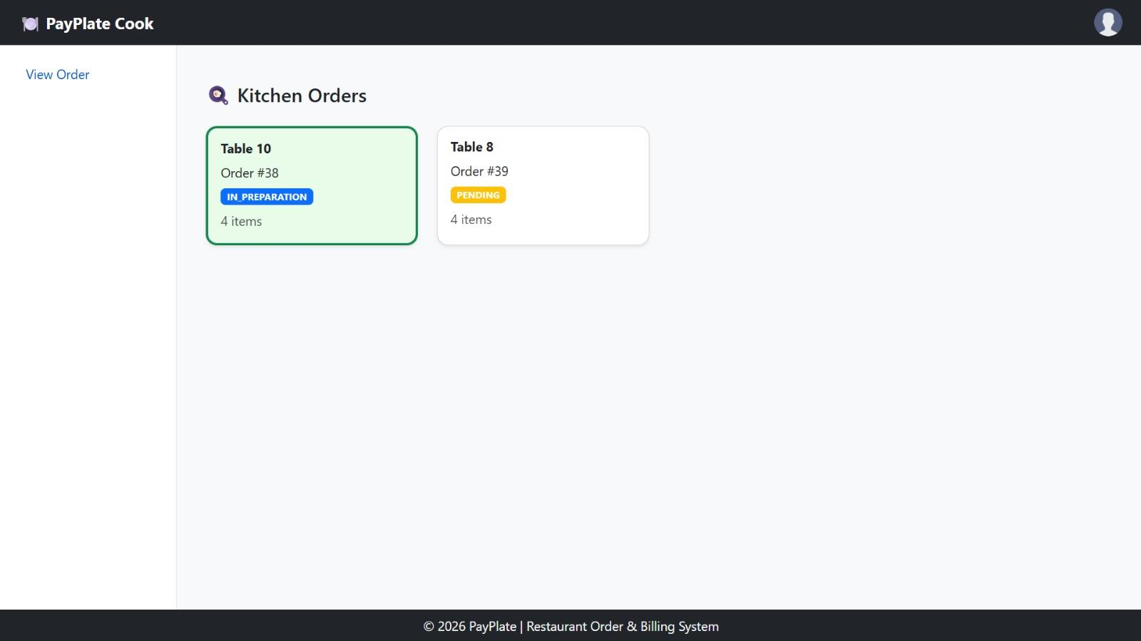
Cook Dashboard

Slide 16
Conclusion
The PayPlate Restaurant Management System successfully integrates multiple services to handle orders, billing, menu, and feedback efficiently.
A microservices-based architecture ensures scalability, flexibility, and independent service development.
Real-time order tracking improves coordination between kitchen, waiter, admin, and customer roles.
Automated billing with tax and discount calculations reduces manual errors and improves accuracy.
The system enhances overall customer experience and operational efficiency in restaurants.

Slide 17



















THANK YOU

