Slide 1
The Long Dark Tail of
Research Data
Tim Vines, University of British Columbia

Slide 2
The Long Dark Tail of
Research Data
Arianne Albert, Rose Andrew, Florence Débarre, Dan Bock, Michelle Franklin, Kim Gilbert, Nolan Kane, Jean-Sébastien Moore, Brook Moyers, Sébastien Renaut, Diana Rennison, Thor Veen, Tim Vines, and Sam Yeaman

Slide 3
The Long Tail
e.g. CERN
PB
the ‘hump’
the ‘tail’
Size of dataset
most experiments
TB
GB
MB
Number of datasets

Slide 4
The Long Tail
e.g. CERN
PB
genomic data
Size of dataset
most experiments
TB
GB
MB
Number of datasets

Slide 5
The Long Dark Tail
The long tail is real

Slide 6
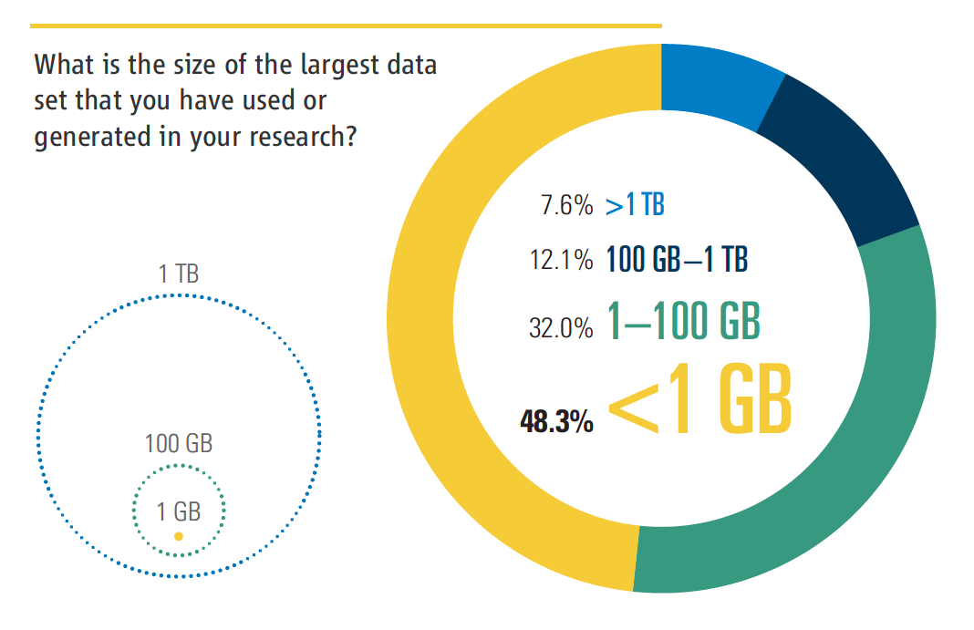
‘Challenges and Opportunities’ (2011) Science

Slide 7
The Long Dark Tail
The long tail is real
It’s mostly ‘dark’

Slide 8
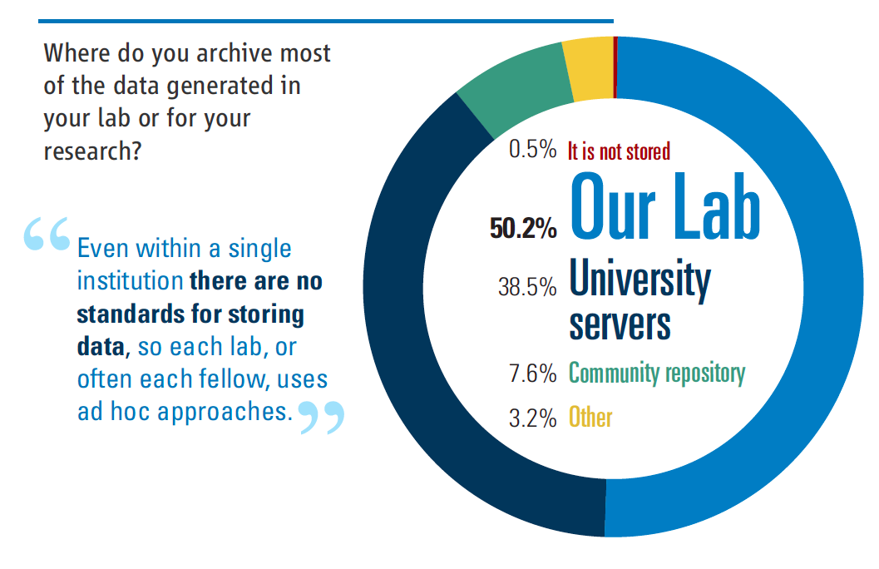
‘Challenges and Opportunities’ (2011) Science

Slide 9
The Long Dark Tail
PB
Size of dataset
TB
GB
MB
Number of datasets

Slide 10
The Long Dark Tail
What’s happening to these data?

Slide 12
How does the availability of long tail data change with time since publication?
Vines et al. Current Biology 2014

Slide 13
Introduction

Slide 14
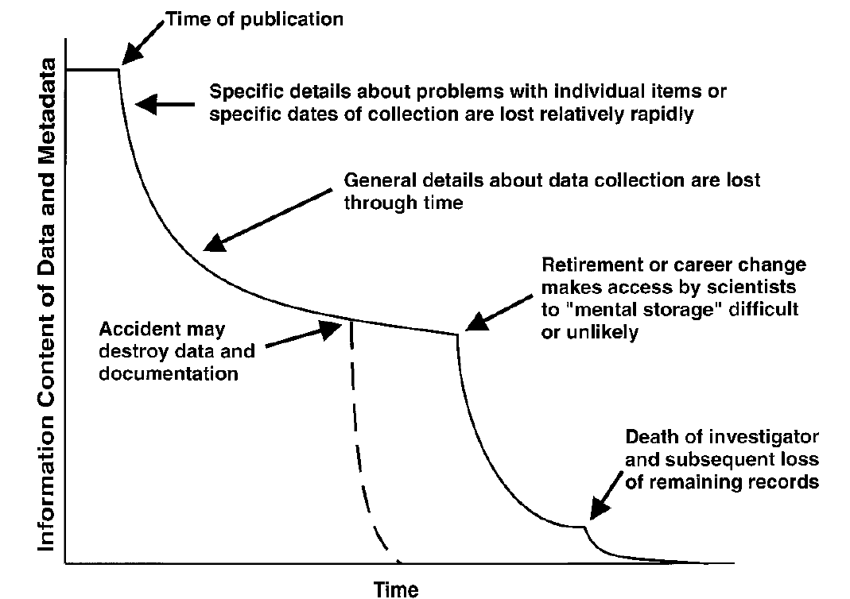
Study published
Minor details lost/forgotten
Important metadata lost/forgotten
Career change, email breaks
Accidentaldata loss
Death of researcher
Time
Michener et al. (1997) Nongeospatial metadata for the ecological sciences. Ecol. Appl. 7:330

Slide 15
How fast does this happen?

Slide 16
Study published
0 5 10 15 20 25 30 35
Years

Slide 17
Study published
0 1 2 3 4 5 6 7
Years

Slide 18
How fast does this happen?
What are the main causes of data loss?

Slide 19
Study published
Data storage defunct
Career change, email breaks
Accidentaldata loss
Death of researcher
Time

Slide 20
How fast does this happen?
What are the main causes of data loss?
Ask for datasets, see how many you get…

Slide 21
Methods

Slide 22
Need to control for data type
morphological data from animals & plants
used in a Discriminant Function Analysis
Reproducing analyses checks the data

Slide 23
Study published
Minor details lost
Important metadata lost
Time

Slide 24
516 studies in odd years 1991 - 2011
Asked for data by email
searched for emails in paper and online
contacted first, last & corresponding authors
“We want to try repeating your DFA”
part of study on reproducibility and paper age

Slide 25
Author motivation :
we’re trapped in burning building vs
we want to print it out for wallpaper
Our request is fairly common practice
expect 20-50% for 2011

Slide 26
Motivation sets total % of data we receive
But our focus is on how % changes with time
as long as we get some data we’re OK

Slide 27
If data were gone, we asked for the reason

Slide 28
Results

Slide 29
Probability that data still extant
(i.e. received + couldn’t be shared)

Slide 30
Probability that data still extant
(i.e. received + couldn’t be shared)

Slide 31
Odds of data being extant fall by 8% per yr
Almost all gone after 20 years
just 3 of 61 datasets extant for 1991 and 1993
Why were we unable to get the data?
which reasons are related to paper age?

Slide 32
Probability that at least one email for authors on the paper we contacted didn’t bounce

Slide 33
Given that at least one email didn’t bounce,
probability we got a response

Slide 34
Given that at least one email didn’t bounce,
probability we got a response
(motivation to respond is unrelated to paper age)

Slide 35
Given that we got a response,
probability we heard about the data

Slide 36
Given that we heard about the data,
probability data is extant

Slide 37
Conclusions

Slide 38
Data held by authors disappears fast
Almost all gone after 20 years
Archiving at publication really is crucial
Vines et al. Current Biology 2014

Slide 40
The Long Dark Tail
What’s happening to these data?
they’re disappearing!
How can they be brought into the light?
be preserved & made public
be re-used in new research

Slide 41
Illuminating the Dark Tail
First, the bad news…

Slide 42
Many (most?) researchers aren’t interested in
- data curation
- long term data preservation
- data sharing
All they care about is getting publications...

Slide 43
Illuminating the Dark Tail
First, the bad news…
Preservating long tail data won’t be voluntary

Slide 44
Illuminating the Dark Tail
Then who’s responsible?
institutions?
funding agencies?
journals?

Slide 45
Illuminating the Dark Tail
Institutions & Funders
have influence via $$$
but can’t monitor data production
only hear about data when researchers tell them

Slide 46
Illuminating the Dark Tail
Journals
control access to publication
datasets are integral to the paper & hence ‘visible’
the data can be delineated
can withhold publication until data are shared

Slide 47
Illuminating the Dark Tail
Who’s responsible?
What can journals do?
adopt data sharing policies
enforce their data sharing policies

Slide 49
Do data archiving policies work?

Slide 50
many journals now have data sharing policies
four flavours:
no policy
recommend
require
Vines et al. (2013) FASEBJ

Slide 51
many journals now have data sharing policies
four flavours:
no policy
recommend
require
no ‘data availability’ statement
‘data availability’ statement
Vines et al. (2013) FASEBJ

Slide 52
focus on single type of data
genetic data used in STRUCTURE
must have established online archive
in this case Dryad (or supp. mat.)
found 229 papers from 2011-12
what % had data available?

Slide 54
Motivating data sharing

Slide 55
wide range of approaches available:
ask for the data (but don’t follow up)
check whether any data is there
check whether all data is there
check it matches data used in paper
reproduce some basic values
reproduce all results

Slide 56
Easy steps

Slide 57
Data statements

Slide 58
Data statements
These can be effective!
we repeated analysis for PLoS ONE in 2016
new data statement rule from March ’14
67% of datasets now available

Slide 61
Data statements
we repeated analysis for PLoS ONE in 2016
new data statement rule from March ’14
67% of datasets now available
EO checks for statement at initial submission
moves archiving earlier in the review process

Slide 62
2) Link data archiving to paper quality

Slide 63
2) Link data archiving to paper quality
add expectations to author guidelines:
“Papers with exemplary data and code archiving are more valuable for future research, and, all else being equal, these are more likely to get accepted for publication”

Slide 64
Medium steps

Slide 65
3) Ask reviewers to assess data statement:
“Does the Data Accessibility section list all the datasets needed to recreate the results in the manuscript? If ‘No’, please specify which additional data are needed in your comments to the authors.”
[Yes/No/I didn’t check]
We find only ~15% provide good feedback

Slide 66
4) Ask editors to assess data statement:
include comments in decision letter
we didn’t explicitly try this at Molecular Ecology
we would likely run into resistance

Slide 67
Harder steps

Slide 68
5) EO checks data statement
checks whether datasets listed in paper are also listed in statement (& available)
have to do all papers, or none
can’t be inconsistent
requires PhD in journal’s field
very effective, but hard work

Slide 69
6) Bring in data reviewers
keen people to check data statement
could also do some sanity checks
only for papers about to be accepted
Molecular Ecology hasn’t tried this

Slide 70
Norris steps

Slide 71
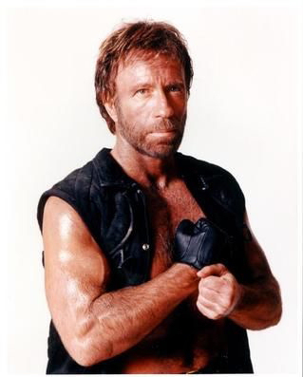

Slide 72
7) Full test for reproducibility
only for fanatics or masochists?
would certainly motivate/terrify authors

Slide 73
The best lever: peer review

Slide 74
Papers with bad data are bad papers

Slide 75
8) Papers with bad data are bad papers
authors must upload data & code
if the data or code are a mess:
➔Editorial reject
if the reviewers find errors in data or code
➔Reject, maybe resubmit

Slide 76
8) Papers with bad data are bad papers
good data management should be a matter of professional pride
backed up by reputation damage
all stakeholders need to emphasize this
otherwise we’re just wasting resources

Slide 78
Thanks to:
Arianne Albert Rose Andrew
Florence Débarre Dan Bock
Michelle Franklin Kim Gilbert
Nolan Kane Jean-Sébastien Moore
Brook Moyers Sébastien Renaut
Diana Rennison Loren Rieseberg
Thor Veen Mike Whitlock
Sam Yeaman

