Slide 1
CSCI 4430 - Spring 23
Tutorial 8
Credits to CUHK CSCI 4430 Spring 2020 Tutorial 03

Slide 2
Assignment 3 will be released by this week
Maintain grouping in Assignment 2.
This assignment requires to implement reliable data transfer using UDP programming. See Github Webpage for details.
The deadline for Assignment 3 is: 23:59:59, Apr 21, 2023. Please start early.

Slide 3
Outline
UDP Introduction
Socket Programming for UDP

Slide 4
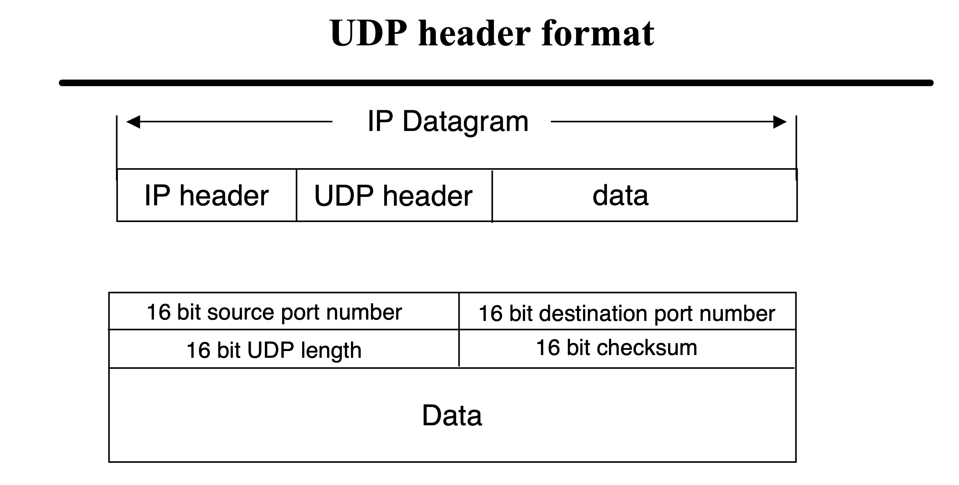
UDP (User Datagram Protocol)

Slide 5
UDP (User Datagram Protocol)
Another transport layer protocol (recall TCP).
Difference from TCP:
TCP guarantees reliable data transmission by establishing connection between client and server.
UDP is a connection-less protocol which does not establish connection between server and client before transferring data.
Each datagram is handled independently.
No handshaking between UDP sender and receiver.
Thus, UDP does not guarantee the arrival, arrival order, arrival time and content of the message (unreliable data transmission).

Slide 6
TCP Socket Programming Workflow:
Listen to connection requirements from client
Server
Client
Handshakes of TCP

Slide 7
UDP Socket Programming Workflow:
socket()
bind()
socket()
Server
Client
recvfrom()
sendto()
recvfrom()
sendto()
close()
close()

Slide 8
Outline
UDP Introduction
Socket Programming for UDP

Slide 9
UDP Socket Programming: socket()
Create a socket

Slide 10
UDP Socket Programming: Server bind()
Bind an address to a socket

Slide 11
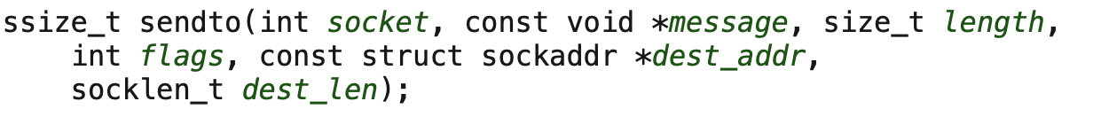
UDP Socket Programming: sendto()
Send a message on a socket
Return: sent length

Slide 12
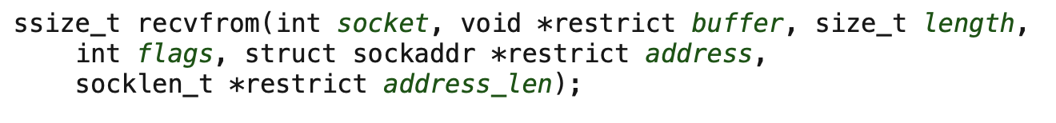
UDP Socket Programming: recvfrom()
Receive a message on a socket
Return: received length

Slide 13
UDP Socket Programming: A Demo
The source code in C language has been released in Github Webpage.

Slide 14
Thanks!

