Slide 1
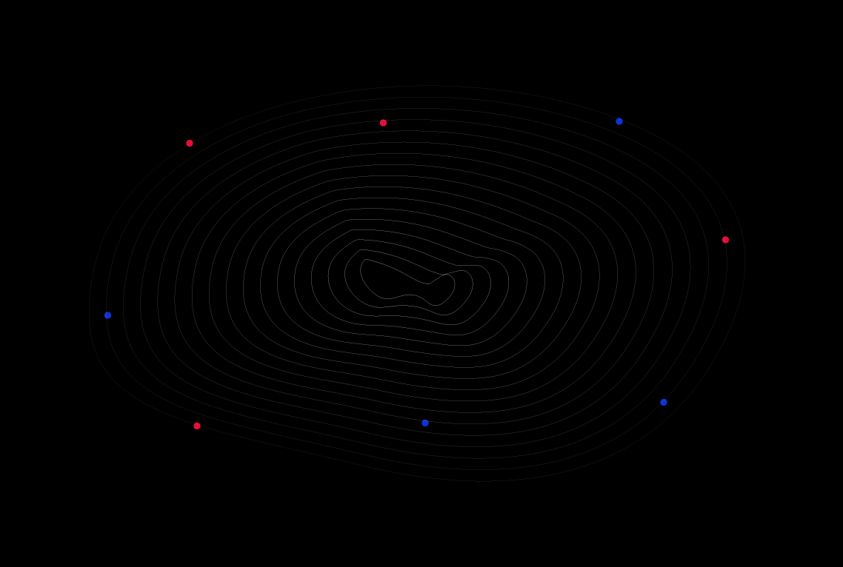
Welcome To
GoMyCode

Slide 2
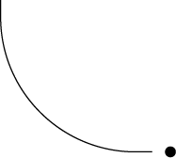
SUMMARY
1
What is JSX?
2
How does it work ?
3
Attributes
4
Components

Slide 3
SUMMARY
5
What are the Component Types?
6
How to use a components
7
Challenge

Slide 4
What is JSX ?

Slide 5
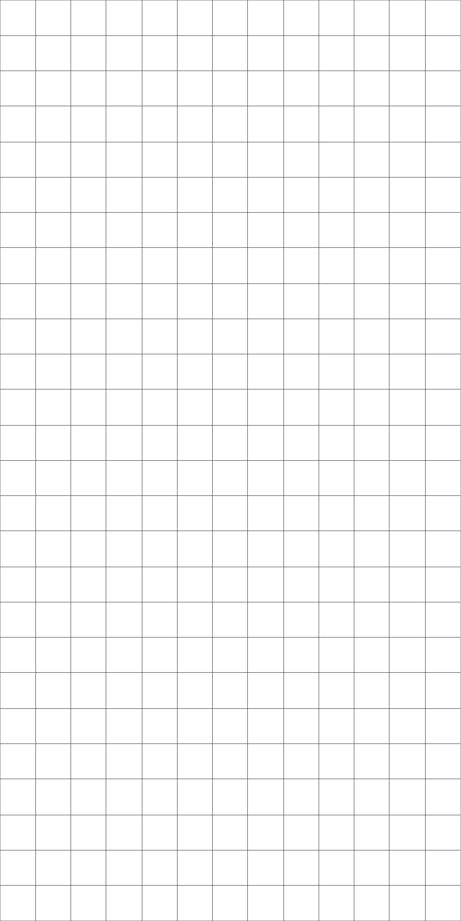
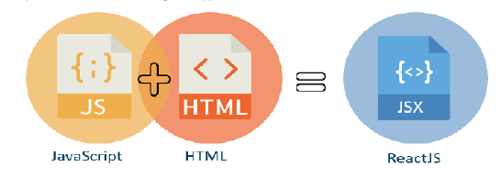
JSX is a syntax extension to JavaScript usually used with React to describe what the UI should look like.

Slide 6
How does it work ?

Slide 7
JSX and HTML look very similar, but in reality they are very different. Working with JSX makes the manipulation of the HTML elements much easier and more effective.

Slide 8
JSX is transformed into HTML and then it gets injected into an HTML element (root). This injection is actually happening in the index.js file ( ReactDOM).
This process only happens one time, because the App is the only root component in our case (we usually need only one root component).

Slide 9
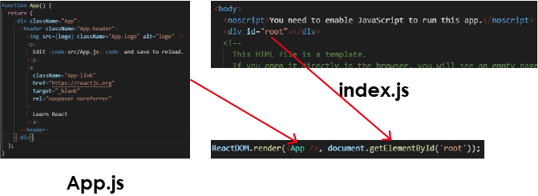

Slide 10
The injection of a component inside an HTML element is called rendering.
In React, we usually have only one root component (called App).
We only need one root component to build a React website.
The root component (App.js) is the entry point of React.
We only need one HTML file called index.html in any single-page application (like React).
JSX is compiled and rendered inside the root element in the index.html.

Slide 11
Attributes?

Slide 12
Attributes-Style
These are some of the rules to keep in mind:
Apostrophes (‘) or quotes (“) on strings
camelCase (See next page)
Commas (,) instead of a semicolon (;)
Two curly brackets {{}} instead of quotes (“”)
ClassName (File)
<h1 style= "color:red; font-size:60px"> ... </h1>
<h1 style={{ color: "red", fontSize: 60 }}>...</h1>

Slide 13
Attributes-SRC
<img/> requires an src attribute, it’s the path to the image.
In React, this path can be set in two ways, depending on which directory the image is in:
📁public directory
(src=”/subfolder/myImage.png”/)
📁src directory
(import …. From ./foldersrc={….})

Slide 14
Components

Slide 15
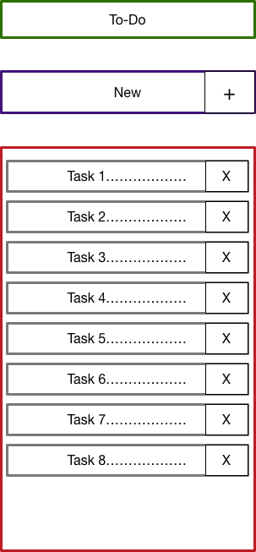
A component is a piece of code that can be reused and made to cooperate with other components to create a UI.

Slide 16
Advantages
Reusability
Maintainability
Platform independence
Privacy

Slide 17
Component Types

Slide 18
The two types of React components are:
Class components: referring to JavaScript classes.
Functional components: referring to JavaScript function.

Slide 19
Challenge

Slide 20
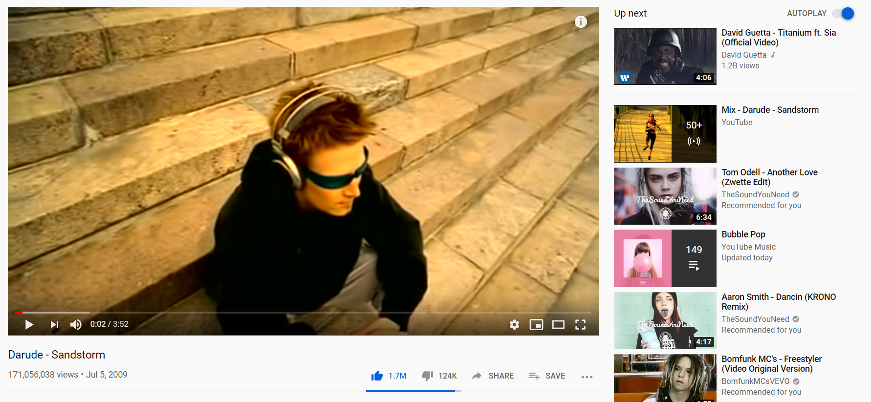

Slide 21
In this project, we will be recreating the youtube video page.
The page must have 3 parts:
Video
Suggestions list
Comments list

Slide 22
Thank You

