Slide 1
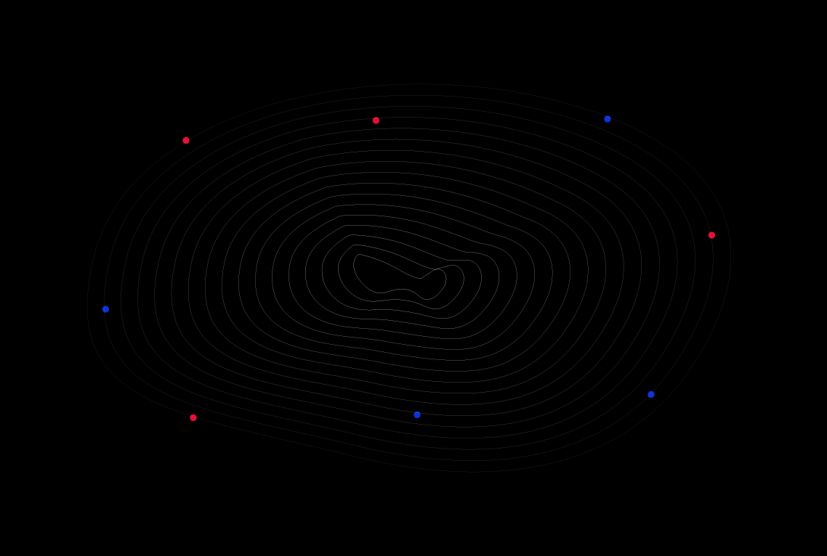
Welcome To
GoMyCode

Slide 2
Intro to web dev

Slide 3
Introduction
Front-end
Back-end
HTML
CSS
JavaScript
React JS
NodeJS
Express
MongoDB
Request
Response

Slide 4
Notes:
Javascript yrod la page dynamique
Na7na chnerakzou 3al HTML w CSS 5ater el nes elkol yesta3louhom
Par contre el javascript 3andou des alternatives o5rin ama houa men akthar les languages el tal3in taw

Slide 5

HTML is a markup language that builds the structure and gives us the skeleton of our website or web app

Slide 6

CSS is a style sheet language that’s responsible for the design and the appearance of our website or web application

Slide 7
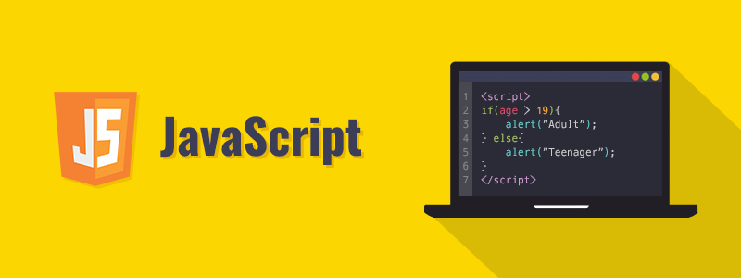
JavaScript adds dynamism and interactivity to our website or web application

Slide 8
Intro to React

Slide 9

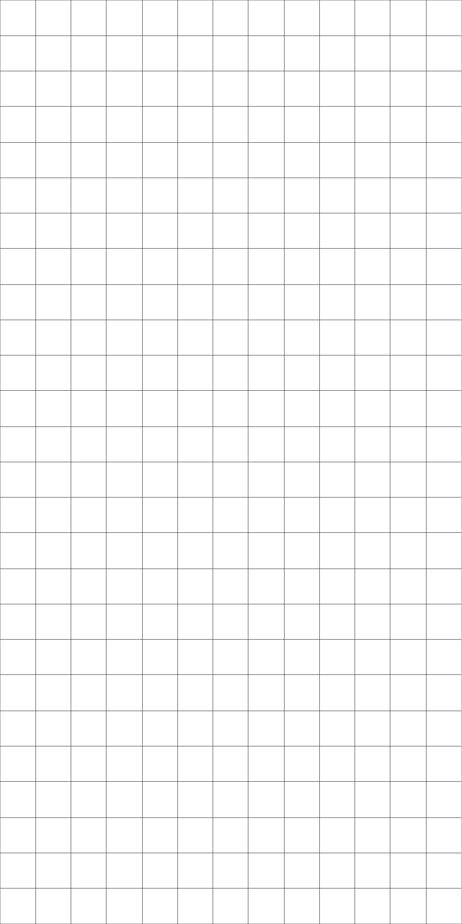

React.js is an open-source JavaScript library that is used for building user interfaces specifically for Single-Page Applications .

Slide 10
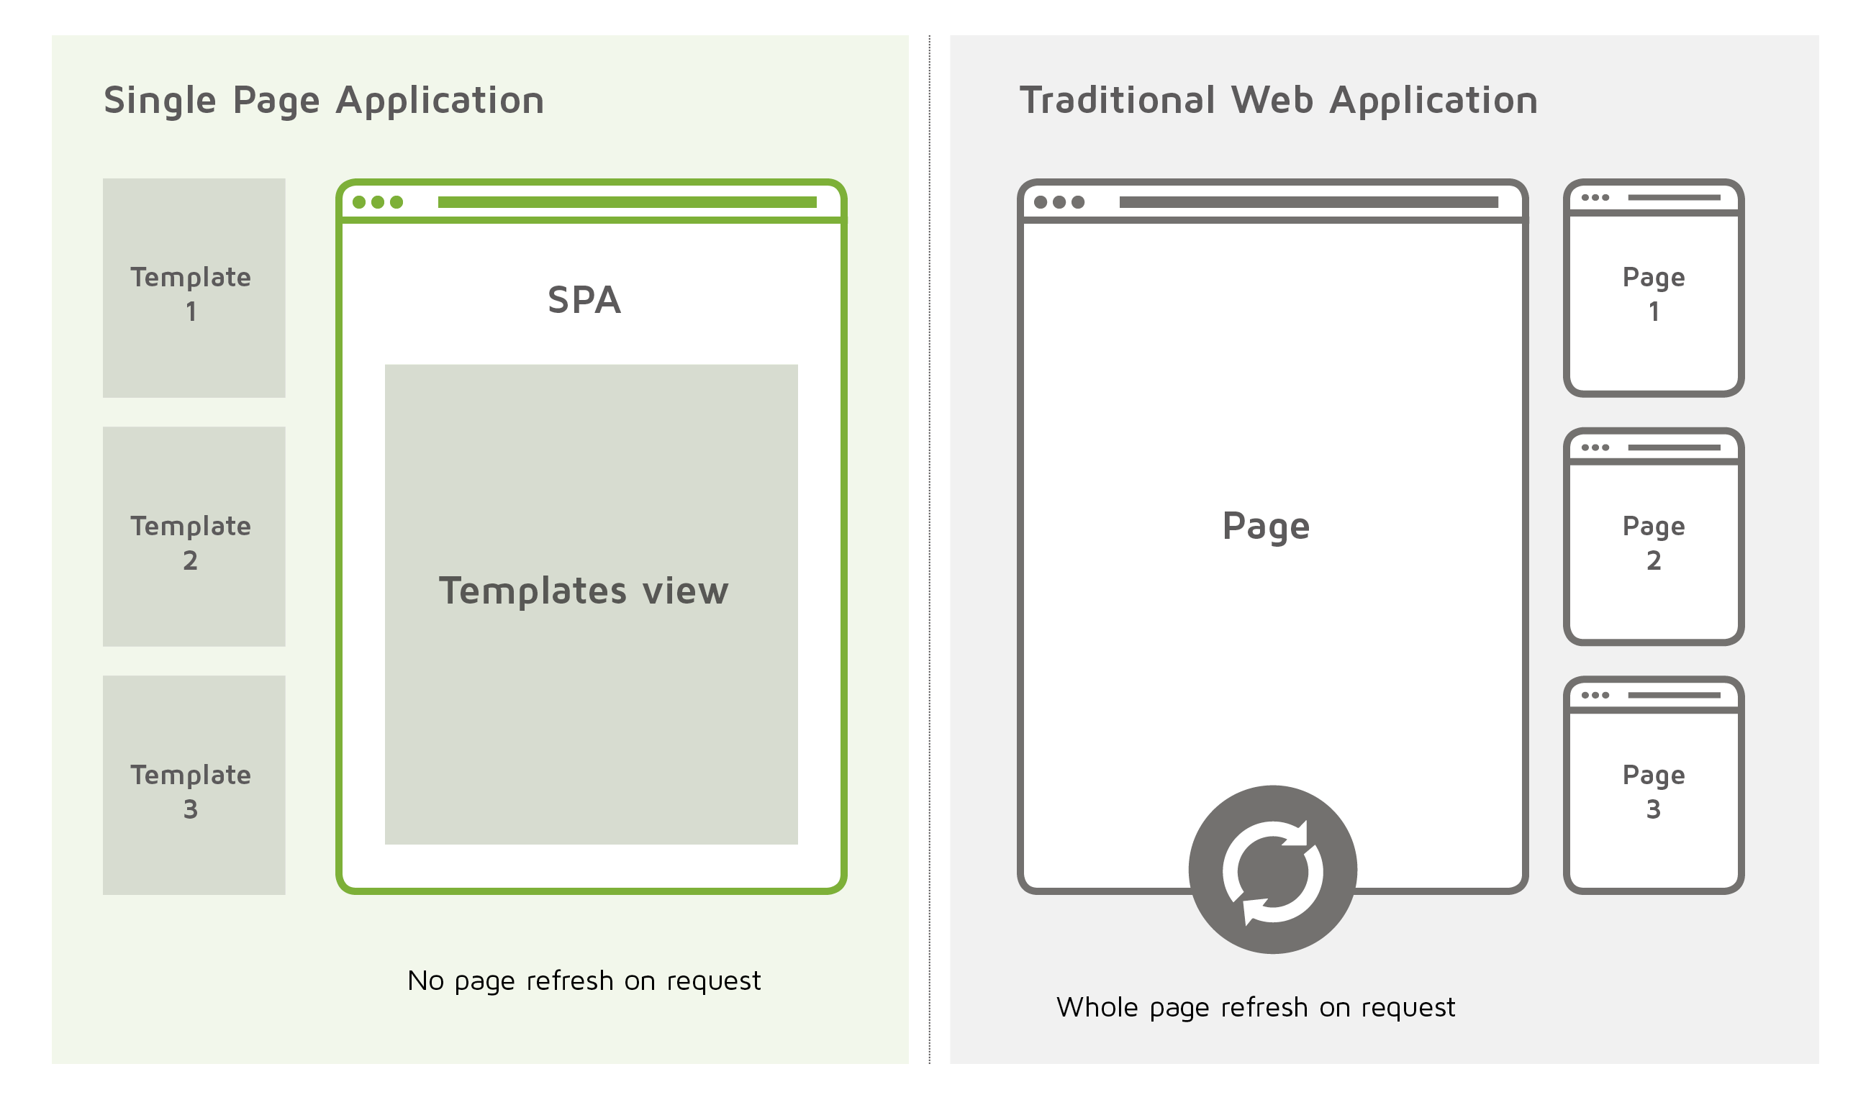
SINGLE PAGE APPLICATION
Single Page Applications are a great tool for making incredibly engaging and unique experiences for your users.
SPA is a single page where a lot of information stays the same and only a few pieces need to be updated at a time.

Slide 11
Why use React ?

Slide 12
In order to solve the previously mentioned problems, libraries and frameworks have fortunately come to light. They make web development much more easier and more convenient for developers

Slide 13
React Features

Slide 14

JSX: React uses the JSX syntax in writing components, which makes them more independent.
Component: React adopts the component-based application approach which allows us to use the same component repeatedly.
One way data flow: React only allows us to pass data from parent to child, which is very helpful in tracing data when debugging.
Virtual DOM: React uses the Virtual DOM which makes rendering UI super fast.
Simplicity: React is very simple to learn and work with, especially for newcomers.

Slide 15
React Props

Slide 16
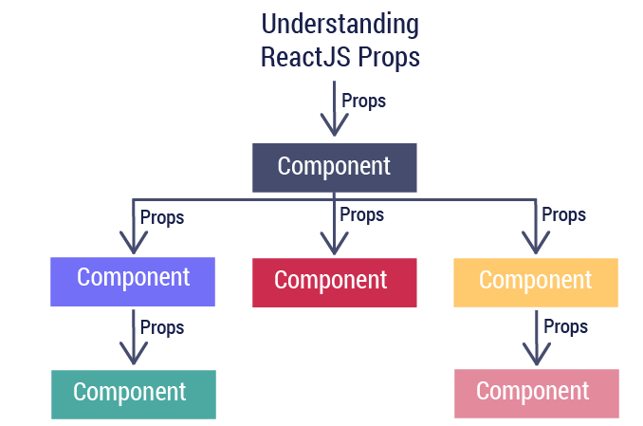
Props is a special keyword in React, which stands for « properties » and is being used for passing data from one component to another.
Props are read-only and
should be considered immutable (can not be modified)

Slide 17
Types of Props
Props could be of different types:
Number <ReactComponent number={number} />
String <ReactComponent string=‘string’ />
Object <ReactComponent object={{val1:’prop1’, val2:’prop2’}} />
Array <ReactComponent array={ [‘string1’, ‘string2’, ‘string3’]} />
Function <ReactComponent function={function} />

Slide 18
React Hooks

Slide 19
UseState Hook
import React, { useState } from "react";
Const [ count, setCount ] = useState ( 0 )
Initialisation
Getter
Setter

Slide 20

Rules of Hooks
Only Call Hooks at the Top Level :
- Don’t call Hooks inside loops, conditions, or nested functions
Hooks are called in the same order each time a component renders
Only Call Hooks from React Functions :
- Don’t call Hooks from regular JavaScript functions

Slide 21
Installation & Env

Slide 22


WHAT DO YOU NEED ?
Working with npm (node package manager) and some libraries related to React, requires NodeJS. You can download it here: https://nodejs.org/.
We need an editor to edit React files. You can download VSCode from here:
https://code.visualstudio.com/download

Slide 23
Thank You

