Slide 1
GiT 202
Python Introduction

Slide 2
Comparison Operators
You already know what an operator is. Can you name a few operators?
In addition to mathematical operators, there are comparison operators.
We use comparison operators to compare two things of data – two variables, two numbers, or two strings

Slide 3
Comparison Operators
== means they are equal
!= means they are NOT equal
>= and <= also are comparison operators
Try this in idle:
print 1 == 2
print 1 = 2
print 1 != 2
myname = ‘dacia’
print myname == ‘dacia’

Slide 4
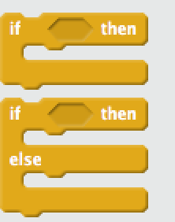
Conditions
We had conditions in Scratch. Do you remember what a condition is?

Slide 5
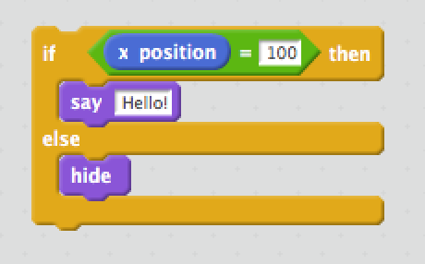
Conditions In Python
We have the same concept in Python (and all programming languages!)
In python, the syntax would look like this…
if xposition == 100:
print(“Hello”)
else:
hide()

Slide 6
Now You’ve Learned…
Integers, Floats, Strings, and Lists
Variables
Operators
Built-In Functions (think raw_input)
Conditions
What else?

Slide 7
Requirements
We are going to create a number guessing game!
Create a program called numbergame.py
Pick your favorite number between 1 and 10 and assign it to a variable
Ask the user of your program to guess your favorite number
Remember: raw_input always returns a string. We cannot compare a string and an int. Ask for a hint when you get here!
print you win! if they guess right. Print you lose! if they guess wrong.

Slide 8
Requirements
What if we want the user to be able to guess more than once?
What concept from Scratch do you know that lets you repeat something?

Slide 9
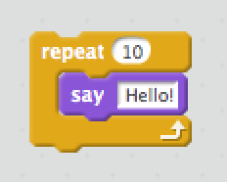
Loops
If we want to do something 10 times in python, the syntax looks like this …
for i in range(10):
print ‘Hello!’

Slide 10
Requirements
Let the user guess up to 5 times in your number guessing game

Slide 11
Requirements
Make the user guess a number between 1 and 1000
On each guess, tell them if your number is higher or lower to give them a hint
Let the user guess 20 times
Play each others game and try to guess the number!

