Slide 1
Spaghetti Squash
Recipe

Slide 2


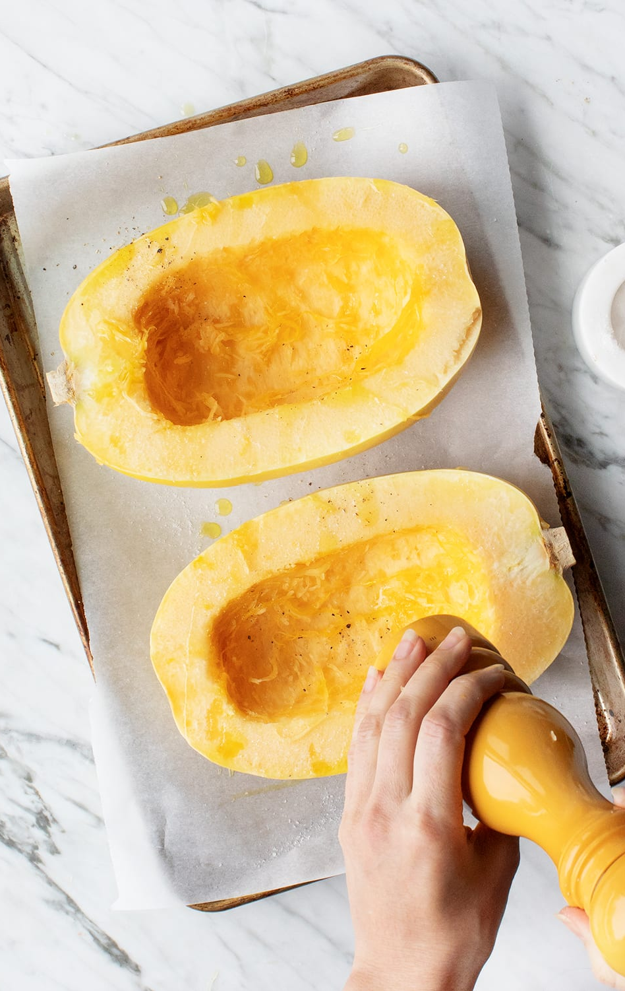

Introduction
Hello everyone
Hobby
Family
Healthy dish

Slide 3
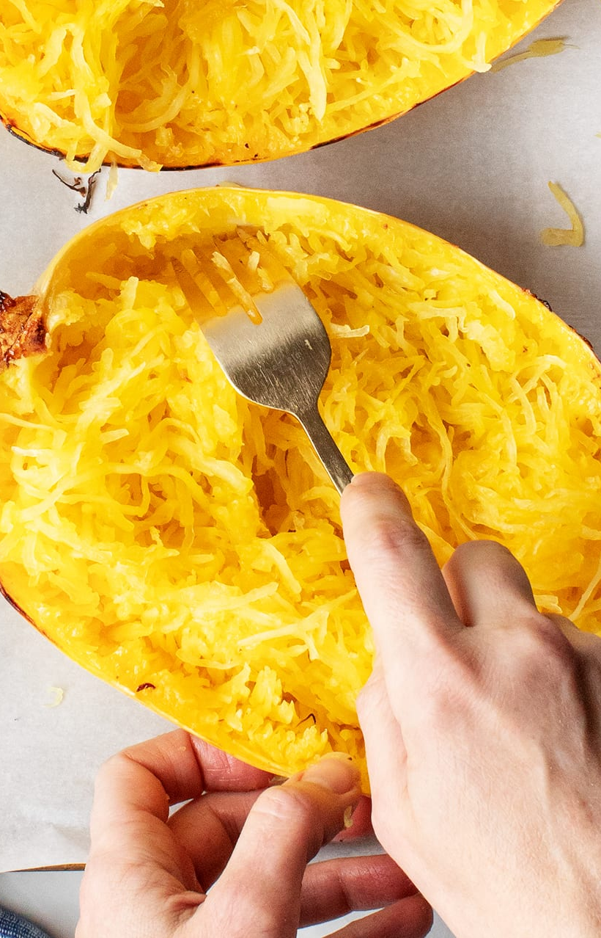
Ingredients
Squash
Salt and pepper
Olive oil

Slide 4
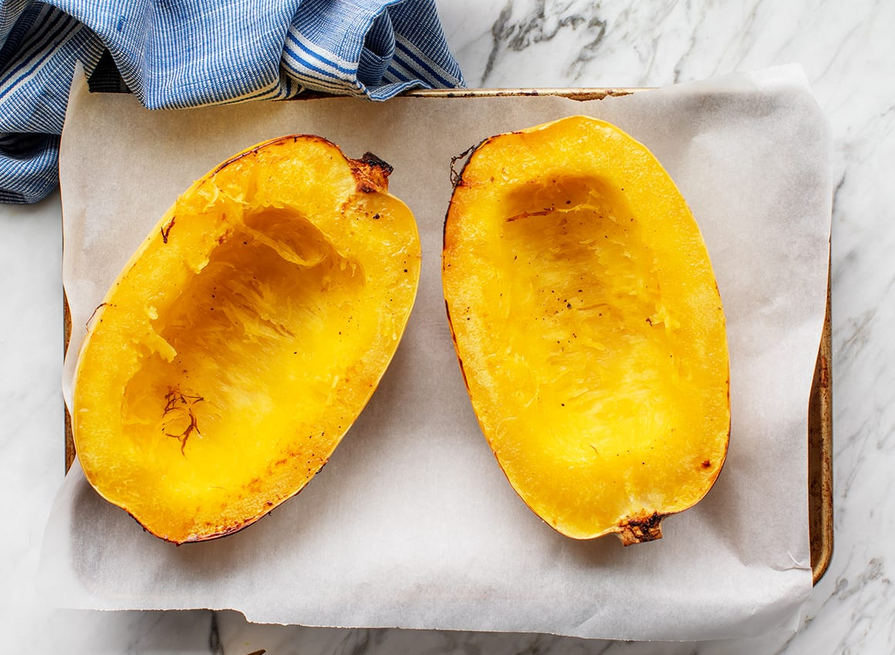
How to cook
Cut it
Scoop out
Oven
400 Fahrenheit

Slide 5
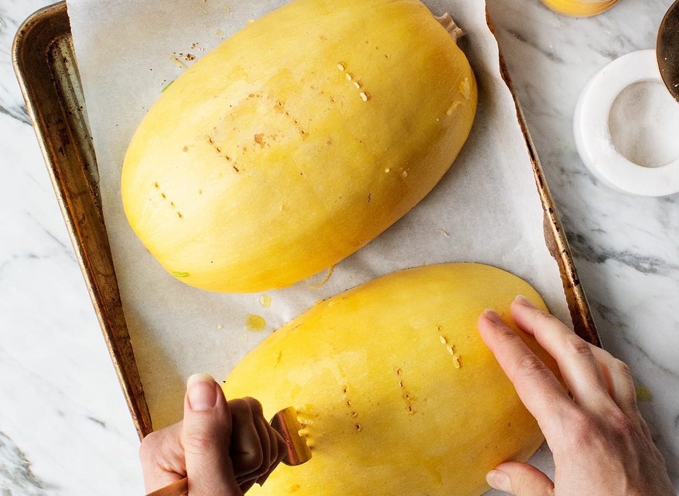
Baking
Baking tray
Drizzle ingredients
Cut down
Slightly brown

Slide 6
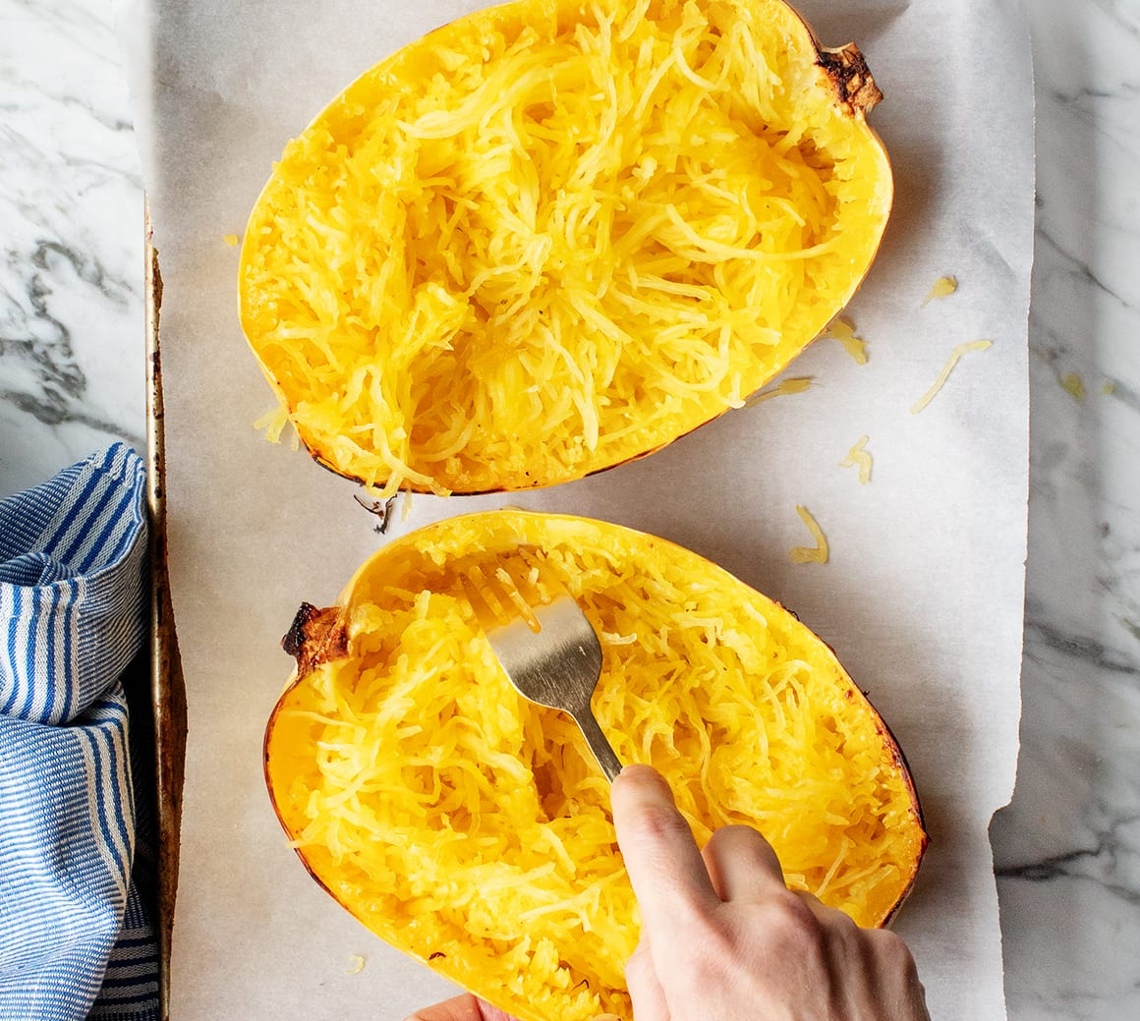
After cooking
Cool down
Scrape strands
Fork
Fluff

Slide 7
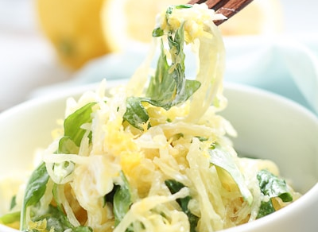
Enjoy
Simple veggie

Slide 8
Questions?

